Slide 1
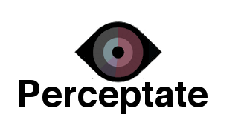
By Charles Lee and Jacqueline Foreman

Slide 2

Crime & Social Media
Notes:
how many of you have heard about crimes on social media ?

Slide 3
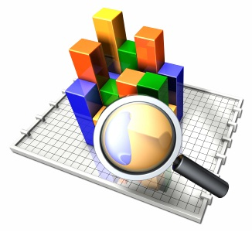
Purpose
Notes:
ANALYSIS TOOL
state the issue
educate us about the issue
engage the audience
- public perception of crime influenced by outside forces (news)
- sources of bias within each presentation.
During the second iteration, we discovered the power of our visualization as an analysis tool that others may employ to explore their own hypothesis about the relationships between police reports, news, and social media. It is a tool with which one can discover a correlation.

Slide 4
Our Hypothesis
Society’s perception of crime more closely mirrors the representation of crime crafted by the media than that of the police reports.
Notes:
society’s perception of crime would more closely mirror the representation of crime crafted by the media than that of the police reports

Slide 5


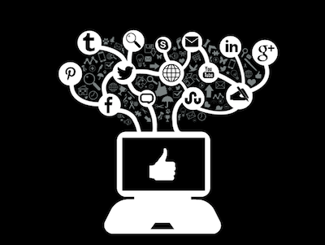
About the Data
Notes:
Police Reports Local News Reports Social Media Shares
The police reports come from the Seattle 911 incident reports online. The data for the media and social media segments was recorded by hand. First local news sites were chosen and then searched for the types of crime. From there, the number of shares on Twitter and Facebook were measured from the article pages.
This visualization was created as a tool with which one can explore the relationships between police reports, news reports, and social media shares of crime in the Seattle area from January 18th to February 7th.

Slide 6
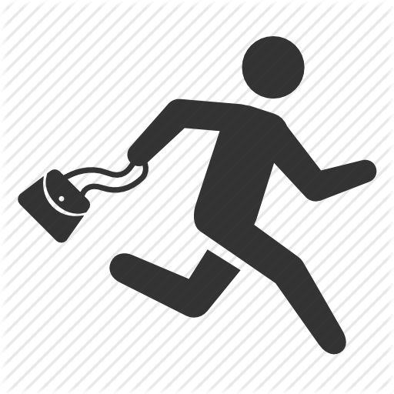

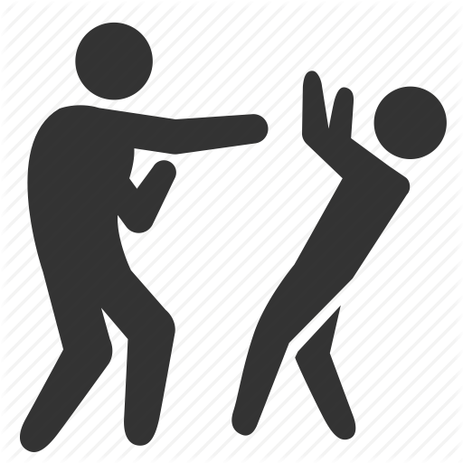
About the Data
Notes:
types of crime analysed
robbery
murder
assault

Slide 7
Project Demo
Notes:
compares three different data sets
you can create your own w/ step by step instructions
talks about where data came from on sidebar, explains biases
this is probably when we should open the website

Slide 8
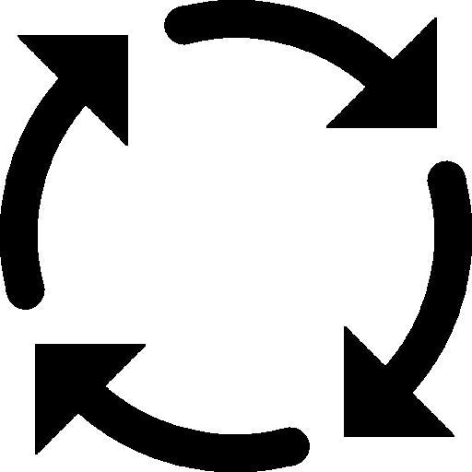

Process
Notes:
we realized that before creating sketches we really needed to create a prototype to see how the data looked so that we could understand what exactly we had to visualize.
when we first created the prototype, we realized the strength of our creation as an analysis tool.
what went wrong ?
too many potential sources of bias
had to collect data by hand
making it a tool -> minimizes, or allows people to prioritize the potential biases
what did we learn about the process ?

Slide 9

Findings
Notes:
People talk most about assault, which also occurs the most frequently. However, they talk about robbery and homicide roughly the same amount, despite homicide being reported the least and not occurring at all during our three week timeframe. People tended to share articles more often on Facebook than on Twitter.
it did kinda more so resemble the news, but w/ more of an emphasis on assault than anything else

