Slide 1

Geonathan Sena
Charles Madere
Suvan Dixit
Jarrad Pinestraw
Tristan Kidder

Slide 2
our project is
A natively built Android application
Socially connected with the Facebook SDK
Cloud powered with Amazon Web Services
Designed with newer Android devices in mind
Follows Android 3.0+ design guidelines
No hardware buttons required through the use of the new Android Action Bar
Compatible down to Android 2.3.3 devices thanks to ActionBarSherlock

Slide 3
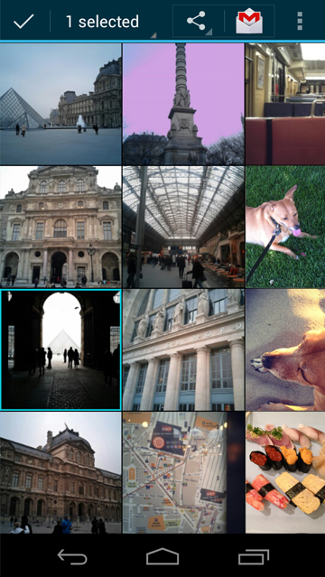
technology and terminology
Amazon Web Services is a large collection of remote computing services
Most well known of their services are Amazon S3 and Amazon EC2
We are using a tier that is free for one year as long as we don’t exceed a certain monthly usage
We’re using Amazon Elastic Beanstalk. This service will handle load balancing and then automatically increase the number of servers that we need if necessary
ActionBarSherlock allows us to have an action bar on devices running a version of Android that predates it being built into the operating system
Action Bar

Slide 4
what’s it do?
Users log in through Facebook and can then challenge their Facebook friends to a game of checkers
New moves and games will be sent over either WiFi or a data connection to our web server to be processed
Server will then send a push notification to the receiving user’s phone to alert them of their turn
Server also performs validation to prevent cheating
To put it very simply, take Words with Friends but replace scrabble with checkers

Slide 5
questions?

Slide 6
ClassyGames.net

Slide 7
