Slide 1
Classy Games
Geonathan Sena | Charles Madere | Jarrad Pinestraw
Subhanga Dixit | Tristan Kidder | Cory Vicknair

Slide 2
our project is
A natively built Android application
Socially connected with the Facebook SDK
Cloud powered with Amazon Web Services
Designed with newer Android devices in mind
Follows Android 3.0+ design guidelines
No hardware buttons required through the use of the new Android Action Bar
Compatible with older Android 2.3.3 devices thanks to ActionBarSherlock

Slide 3
what’s it do?
Users log in through Facebook and then challenge their Facebook friends to a game of checkers
Push notification will be sent out to the user’s phone that is receiving the move to alert them of their turn
To put it very simply, take Words with Friends but replace scrabble with checkers

Slide 4
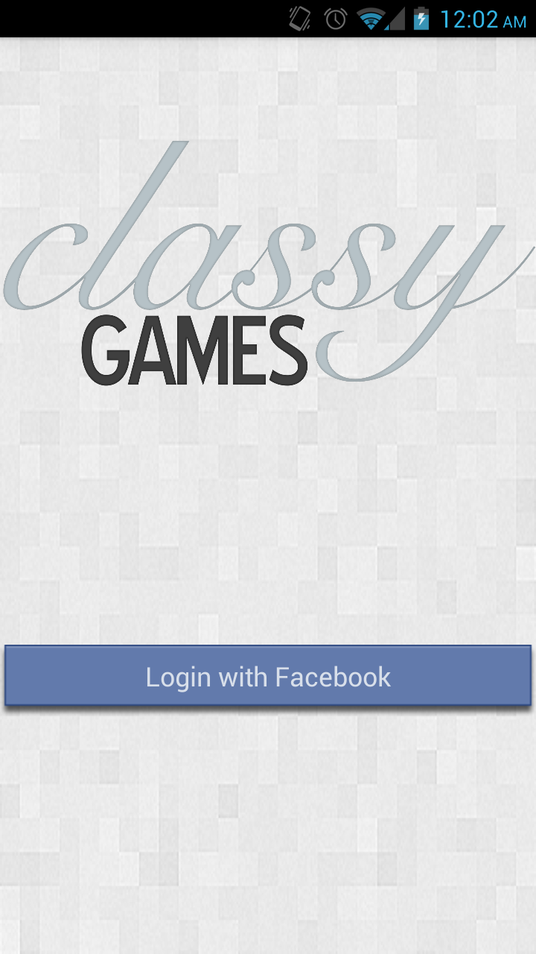
intro screen

Slide 5
questions?

