Slide 1
Charter Fishing
Charles Madere and Joseph Gautier

Slide 2
Hello, World!
Here’s some text.

Slide 3

Making it Special
We made a cool li’l Android application
It’s called Fish ‘n’ Spots
Check out our custom icon!
We haven’t yet decided what kind of fish that is

Slide 4
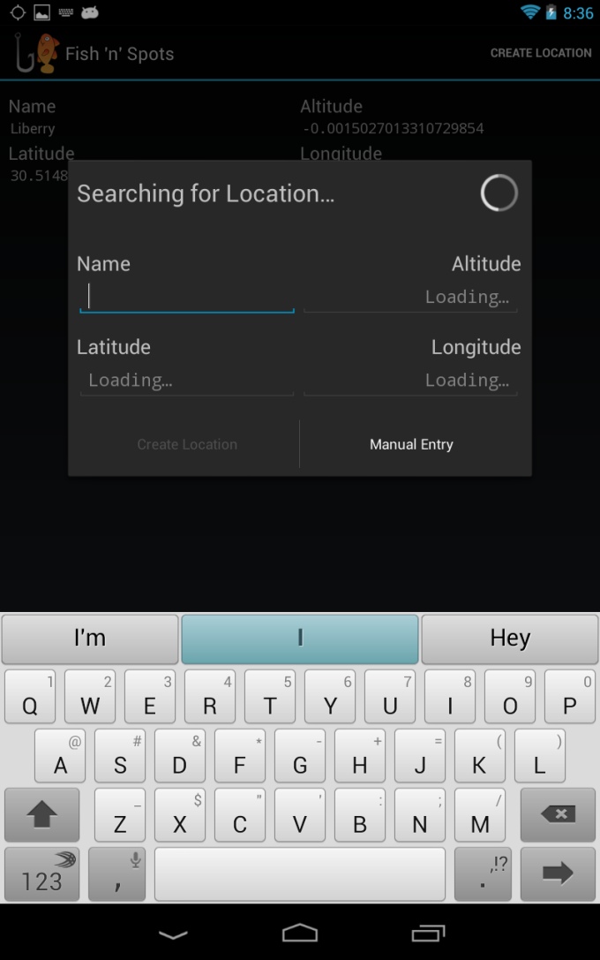
What is Fish ‘n’ Spots?
An application that can allow a fisherman to save their current location
Location is found using the device’s GPS
Allows angler to build up a list of locations
These are their favorite fishing spots!
Shows a Google satellite picture of the fishin’ spot

Slide 5

Technology in Fish ‘n’ Spots
Built for Android v4.0 (Ice Cream Sandwich) and above
Uses the Fragment class
This means that it works awesomely (and differently) on devices with bigger screens
Uses the Google Maps SDK to show a satellite view of saved locations
SQLite is used to store the list of locations

Slide 6
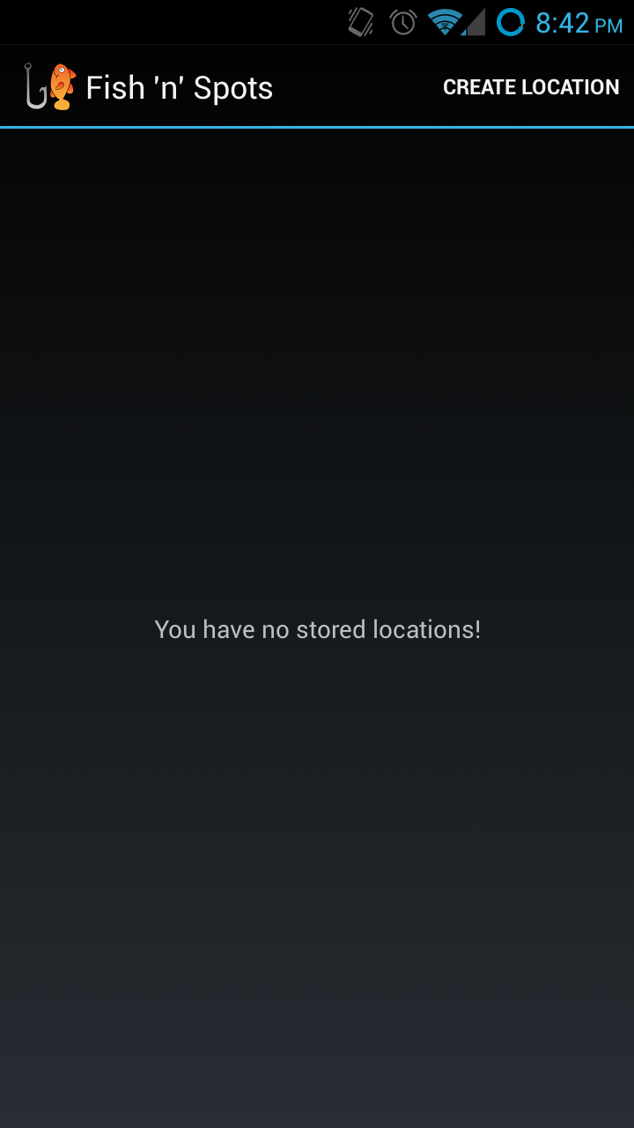
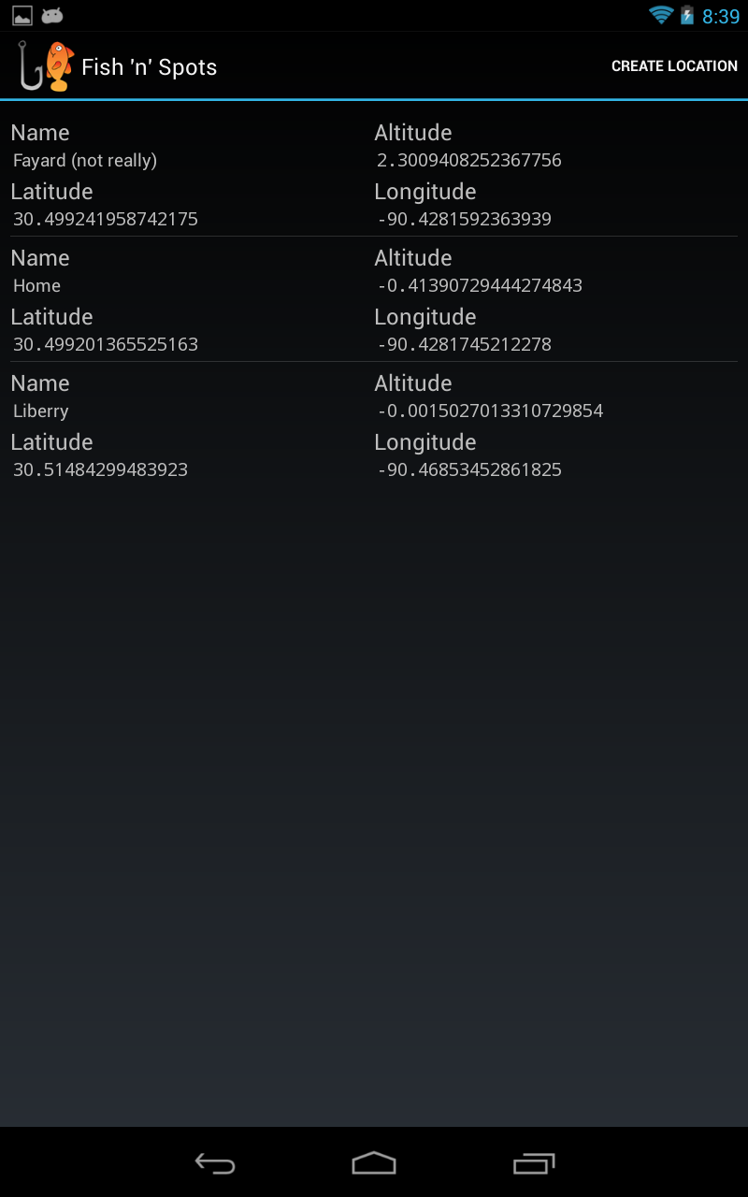
Screenshots of Fish ‘n’ Spots
Location List (Phone)
Location List (Tablet)

Slide 7
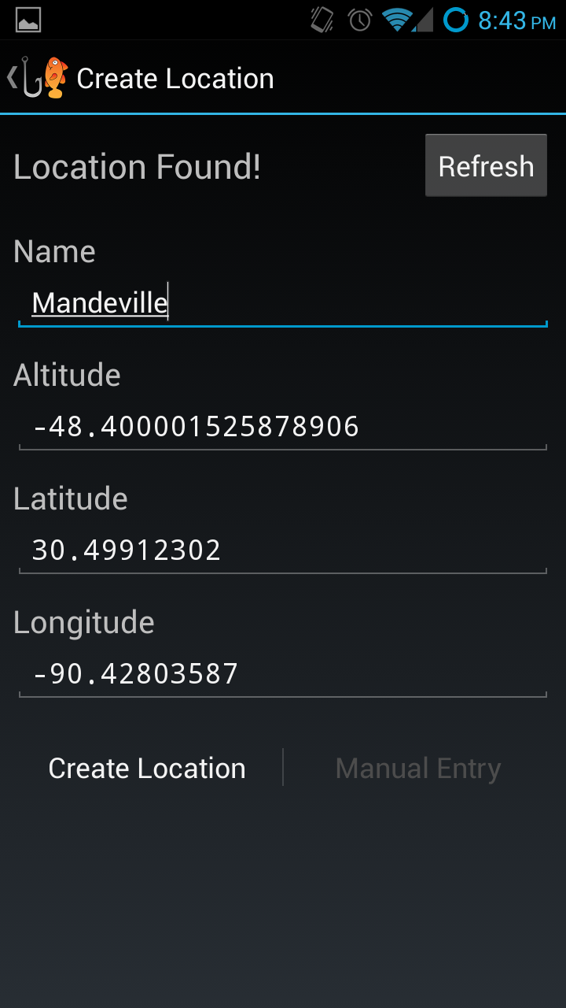
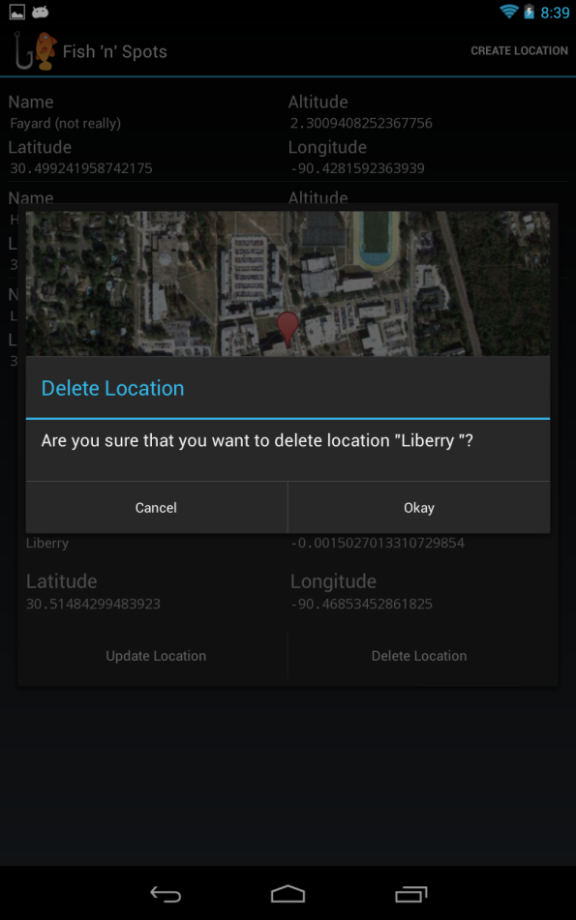
Screenshots of Fish ‘n’ Spots
Creating a Location (Phone)
Deleting a Location (Tablet)

Slide 8
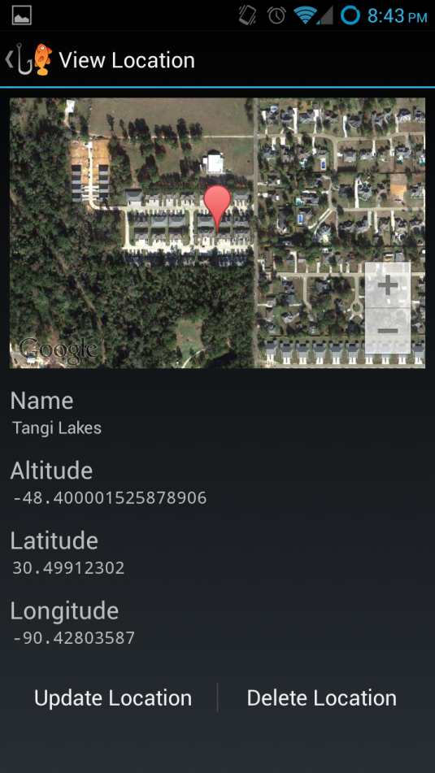
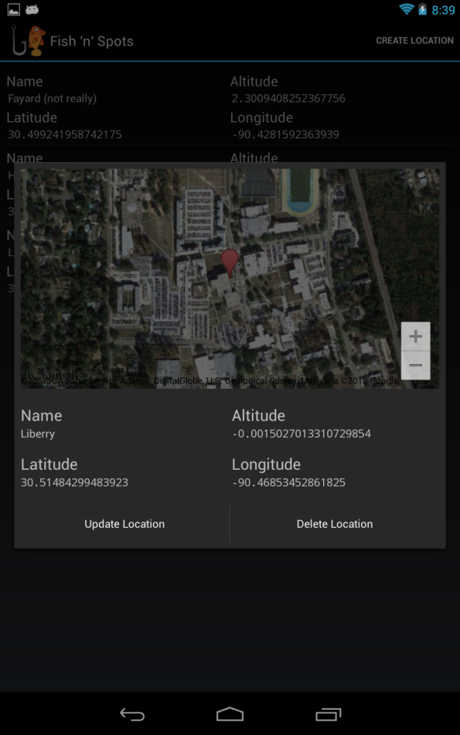
Screenshots of Fish ‘n’ Spots
Viewing a Location (Phone)
Viewing a Location (Tablet)

Slide 9
Thank you!

