Slide 1
Charter Fishing
Charles Madere and Joseph Gautier

Slide 2
What is our DB used for?
Intended for Charter Fishing companies
Stores information about
Groups
These are customers that want to go fishing
Boats
Crew Members
Captains and skippers
Fishing locations
Fishing equipment
Trips for customers to go on
Bunch more!

Slide 3
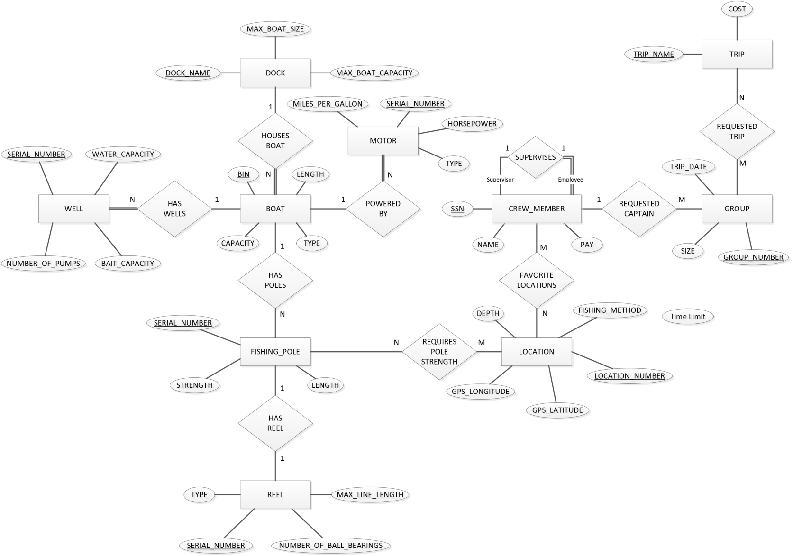
E/R Diagram (quick overview)

Slide 4
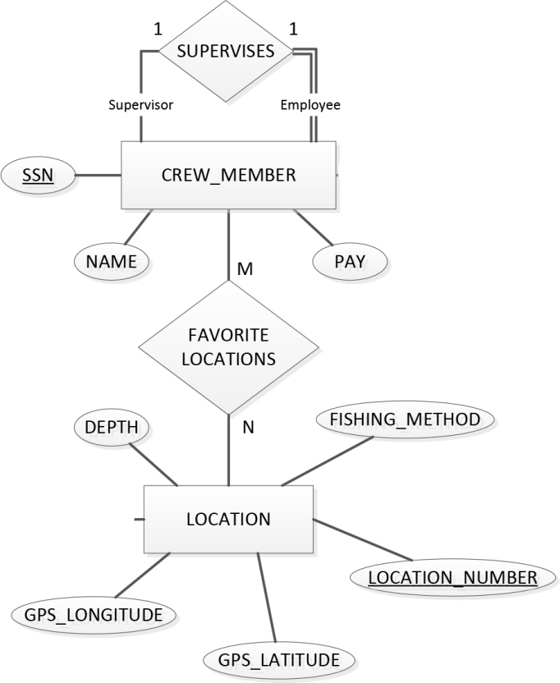
E/R Diagram (zoom in 1)
Recursive relationship for CREW_MEMBER
Captains can have favorite locations to fish

Slide 5
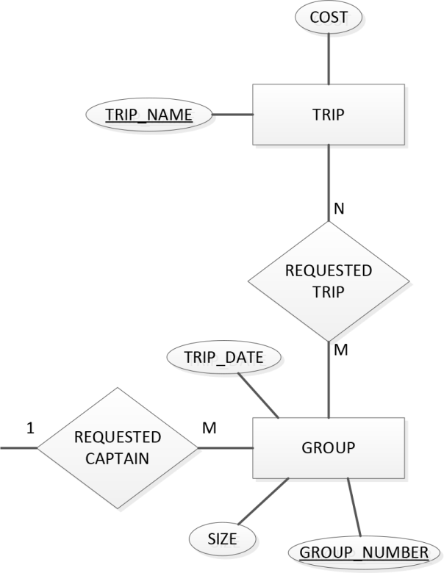
E/R Diagram (zoom in 2)
Customers choose from a list of the different trips available
They have the option to request a specific captain

Slide 6
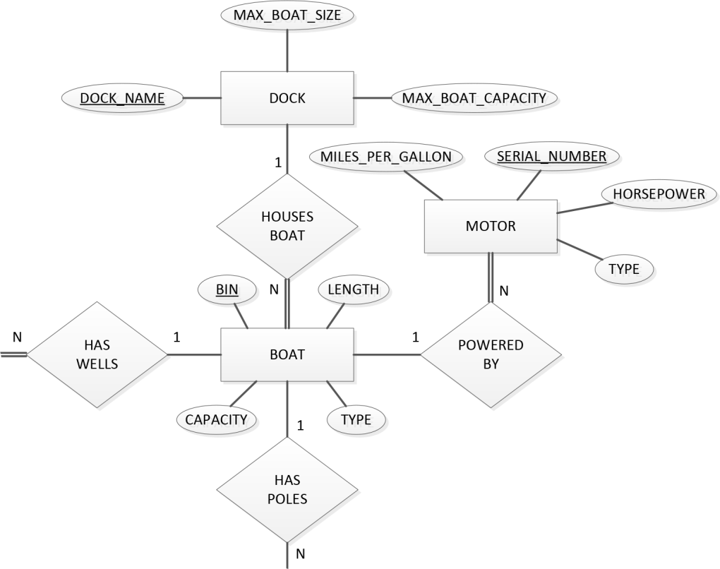
E/R Diagram (zoom in 3)
This section keeps track of the various items on the different boats and which dock the boats are located in.

Slide 7
Making it Special

Slide 8

Making it Special
We made a cool li’l Android application
It’s called Fish ‘n’ Spots
Check out our custom icon!
We haven’t yet decided what kind of fish that is
And it’s open source on GitHub

Slide 9
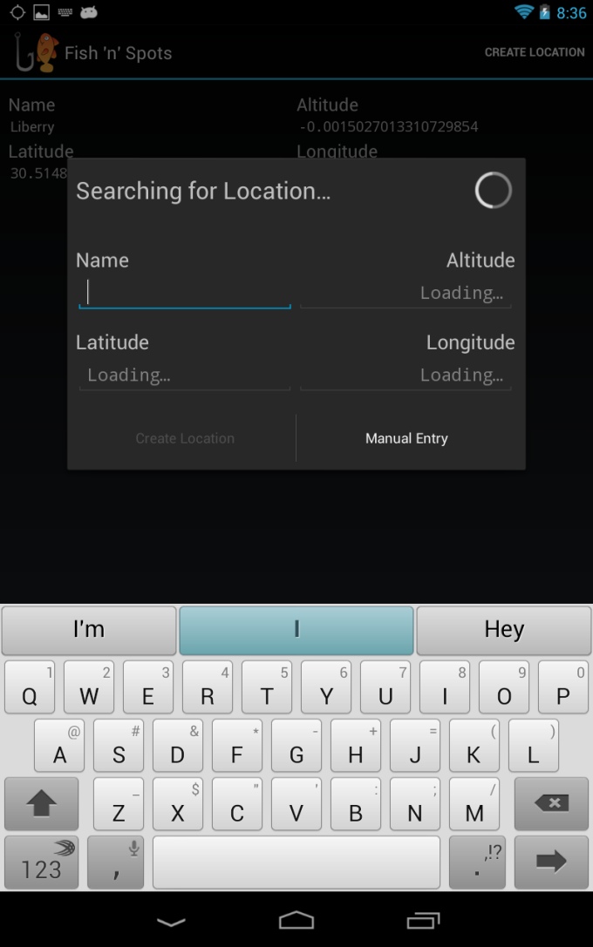
What is Fish ‘n’ Spots?
An application that can allow a fisherman to save their current location
Location is found using the device’s GPS
Allows angler to build up a list of locations
These are their favorite fishing spots!
Shows a Google satellite picture of the fishin’ spot

Slide 10

Technology in Fish ‘n’ Spots
Built for Android v4.0 (Ice Cream Sandwich) and above
Uses the Fragment class
This means that it works awesomely (and differently) on devices with bigger screens
Uses the Google Maps SDK to show a satellite view of saved locations
SQLite is used to store the list of locations

Slide 11
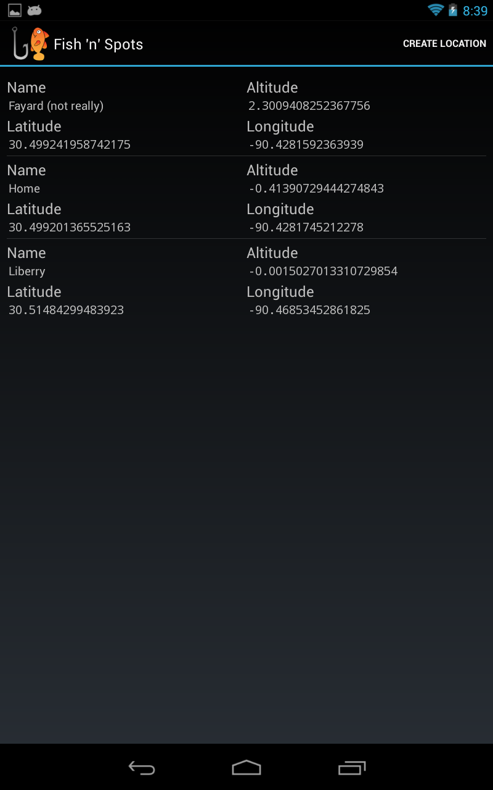
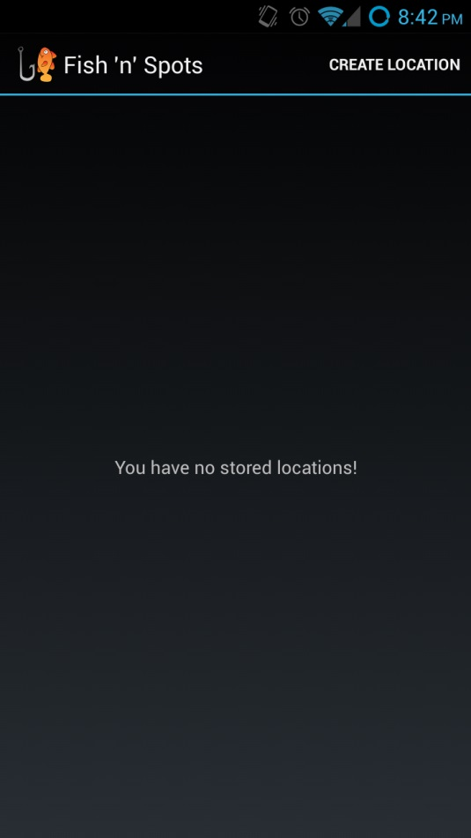
Screenshots of Fish ‘n’ Spots
location list (phone)
location list (tablet)

Slide 12
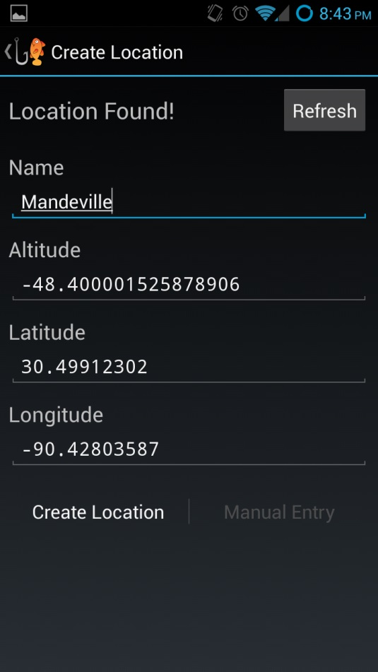
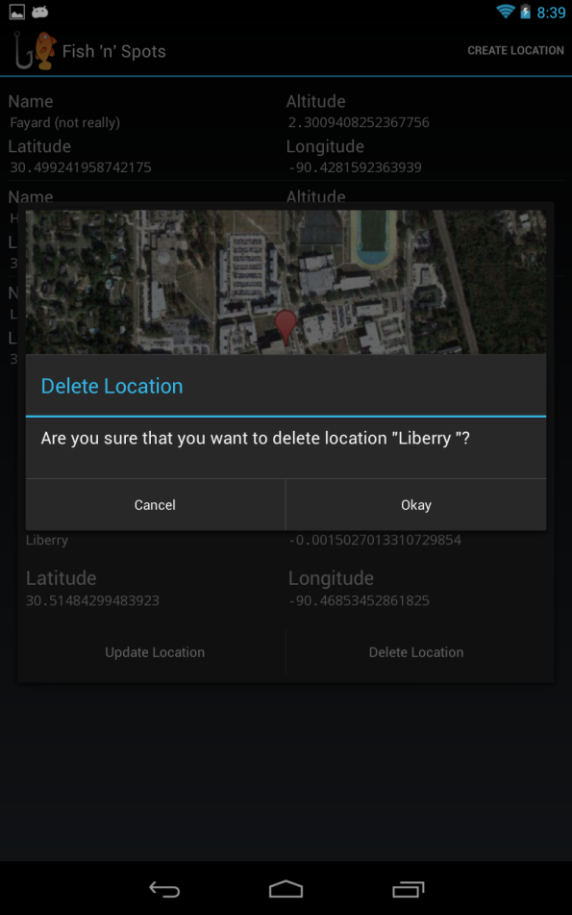
Screenshots of Fish ‘n’ Spots
creating a location (phone)
deleting a location (tablet)

Slide 13
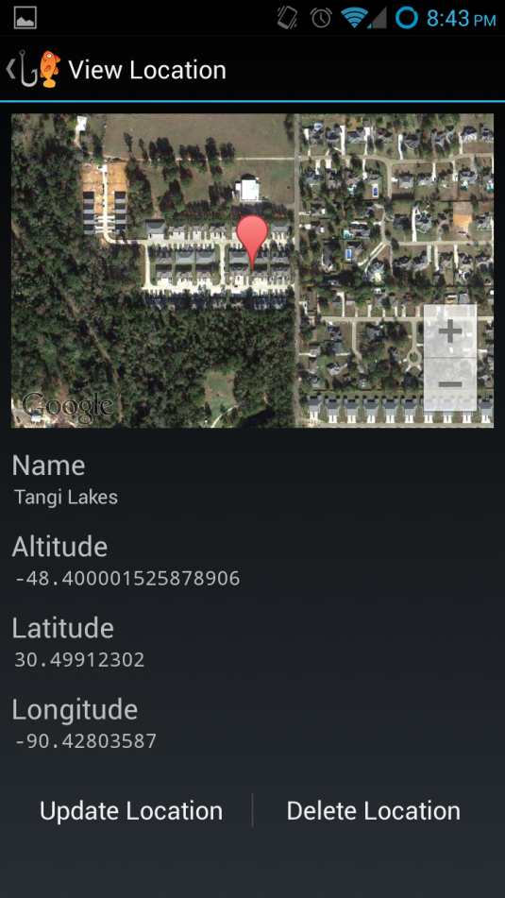
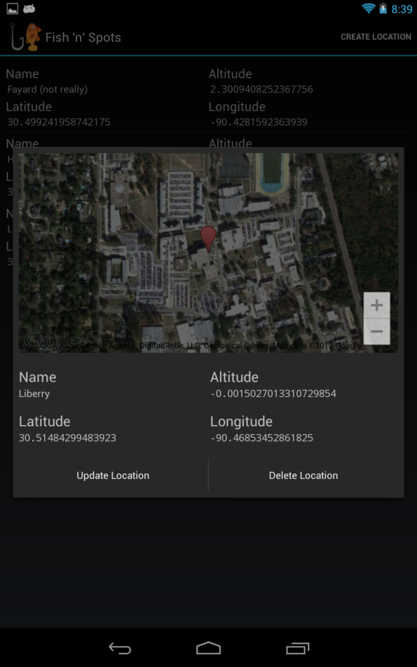
Screenshots of Fish ‘n’ Spots
viewing a location (phone)
viewing a location (tablet)

Slide 14
Thank you!

