Slide 1
Charter Fishing
Charles Madere and Joseph Gautier

Slide 2
Why Charter Fishing?
We both enjoy fishing

Slide 3
What is our DB used for?
Intended for Charter Fishing companies
Stores information about
Groups
These are customers that want to go fishing
Boats
Crew Members
Captains and skippers
Fishing locations
Fishing equipment
Trips for customers to go on
Bunch more!

Slide 4
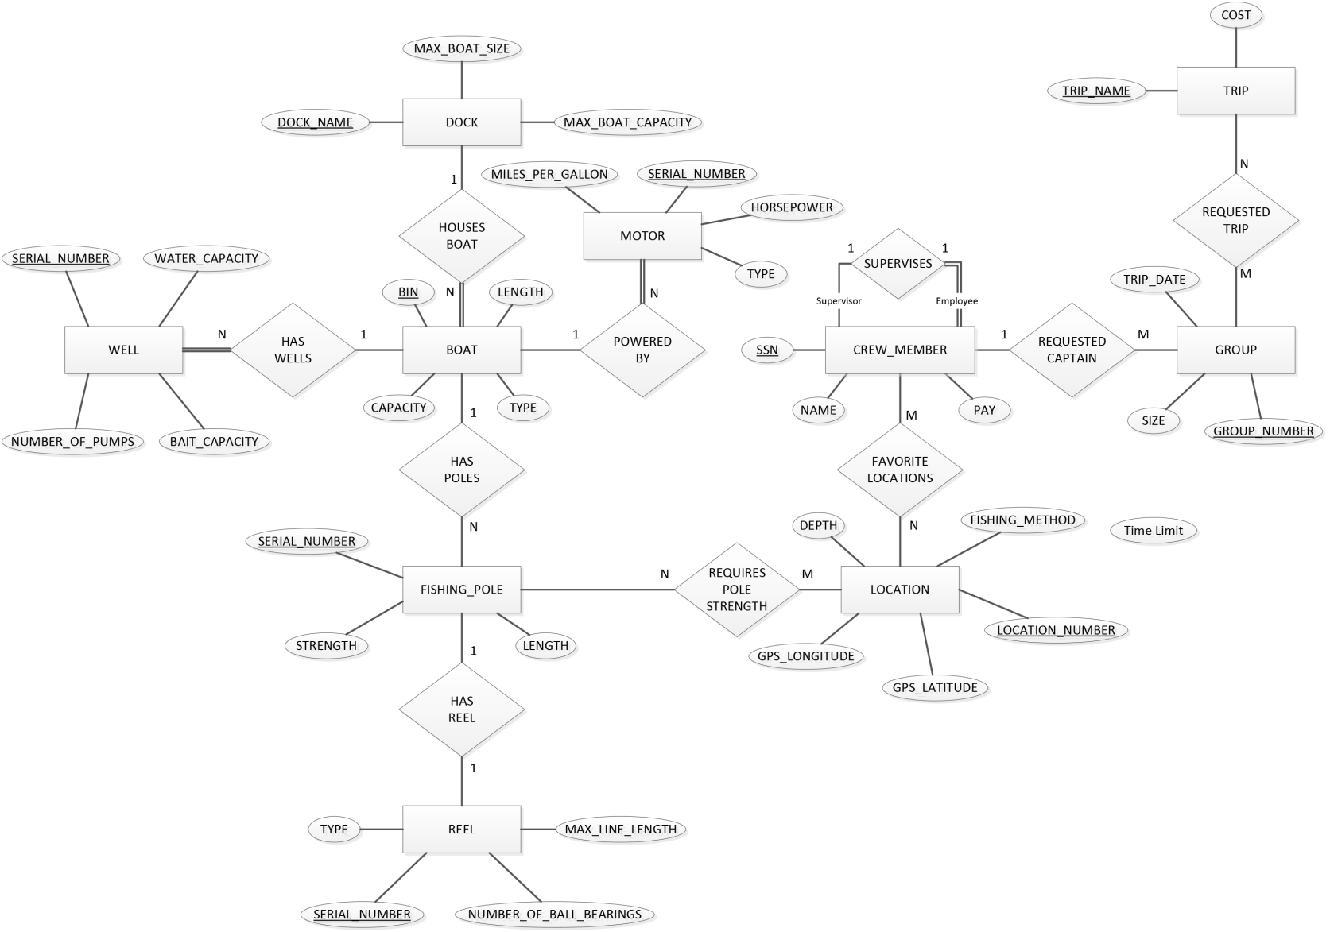
E/R Diagram (quick overview)

Slide 5
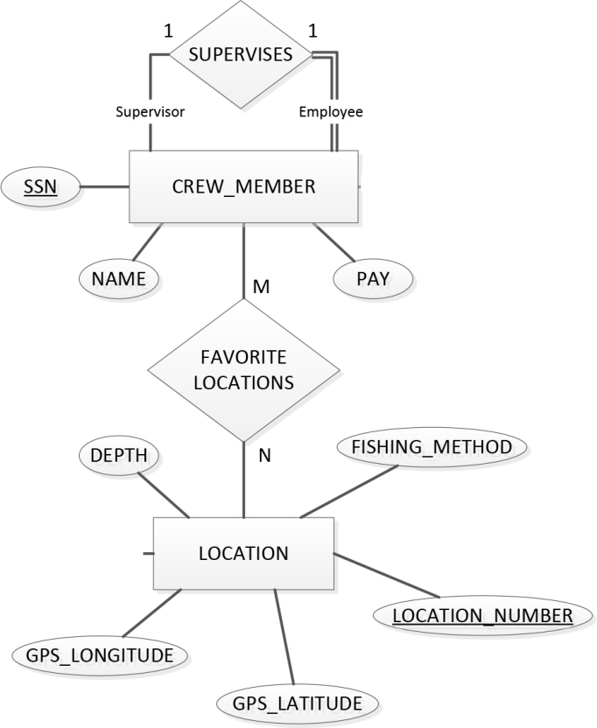
E/R Diagram (zoom in 1)

Slide 6
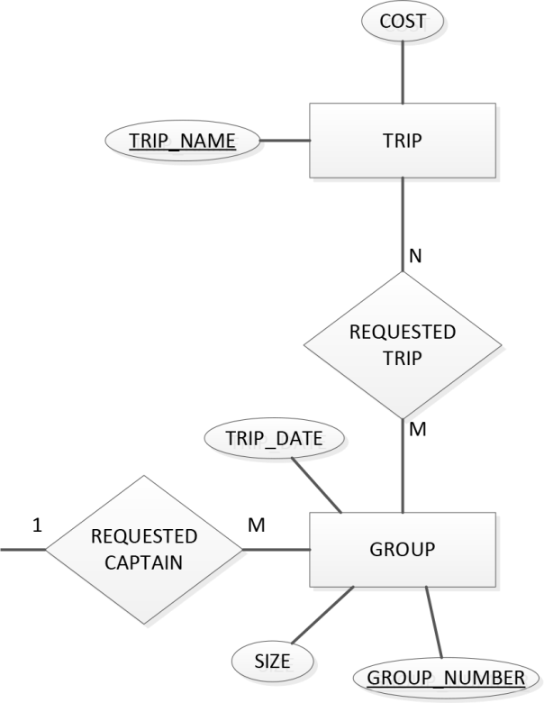
E/R Diagram (zoom in 2)

Slide 7
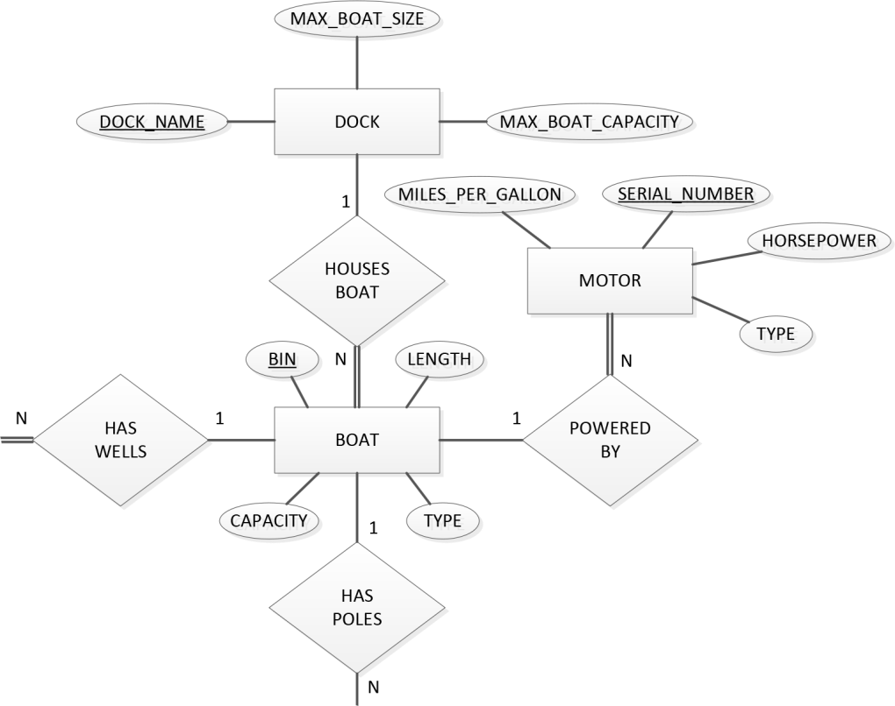
E/R Diagram (zoom in 3)

Slide 8
Making it Special

Slide 9

Making it Special
We made a cool li’l Android application
It’s called Fish ‘n’ Spots
Check out our custom icon!
We haven’t yet decided what kind of fish that is
And it’s open source on GitHub

Slide 10
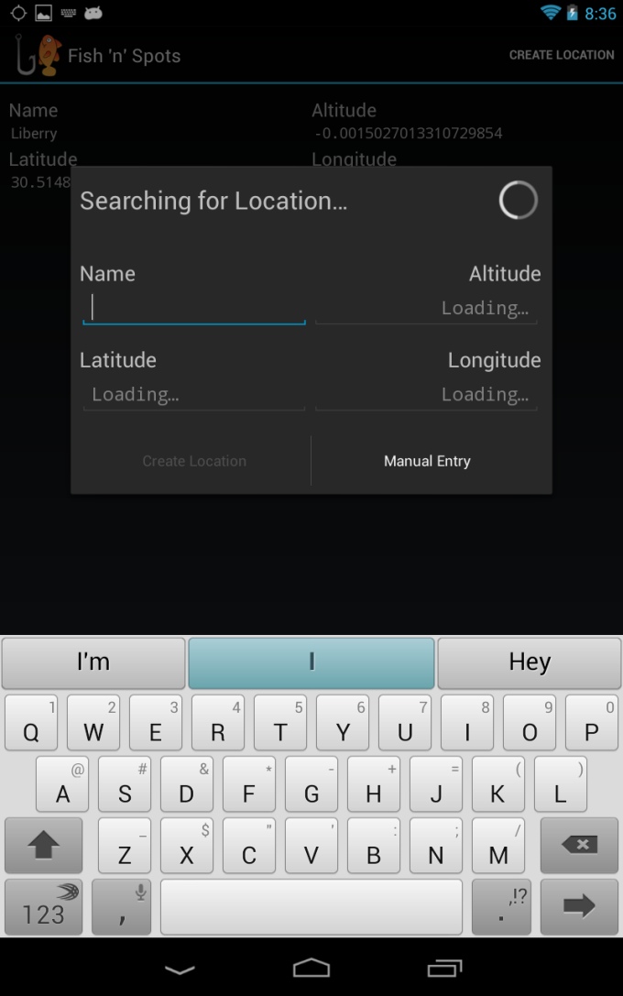
What is Fish ‘n’ Spots?
An application that can allow a fisherman to save their current location
Location is found using the device’s GPS
Allows angler to build up a list of locations
These are their favorite fishing spots!
Shows a Google satellite picture of the fishin’ spot

Slide 11

Technology in Fish ‘n’ Spots
Built for Android v4.0 (Ice Cream Sandwich) and above
Uses the Fragment class
This means that it works awesomely (and differently) on devices with bigger screens
Uses the Google Maps SDK to show a satellite view of saved locations
SQLite is used to store the list of locations

Slide 12
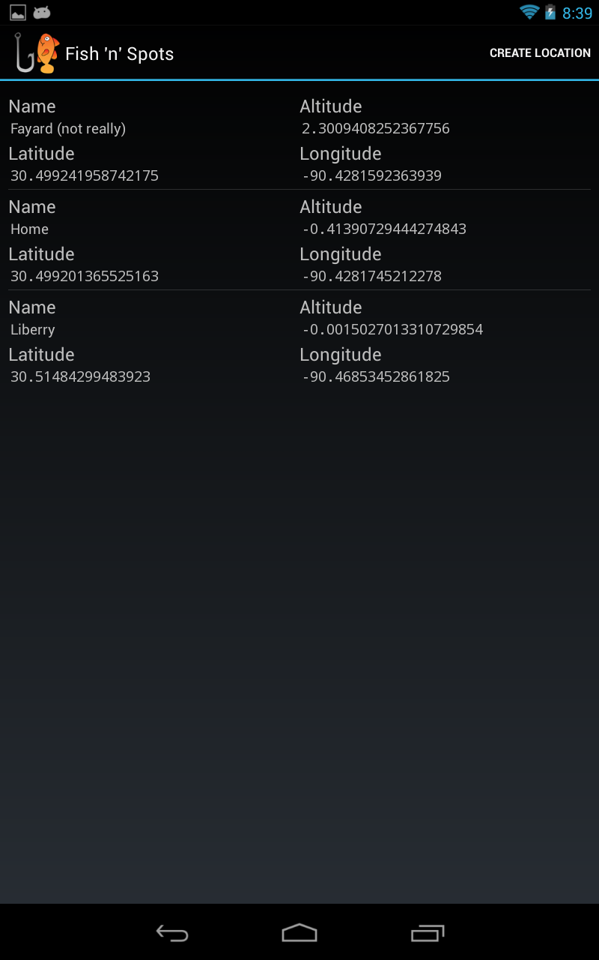
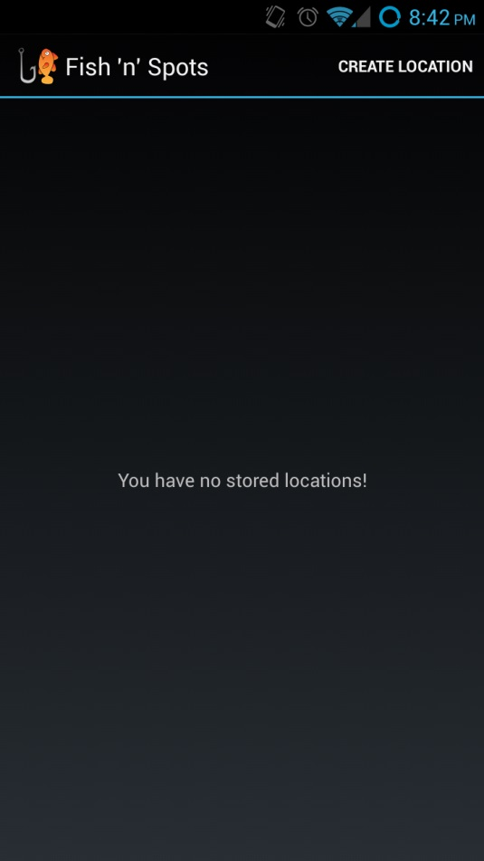
Screenshots of Fish ‘n’ Spots
location list (phone)
location list (tablet)

Slide 13
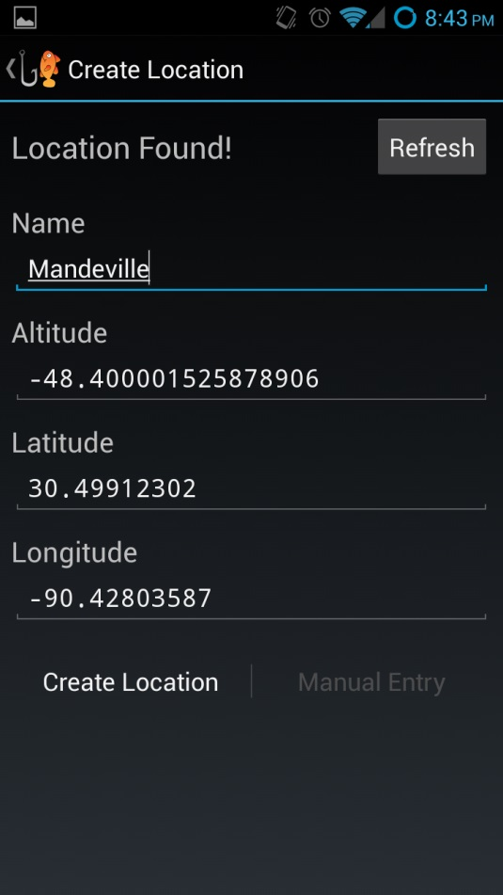
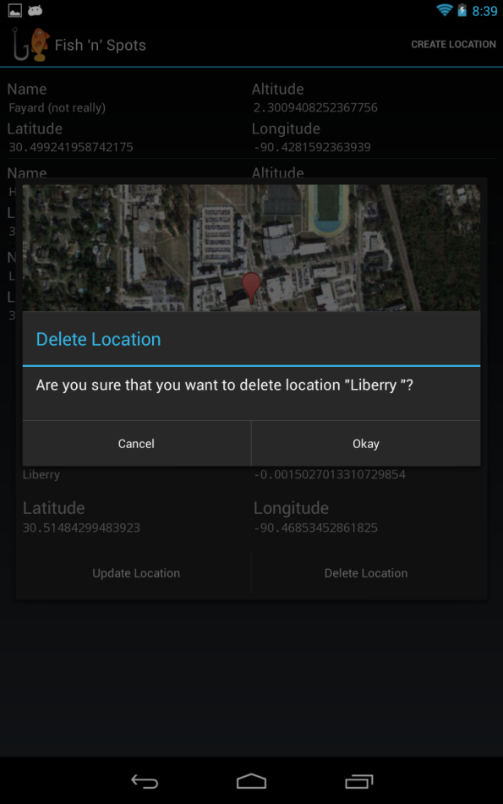
Screenshots of Fish ‘n’ Spots
creating a location (phone)
deleting a location (tablet)

Slide 14
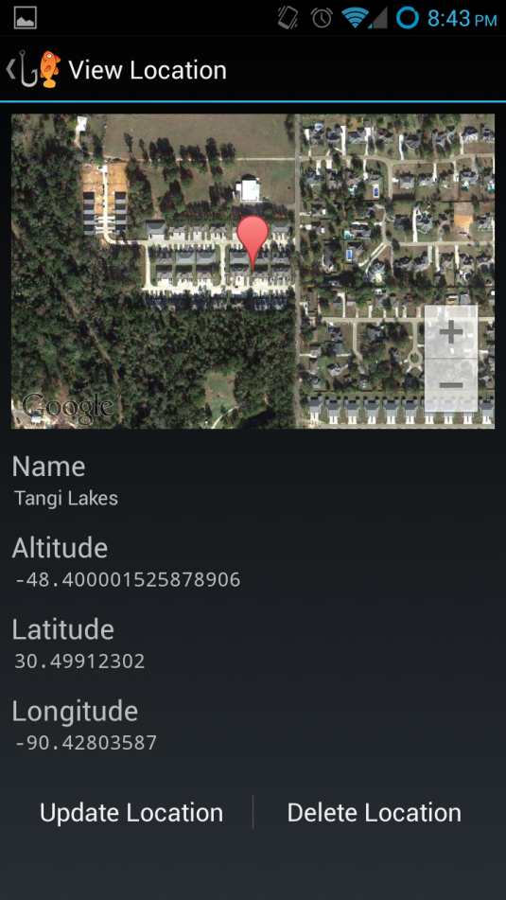
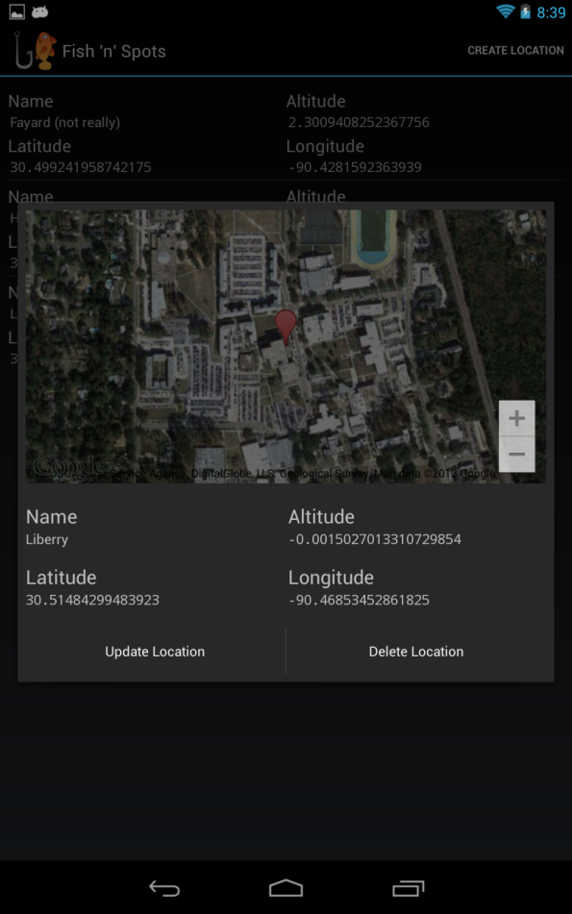
Screenshots of Fish ‘n’ Spots
viewing a location (phone)
viewing a location (tablet)

Slide 15
Thank you!

