Slide 1
Charter Fishing
Charles Madere and Joseph Gautier

Slide 2
Hello, World!
Here’s some text.

Slide 3

Making it Special
We made a cool li’l Android application
It’s called Fish ‘n’ Spots
Check out our custom icon!
We haven’t yet decided what kind of fish that is

Slide 4
About Fish ‘n’ Spots

Slide 5

About Fish ‘n’ Spots
Built for Android v4.0 (Ice Cream Sandwich) and above
Uses the Fragment class
This means that it works awesomely (and differently) on devices with bigger screens
Uses the Google Maps SDK to show a satellite view of saved locations

Slide 6
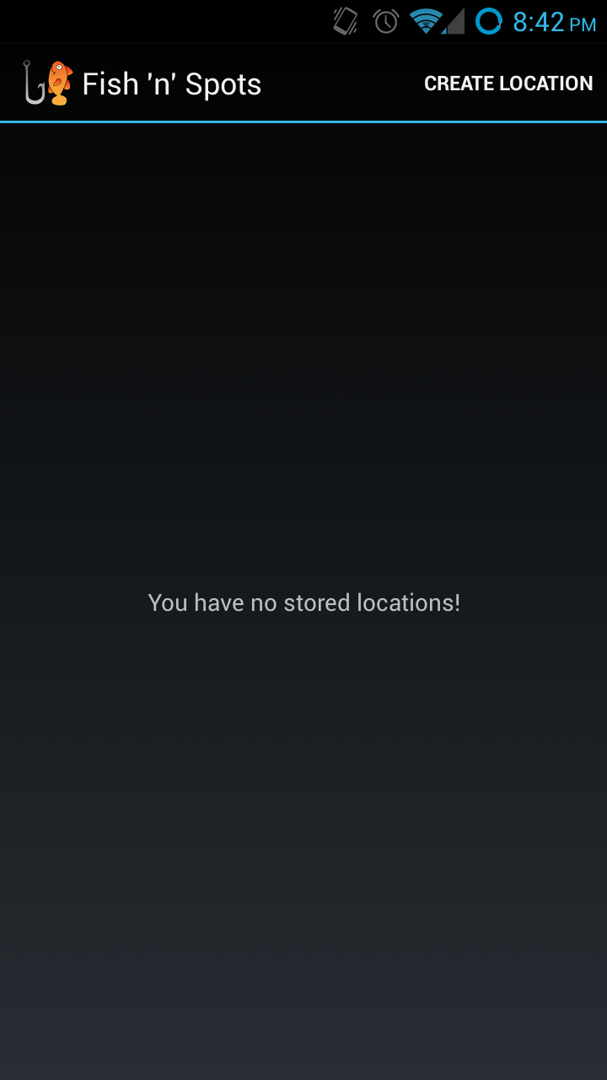
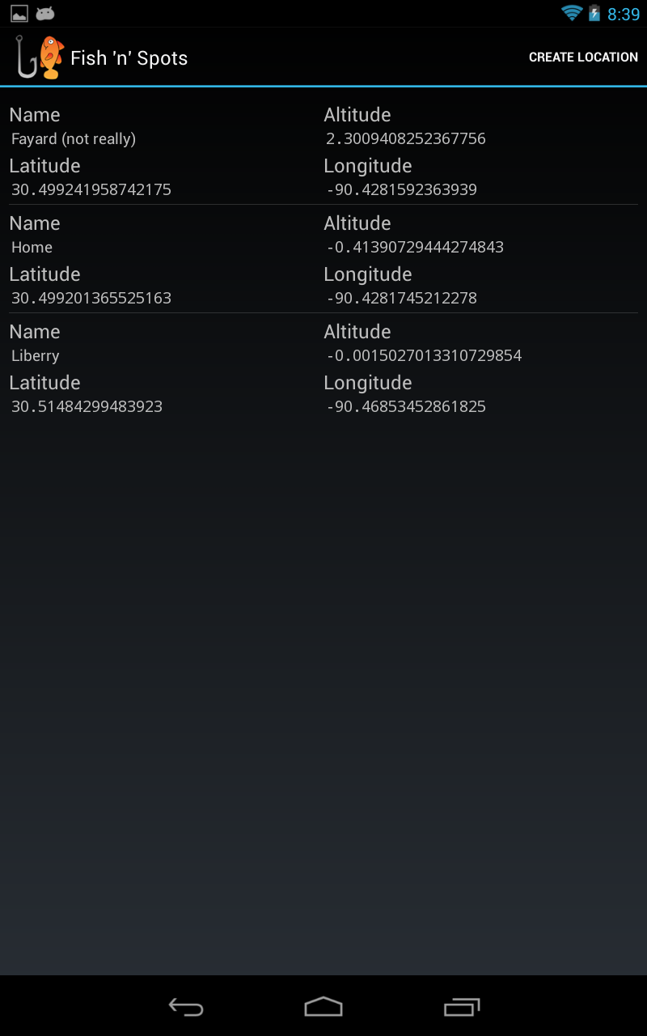
Fish ‘n’ Spots: Screenshots
Location List on Phone
Location List on Tablet

