Slide 1



Home IoT
Guardian
Reclaiming privacy in a connected world
Vada Boyz

Slide 2
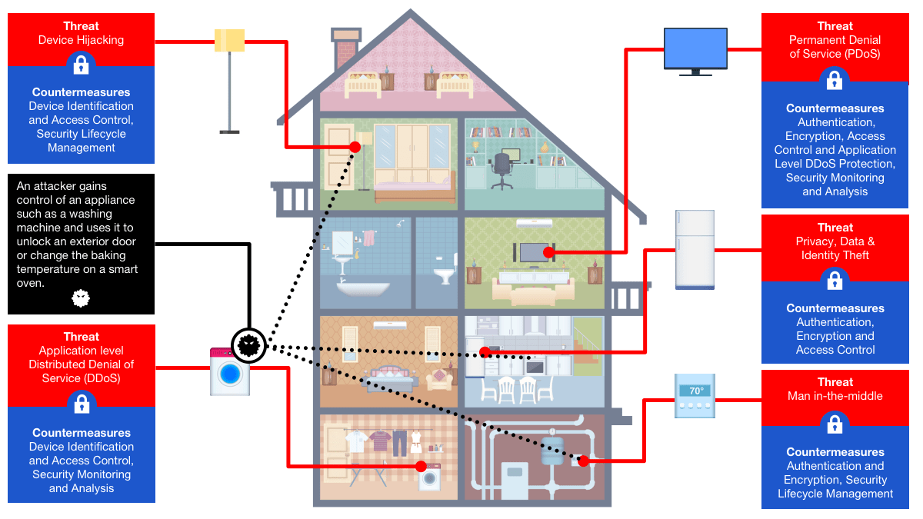

The Problem – Rising IoT Threats
Home networks vulnerable: 820K daily attacks from botnets like Eleven11 and Mirai.
Weak passwords & firmware expose cameras, thermostats to spying & DDoS.
75% devices at risk; cyber costs hit $10.5T annually.
Families face privacy invasions—e.g., unauthorized surveillance.
2025 surge: Botnets compromised 86K+ devices for 5.6 Tbps attacks.

Slide 3
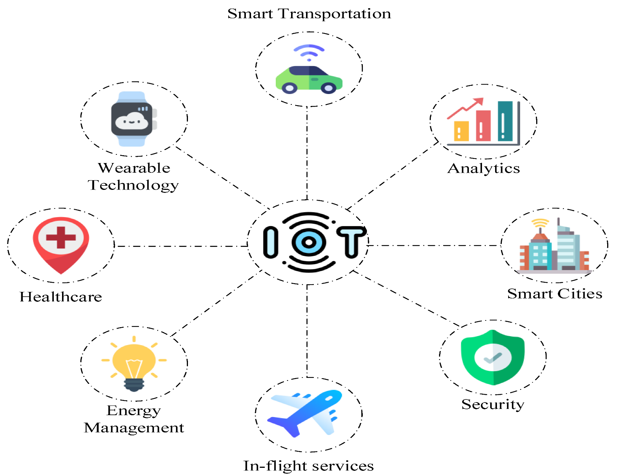

The Problem - Scale of the Crisis
Global IoT devices: 18B in 2025, up 50% YoY
High-impact breaches: NVRs and IP cams most vulnerable per reports.
Economic toll: Billions in losses from privacy & infrastructure attacks.
Underserved market: Homes lag behind enterprise security.

Slide 4
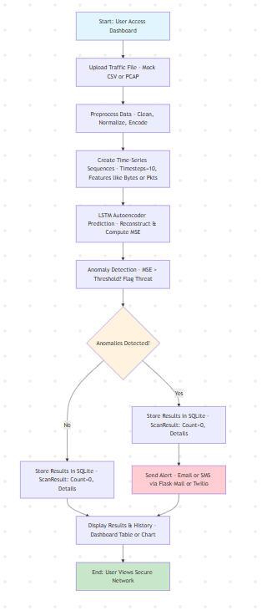

Home IoT Guardian
AI-Powered Threat Detection
AI-driven web dashboard for anomaly detection in network traffic. Uses LSTM ML to spot threats (e.g., data spikes) with 85%+ accuracy.
Real-Time Alerts
Phishing, ransomware, and social engineering are tactics used to steal or damage data.
Freemium model
Free scans, Rs. 399/month premium for edge integration
Scalability and Privacy
Scales to routers with federated learning for privacy

Slide 5
How it works – core technology
Tech stack: Python/Flask, scikit-learn/Keras (200K params model), Postgres (SQLite for demo)
Step 1
Step 2
Step 3
Step 4
Upload/ingest traffic data
Preprocess & sequence (timesteps=10, features like bytes/pkts)
LSTM autoencoder reconstructs; flags MSE > threshold as anomaly
Store in database, send alerts if threats detected

Slide 6
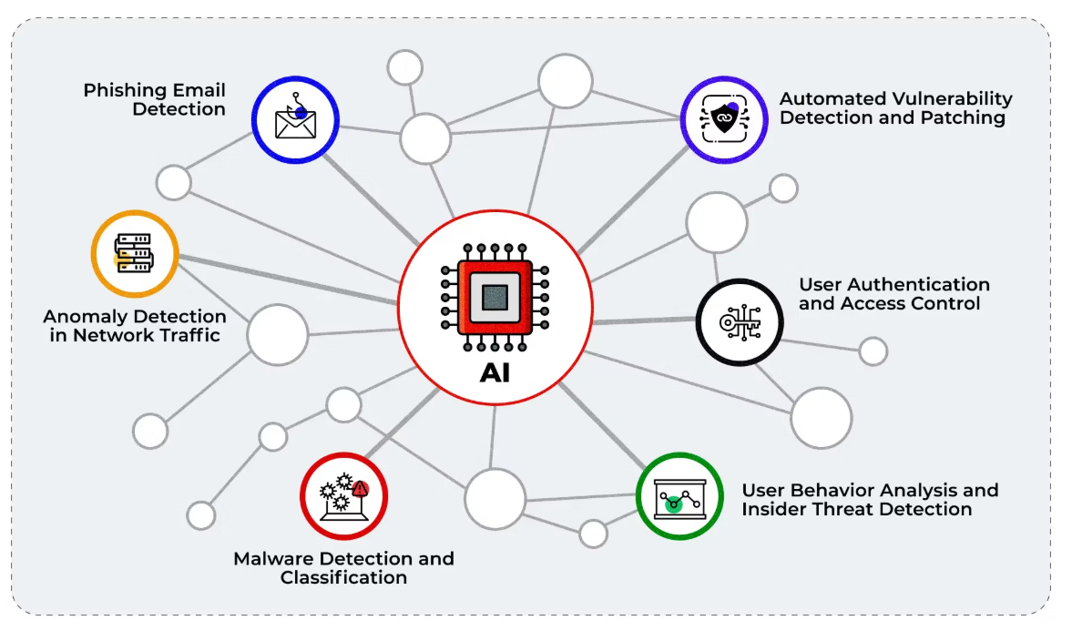
How it works – User flow
Upload
Analysis
Review
Expansion
User uploads traffic file via dashboard.
AI analyzes in <4min, detects >85% threats, <10% false positives
View results/history; get email/SMS alerts
Real-time edge ML on routers

Slide 7
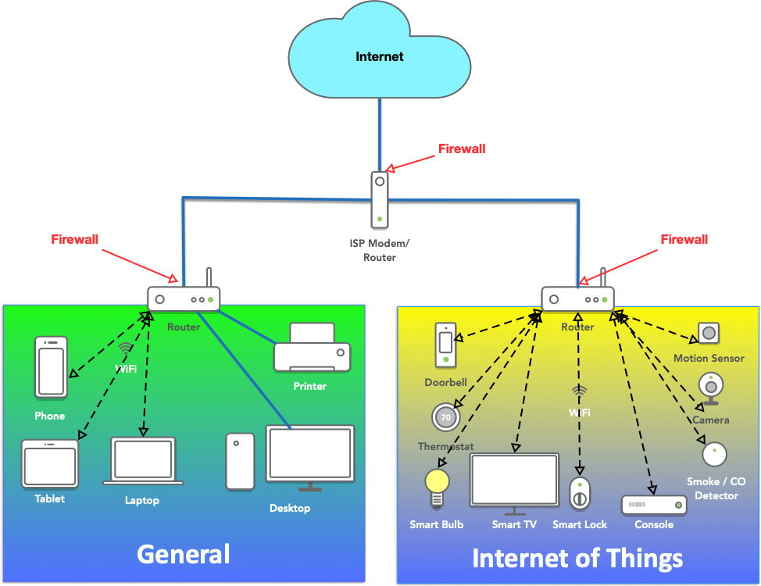
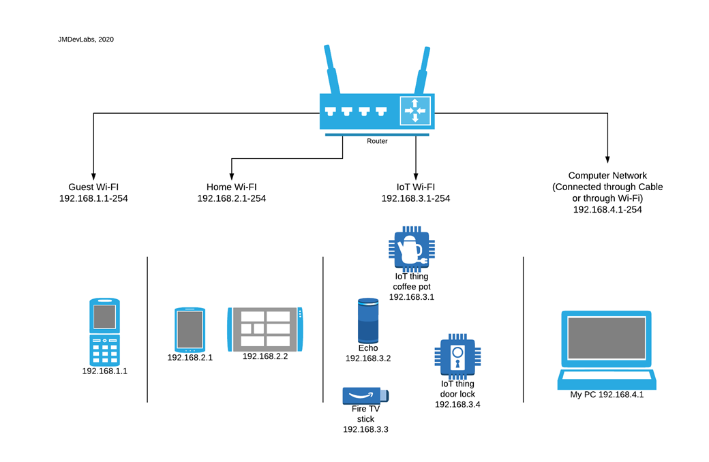
Future Integrations
Router Firmware Integration
Embed AI anomaly detection directly into router firmware (e.g., Netgear, TP-Link) Enables always-on protection with OTA updates; white-label for revenue share (10-20% on premium models)
Anomaly Handling & Device Isolation
On detection (e.g., traffic spikes), auto-quarantine via VLAN segmentation or MAC blocking to contain threats. Use SDN APIs for dynamic rerouting; notify users for remediation (e.g., firmware updates)
Secure, simple device onboarding
Devices are verified using hardware signatures/serial numbers etc. Users will be warned if they try to install an unverified device, and these devices will be added to an isolated layer.
Overall Benefits
Scales to edge computing for real-time security; boosts user retention 20-30% via trust-building; addresses 70% of home IoT risks from unauthorized devices.

Slide 8
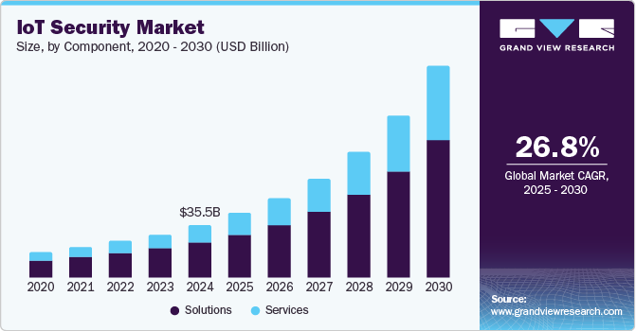
TAM
Market Potential
$270M in 2025 for India IoT security, growing to $2.34B by 2033 at 31% CAGR—driven by 2B connected devices by end-2025
SAM (Home Segment)
$54M (20% of TAM, focusing on urban households with 10+ IoT devices)
SOM
$5.4M Year 1 (1% capture, targeting 5M Indian homes at $1.08 ARPU; 5% conversion from free trials)
Drivers
Rapid IoT revenue to $26.93B in 2025; regs like DPDP Act & IT Act mandating data protection for IoT
Competitors
Global like Nozomi/Armis; local edge via affordable home focus over enterprise-heavy players.

Slide 9
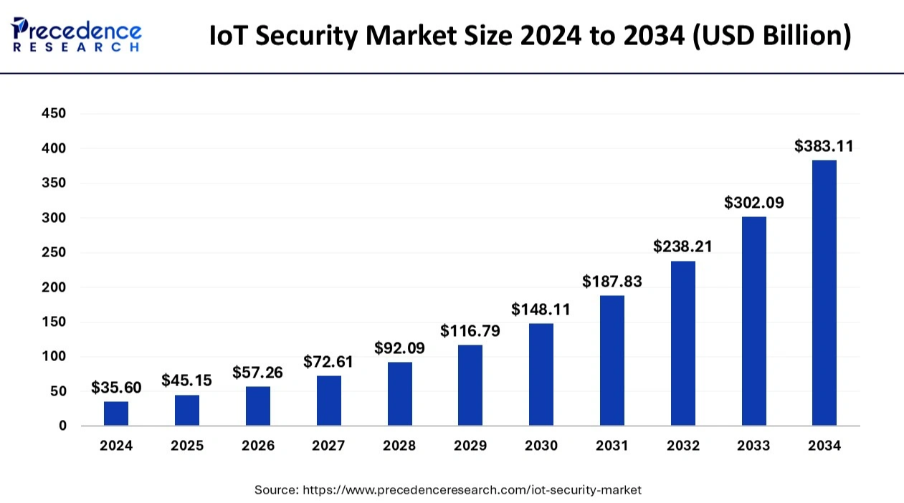
Target
Go-to-Market Strategy
Urban homeowners/families with smart homes; 62M households by 2025, prioritizing Tier-1/2 cities
Channels
Freemium app on Google Play/Apple Store; e-commerce via Flipkart/Amazon; B2B partnerships with Jio Fiber & Airtel Xstream
Pricing
Free basic scans, ₹399/mo premium (subscriptions + router upsell bundles)
Launch
Q1 2026 beta in metros; marketing via SEO, YouTube influencers, and Smart Cities initiatives
Metrics
50K users Month 1, 75% retention; monetize via SaaS with ARPU ramp-up through telecom tie-ups

Slide 10

Thank You

