Slide 1
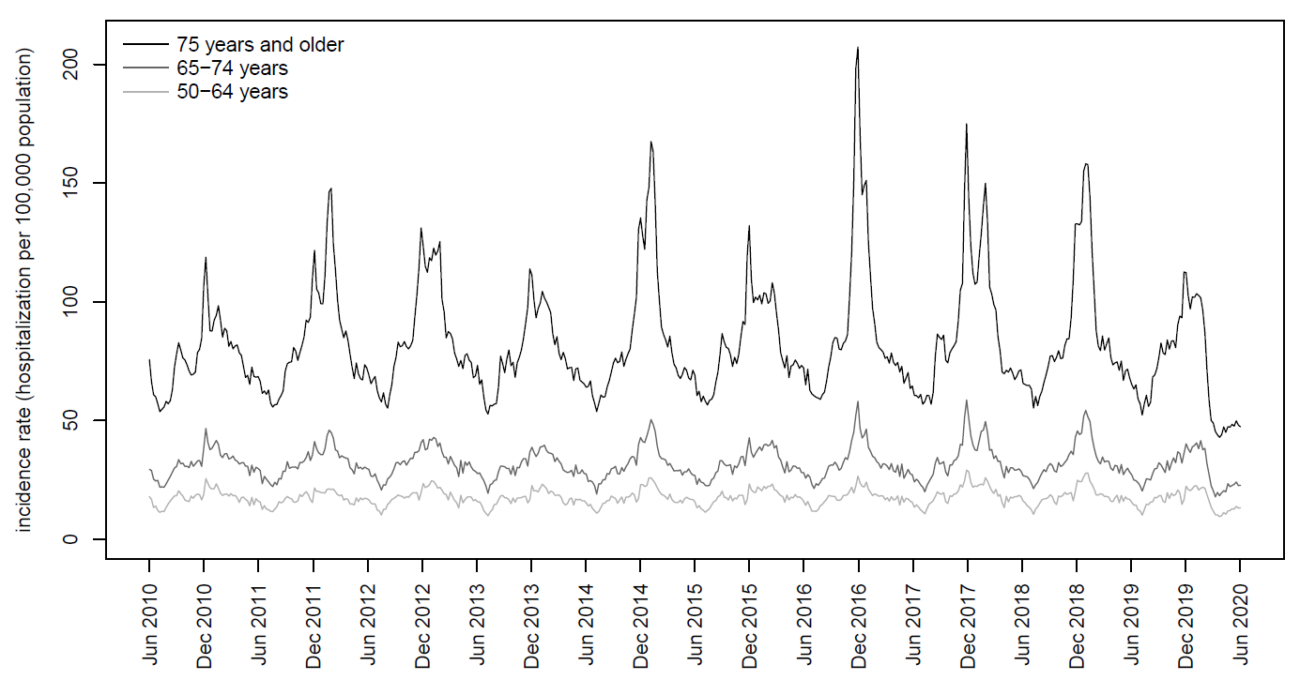
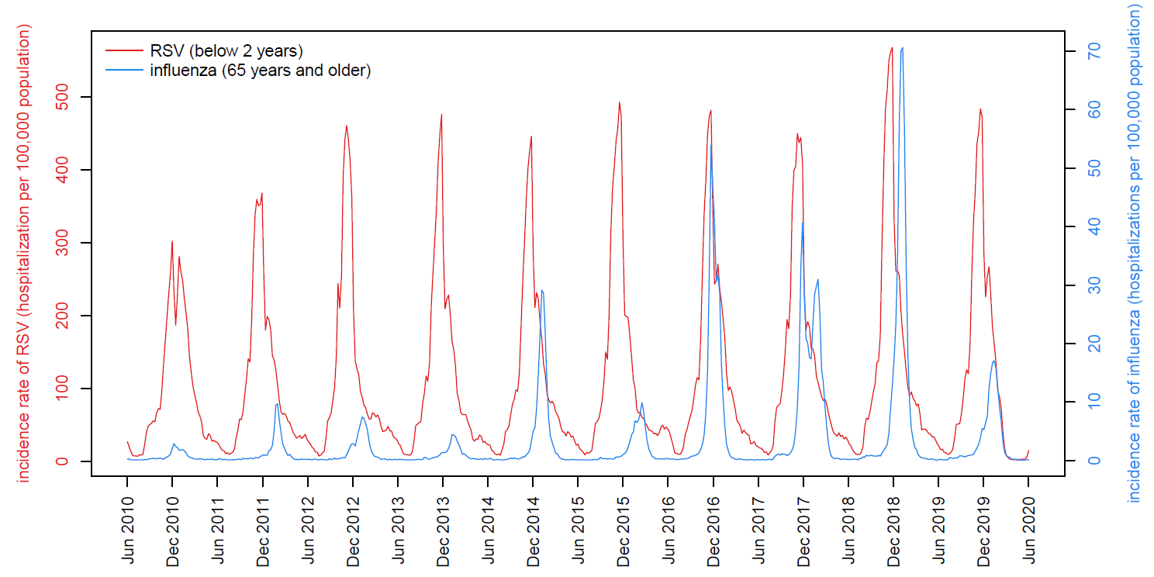


ESTIMATION OF HOSPITALIZATIONS ATTRIBUTABLE TO RSV INFECTION IN ADULTS OVER 50 YEARS OLD IN FRANCE USING A MODEL-BASED APPROACH, 2010-2020
Charles Nuttens¹,Vanessa Barbet² Laurence Watier³, Paul Loubet⁴, Jean-Sébastien Casalegno⁵, Philippe Vanhems⁵, Hervé Lilliu⁶, Stéphane Fievez¹, Emmanuelle Blanc¹, Elizabeth Begier⁷, Magali Lemaitre²,
1. Pfizer, Paris, France ; 2. Horiana, Bordeaux, France ; 3. INSERM - Université Paris-Saclay, UVSQ, Montigny-Le-Bretonneux, France ; 4. CHU de Nîmes, Nîmes, France; 5. Hospices Civils de Lyon, Lyon, France ; 6. Inbeeo, London, United Kingdom ; 7. Pfizer, Dublin, Ireland
Introduction
Methods
The epidemiology of respiratory syncytial virus (RSV) is poorly described and underestimated among older adults due to nonspecific symptomatology and insufficient testing. A few studies estimated the incidence of RSV using a model-based approach^{1,2}. However, this analysis has never been performed in France.
The objective of this study was to estimate the incidence rate of RSV infection in adults over 50 years old in France, with a focus on 65 years and older, using a model-based approach.
The numbers of hospitalizations for respiratory (J00-J99) and cardio-respiratory (I21, I50, I63, I64, J00-J99) causes coded as principal diagnoses were extracted from the national hospital discharge database. Circulation of RSV and influenza were estimated from pathogen-specific hospitalizations in those below 2 years of age and 65 years of age and older respectively.
Poisson cyclic regressions were used to estimate the weekly number of age- and cause-specific hospitalizations attributable to RSV from July 2010 to February 2020.
Results
Visualization of hospitalization data
Estimation of incidence rate
Weekly numbers of hospitalization for respiratory and cardio-respiratory causes followed a seasonality trend disrupted by an excess of hospitalization during the winter period, characterized by two sequential peaks (arrows).
Over the study period, the average annual hospitalization rates attributable to RSV in adults 65 years and older were 173.7 [95% CI 169.7-177.4] hospitalizations per 100,000 inhabitants for respiratory causes and 202.0 [95% CI 197.2-206.7] for cardio-respiratory causes, representing 20,904 and 24,319 yearly hospitalizations respectively.
The percentages of annual respiratory and cardio-respiratory hospitalizations estimated to be RSV-related were 6.0% and 3.3% respectively.
The RSV-related hospitalization rates increased with age (Table1). Rates for respiratory causes were 34, 93, 256/100,000 for 50-64 years, 65-74 years and 75 years and older respectively. Rates for cardio-respiratory causes were 48, 131, 275/100,000 for 50-64 years, 65-74 years and 75 years and older respectively.
Figure 1. Evolution of incidence rate of hospitalization by age group for respiratory causes, 2010-2020
 |  | Respiratory causes (ICD-10 J00-J99) | Cardio-respiratory causes (ICD-10 I21, I50, I63, I64, J00-J99)
50 - 64 years | n | 4,199 [3,746 ; 4,656] | 5,955 [5,425 ; 6,461]
 | n/100,000 | 33.9 [30.2 ; 37.6] | 48.1 [43.8 ; 52.1]
65 - 74 years | n | 5,696 [5,467 ; 5,913] | 8,007 [7,728 ; 8,280]
 | n/100,000 | 93.4 [89.6 ; 96.9] | 131.1 [126.5 ; 135.6]
75 years and older | n | 15,208 [14,952 ; 15,422] | 16,312 [16,014 ; 16,602]
 | n/100,000 | 255.9 [251.6 ; 259.5] | 274.5 [269.5 ; 279.4]
Circulation of RSV and influenza
The circulation of RSV was stable over the study period with annual peaks occurring in mid-December. The circulation of influenza was shifted compared to RSV and the intensity fluctuated over years. A lag of 1 week was applied to RSV to consider a temporal shift in circulation between children and adult population, based on Akaike information criterion and real-world clinical data.
Table 1. Evolution of the number of cases and incidence rate of hospitalization by age group for respiratory and cardio-respiratory causes, 2010-2020
Conclusion
The initial results of this study demonstrated RSV infection is responsible for a significant hospital burden in France among adults over 50 years old, particularly those 75 years and older.
Additional work will be performed to evaluate the impact of RSV and influenza circulation data on results and compare RSV estimations to influenza.
Figure 2. Evolution of incidence rate of RSV and influenza hospitalization, 2010-2020
References
1. John M McLaughlin et al., Rates of Medically Attended RSV Among US Adults: A Systematic Review and Meta-analysis, Open Forum Infect Dis (2022)
2. Ashley Sharp et al., Estimating the burden of adult hospital admissions due to RSV and other respiratory pathogens in England, Influenza Other Respir Viruses (2022)
Charles Nuttens, PhD
Medical Development, Scientific and Clinical Affairs - Pfizer
23-25 avenue du Docteur Lannelongue, 75014 Paris, France
charles.nuttens@pfizer.com - 0000-0001-6288-8023
Scan the QR code
to download the PDF version of the poster

