Slide 1
Classification-Kmeans
Week 8
Mohammad Esmalifalak

Slide 2
What is Classification?
Flower B
Flower A
Sepal Width
Sepal Length
Notes:
Crime rate: Per Capita

Slide 3
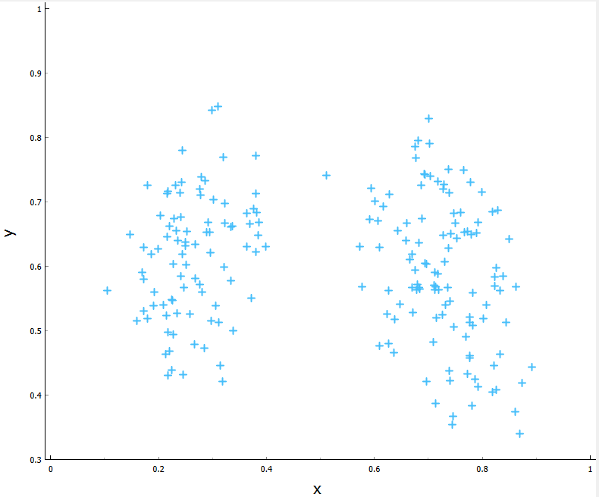
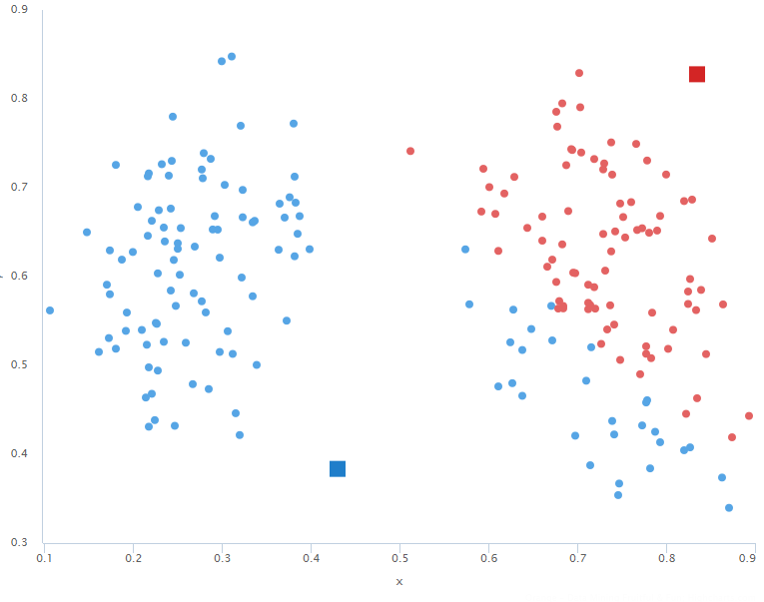
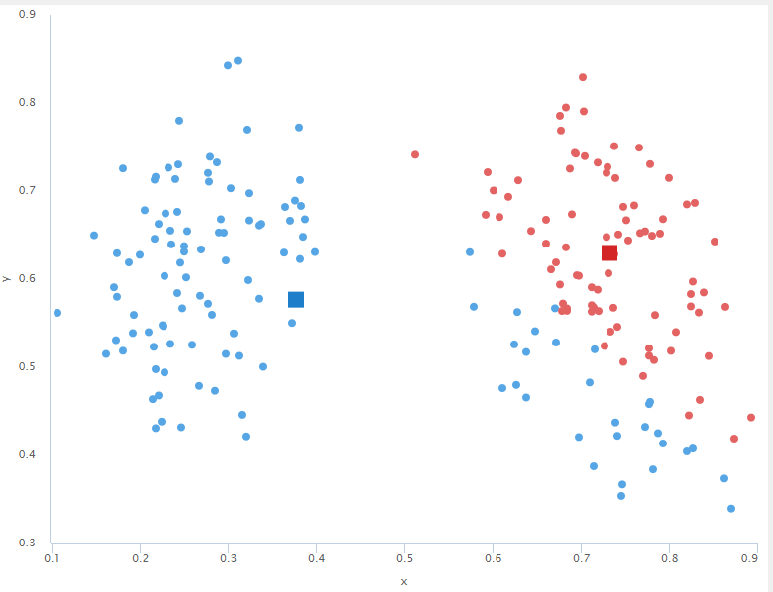
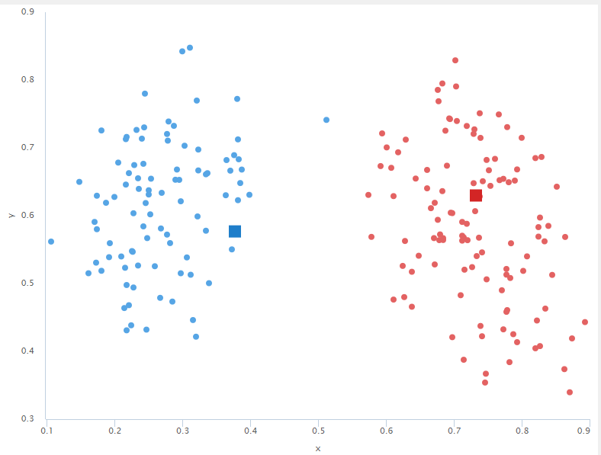
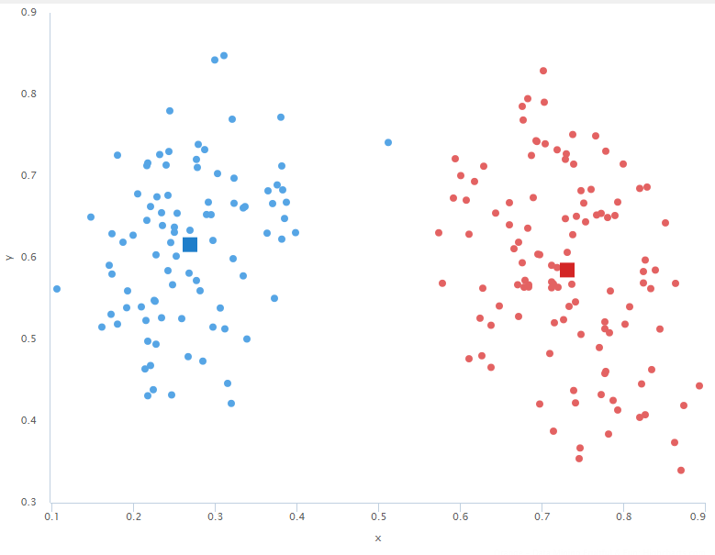

Kmeans
Assign Points to centers
Update the centers
1
2
Assign Points to centers
Update the centers
Assign Points to centers
3
4
5
Notes:
Crime rate: Per Capita

Slide 4

Notes:
Crime rate: Per Capita

