Slide 1
Preparing Data and Feature Engineering
Week 2
Mohammad Esmalifalak

Slide 2
Why Feature Engineering or Data Cleaning?
Garbage
Model
Perfect input
Garbage output
Perfect
Model
Garbage input
Garbage out

Slide 3
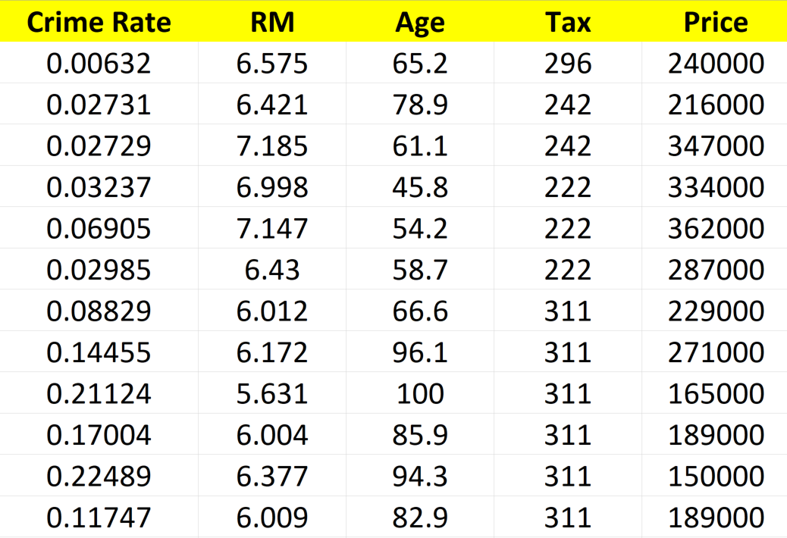
Feature Engineering
Door color
White
Brown
.
.
.
Feature selection: Deciding which data to collect (Domain Knowledge)
Feature creation: Combinations of features

Slide 4
Data Cleaning
Feature Normalization
Y
Anomaly
Nan
‘6.43’
X
Removing Anomalies
Strings (Convert to int. or Float)
Missing values

Slide 5
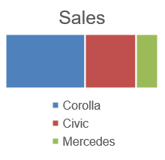
Types of Data-Level of Measurement
Categorical (Nominal, Qualitative):
Don’t have order (e.g. Sex, Preferred type of car, Color)
Can be summarized by frequency of observation for each category
Not possible to calculate mean

Slide 6
Types of Data-Level of Measurement
Ordinal:
Have meaningful order (e.g. Rank, Satisfaction, Fanciness)
Can be summarized by frequency of observation
Usually not good idea to get mean

Slide 7
Types of Data-Level of Measurement
Interval/Ratio (Scale, Quantitative, Parametric):
Can be measured (rather than classified or ordered).
Can be discrete (#of costumers, age) or continuous (distance, weight)
Common summary measures are, mean, median, standard deviation

Slide 8
Dealing with Missing Values - Methods
Replace with mean, median, interpolation, remove from dataset : each of these choices is associated with various trade-offs.
Method | Strengths | Weaknesses | Python
Mean | Averages of numerical data are used in many computations that will need to be done with numerical data, replacing with average value will not distort | Skewed by outliers Only meaningful for rational data types (i.e. float, int) and possibly interval, but not nominal (categorical) or ordinal | mean_age = df.Age.mean() df.Age = df.Age.fillna(mean_age)

Slide 9
Dealing with Missing Values - Methods
Replace with mean, median, interpolation, remove from dataset : each of these choices is associated with various trade-offs.
Method | Strengths | Weaknesses | Python
Median | Robust to outliers | May not be appropriate for datasets with “skewed’ distributions (i.e. poisson) in certain applications | med_age = df.Age.median()

Slide 10
Dealing with Missing Values - Methods
Replace with mean, median, interpolation, remove from dataset : each of these choices is associated with various trade-offs.
Method | Strengths | Weaknesses | Python
Mode | Using the most frequent value in a large dataset will not usually distort the average or other values too greatly | May not be appropriate for datasets with kurtosis (i.e. stable distributions ) in certain applications | mod_age = df.Age.mode()[0] *Mode returns a series

Slide 11
Dealing with Missing Values - Methods
Replace with mean, median, interpolation, remove from dataset : each of these choices is associated with various trade-offs.
Method | Strengths | Weaknesses | Python
Remove | Does not introduce any bias if missing values are randomly distributed | Selection bias may occur if missing values are concentrated among population subgroups (i.e. mostly older or mostly younger patients in a medical database) | A = df.dropna(how='all') df.dropna(how='any') df.dropna(thresh=2)

Slide 12
Pandas Data Frames and Useful Commands
Some commands that can be used to understand your data set. This can help you decide how to best handle missing values and other data cleaning tasks we will discuss in this lecture
df.head() (method)
df.tail() (method)
df.columns (attribute)
df.shape (attribute)
df.info()
df.column.value_counts(dropna=False)
df.describe()

Slide 13
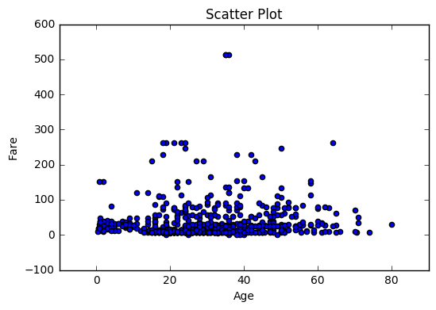
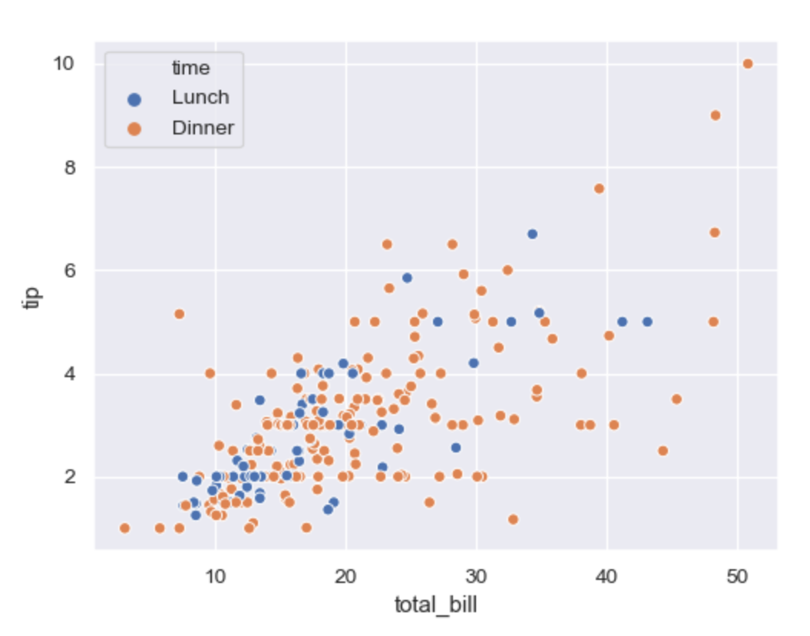
Visualizing Data with Graphs
Plot | Strengths | Weaknesses | Python
Scatter | Visualize relationships between variables, see outliers | Useful only for 2 or 3 variables at a time | # Matplotlib Import matplotlib.pyplot as plt plt.scatter(x, y) # Seaborn Import seaborn as sns Sns.scatterplot(x=…,y=…,hue=…)

Slide 14
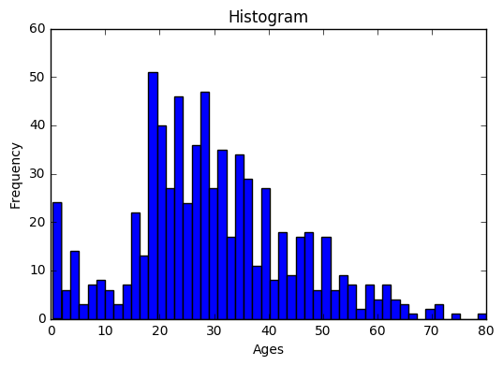
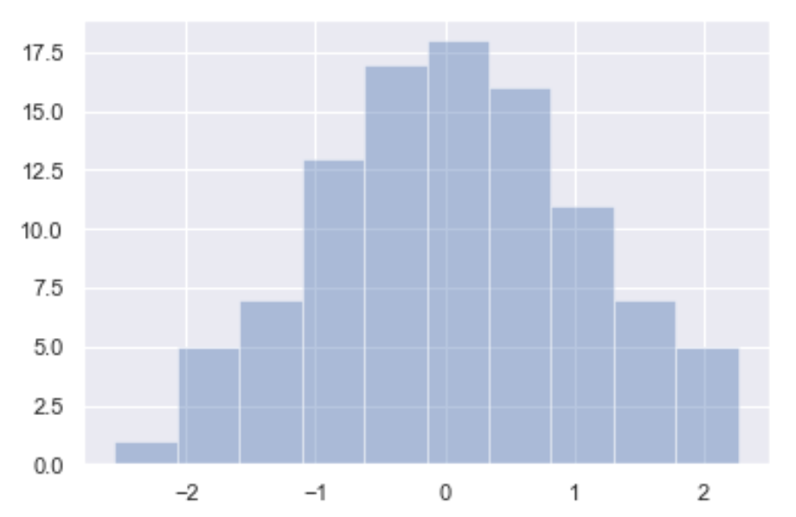
Visualizing Data with Graphs
Plot | Strengths | Weaknesses | Python
Histogram | Find distribution of a single variable, see outliers | Selecting Bin size | # Matplotlib Import matplotlib.pyplot as plt plt.hist(x, bins=10) # Seaborn Import seaborn as sns sns.distplot(x, bins=10, kde=False)

Slide 15
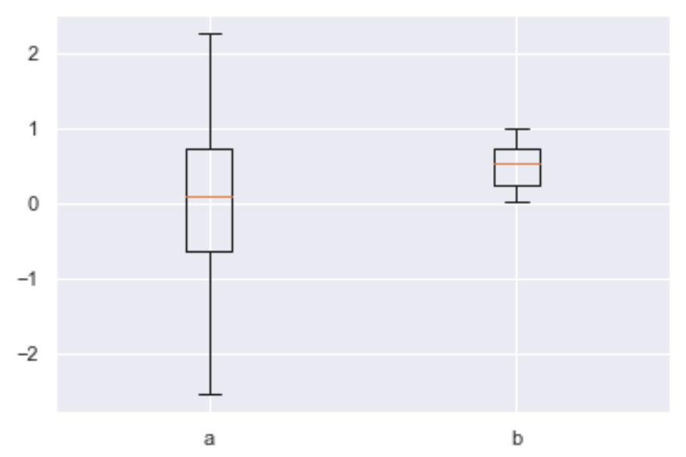
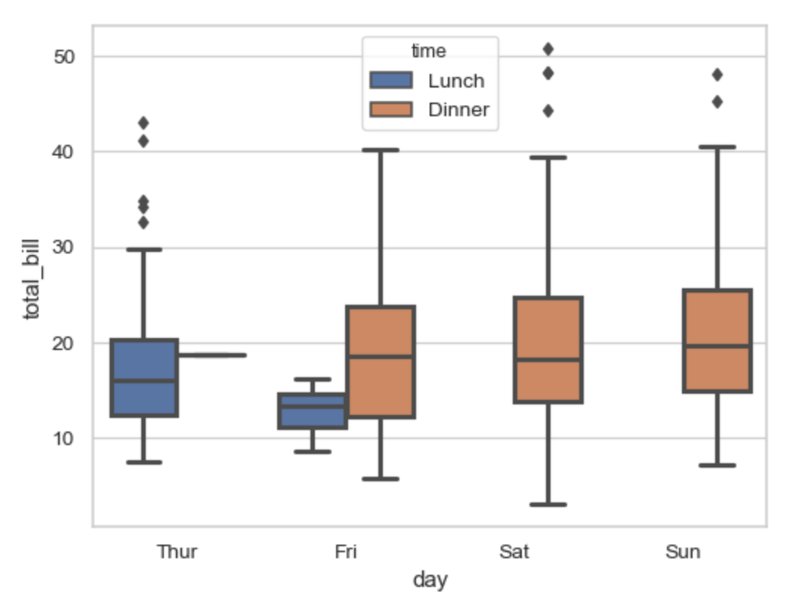
Visualizing Data with Graphs
Plot | Strengths | Weaknesses | Python
Box Plot | Visualize coarse grained distribution of numerical data by category, see outliers Can handle several categorical variables | Distribution is only min, max, quartiles and outliers | # Matplotlib Import matplotlib.pyplot as plt plt.boxplot([x ,y],labels=['a','b']) plt.legend # Seaborn Import seaborn as sns sns.boxplot(x="day", y="total_bill", hue="time“)

Slide 16
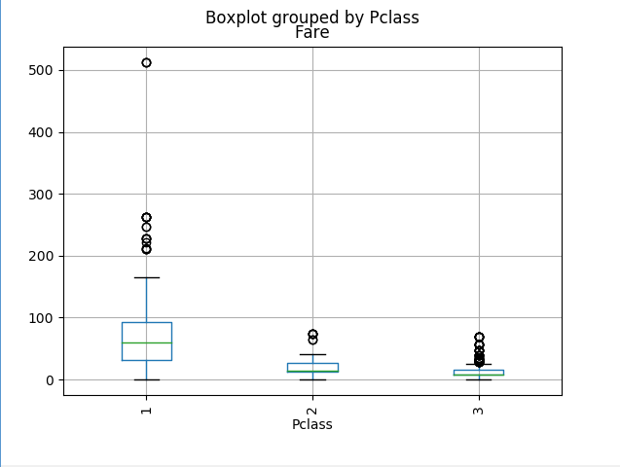
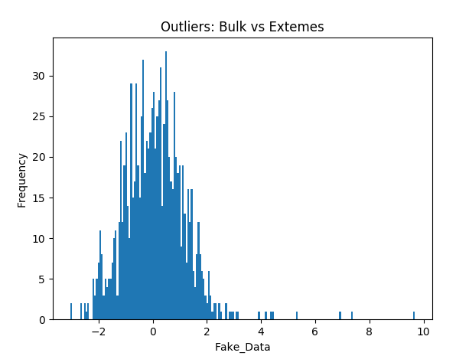
Data cleaning/Outliers
Outlier
Outliers
May be found using visual inspection
Having less than a certain probability of occurring

Slide 17
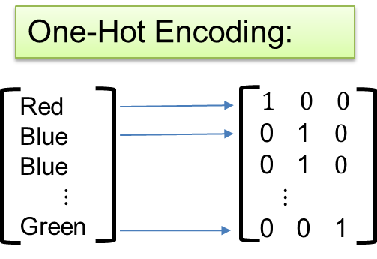
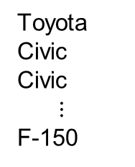

Categorical Data
Label Encoding:
Toyota
Civic
Civic
$⋮$
F-150
$$1$$
2
2
$$⋮$$
5
Five categories
Five Numbers.
Three categories
Three columns
Pros: One new column
Cons: Order could confuse algorithm
Pros: Doesn’t have any order
Cons: Can create lots cols.+rows
df[“C3"] = df[“C3"].astype('category')
df[“Cn"] = df[“C3"].cat.codes
pd.get_dummies(df, columns=[‘Sex’,’Color’])

