Slide 1
Classification-Logistic Regression
Week 4
Mohammad Esmalifalak

Slide 2
What is Classification?
Flower B
Flower A
Sepal Width
Sepal Length
Notes:
Crime rate: Per Capita

Slide 3


Which ones are classification problems?
Predicting the price of a car (based on model, brand, year, etc.)
Predicting if an email is spam or not
Predicting if the price of a car is below $15K or not
x
✓
✓
0: “Negative Class”
$\hat{y}$ ∊ {0, 1, 2, 3, 4}
$\hat{y}$∊ {0, 1}
1: “Positive Class”
Multiclass Classification
Notes:
Crime rate: Per Capita

Slide 4



Algorithm Development
$$h_{}(X)=^{T}X$$
Yes 1
XXXX
0.5
If $h_{θ}\left(X\right)>$= 0.5, $then \hat{y}=$1
Engine
Failed?
If $h_{θ}\left(X\right)<$ 0.5, $then \hat{y}=$0
No 0
X XXXX X
Generated Heat
Notes:
Crime rate: Per Capita

Slide 5


Algorithm Development
$$h_{}(X)=^{T}X$$
Yes 1
XXXX X
0.5
If $h_{}\left(X\right)≥$0.5, $then \hat{y}=$1
Engine
Failed?
If $h_{θ}\left(X\right)<$ 0.5, $then \hat{y}=$0
No 0
X XXXX X
Generated Heat
Notes:
Crime rate: Per Capita

Slide 6


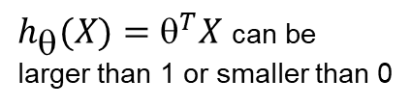
Algorithm Development
Another problem of using linear regression in classification,
In classification problems,
$\hat{y}$∊ {0, 1}
In linear regression problems,
$h_{}(X)=^{T}X$ can be
larger than 1 or smaller than 0
In fact we want
${0 ≤h}_{}(X)$ $≤1$
Notes:
Crime rate: Per Capita

Slide 7
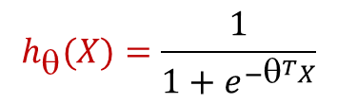




Logistic Regression Hypothesis
$$1$$
$$h_{θ}(X)=\frac{1}{1+e^{−θ^{T}X}}$$
$$0.5$$
$$0$$
$$^{T}X$$
Suppose we know $^{T}$ and we get $h_{θ}\left(X_{new}\right)=0.8$for the new engine.
Question: What is the meaning of $h_{θ}\left(X_{new}\right)=0.8$?
Answer: There is an 80% chance that new engine is broken!
Notes:
Crime rate: Per Capita

Slide 8









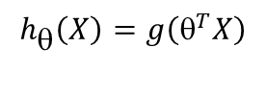

Logistic Regression Hypothesis
$h_{θ}\left(X\right)=\frac{1}{1+e^{{−θ}^{T}X}}=P(y=1|x,$ θ)
$$1$$
$$h_{θ}\left(X\right)=g\left(θ^{T}X\right)$$
$$g(z)$$
$$0.5$$
$$g(z)=\frac{1}{1+e^{−z}}$$
$$0$$
$$z$$
Predict $y=1$
if $h_{θ}\left(X\right)=g\left(θ^{T}X\right)$ $≥$ 0.5
$^{T}X=z$ $≥ 0$
Predict $y=0$
if $h_{θ}\left(X\right)=g\left(θ^{T}X\right)$ $<$ 0.5
$^{T}X=z$ $< 0$
How this hypothesis makes predictions?
Notes:
Crime rate: Per Capita

Slide 9














Decision Boundary
$h_{θ}\left(X\right)=\frac{1}{1+e^{{−θ}^{T}X}}=P(y=1|x,$ θ)
$$1$$
$$g(z)$$
Predict $y=1$
$^{T}X=z$ $≥ 0$
$$0.5$$
$$0$$
$$z=^{T}X$$
Predict $y=0$
$^{T}X=z$ $< 0$
$$x_{2}$$
Suppose: ${ }^{T}=[4, −2 −1]$
4
Predict y=0
$4−2x_{1}−x_{2}$< 0
Predict y=1
$4−2x_{1}−x_{2}$≥ 0
$$x_{1}$$
2
Notes:
Crime rate: Per Capita

Slide 10
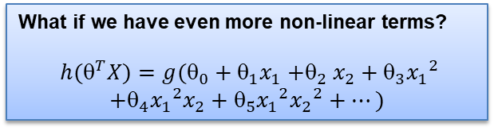







Non-Linear Decision Boundary
$$x_{2}$$
Suppose:
$${ }^{T}X=−7+4x_{1}+4x_{2}− {x_{1}}^{2}− {x_{2}}^{2}$$
Predict y=0 if:
$$−7+4x_{1}+4x_{2}− {x_{1}}^{2}− {x_{2}}^{2}<0$$
2
Predict y=1
$$−7+4x_{1}+4x_{2}− {x_{1}}^{2}− {x_{2}}^{2}≥0$$
$$x_{1}$$
2
$$x_{2}$$
What if we have even more non-linear terms?
$${ h(}^{T}X)=g(_{0}+_{1}x_{1}{+}_{2}x_{2}+_{3}{x_{1}}^{2}$$
$$+_{4}{x_{1}}^{2}x_{2}+_{5}{x_{1}}^{2}{x_{2}}^{2}+…)$$
$$x_{1}$$
Notes:
Crime rate: Per Capita

Slide 11


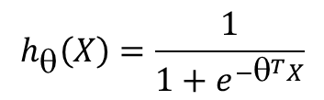

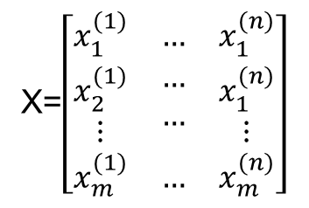
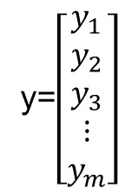
Fitting${ }_{0}$, $_{1},_{2}, …$
What we have:
Training set:
X=$\left[\begin{matrix}x_{1}^{(1)} & … & x_{1}^{(n)} \\ \begin{aligned}x_{2}^{(1)} \\ ⋮\end{aligned} & \begin{aligned}… \\ …\end{aligned} & \begin{aligned}x_{1}^{(n)} \\ ⋮\end{aligned} \\ x_{m}^{(1)} & … & x_{m}^{(n)}\end{matrix}\right]$
y=$\left[\begin{aligned}y_{1} \\ y_{2} \\ y_{3} \\ ⋮ \\ y_{m}\end{aligned}\right]$
and
where
$$y_{i}∊\{0,1\}$$
What we want:
$$h_{θ}\left(X\right)=\frac{1}{1+e^{{−θ}^{T}X}}$$
Find
${^{T}=[}_{0}$, $_{1},_{2}, …]$
in
Notes:
Crime rate: Per Capita

Slide 12


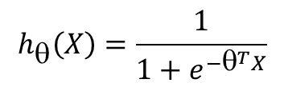
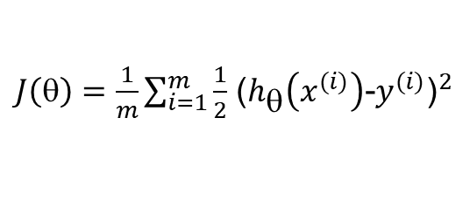

Cost Function:
$J\left(θ\right)=\frac{1}{m}\sum_{i=1}^{m}{\frac{1}{2}}$ ${\text{(}h_{θ}\left(x^{(i)}\right)\text{−}y^{(i)}\text{)}}^{2}$
Linear regression
Logistic regression
$$h_{θ}\left(X\right)=θ^{T}X$$
$$h_{θ}\left(X\right)=\frac{1}{1+e^{{−θ}^{T}X}}$$
$J\left(θ\right)$ Convex
$J\left(θ\right)$ Non-convex
Notes:
Crime rate: Per Capita

Slide 13
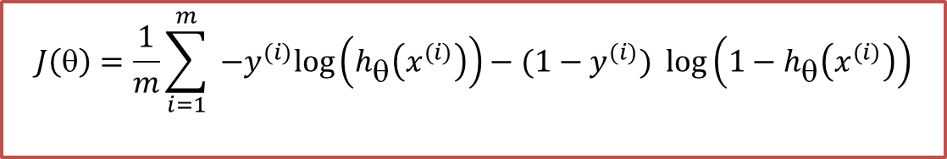
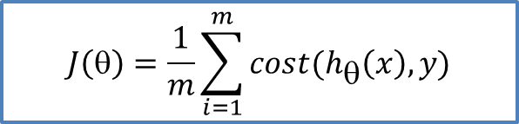

Cost Function:
Different cost function which is convex:
$$J\left(θ\right)=\frac{1}{m}\sum_{i=1}^{m}{{ −y}^{(i)}\log\left(h_{θ}\left(x^{(i)}\right)\right)−(1−y^{(i)}) \log\left(1−h_{θ}\left(x^{(i)}\right)\right)}$$
$$cost(h_{θ}\left(x\right),y)$$
$$J\left(θ\right)=\frac{1}{m}\sum_{i=1}^{m}{cost(h_{θ}\left(x\right),y)}$$
Notes:
Crime rate: Per Capita

Slide 14










Cost Function:
$${cost\left(h_{θ}\left(x\right),y\right) =−y}^{(i)}\log\left(h_{θ}\left(x\right)\right)−(1−y^{(i)}) \log\left(1−h_{θ}\left(x\right)\right)$$
When y=1:
When y=0:
$$cost\left(h_{θ}\left(x\right),y\right)=−log\left(h_{θ}\left(x\right)\right)$$
$$cost\left(h_{θ}\left(x\right),y\right)=−log\left(1−h_{θ}\left(x\right)\right)$$
$$cost\left(h_{θ}\left(x\right),y\right)$$
$$cost\left(h_{θ}\left(x\right),y\right)$$
$$h_{θ}\left(x\right)$$
$$h_{θ}\left(x\right)$$
$$0$$
$$1$$
$$0$$
$$1$$
Notes:
Crime rate: Per Capita

Slide 15
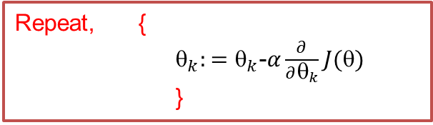
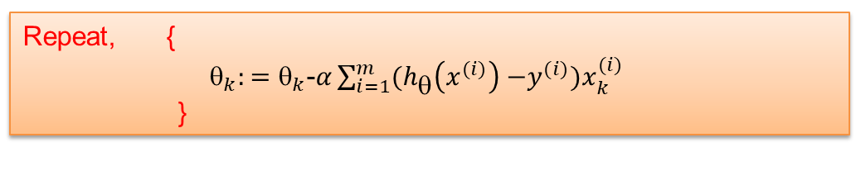

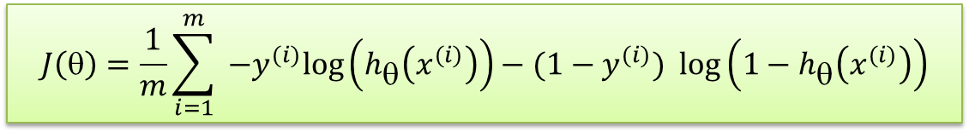
Gradient Descent:
$$J\left(θ\right)=\frac{1}{m}\sum_{i=1}^{m}{{ −y}^{(i)}\log\left(h_{θ}\left(x^{(i)}\right)\right)−(1−y^{(i)}) \log\left(1−h_{θ}\left(x^{(i)}\right)\right)}$$
Repeat, {
$_{k}:=_{k}$-$α\frac{∂}{∂θ_{k}}J(θ)$
}
To get, $\min_{θ} J\left(θ\right)$:
Repeat, {
$_{k}:=_{k}$-$α\sum_{i=1}^{m}{{(h}_{θ}\left(x^{(i)}\right){ −y}^{(i)})x_{k}^{(i)}}$
}
Notes:
Crime rate: Per Capita

Slide 16
Feature Selection
Deep NN with lots of observations
Accuracy
Classical ML with limited observations
# of features
Notes:
Crime rate: Per Capita

Slide 17


Recursive Feature Elimination (RFE)
X1
X2
X3
X4
$$h_{θ}\left(X\right)=5+3X1+8X2+0.1X3−5X4$$
X1
X2
X4
$$h_{θ}\left(X\right)=6+2X1+11X2−6X4$$
X2
X4
So what is the optimal
number of features?
Notes:
Crime rate: Per Capita

Slide 18
Kfold Cross Validation
Divide the whole data set to k buckets and select each bucket as test set and the rest as training sets.
Example, K=3
33% Test
33% Train
33% Train
Acc1
33% Train
33% Test
33% Train
Acc2
Mean of accuracies
33% Train
33% Train
33% Test
Acc3
Notes:
Crime rate: Per Capita

Slide 19
RFE in Sklearn
The least important features are pruned from current set of features recursively.
sklearn.feature_selection.RFE(estimator, step=1, n_features_to_select=None, cv=3)
estimator = SVR(kernel="linear")
selector = RFE(estimator, step=1, )
selector = selector.fit(X, y)
Example:
selector. ranking_
array([1, 1, 1, 1, 1, 4, 2, 1, 1, 3])
Notes:
Crime rate: Per Capita

Slide 20
RFE with Kfold Cross Validation
Ranks the features with RFE.
Cross-validates selection of the best number of features (K-Fold).
sklearn.feature_selection.RFECV(estimator, step=1, min_features_to_select=1, cv=3)
estimator = SVR(kernel="linear")
selector = RFECV(estimator, step=1, cv=5)
selector = selector.fit(X, y)
Example:
selector. ranking_
array([1, 1, 1, 1, 1, 4, 2, 1, 1, 3])
Notes:
Crime rate: Per Capita

Slide 21
RFE in Sklearn
from sklearn import linear_model
estimator = linear_model.LinearRegression()
sklearn.feature_selection.RFE(estimator, n_features_to_select=None)
For other feature selection methods, refer to:
https://scikit-learn.org/stable/modules/feature_selection.html
Notes:
Crime rate: Per Capita

Slide 22

Notes:
Crime rate: Per Capita

