Slide 1
Regression
Week 3

Slide 2
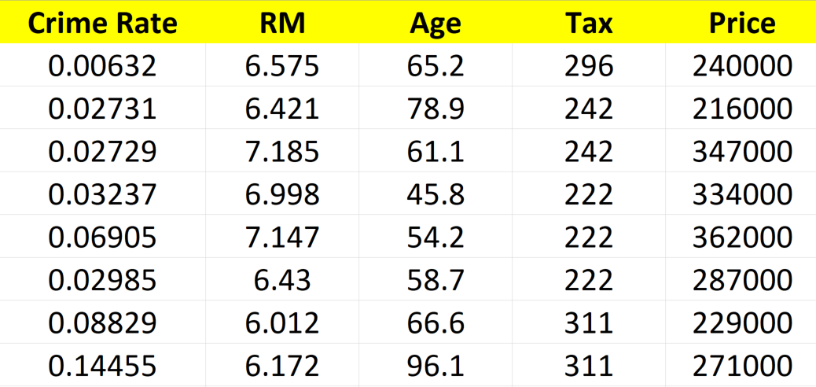
What is Regression?
Input variables, Features, X
Output, Label, Target, Y
??
Can we predict the price of a home based on input features?
Notes:
Crime rate: Per Capita

Slide 3





What is Regression?
Output: continuous.
Input: Continuous or categorical.
Expected
$
Model
For new house

Slide 4
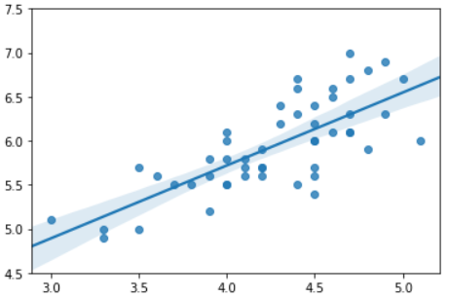
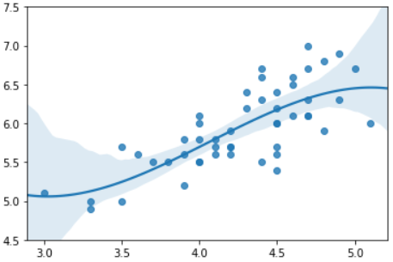
Linear Regression
Non-Linear Regression
Price (in $1000)
Price (in $1000)
# of rooms
# of rooms

Slide 5
Other Examples of Regression
Label (Y) | Features (X)
Salary | Occupation, Education, Work Experience, etc.
Pollution | Engine Size, Year, Make, Model, etc.
Sales | Age, Education, Work Experience, etc.
Weather | Hour, Month, Location, etc.
Practice: Identify the regression problem,
1- Predicting Normal vs Abnormal 3- Grouping similar cars
2- Predicting if stock will rise or fall 4- Predicting stock price for tomorrow

Slide 6
Regression Algorithms
Bayesian linear regression
Neural network regression
k-nearest neighbors
Ordinal regression
Linear, polynomial,…

Slide 7
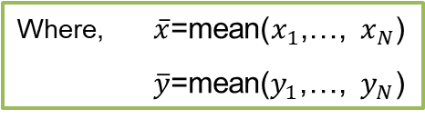

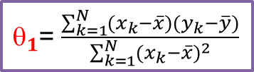
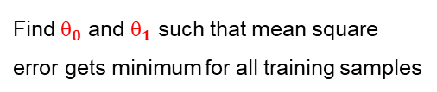

Linear Regression
$$\hat{y}=θ_{0}+θ_{1}x_{1}$$
Problem:
Price (in $1000)
Find $_{0}$ and $_{1}$ such that mean square
error gets minimum for all training samples
error
Solution:
$_{1}$= $\frac{\sum_{k=1}^{N}{(x_{k}−\overline{x})(y_{k}−\overline{y})}}{\sum_{k=1}^{N}{{(x_{k}−\overline{x})}^{2}}}$
# of rooms
Where, $\overline{x}$=mean($x_{1}$,…, $x_{N}$)
$\overline{y}$=mean($y_{1}$,…, $y_{N}$)
$_{0}$=$\overline{y}−θ_{1}\overline{x}$

Slide 8
Training vs Testing
Why we should split the data to, Train set and Test set?
1- To make sure model will perform well on future data (not just historical data)
2- To make sure we are not over-fitting or under-fitting data
y
y
y
x1
x1
x1
Over-fitted
Under-fitted
Just right!

Slide 9


