Slide 1
Dimensionality Reduction
Week 8- Principle Component Analysis
Mohammad Esmalifalak

Slide 2
Why We Reduce Dimension?
Less Memory Usage
Speeding up learning algorithms
Visualization

Slide 3
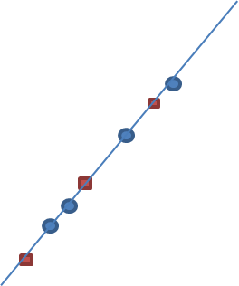
Principle Component Analysis (2D)
X2
X2
Z1
X1
X1
Reducing dimension from 2D to 1D will not cause two much of information loss

Slide 4

Principle Component Analysis (2D)
X2
X2
Z1
X1
X1
Reducing dimension from 2D to 1D could cause two much of information loss

Slide 5
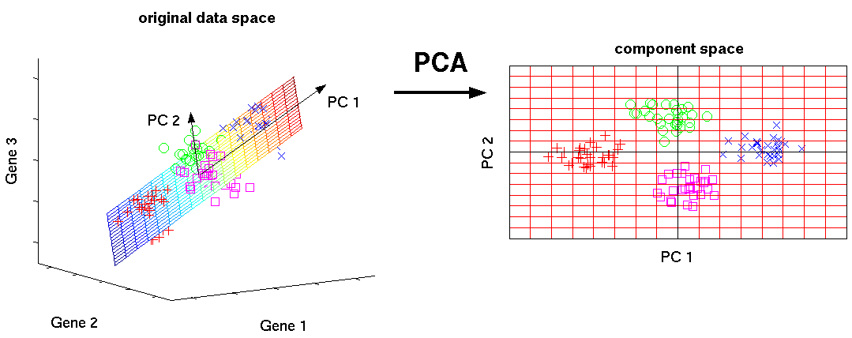
Principle Component Analysis (3D)

Slide 6
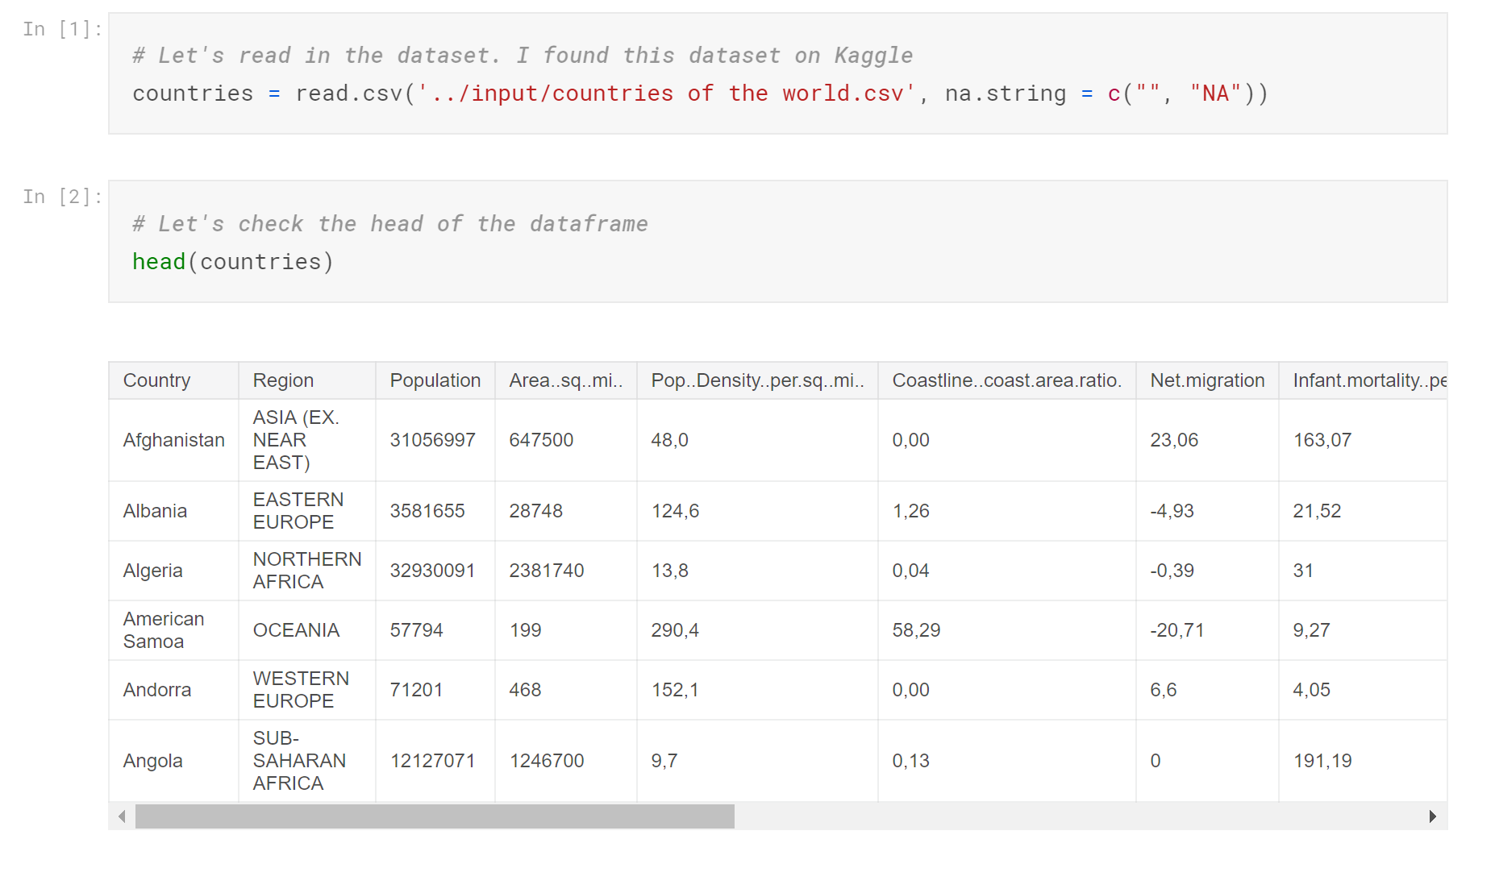
PCA for Visualization

Slide 7
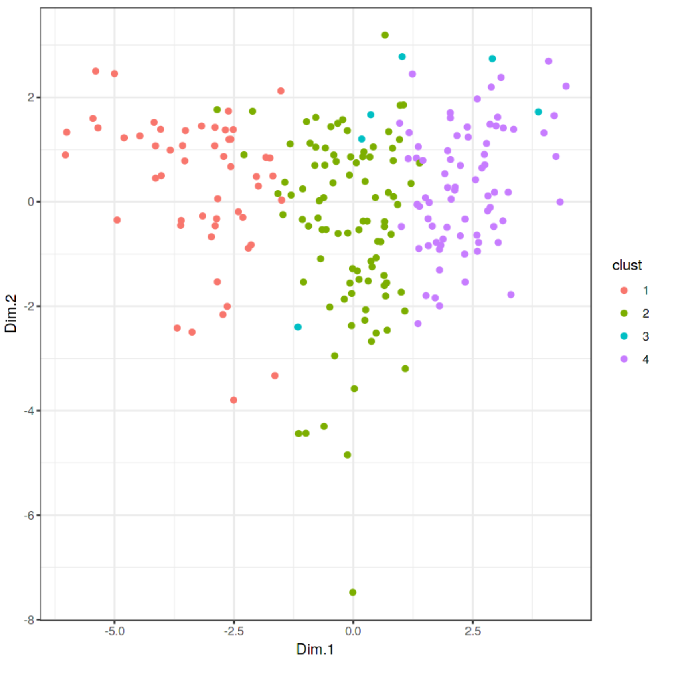
PCA for Visualization
~ Per Person GDP
~ Country Size/GDP

Slide 8
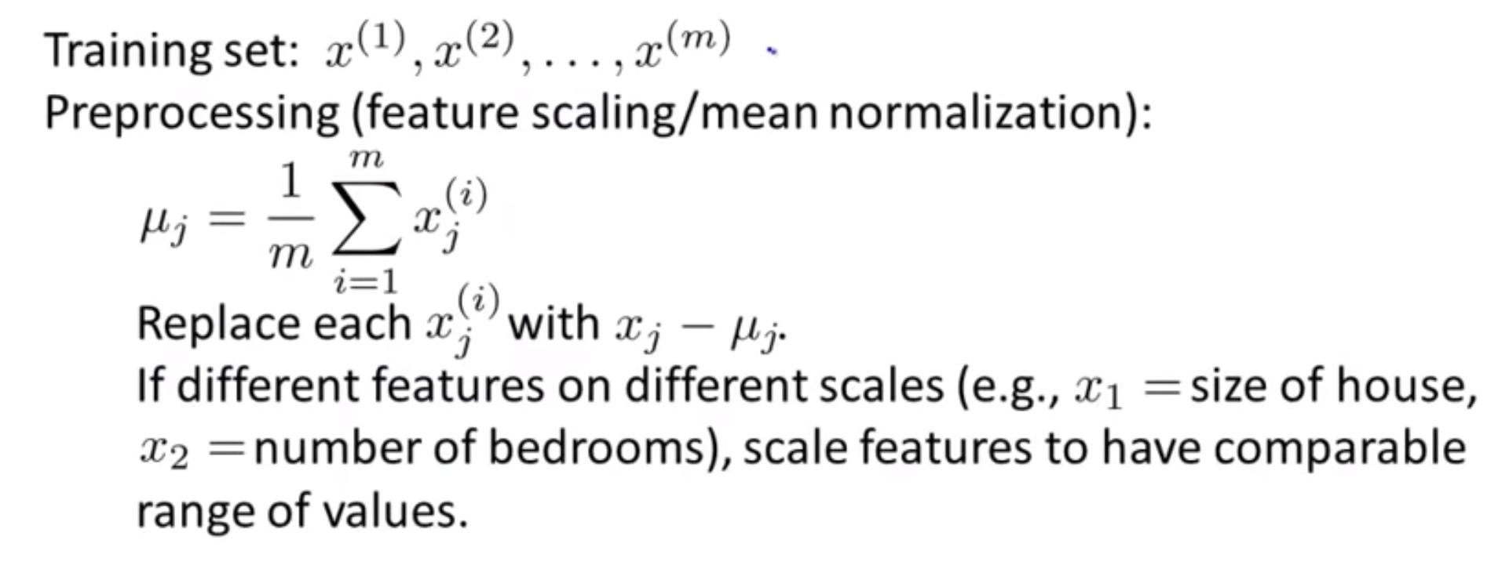
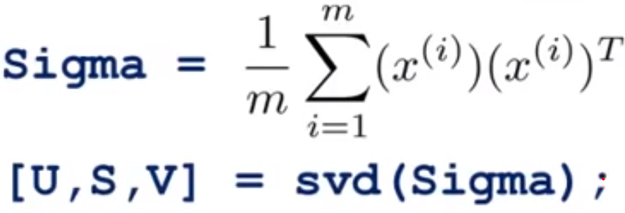
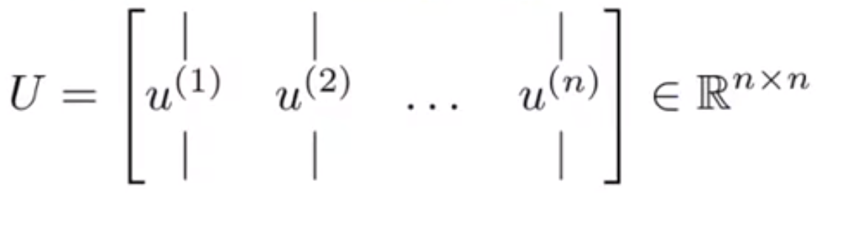





PCA-Algorithm
1
$$U_{k}$$
2
$$x∈R^{n}$$
$$z∈R^{k}$$
3
$$U_{k}^{T} × X=Z$$
$$\left(k×n\right)×\left(n×1\right)=(k×1)$$

Slide 9






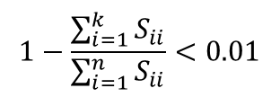
PCA-Choosing ‘K’
$$S_{11}$$
$$0$$
$$S_{22}$$
$$1−\frac{\sum_{i=1}^{k}{S_{ii}}}{\sum_{i=1}^{n}{S_{ii}}}<0.01$$
99% of variance is retained
$$⋱$$
$$0$$
$$S_{nn}$$

Slide 10









PCA-Reconstruction ($X_{app}$)
$$x∈R^{n}$$
$$z∈R^{k}$$
$$z∈R^{k}$$
$$x∈R^{n}$$
$$U_{k}^{T} × X=Z$$
$$U_{k}×Z=X_{app}$$
$$\left(k×n\right)×\left(n×1\right)=(k×1)$$
$$\left(n×k\right)×\left(k×1\right)=(n×1)$$

Slide 11
References:
[1] Andrew Ng, Principal components analysis, CS229 Lecture notes
[2] http://www.nlpca.org
[3] SVD MIT OpenCourseWare
https://www.youtube.com/watch?v=EqSJLHkixSs

