Slide 1

GA WDI Project Three SNPPR (pronounced Snipper)
Team CharTindIan
Ian Florentino, Satinder Grewal, Charles Park

Slide 2

Why SNPPR?
People want to quickly share images and information online, without having to format or upload each piece
Sending multiple pictures and web links at one time to friends is still a cumbersome and time-consuming process
Currently available picture-sharing methods are especially confusing and tedious for mature users
SNPPR makes it quicker for people to share images

Slide 3
What SNPPR Does
SNPPR is for all people who want to share images and links with their contacts quickly.
SNPPR is a web application that gives users a simple interface to share quick pictures and links.
Unlike current cut-and-paste methods, SNPPR gives a quick way to spread information with any and all contacts.

Slide 4
Current Competitive Landscape
Email
Text Messaging
imgur/Flickr
Gchat
bit.ly/TinyURL

Slide 5
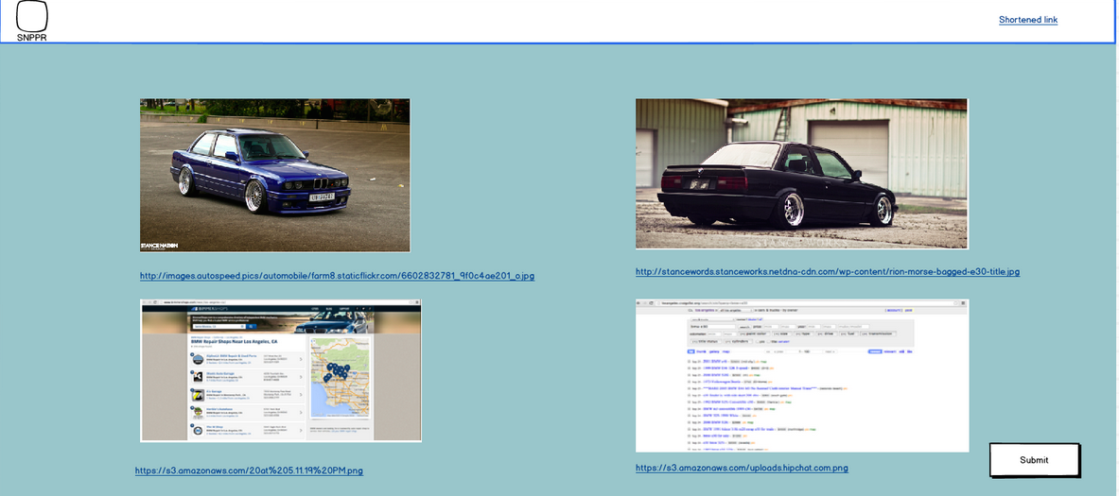
So what does SNPPR look like?

Slide 6
What’s IN, What’s OUT
IN: Image-sharing
IN: Link-sharing
out: Hosting and sharing offline images
Unresolved: Chrome Extension and other browser support

Slide 7
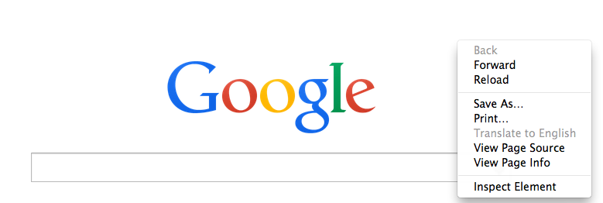
The Secret Sauce/X Factor
The RIGHT CLICK Chrome Extension!

Slide 8
Your project community
People doing research
SNPPR
Planners
Mature (Old) People
... is always bigger than you think!

Slide 9



Technical solution
Technologies:
Ruby on Rails - API
JavaScript – Front End
- AngularJS/JQuery
PostgreSQL – DB
RSpec - Testing
- Chrome Extension
Danger!
Out of scope

Slide 10

What keeps us up at night
Diving into Chrome extensions
Slugging URL IDs
Communicating between API and Front End
Scraping websites for metadata

Slide 11
The A-Team
 |  | Competencies/Expectations
 | Ian | Ruby on Rails engineer, map out BE, support FE, QA
 | Satinder | JavaScript engineer, map out FE, support BE, QA
 | Charles | FE/BE support, Pivotal Tracker, Code Review, QA

Slide 12
Timeline
September 26 – Present This Pitch
October 3 – API complete
October 8 – FE compatible with BE API
October 10 – Chrome Extension Ready
October 10-14 - Styling
October 14 – Present SNPPR
Testing takes place throughout Development

Slide 13
Trade-off sliders
Scale of 1 – 10
10 - Time (This is going to get done)
4 - User Experience
7 - Chrome Extension
8 - Quality

Slide 14
The Beginning…

