Slide 1
Microprocessor and
Microcontroller Fundamentals
ELEC 330
Digital Systems Engineering
Dr. Ron Hayne
Images Courtesy of Ramesh Gaonkar and Delmar Learning
Notes:
ELEC 330

Slide 2
Admin
Course materials available online
http://ece.citadel.edu/hayne/
  Students are encouraged to print lecture slides in advance and use them to take notes in class
330_01
Notes:
ELEC 330

Slide 3
Microcontrollers
Embedded Systems
  Operations managed behind the scenes by a microcontroller
Microcontroller (MCU)
  Integrated electronic computing device that includes three major components on a single chip
    Microprocessor (MPU)
    Memory
    I/O (Input/Output) ports
330_01

Slide 4
Microcontrollers
Support Devices
  Timers
  A/D converter
  Serial I/O
Common communication lines
  System Bus
330_01

Slide 5
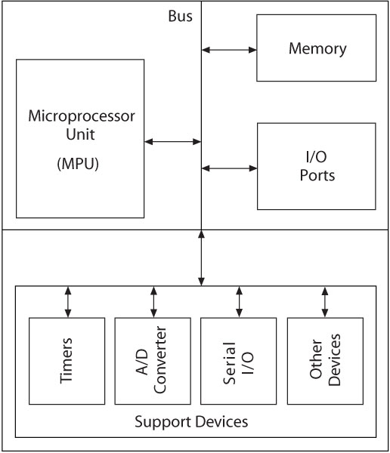
Block Diagram
330_01
Notes:
ELEC 330

Slide 6
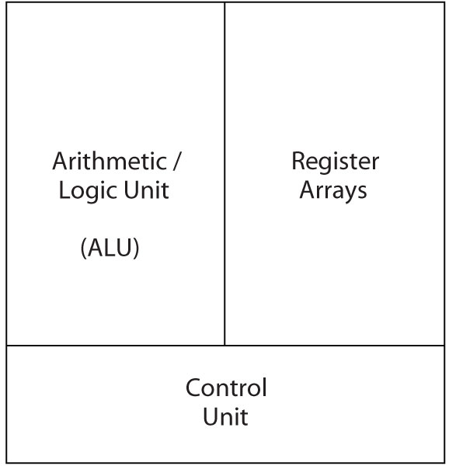
Microprocessor (MPU)
MPU (CPU)
  Read instructions
  Process binary data
330_01

Slide 7
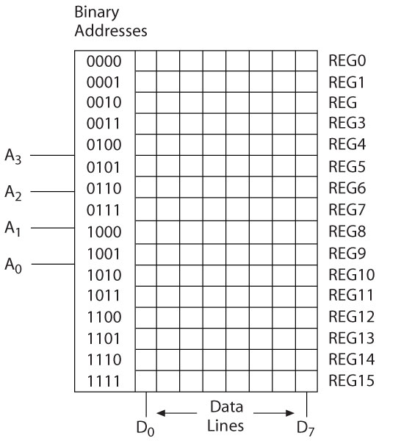
Memory
Storage Device
  Addresses
  Registers
Major Categories
  Read/Write Memory (R/W)
  Read-only-Memory (ROM)
D₇
D₀
330_01

Slide 8
Input/Output (I/O)
Input Devices
  Switches and Keypads
  Provide binary information to the MPU
Output devices
  LEDs and LCDs
  Receive binary information from the MPU
330_01

Slide 9
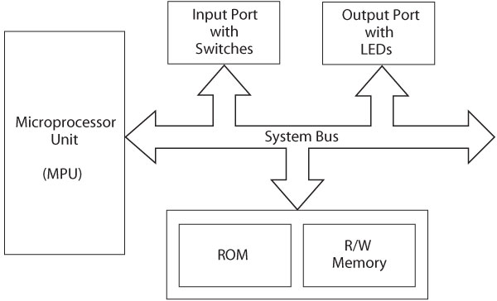
Microprocessor-Based Systems
330_01

Slide 10
Microprocessor Architecture
MPU communicates with Memory and I/O using the System Bus
  Address bus
    Unidirectional
    Memory and I/O Addresses
  Data bus
    Bidirectional
    Transfers Binary Data and Instructions
  Control lines
    Read and Write timing signals
330_01

Slide 11
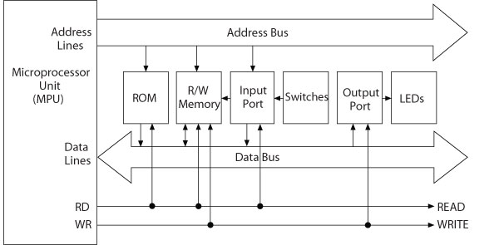
Microprocessor-Based System
330_01

Slide 12
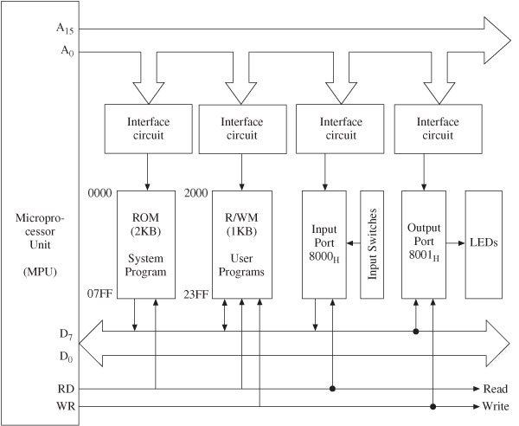
Example Microprocessor System
330_01

Slide 13
Software
Machine Language
  Binary Instructions
  Difficult to decipher and write
    Error-prone
  All programs converted into machine language for execution
Instruction | Hex | Mnemonic | Description | Processor
10000000 | 80 | ADD B | Add reg B to Acc | Intel 8085
00101000 | 28 | ADD A, R0 | Add Reg R0 to Acc | Intel 8051
00011011 | 1B | ABA | Add Acc A and B | Motorola 6811
330_01

Slide 14
Software
Assembly Language
  Machine instructions represented in mnemonics
  One-to-one correspondence
  Efficient execution and use of memory
  Machine-specific
330_01

Slide 15
Software
High-Level Languages
  BASIC, C, and C++
  Written in statements of spoken languages
  Machine independent
  Easy to write and troubleshoot
  Larger memory and less efficient execution
330_01

Slide 16
Data Format (8-bit)
Unsigned Integers
  All eight bits represent the magnitude of a number
    Bit7 to Bit0
  Range 00_{H} to FF_{H} (0₁₀ to 255₁₀)
330_01

Slide 17
Data Format (8-bit)
Signed Integers
  2's Complement
    Bit7 is sign bit
  Positive numbers: 00_{H} to 7F_{H} (0₁₀ to 127₁₀)
  Negative numbers: 80_{H} to FF_{H} (-1₁₀ to -128₁₀)
330_01

Slide 18
Data Format (8-bit)
Binary Coded Decimal Numbers (BCD)
  8-bit number divided into two groups of four
    Each group represents a decimal digit from 0 to 9
  A_{H} through F_{H} are invalid
  Example: 0010 0101_{BCD} = 25₁₀
330_01

Slide 19
Data Format (8-bit)
American Standard Code for Information Interchange (ASCII)
  7-bit alphanumeric code with 128 combinations (00_{H} to 7F_{H})
  Represents English alphabet, decimal digits from 0 to 9, symbols, and commands
330_01

Slide 20
MPU-Based Systems
System hardware
  Discrete components
    Microprocessor, Memory, and I/O
  Components connected by buses
    Address, Data, and Control
System software
  Group of programs that monitors the functions of the entire system
330_01

Slide 21
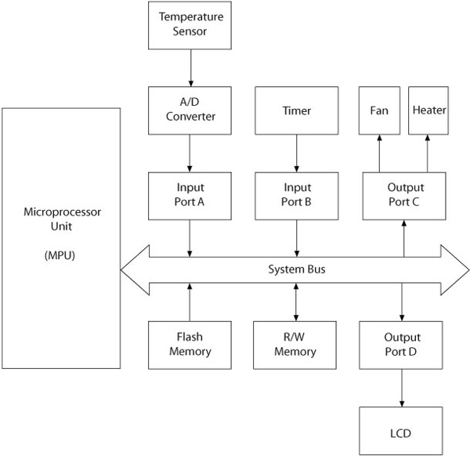
MPU-Based System
330_01

Slide 22
MCU-Based Systems
Microprocessor, memory, I/O ports, and support devices on a single chip
Buses generally not available to a system designer
I/O ports generally multiplexed and can be programmed to perform different functions
330_01

Slide 23
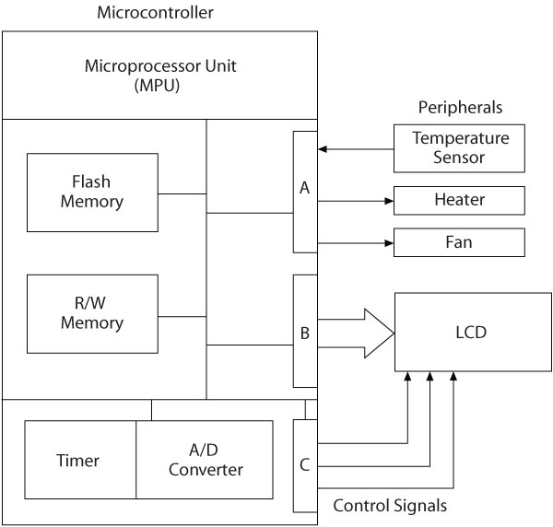
MCU-Based System
330_01

Slide 24
Computer Architectures
Princeton versus Harvard Architecture
CISC versus RISC processors
Microprocessors and Microcontrollers
330_01
Notes:
ELEC 330

