Slide 1
Microcontroller Architecture
PIC18F Family
ELEC 330
Digital Systems Engineering
Dr. Ron Hayne
Images Courtesy of Ramesh Gaonkar and Delmar Learning
Notes:
ELEC 330

Slide 2
PIC18F Microcontrollers
Microcontroller Unit (MCU)
  Microprocessor unit (MPU)
  Harvard Architecture
    Program memory for instructions
    Data memory for data
  I/O ports
  Support devices such as timers
330_02

Slide 3
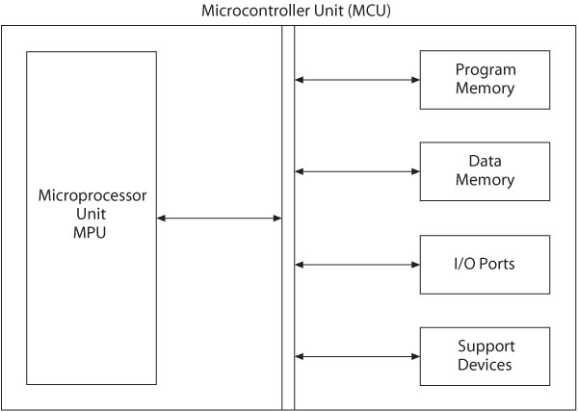
Microcontroller Unit
330_02

Slide 4
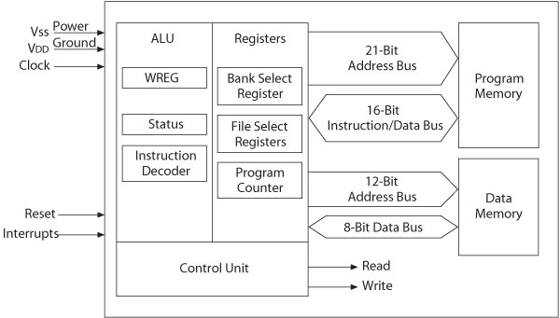
PIC18F – MPU and Memory
330_02

Slide 5
Microprocessor Unit
Includes Arithmetic Logic Unit (ALU), Registers, and Control Unit
  Arithmetic Logic Unit (ALU)
    Instruction decoder
      16-bit instructions
    Status register that stores flags
      5-bits
    WREG – working register
      8-bit accumulator
330_02

Slide 6
Microprocessor Unit
  Registers
    Program Counter (PC)
      21-bit register that holds the Program Memory address
    Bank Select Register (BSR)
      4-bit register used in direct addressing the Data Memory
    File Select Registers (FSRs)
      12-bit registers used as memory pointers in indirect addressing Data Memory
  Control unit
    Provides timing and control signals
      Read and Write operations
330_02

Slide 7
PIC18F - Address Buses
Address bus
  21-bit address bus for Program Memory
    Addressing capacity: 2 MB
  12-bit address bus for Data Memory
    Addressing capacity: 4 KB
330_02

Slide 8
Data Bus and Control Signals
Data bus
  16-bit instruction/data bus for Program Memory
  8-bit data bus for Data Memory
Control signals
  Read and Write
330_02

Slide 9
PIC18F452/4520 Memory
Program Memory: 32 K
  Address range: 000000 to 007FFF_{H}
Data Memory: 4 K
  Address range: 000 to FFF_{H}
Data EEPROM
  Not part of the data memory space
  Addressed through special function registers
330_02

Slide 10
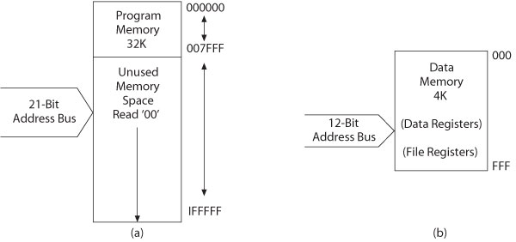
PIC18F452/4520 Memory
Program Memory
Data Memory
330_02

Slide 11
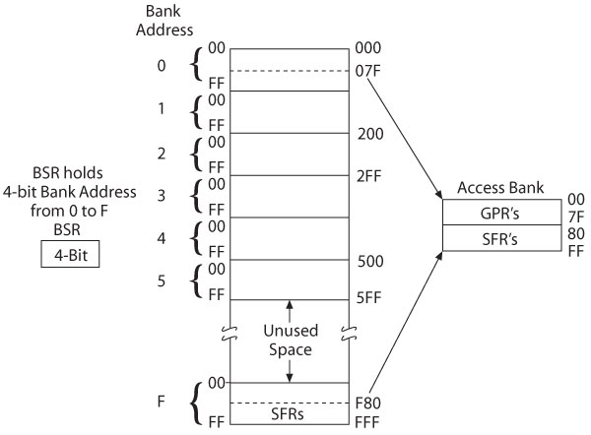
Data Memory Banks
330_02

Slide 12
PIC18F452 I/O Ports
Five I/O ports
  PORT A through PORT E
  Most I/O pins are multiplexed
  Generally have eight I/O pins
  Addresses already assigned to these ports
  Each port is identified by its assigned SFR
330_02

Slide 13
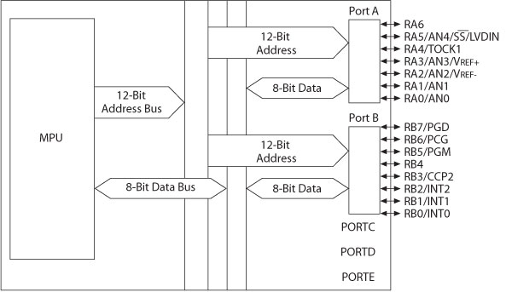
I/O Ports A and B
330_02

Slide 14
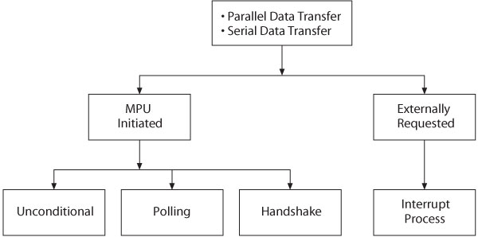
Data Transfer
330_02

Slide 15
MCU Support Devices
Timers
  Capture, Compare and PWM (CCP Modules)
Serial Communications
  Master Synchronous Serial Port (MSSP)
  Addressable USART
A/D converter
Parallel Slave Port (PSP)
Data EEPROM
330_02

Slide 16
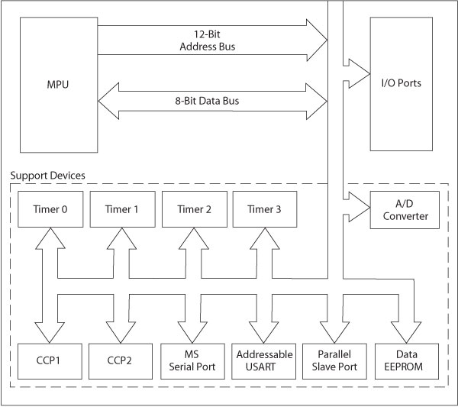
MCU Support Devices
330_02

Slide 17
PIC18F Special Features
Sleep mode
Watchdog timer (WDT)
Code protection
In-circuit serial programming
In-circuit debugger
330_02

Slide 18
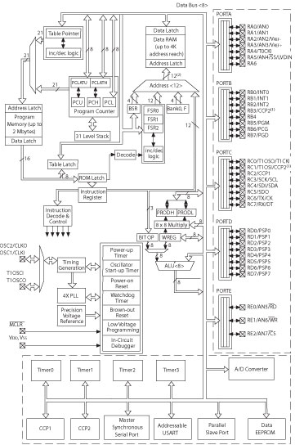
PIC18F4X2 Architecture Block Diagram

Slide 19
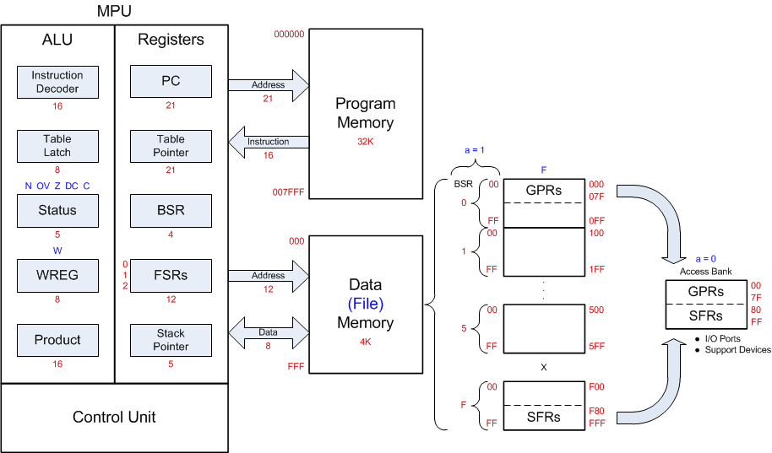
PIC18F452 Programming Model
330_02

Slide 20
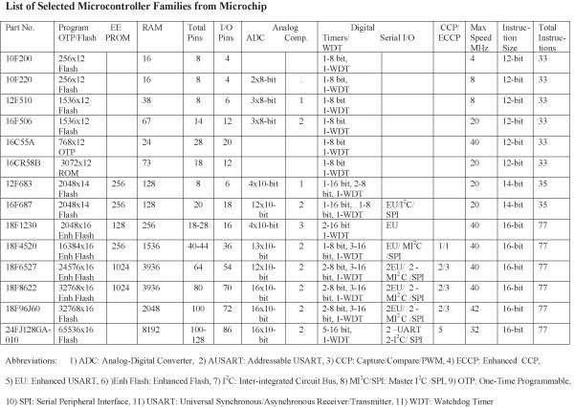
330_02

Slide 21
PIC18F Instructions
77 assembly language instructions
  Earlier PIC families have 33 or 35 instructions
PIC18F instruction set
  Most instructions are 16-bit word length
  Four instructions are 32-bit length
330_02

Slide 22
Instruction Descriptions
Copy (Move) 8-bit number (Literal) into W register
  Mnemonics: MOVLW 8-bit
  Binary format:
0000 1110 XXXX XXXX (any 8-bit number)
Copy (Move) contents of W register into PORTC (File)
  Mnemonics: MOVWF PORTC, a
    (‘a’ indicates that PORTC is in the Access Bank)
  Binary format:
0110 1110 1000 0010 (82_{H} is PORTC address)
330_02

Slide 23
Illustrative Program
Problem statement:
  Write instructions to light up alternate LEDs at PORTC
Hardware:
  PORTC
    Bidirectional (input or output) port
    Setup as output port for display
  Logic 1 will turn on an LED
330_02

Slide 24
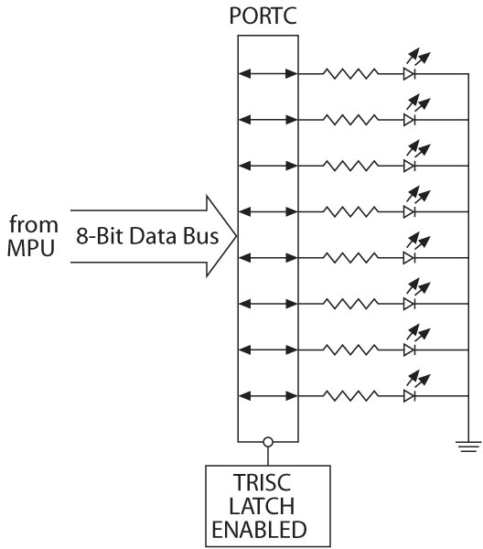
Illustration
Interfacing LEDs to PORTC
330_02

Slide 25
Illustration
Program (software)
  Logic 0 to TRISC sets up PORTC as an output port
  Byte 55_{H} turns on alternate LEDs
    MOVLW 00 ;Load W register with 0
    MOVWF TRISC ;Set up PORTC as output
    MOVLW 0x55 ;Byte 55_{H} to turn on LEDS
    MOVWF PORTC ;Turn on LEDs
    SLEEP ;Power down
330_02

Slide 26
Illustration
Address | Hex | Mnemonics | Comments
000000 | 0E00 | MOVLW 00 | ;Load W with 0s
000002 | 6E94 | MOVWF TRISC | ;Set PORTC as output
000004 | 0E55 | MOVLW 0x55 | ;Load 55 to turn on LEDs
000006 | 6E82 | MOVWF PORTC | ;Turn on LEDs
000008 | 0003 | SLEEP | ;Power Down
330_02
Notes:
ELEC 330

Slide 27
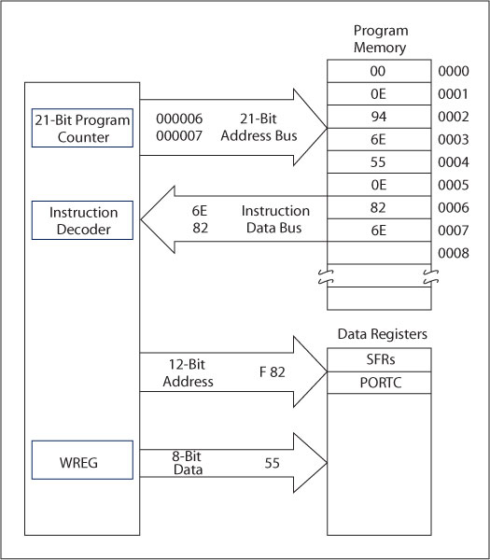
Illustration
Execution of the
instruction:
MOVWF PORTC
330_02

Slide 28
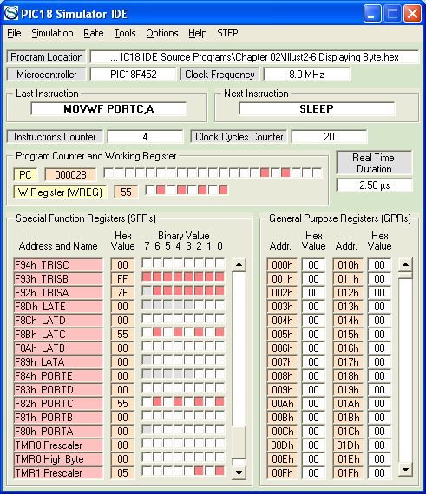
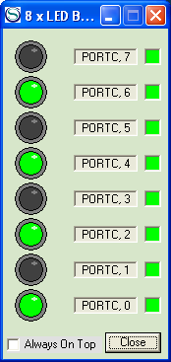
PIC18 Simulator IDE
330_02
Notes:
ELEC 330

Slide 29
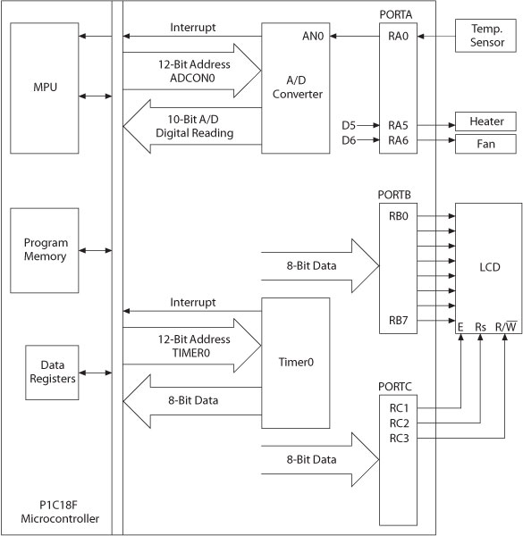
Embedded System
MCU-based System
330_02

