Slide 1
PIC18F Programming Model and Instruction Set
ELEC 330
Digital Systems Engineering
Dr. Ron Hayne
Images Courtesy of Ramesh Gaonkar and Delmar Learning
Notes:
ELEC 330

Slide 2
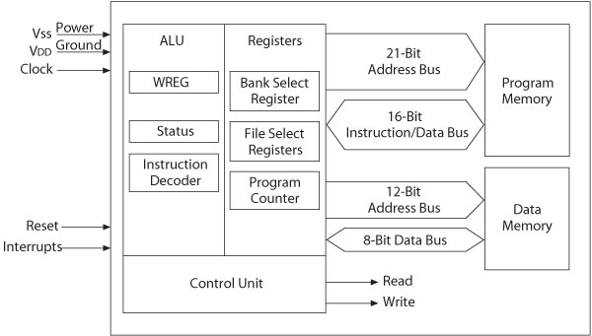
Review: MPU and Memory
330_02

Slide 3
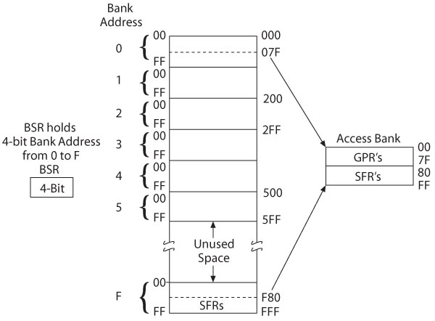
Review: Data Memory
330_02

Slide 4
PIC18F Programming Model
Representation of the internal architecture necessary to write assembly language programs
Divided into two groups
  Arithmetic Logic Unit (ALU) and Registers
    From Microprocessor Unit (MPU)
  Special Function Registers (SFRs)
    From Data (File) Memory
330_03

Slide 5
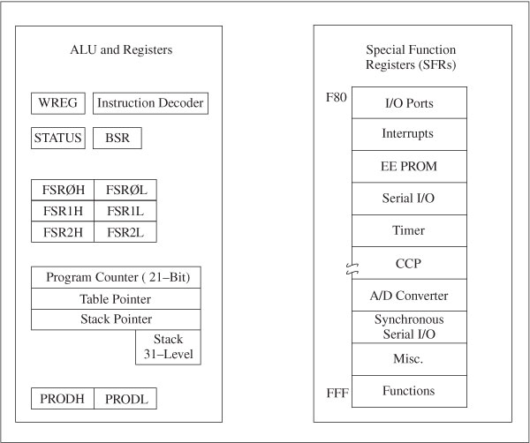
PIC18F Programming Model
330_03

Slide 6
ALU
Instruction Decoder
  16-bit Instructions
Table Latch
  8-bit Data
STATUS: Flag Register
  5 individual bits called flags
WREG (W): Working Register
  8-bit Accumulator
Product
  16-bit Product of 8-bit by 8-bit Multiply
330_03

Slide 7
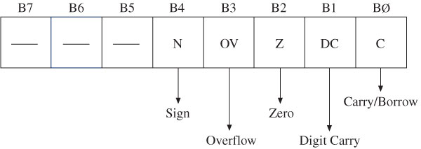
Flags in Status Register
N (Negative Flag)
  Set when bit B7 is one as the result of an arithmetic/logic operation
OV (Overflow Flag)
  Set when result of an operation of signed numbers goes beyond 7-bits
Z (Zero Flag)
  Set when result of an operation is zero
DC (Digit Carry Flag) (Half Carry)
  Set when carry generated from Bit3 to Bit4 in an arithmetic operation
C (Carry Flag)
  Set when an addition generates a carry (out)
330_03

Slide 8
Registers
Program Counter (PC)
  21-bit register used as a pointer to Program Memory during program execution
Table Pointer
  21-bit register used as a pointer to copy bytes between Program Memory and data registers
Stack Pointer (SP)
  5-bit register used to point to the stack
Stack
  31 registers used for temporary storage of memory addresses during execution of a subroutines
330_03

Slide 9
Registers
BSR: Bank Select Register (0_{H} to F_{H})
  4-bit Register
    Provides upper 4-bits of 12-bit address of Data Memory
FSR: File Select Registers
  FSR0, FSR1, and FSR2
  FSR: composed of two 8-bit registers
    FSRH and FSRL
  Used as pointers for Data Memory
    Holds 12-bit address of data register
330_03

Slide 10
Special Function Registers
SFRs: Table 3-1
  Data registers associated with I/O ports, support devices, and processes of data transfer
    I/O Ports (A to E)
    Interrupts
    EEPROM
    Serial I/O
    Timers
    Capture/Compare/PWM (CCP)
    Analog-to-Digital (A/D) Converter
330_03
Notes:
ELEC 330

Slide 11
PIC18 Instruction Set
Includes 77 instructions
  73 one word (16-bit) long
  4 two words (32-bit) long
Divided into seven groups
  Move (Data Copy) and Load
  Arithmetic
  Logic
  Program Redirection (Branch/Jump)
  Bit Manipulation
  Table Read/Write
  Machine Control
330_03

Slide 12
Addressing Modes
Method of specifying of an operand
  Immediate (Literal) addressing
    The operand is a number that follows the opcode
  Direct addressing
    The address of the operand is a part of the instruction
  Indirect addressing
    An address is specified in a register (pointer) and the MPU looks up the address in that register
330_05

Slide 13
Move and Load Instructions
MOVLW 8-bit ;Load an 8-bit Literal into WREG
MOVLW 0xF2 ;Load F2_{H} into W
MOVWF F,a ;Copy WREG into File (Data) Reg.
;If a = 0, F is in Access Bank
;If a = 1, Bank is specified by BSR
MOVWF 0x25,0 ;Copy W into F Reg25_{H}
MOVWF 0x25 ;Alternate format
MOVFF fs,fd ;Copy from one File Reg. to ;another File Reg.
MOVFF 0x20,0x30 ;Copy F Reg20_{H} into Reg30_{H}
330_03

Slide 14
Move and Load Instructions
MOVF F,d,a ;Copy F into itself or W
;If d = 0 (or W), destination is W
;If d = 1 (or F), destination is F
;Affects N & Z flags
MOVF 0x25,0,0 ;Copy F Reg25_{H} into W
MOVF 0x25,W ;Alternate format
CLRF F,a ;Clear F Reg.
;Sets Z flag
CLRF 0x25 ;Clear Reg25_{H}
SETF F,a ;Sets all bits to 1 in F Reg.
330_03

Slide 15
Points to Remember
Each instruction has two parts
  Opcode and Operand
When instructions copy data from one register to another, the source is not modified
In general, these instructions do not affect flags
  Except CLRF and MOVF
330_03
Notes:
ELEC 330

Slide 16
Arithmetic Instructions
ADDLW 8-bit ;Add 8-bit number to W & set flags
ADDLW 0x32 ;Add 32_{H} to W
ADDWF F,d,a ;Add W to F & set flags
;Save result in W if d = 0 (or W)
;Save result in F if d = 1 (or F)
ADDWF 0x20,0 ;Add W to REG20_{H} and ;save result in W
ADDWF 0x20,W ;Alternate format
ADDWF 0x20,1 ;Add W to REG20_{H} and ;save result in REG20_{H}
ADDWF 0x20,F ;Alternate format
330_03

Slide 17
Arithmetic Instructions
ADDWFC F,d,a ;Add W to F with carry ;and save result in W or F
SUBLW 8-bit ;Subtract W from literal
SUBWF F,d,a ;Subtract W from F
SUBWFB F,d,a ;Subtract W from F with borrow
INCF F,d,a ;Increment F
DECF F,d,a ;Decrement F
NEGF F,a ;Take 2’s Complement of F
330_03

Slide 18
Arithmetic Instructions
MULLW 8-bit ;Multiply 8-bit Literal and W ;Save result in PRODH:PRODL
MULWF F,a ;Multiply W and F ;Save result in PRODH:PRODL
DAW ;Decimal adjust W for BCD
;Addition
330_03

Slide 19
Points to Remember
Arithmetic instructions
  Can perform operations on W and 8-bit literals
    Save the result in W
  Can perform operations an W and F
    Save the result in W or F
  In general, affect all flags
330_03
Notes:
ELEC 330

Slide 20
Logic Instructions
COMF F,d,a ;Complement (NOT) F
;and save result in W or F
ANDLW 8-bit ;AND Literal with W
ANDWF F,d,a ;AND W with F and ;save result in W or F
IORLW 8-bit ;Inclusive OR Literal with W
IORWF F,d,a ;Inclusive OR W with F ;and save result in W or F
IORWF 0x12,F ;OR W with REG12_{H} and
;save result in REG12_{H}
XORLW 8-bit ;Exclusive OR Literal with W
XORWF F,d,a ;Exclusive OR W w/ F ;and save result in W or F
330_03

Slide 21
Points to Remember
Logic instructions
  Can perform operations on W and 8-bit literals
    Save the result in W
  Can perform operations an W and F
    Save the result in W or F
  In general, affect only two flags: N and Z
330_03
Notes:
ELEC 330

Slide 22
Branch Instructions
BC n ;Branch if C flag = 1, + or – 64 Words
;to PC+2+2n
BC 5 ;Branch on Carry to PC+2+10
BC Label ;Alternate: Branch to Label
BNC n ;Branch if C flag = 0
BZ n ;Branch if Z flag = 1
BNZ n ;Branch if Z flag = 0
BN n ;Branch if N flag = 1
BNN n ;Branch if N flag = 0
BOV n ;Branch if OV flag = 1
BNOV n ;Branch if OV flag = 0
BRA nn ;Branch always, + or – 512 Words
330_03

Slide 23
Branch Example
Address | Label | Opcode | Operand | Comment
000020 | START: | MOVLW | BYTE1 | ;Load BYTE1 into W
000022 |  | MOVWF | REG0 | ;Save into REG0
000024 |  | MOVLW | BYTE2 | ;Load BYTE2 into W
000026 |  | MOVWF | REG1 | ;Save into REG1
000028 |  | ADDWF | REG0,W | ;Add REG0 to REG1
00002A |  | BNC | SAVE | ;Branch if no carry
00002C |  | MOVLW | 0x00 | ;Clear W
00002E | SAVE: | MOVWF | REG2 | ;Save Result
000030 |  | SLEEP
330_03
Notes:
ELEC 330

Slide 24
Call and Return Instructions
RCALL nn ;Relative Call subroutine
;within + or – 512 words
CALL 20-bit,s ;Call subroutine
;If s = 1, save W, STATUS, BSR
RETURN s ;Return subroutine
;If s = 1, retrieve W, STATUS, BSR
RETFIE s ;Return from interrupt
;If s = 1, retrieve W, STATUS, BSR
330_03

Slide 25
Points to Remember
Eight conditional relative branch instructions
  Based on four flags
  Range is ± 64 words
Unconditional relative branch instruction
  Range is ± 512 words
If the operand is positive, the jump is forward
If negative, the jump is backward
330_03
Notes:
ELEC 330

Slide 26
Bit Manipulation Instructions
BCF F,b,a ;Clear bit b of F, b = 0 to 7
BCF 0x2,7 ;Clear bit 7 of Reg2
BSF F,b,a ;Set bit b of F, b = 0 to 7
BTG F,b,a ;Toggle bit b of F, b = 0 to 7
RLCF F,d,a ;Rotate bits left in F through
;carry and save in W or F
RLNCF F,d,a ;Rotate bits left in F
;and save in W or F
RRCF F,d,a ;Rotate bits right in F through
;carry and save in W or F
RRNCF F,d,a ;Rotate bits right in F
;and save in W or F
330_03

Slide 27
Points to Remember
Any bit in a File (data) register
  Set, reset, or complemented
There are two types of rotate instructions
  8-bit and 9-bit (include C)
  Any file (data) register can be rotated left or right
    Saved in W or F
330_03
Notes:
ELEC 330

Slide 28
Test and Skip Instructions
BTFSC F,b,a ;Test bit b in F and skip the ;next instruction if bit is cleared (bit=0)
BTFSC 0x2,7 ;Test bit B7 in REG2
;if B7=0 then skip next instruction
BTFSS F,b,a ;Test bit b in F and skip the ;next instruction if bit is set (bit=1)
CPFSEQ F,a ;Compare F with W, skip if F = W
CPFSGT F,a ;Compare F with W, skip if F > W
CPFSLT F,a ;Compare F with W, skip if F < W
TSTFSZ F,a ;Test F, skip if F = 0
330_03

Slide 29
Increment/Decrement and Skip Next Instruction
DECFSZ F,d,a ;Decrement F and skip the ;next instruction if F = 0
DECFSNZ F,d,a ;Decrement F and skip the ;next instruction if F ≠ 0
INCFSZ F,d,a ;Increment F and skip the ;next instruction if F = 0
INCFSNZ F,d,a ;Increment F and skip the ;next instruction if F ≠ 0
330_03

Slide 30
Points to Remember
Any File (data) register or single bit in a File (data) register can be tested for 0
A File (data) register can be compared with W for equality, greater than, and less than
A File (data) register can be incremented or decremented and tested for 0
If a condition is met, the next instruction is skipped (no flags are affected)
330_03
Notes:
ELEC 330

Slide 31
Table Read/Write Instructions
TBLRD* ;Read Program Memory pointed by TBLPTR
;into TABLAT
TBLRD*+ ;Read Program Memory pointed by TBLPTR
;into TABLAT and increment TBLPTR
TBLRD*- ;Read Program Memory pointed by TBLPTR
;into TABLAT and decrement TBLPTR
TBLRD+* ;Increment TBLPTR and Read Program ;Memory pointed by TBLPTR into TABLAT
330_03

Slide 32
Table Read/Write Instructions
TBLWT* ;Write TABLAT into Program Memory pointed ;by TBLPTR
TBLWT*+ ;Write TABLAT into Program Memory pointed ;by TBLPTR and increment TBLPTR
TBLWT*- ;Write TABLAT into Program Memory pointed ;by TBLPTR and decrement TBLPTR
TBLWT+* ;Increment TBLPTR and Write TABLAT into ;Program Memory pointed by TBLPTR
330_03

Slide 33
Machine Control Instructions
CLRWDT ;Clear Watchdog Timer
RESET ;Reset all registers and flags
SLEEP ;Go into standby mode
NOP ;No operation
330_03

Slide 34
Instruction Format
The PIC18F instruction format divided into four groups
  Byte-Oriented operations
  Bit-Oriented operations
  Literal operations
  Branch operations
330_03

Slide 35
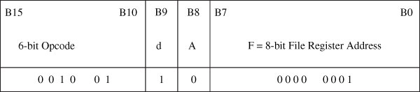
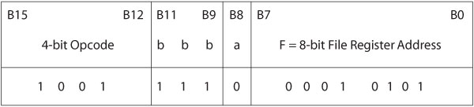
Instruction Format
Byte-oriented instruction – ADDWF F, d, a
  ADDWF 0x1,F ;Add W to REG1, save in REG1
Bit-oriented instruction – BCF F, b, a
  BCF 0x15,7 ;Clear bit7 in REG15_{H}
330_03

Slide 36


Instruction Format
Literal instruction — MOVLW k
  MOVLW 0x7F ;Load 7F_{H} into W
Branch instruction — BC n
  BC 0x15 ;Branch if carry +15_{H} words
0
330_03

Slide 37
Illustration: Addition
Problem Statement
  Load two bytes (37_{H} and 92_{H}) in registers REG0 and REG1
  Add the bytes and store the sum in REG2
Address | Hex | Opcode | Operand | Comments
0020 | 0E37 | MOVLW | 0x37 | ;Load first byte in W
0022 | 6E00 | MOVWF | REG0 | ;Save first byte in REG0
0024 | 0E92 | MOVLW | 0x92 | ;Load second byte in W
0026 | 6E01 | MOVWF | REG1 | ;Save second byte in REG1
0028 | 2400 | ADDWF | REG0,W | ;Add bytes and save sum in W
002A | 6E02 | MOVWF | REG2 | ;Save sum in REG2
002C | 0003 | SLEEP |  | ;Power Down
330_03
Notes:
ELEC 330

Slide 38
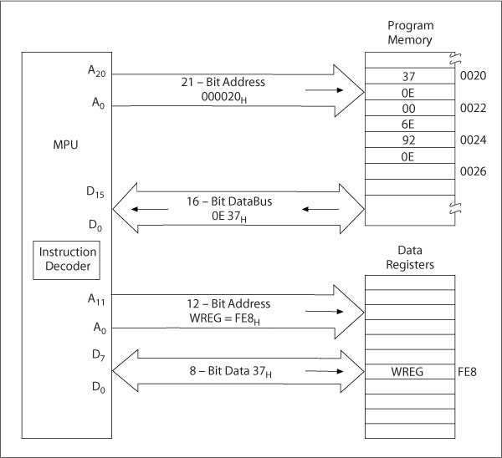
Bus Contents
Execution of the
instruction:
MOVLW 0x37
330_03

Slide 39
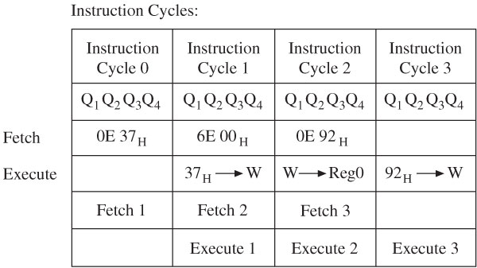
Pipeline Fetch and Execution
330_03

