Slide 1
Programming and
Problem Solving
ELEC 330
Digital Systems Engineering
Dr. Ron Hayne
Images Courtesy of Ramesh Gaonkar and Delmar Learning
Notes:
ELEC 330

Slide 2
Problem Solving
Modular Design
  Divide problem into various tasks
Subroutines
  Independent units that can be combined
Flowchart
  Graphical representation of processes (tasks)
  Sequence to be followed
330_04

Slide 3
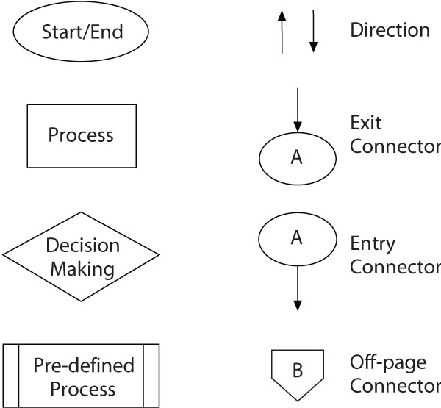
Flowcharting
330_04

Slide 4
Example 4.1
Write instructions to load two bytes (37_{H} and 92_{H}) in data registers REG0 and REG1. Add the bytes and store the sum in REG2.
Steps
  Load two bytes in data registers REG0 and REG1
  Add the bytes
  Save the sum in data register REG2
330_04

Slide 5
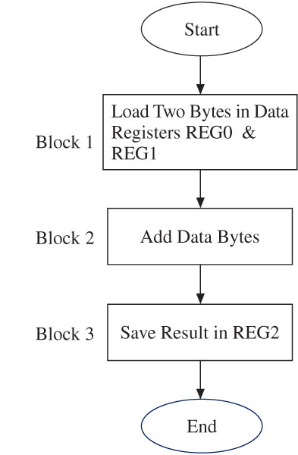
Example 4.1
330_04

Slide 6
Assembly Language Programming
Analyze the problem
Draw a flowchart
Convert the flowchart into mnemonics
Look up Hex code and assign memory addresses
Enter the Hex code into memory
Execute the program
Debug the program if necessary
330_04

Slide 7
Illustrative Program
Addition With Carry Check
  Write instructions to load two bytes (F2_{H} and 32_{H}) in data registers REG0 and REG1 and add the bytes.
  If the sum generates a carry, clear the data register REG2; otherwise, save the sum in REG2.
330_04

Slide 8
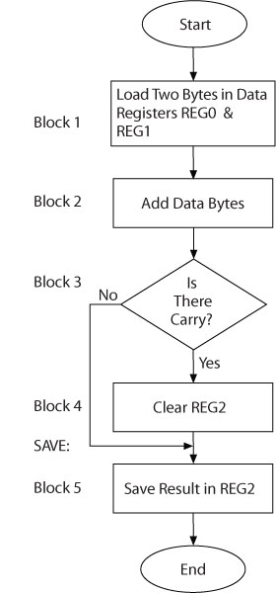
Illustrative Program
330_04

Slide 9
Assembly Language
Label | Opcode | Operand | Comments
START: | MOVLW | 0xF2 | ;Load first byte in W
 | MOVWF | REG0 | ;Save first byte in REG0
 | MOVLW | 0x32 | ;Load second byte in W
 | MOVWF | REG1 | ;Save second byte in REG1
 | ADDWF | REG0,W | ;Add bytes and save sum in W
 | BNC | SAVE | ;Branch if no carry
 | MOVLW | 0 | ;Clear W
SAVE: | MOVWF | REG2 | ;Save sum in REG2
 | SLEEP |  | ;Power Down
330_04
Notes:
ELEC 330

Slide 10
Code Look-up?
Address | Hex | Label | Opcode | Operand
000020 | 0EF2 | START: | MOVLW | 0xF2
000022 | 6E00 |  | MOVWF | REG0
000024 | 0E32 |  | MOVLW | 0x32
000026 | 6E01 |  | MOVWF | REG1
000028 | 2400 |  | ADDWF | REG0,W
00002A | E301 |  | BNC | SAVE
00002C | 0E00 |  | MOVLW | 0
00002E | 6E02 | SAVE: | MOVWF | REG2
000030 | 0003 |  | SLEEP
330_04
Notes:
ELEC 330

Slide 11
Execute the Program
Hardware
  MPLAB IDE
  PICDEM™ 2 Plus Demo Board
  Microchip PIC18F4520 MPU
  MPLAB ICD2
Simulation
  PIC18 Simulator IDE
  Microchip PIC18F452 MPU
330_04
Notes:
ELEC 330

Slide 12
PIC18 Simulator IDE
Integrated Development Environment
  Editing
  Assembling
  Linking
  Downloading
  Executing
  Simulation
  Debugging
330_04
Notes:
ELEC 330

Slide 13
Using an Assembler
Assembly Language Programs
  Program in Mnemonics
  Assembler Directives
  Comments
Assembly Language Statements (4 fields)
  Label
  Opcode
  Operand (data, register, or memory address)
  Comment
330_04

Slide 14
Assembly Language Format
Label Opcode Operand Comment
START: MOVLW 0xF2 ;Load F2H in W
↑ ↑ ↑ ↑
Tab Tab Tab Semicolon
330_04

Slide 15
Assembler Directives
#INCLUDE Include resources from library
ORG Origin
EQU Equate
DB Data byte
END End of assembly
330_04

Slide 16
Radix Formats
Type | Format
Hexadecimal | 0x4F H’4F’ 4F 4FH
Decimal | D’100’
Binary | B’10011000’
ASCII | ‘Susan’ A’Susan’
330_04
Notes:
ELEC 330

Slide 17
PIC18 Simulator IDE
Editor
  Assembler
Debugger
  Breakpoint Manager
  Watch Variables
Simulator
  Run and Step
I/O Modules
  LED Board
  7-Segment Display
  Keypad Matrix
330_04

Slide 18
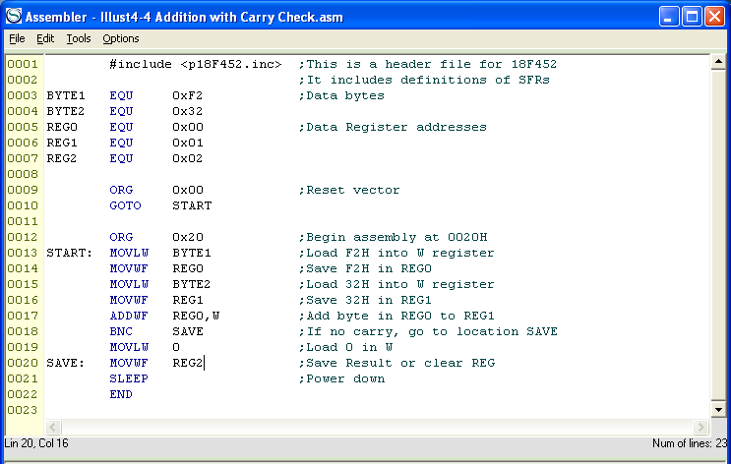
Assembler (Editor)
330_04
Notes:
ELEC 330

Slide 19
Understanding the List File
List file generated primarily for documentation
Includes seven columns
  Line numbers
  Memory addresses where binary code is stored
  Hex code
  Contents of source file
    Labels
    Opcode
    Operands
    Comments
330_04

Slide 20
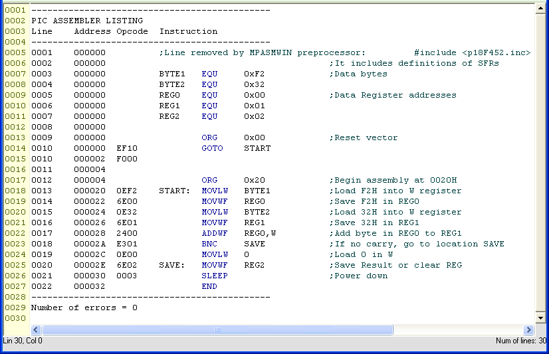
Assembler Listing
330_04
Notes:
ELEC 330

Slide 21
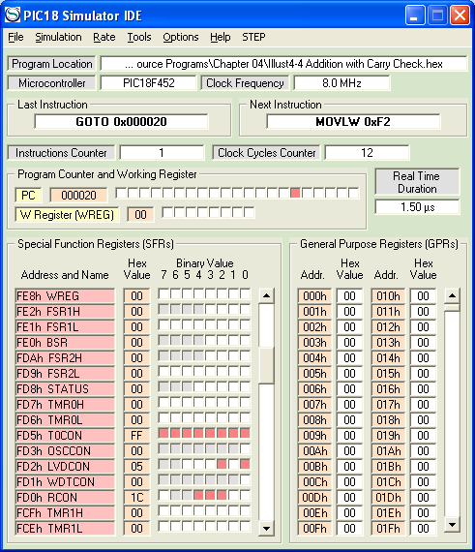
Executing a Program
330_04

Slide 22
Debugging a Program
Single-step technique
  Execute one instruction at a time
  Observe registers for expected results
Breakpoint technique
  Execute a group of instructions
  Observe registers for expected results
330_04

Slide 23
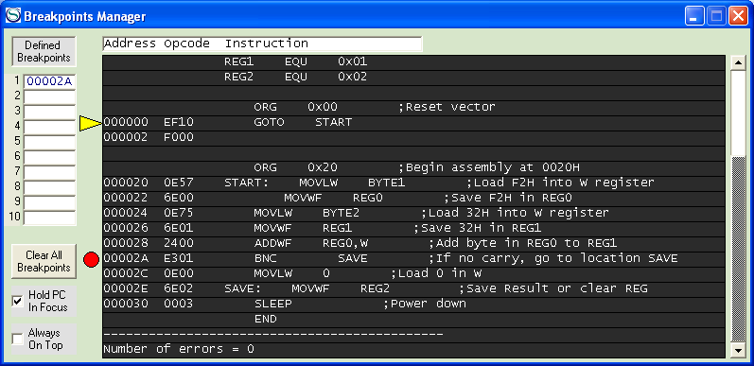
Breakpoint Manager
Simulation automatically switches to step-by-step mode when reaching a breakpoint
330_04
Notes:
ELEC 330

Slide 24
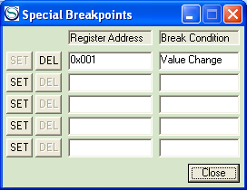
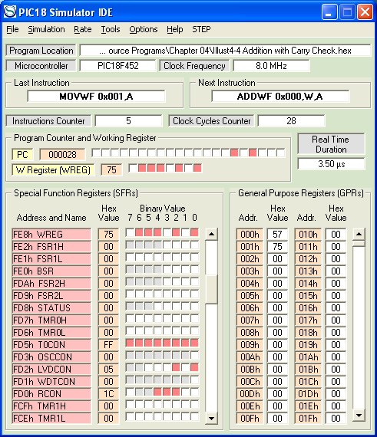
Special Breakpoints
Switch to step-by-step when the value of a register has changed or equals a predefined value
330_04
Notes:
ELEC 330

