Slide 1
Assembly Language Instructions
ELEC 330
Digital Systems Engineering
Dr. Ron Hayne
Images Courtesy of Ramesh Gaonkar and Delmar Learning
Notes:
ELEC 330

Slide 2
Data Copy Operations
Load 8-bit data directly in WREG
Copy data between WREG and data (file) register including I/O ports
Copy data from one data (file) register to another data (file) register
Clear or set all data bits in data (file) register
Exchang low-order four bits (nibble) with high-order four bits in data (file) register
330_05

Slide 3
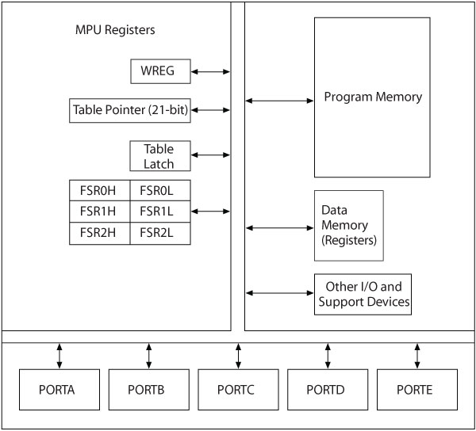
Frequently Used Registers
330_05

Slide 4
Addressing Modes
Method of specifying of an operand
  Immediate (Literal) addressing
    The operand is a number that follows the opcode
  Direct addressing
    The address of the operand is a part of the instruction
  Indirect addressing
    An address is specified in a register (pointer) and the MPU looks up the address in that register
330_05

Slide 5
MOV (Copy) Operations
Instructions
MOVLW 8-bit
MOVWF F,a
MOVF F,d,a
MOVFF Fs,Fd
Examples
MOVLW 0xF2
Load F2H into WREG
MOVWF REG1
Copy WREG into REG1
MOVF REG1,F
Copy REG1 into REG1
MOVF REG1,W
Copy REG1 into WREG
MOVFF REG1,REG2
Copy REG1 into REG2
330_05

Slide 6
SET/CLR Instructions
Instructions
CLRF F,a
SETF F,a
SWAPF F,d,a
Examples
CLRF REG1
Clear REG1
SETF REG1
Set all bits in REG1
SWAPF REG1,F
Exchange low and high nibbles in REG1
330_05

Slide 7
Points to Remember
When instructions copy data from one register to another, the source is not modified
In general, these instructions do not affect flags
  Except CLRF and MOVF F
The letter “d” represents the destination
  If d = 0 or W, result saved in WREG
  If d = 1 or F, result saved in File (data) register
330_03
Notes:
ELEC 330

Slide 8
File Select Registers as Pointers
Three registers: FSR0, FSR1, and FSR2
  LFSR F,12-bit Load 12-bit address into FSR
Each can be used in five different formats
  INDF0 Use FSR0 as pointer
  POSTINC0 Use FSR0 as pointer and increment FSR0
  POSTDEC0 Use FSR0 as pointer and decrement FSR0
  PREINC0 Increment FSR0 first and use as pointer
  PLUSW0 Add W to FSR0 and use as pointer
330_05

Slide 9
Pointer Example
Opcode | Operands | Comments
LFSR | FSR1,0x0120 | ;Load 120H into FSR1
LFSR | FSR2,0x0150 | ;Load 150H into FSR2
MOVFF | POSTINC1,POSTINC2 | ;Copy data in register 120H into register 150H and increment both FSRs
330_05
Notes:
ELEC 330

Slide 10
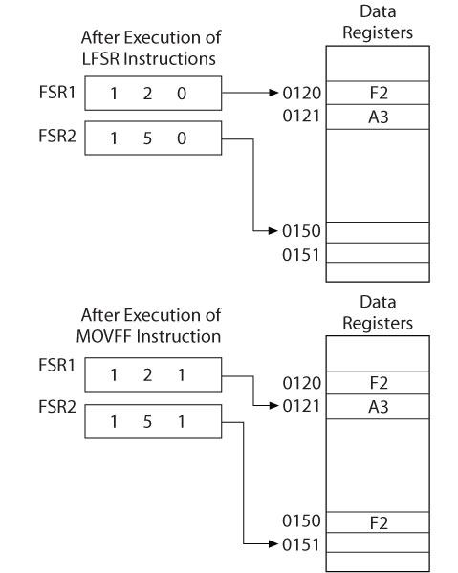
Indirect Addressing
330_05

Slide 11
Using Table Pointers to Copy Data
TBLRD*
  Copy from Program Memory into Table Latch Using Table Pointer
TBLRD*+
  Copy from Program Memory into Table Latch and Increment Table Pointer
TBLRD*-
  Copy from Program Memory into Table Latch and Decrement Table Pointer
TBLRD+*
  Increment Table Pointer first and then copy from Program Memory into Table Latch
330_05

Slide 12
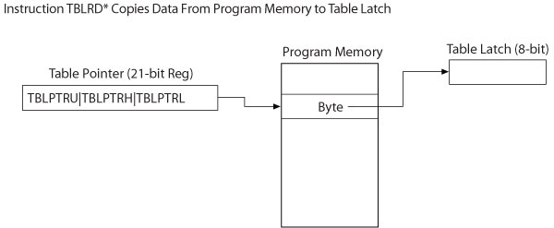
Copying Data
330_05

Slide 13
Example 5.3
The program memory location BUFFER (at address 000040_{H}) holds the byte F6_{H}.
Write the assembly language instructions to copy the byte from BUFFER to the data register REG10 (at address 010_{H})
330_05

Slide 14
Table Pointer Example
Label | Opcode | Operand | Comment
REG10 | EQU | 0x10 | ;Data Register
 | MOVLW | UPPER BUFFER | ;Load upper bits of BUFFER
 | MOVWF | TBLPTRU
 | MOVLW | HIGH BUFFER | ;Load high byte of BUFFER
 | MOVWF | TBLPTRH
 | MOVLW | LOW BUFFER | ;Load low byte of BUFFER
 | MOVWF | TBLPTRL
 | TBLRD* |  | ;Copy data to Table Latch
 | MOVF | TABLAT,W | ;Copy Table Latch to WREG
 | MOVWF | REG10 | ;Copy WREG to REG10
 | SLEEP
 | ORG | 0x40
BUFFER | DB | 0xF6 | ;Data Byte
 | END
330_05
Notes:
ELEC 330

Slide 15
Arithmetic Operations
PIC18F MPU
  Add
  Subtract
  Multiply
  Negate (2s complement)
  Increment
  Decrement
330_05

Slide 16
Points to Remember
Arithmetic instructions
  Can perform operations on W and 8-bit literals
    Save the result in W
  Can perform operations an W and F
    Save the result in W or F
  In general, affect all flags
330_03
Notes:
ELEC 330

Slide 17
Redirection of Program Execution
Three groups of instructions that change the direction of execution
  Branch
  Skip
  Call (discussed in Chapter 7)
330_05

Slide 18
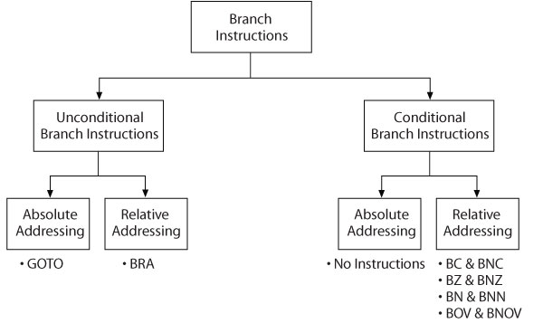
Branch Instructions
330_05

Slide 19
Points to Remember
Branch instructions use relative addressing
  If the operand is positive, the jump is forward
  If negative, the jump is backward
These instructions do not affect flags
  Flags set by previous instructions used to make decisions
330_05
Notes:
ELEC 330

Slide 20
Arithmetic Instructions with Skip
Compare File (Data) Register with W:
  CPFSEQ F,a ;Skip next instruction if F = W
  CPFSGT F,a ;Skip next instruction if F > W
  CPFSLT F,a ;Skip next instruction if F < W
Increment File (Data) Register:
  INCFSZ F,d,a ;Skip next instruction if F = 0
  INFSNZ F,d,a ;Skip next instruction if F ≠ 0
Decrement File (Data) Register:
  DECFSZ F,d,a ;Skip next instruction if F = 0
  DCFSNZ F,d,a ;Skip next instruction if F ≠ 0
330_05

Slide 21
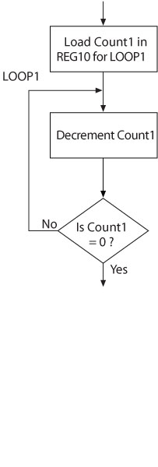
Flowchart for Loop
330_05

Slide 22
Loop Example
Label | Opcode | Operand | Comments
COUNT1 | EQU | 0x01 | ;Counter is REG01
 | ORG | 0x20
START: | MOVLW | 0x05 | ;Initialize Counter to 5
 | MOVWF | COUNT1
LOOP1: | DECF | COUNT1,F | ;Decrement Counter
 | BNZ | LOOP1 | ;Count1 = 0?
 | SLEEP |  | ;Done
 | END
330_05
Notes:
ELEC 330

Slide 23
Loop Example2
Label | Opcode | Operand | Comments
COUNT1 | EQU | 0x01 | ;Counter is REG01
 | ORG | 0x20
START: | MOVLW | 0x05 | ;Initialize Counter to 5
 | MOVWF | COUNT1
LOOP1: | DECFSZ | COUNT1,F | ;Decrement Counter, Skip if 0
 | BRA | LOOP1
 | SLEEP |  | ;Done
 | END
330_05
Notes:
ELEC 330

Slide 24
Illustrative Program
Problem Statement
  Write a program to copy five data bytes from program memory (with the starting location 000050_{H} called SOURCE) to data registers (with beginning address 010_{H} called BUFFER).
  When the copying process is complete, turn on all LEDs at PORTC.
  Data Bytes: F6_{H}, 67_{H}, 7F_{H}, A9_{H}, 72_{H}
330_05
Notes:
ELEC 330

Slide 25
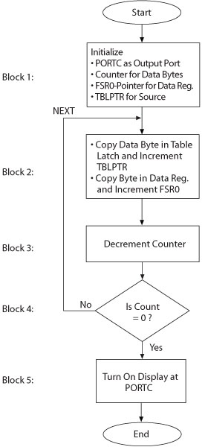
Copy Data Program
330_05

Slide 26
Copy Data Program
Label | Opcode | Operand | Comments
BUFFER | EQU | 0x10 | ;Begin Data Registers
COUNTER | EQU | 0x01 | ;Counter is REG01
 | ORG | 0x00 | ;Reset Vector
 | GOTO | START
330_05
Notes:
ELEC 330

Slide 27
Copy Data Program
Label | Opcode | Operand | Comments
 | ORG | 0x20
START: | MOVLW | 0x00 | ;Init PORTC as Output
 | MOVWF | TRISC
 | MOVLW | 0x05 | ;Init COUNTER = 5
 | MOVWF | COUNTER
 | LFSR | FSR0, BUFFER | ;Init FSR0 Pointer
 | MOVLW | UPPER SOURCE | ;Init Table Pointer
 | MOVWF | TBLPTRU
 | MOVLW | HIGH SOURCE
 | MOVWF | TBLPTRH
 | MOVLW | LOW SOURCE
 | MOVWF | TBLPTRL
330_05
Notes:
ELEC 330

Slide 28
Copy Data Program
Label | Opcode | Operand | Comments
NEXT: | TBLRD*+ |  | ;Copy to Table Latch
 |  |  | ;Inc Table Pointer
 | MOVF | TABLAT,W | ;Copy data to W
 | MOVWF | POSTINC0 | ;Copy to Register
 |  |  | ;Inc FSR0 Pointer
 | DECF | COUNTER,F | ;Dec COUNTER
 | BNZ | NEXT | ;COUNTER = 0?
 | MOVLW | 0xFF | ;Set W
 | MOVWF | PORTC | ;Turn ON LEDs
 | SLEEP
330_05
Notes:
ELEC 330

Slide 29
Copy Data Program
Label | Opcode | Operand | Comments
 | ORG | 0x50
SOURCE | DB | 0xF6,0x67,0x7F,0xA9,0x72
 | END
330_05
Notes:
ELEC 330

Slide 30
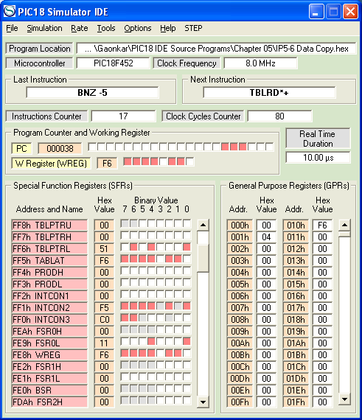
Program Execution and Troubleshooting (Debugging)
330_05
Notes:
ELEC 330

Slide 31
Logic Operations
COMF F,d,a ;Complement (NOT) F
;and save result in W or F
ANDLW 8-bit ;AND Literal with W
ANDWF F,d,a ;AND W with F and ;save result in W or F
IORLW 8-bit ;Inclusive OR Literal with W
IORWF F,d,a ;Inclusive OR W with F ;and save result in W or F
XORLW 8-bit ;Exclusive OR Literal with W
XORWF F,d,a ;Exclusive OR W w/ F ;and save result in W or F
330_05

Slide 32
Application Example
The W register holds a packed BCD number 68_{H}.
Write the instructions to mask the high-order four bits (7-4), preserve the low-order bits (3-0), and save the result in REG1.
Label | Opcode | Operand | Comments
 | ANDLW | B’00001111’ | ;And with Mask
 | MOVWF | REG1 | ;Save Result
330_05
Notes:
ELEC 330

Slide 33
Points to Remember
Each bit (7-0) of W is logically operated with the corresponding bit of the operand
When the operand is a File (data) register, the result can be saved in either W or F using the “d” parameter
These instructions affect only the N and Z flags
330_05
Notes:
ELEC 330

Slide 34
Bit Set, Clear, and Toggle
Instructions
BCF F,b,a
BSF F,b,a
BTG F,b,a
These instructions can set, reset, or toggle any (single) bit in a data register.
Examples
BCF REG1,7
Clear Bit7 in REG1
BSF REG2,4
Set Bit4 in REG2
BTG REG5,0
Toggle Bit0 in REG5
330_05

Slide 35
Bit Test and Skip Instructions
Instructions test a bit in a data register for set or reset condition; if conditions met, MPU skips next instruction.
Instructions Examples
BTFSC F,b,a BTFSC REG1,7
Test BIT7 in REG1 and if the bit is zero, skip the next instruction
BTFSS F,b,a BTFSS REG1,5
Test Bit5 in REG1 and if the bit is one, skip the next instruction
330_05

Slide 36
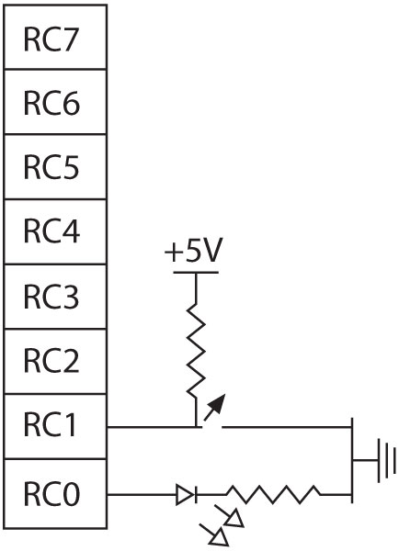
Application Example
The MPU checks RC1 (Bit1) at PORTC.
  If the switch is open (RC1=1), it stays in the loop and continues to check the switch.
  When the switch is closed (RC1=0), the MPU skips the branch instruction, and turns on the LED.
Label | Opcode | Operand
CHECK: | BTFSC | PORTC,1
 | BRA | CHECK
 | BSF | PORTC,0
330_05

Slide 37
Bit Rotation
The instruction set includes four instructions that can shift a bit to the adjacent position
  Left or right
The instructions are further classified as 8-bit rotation and 9-bit rotation
  In 9-bit rotation, carry flag becomes the ninth bit
330_05

Slide 38
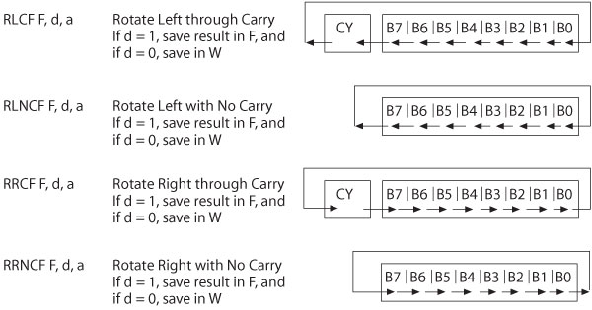
Rotate Instructions
330_05

Slide 39
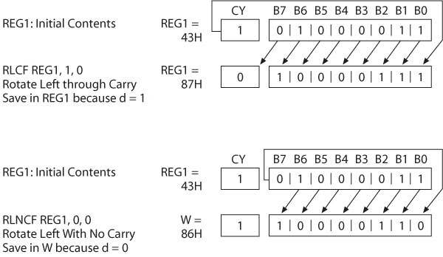
Rotate Left Example
330_05

Slide 40
Unpacking Example
Write a program to unpack a packed BCD byte into two buffers, so it can be displayed on two seven-segment displays.
330_05
Notes:
ELEC 330

Slide 41
Unpacking Example
Label | Opcode | Operand | Comments
BCD0 | EQU | 0x10 | ;Define Data Registers
BCD1 | EQU | 0x11
REG1 | EQU | 0x01
 | ORG | 0x00 | ;Reset Vector
 | GOTO | START
330_05
Notes:
ELEC 330

Slide 42
Unpacking Example
Label | Opcode | Operand | Comments
 | ORG | 0x20
START: | MOVLW | 0x37 | ;Load packed byte
 | MOVWF | REG1
 | ANDLW | 0x0F | ;Mask high order digit
 | MOVWF | BCD0 | ;Save low order digit
 | MOVF | REG1,W | ;Reload byte
 | ANDLW | 0xF0 | ;Mask low order digit
 | RRNCF | WREG,W | ;Rotate 4 times
 | RRNCF | WREG,W
 | RRNCF | WREG,W
 | RRNCF | WREG,W
 | MOVWF | BCD1 | ;Save high order digit
 | SLEEP
330_05
Notes:
ELEC 330

Slide 43
Illustrative Program
Find the Highest Temperature in a Data String
  Data string includes positive and negative 8-bit readings.
  Terminated in null character 00.
  To find the highest temperature.
    Get a reading and check whether it is zero.
    Check whether the byte is negative.
    Is the byte larger than the previously saved data?
      If yes, replace the existing byte.
    Go back to get the next byte.
330_05

Slide 44
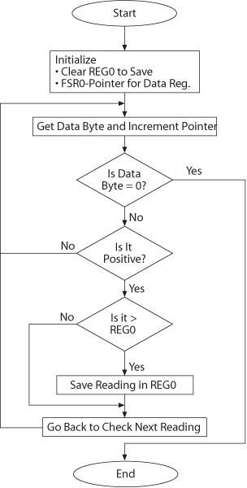
Flow Chart
330_05

Slide 45
Highest Temperature
Label | Opcode | Operand | Comments
REG0 | EQU | 0x00 | ;Define Data Registers
BUFFER | EQU | 0x10
 | ORG | 0x00 | ;Reset Vector
 | GOTO | START
330_05
Notes:
ELEC 330

Slide 46
Highest Temperature
Label | Opcode | Operand | Comments
 | ORG | 0x20
START: | CLRF | REG0 | ;Init REG0
 | LFSR | FSR0,BUFFER | ;Init Pointer
NEXT: | MOVF | POSTINC0,W | ;Get Data & Inc Pointer
 | BZ | FINISH | ;Data = 0?
 | BTFSC | WREG,7 | ;Data > 0?
 | BRA | NEXT
 | CPFSLT | REG0 | ;REG0 < Data?
 | BRA | NEXT
 | MOVWF | REG0 | ;Save Larger Data
 | BRA | NEXT
FINISH | SLEEP
330_05
Notes:
ELEC 330

Slide 47
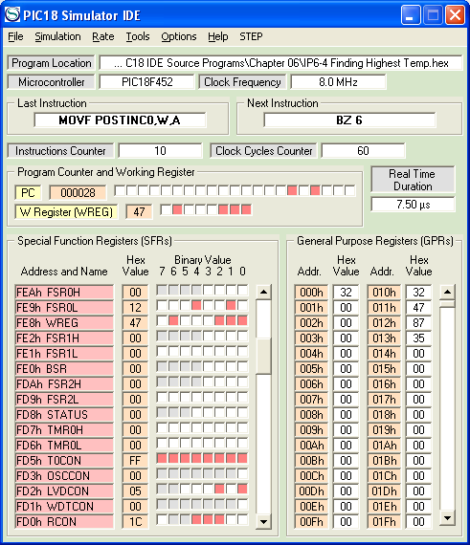
Program Execution
N
Z
330_05
Notes:
ELEC 330

