Slide 1
Stacks and Subroutines
ELEC 330
Digital Systems Engineering
Dr. Ron Hayne
Images Courtesy of Ramesh Gaonkar and Delmar Learning
Notes:
ELEC 330

Slide 2
Subroutine
A group of instructions that performs a specified task
Written independent of main program
Can be called multiple times to perform task
  By main program
  By another subroutine
330_07

Slide 3
Stack
Temporary memory storage space used during the execution of a program
Can be part of R/W memory or specially designed group of registers
Stack Pointer (SP)
  Keeps track of available stack locations
330_07

Slide 4
PIC18 Microcontroller Stack
Hardware Stack
  31 registers
  21-bits wide
  Not part of program memory or data registers
Stack Pointer (STKPTR)
  5-bit address
Top of the Stack (TOS)
  Pointed to by the stack pointer
  Copied into three special function registers
  TOSU (Upper), TOSH (High), and TOSL (Low)
330_07

Slide 5
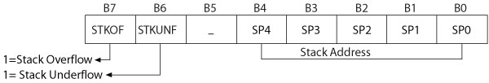
STKPTR Register
SP4-SP0: Stack Address
STKOF: Stack overflow
  Attempt to use more than 31 registers to store information on the stack
STKUNF: Stack underflow
  Attempt to retrieve more information than was stored previously on the stack
330_07

Slide 6
Stack Instructions
PUSH
  Increment the memory address in the stack pointer and store the contents of the program counter (PC+2) on the top of the stack
POP
  Discard the address of the top of the stack and decrement the stack pointer by one
330_07

Slide 7
Subroutine
A group of instructions that performs a specified task
Written independent of a main program
Can be called multiple times to perform task
  By main program
  By another subroutine
Call and Return instructions
  Call a subroutine
  Return from the subroutine
330_07

Slide 8
Call and Return Instructions
CALL Label, s ;Call subroutine at Label
CALL Label, FAST ;FAST equivalent to s = 1
  If s = 0: Increment the stack pointer
  Store the return address (PC+4) on the TOS
  Go to the subroutine located at Label
  If s = 1: Also copy W, STATUS, and BSR
  to their respective shadow registers
RCALL, n ;Relative call to subroutine
  Increment the stack pointer
  Store the return address (PC+2) on the TOS
  Branch to the location Label ± 512 words
330_07

Slide 9
Call and Return Instructions
RETURN, s ;Return from subroutine
RETURN FAST :FAST equivalent to s = 1
  If s = 0: Get the return address from the TOS (to PC)
  Decrement the stack pointer
  If s = 1: Also retrieve W, STATUS, and BSR
  from their shadow registers
RETLW 8-bit ;Return literal to WREG
  Get the return address from the TOS (to PC)
  Decrement the stack pointer
  Return 8-bit literal to WREG
330_07

Slide 10
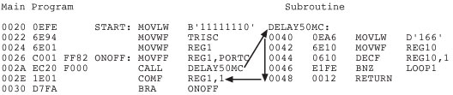
Example 7.2
Program Listing with Memory Addresses
330_07

Slide 11
Parameter Passing
Parameter passing
  Information exchanged between a calling program and a subroutine
Subroutine documentation should include
  Function of the subroutine
  Input parameters
  Output parameters
  Registers modified
  List of subroutines called
330_07

Slide 12
Illustrative Program
Problem Statement
  Write a program to copy a given number of unsigned 8-bit numbers from program memory into specified data registers
  Add the numbers and display the 16-bit sum at PORTB and PORTC
  The program should be subdivided into general purpose subroutines
330_07
Notes:
ELEC 330

