Slide 1
Application Programs
ELEC 330
Digital Systems Engineering
Dr. Ron Hayne
Images Courtesy of Ramesh Gaonkar and Delmar Learning
Notes:
ELEC 330

Slide 2
Application Programs
BCD to Binary Conversion
Binary to BCD Conversion
ASCII Code to Binary Conversion
Binary to ASCII Code Conversion
Multiplication of 16-bit Numbers
Division of Two Unsigned Numbers

Slide 3
BCD to Binary Conversion
Data often entered in decimal format
A through F are invalid
Special care taken to process the data in BCD
  Sometimes necessary to convert the BCD data into binary numbers

Slide 4
BCD to Binary Conversion
Problem statement
  Given a packed BCD number in WREG
    Write a subroutine to unpack the number
    Convert it into its equivalent binary number
    Return the number in WREG

Slide 5
BCD to Binary Conversion
Problem analysis
  The BCD numbers include only ten digits from 0 to 9
  The value of the digit is based on its position
    Example, in decimal number 97, the value of 9 is 90
  To find the binary value of 97_{BCD} = 1001 0111
    Unpack the number
      9 (00001001) and 7 (00000111)
    Multiply high-order digit by 10 and add low-order digit
      (00001001) x 10 + (0000111)

Slide 6
Unpack
Opcode | Operands | Comments
MOVWF | REG1 | ;Save BCD
ANDLW | 0x0F | ;Mask high digit
MOVWF | BCD0 | ;Save low digit
MOVF | REG1,W | ;Get saved BCD
SWAPF | WREG,W | ;Swap digits
ANDLW | 0x0F | ;Mask low digit
MOVWF | BCD1 | ;Save high digit
330_01
Notes:
ELEC 330

Slide 7
Convert
Opcode | Operands | Comments
MULLW | D’10’ | ;Multiply high digit
MOVFF | PRODL,WREG | ;Move product
ADDWF | BCD0,W | ;Add low digit
RETURN
330_01
Notes:
ELEC 330

Slide 8
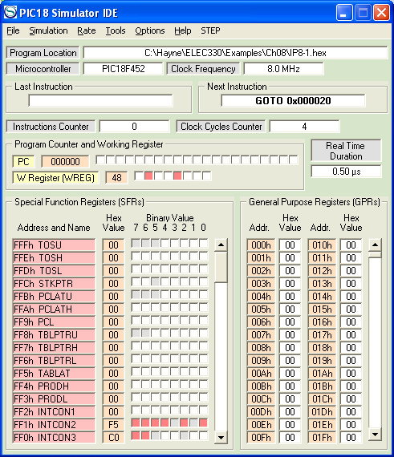
PIC18 Simulator
330_01
Notes:
ELEC 330

