Slide 1
Input/Output Ports and Interfacing
ELEC 330
Digital Systems Engineering
Dr. Ron Hayne
Images Courtesy of Ramesh Gaonkar and Delmar Learning
Notes:
ELEC 330

Slide 2
Basic I/O Concepts
Peripherals such as LEDs and keypads are essential components of microcontroller-based systems
Input devices
  Provide digital information to an MPU
  Examples: switch, keyboard, scanner, and digital camera
Output devices
  Receive digital information from an MPU
  Examples: LED, seven-segment display, LCD, and printer
Devices are interfaced to an MPU using I/O ports
330_09

Slide 3
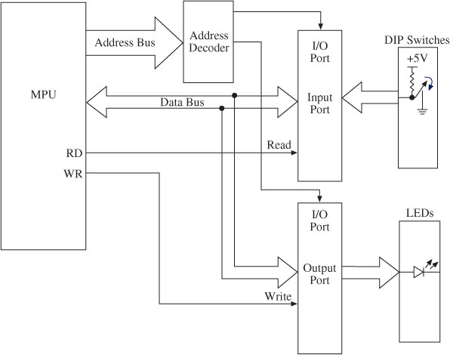
I/O Interfacing
330_09

Slide 4
Interfacing and Addressing
I/O ports
  Buffers and latches on the MCU chip
    Assigned binary addresses by decoding the address bus
  Generally bidirectional
    Internal data direction registers
  To read binary data from an input peripheral
    MPU places the address of an input port on the address bus
    Enables the input port by asserting the RD signal
    Reads data using the data bus
  To write binary data to an output peripheral
    MPU places the address of an output port on the address bus
    Places data on data bus
    Asserts the WR signal to enable the output port
330_09

Slide 5
PIC18F452/4520 I/O Ports
MCU includes five I/O ports
  PORTA, PORTB, PORTC, PORTD, PORTE
Ports are multiplexed
  Can be set up to perform various functions
Each I/O port is associated with several SFRs
  PORT
    Functions as a latch or a buffer
  TRIS
    Data direction register
    Logic 0 sets up the pin as an output
    Logic 1 sets up the pin as an input
  LAT
    Output latch similar to PORT
330_09

Slide 6
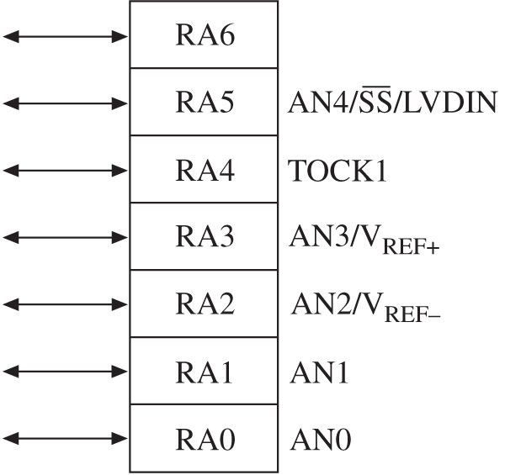
PIC18F452/4520 I/O Ports
PORTA: Example of Multiple Fns
Digital I/O: RA6-RA0
Analog Input: AN0-AN4
V _{REF}+ : A/D Reference Plus V
V _{REF}- : A/D Reference Minus V
TOCK1: Timer0 Ext. Clock
SS: SPI Slave Select Input
LVDIN: Low V Detect Input
330_09

Slide 7
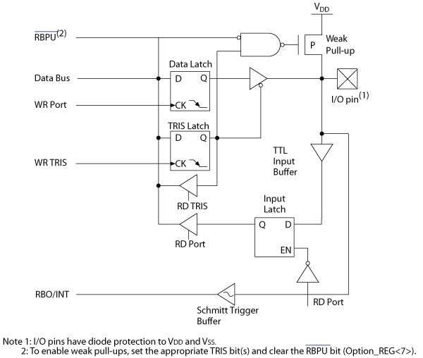
PIC18F452/4520 I/O Ports
PORTB
330_09

Slide 8
I/O Example
Write instructions to set up pins RB7-RB4 of PORTB as inputs and pins RB3-RB0 as outputs
Opcode | Operands | Comments
MOVLW | 0xF0 | ;Load B’11110000’ into WREG
MOVWF | TRISB | ;Set PORTB TRIS Reg
330_09
Notes:
ELEC 330

Slide 9
Interfacing Output Peripherals
Commonly used output peripherals in embedded systems
  LEDs
  Seven-Segment Displays
  LCDs
Two ways of connecting LEDs to I/O ports
  Common Cathode
    LED cathodes are grounded
    Logic 1 from the I/O port turns on the LEDs
    Current is supplied by the I/O port called current sourcing
  Common Anode
    LED anodes are connected to the power supply
    Logic 0 from the I/O port turns on the LEDs
    Current is received by the chip called current sinking
330_09

Slide 10
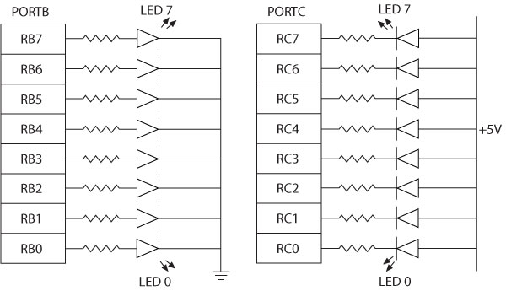
Interfacing Output Peripherals
Common Cathode
Common Anode
330_09

Slide 11
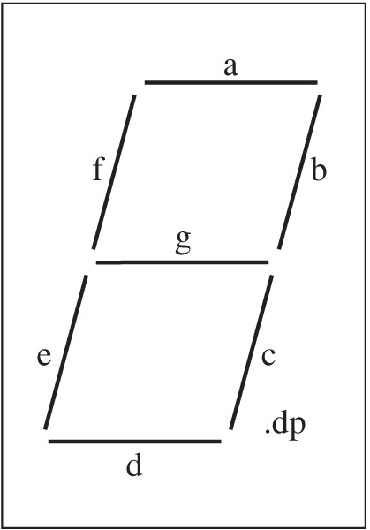
Seven-Segment Display
Seven-segment Displays
  Used to display BCD digits
    0 thru 9
  A group of 7 LEDs physically mounted in the shape of the number eight
    Plus a decimal point
  Each LED is called a segment
    ‘a’ through ‘g’
  Two types
    Common anode
    Common cathode
330_09

Slide 12
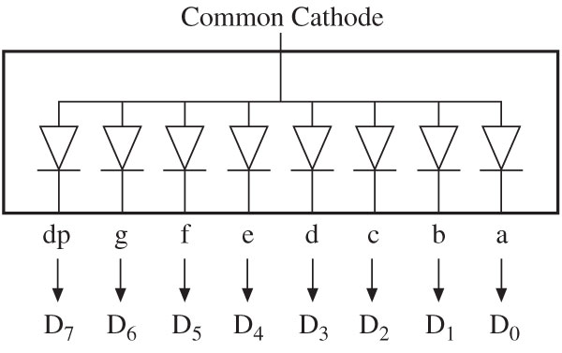
Seven-Segment Display
Common Anode
  All anodes are connected together to a power supply
  Cathodes are connected to data lines
Logic 0 turns on a segment
Example: To display the digit 1
  All segments except b and c should be off
  11111001 = F9_{H}
Common Anode
330_09

Slide 13
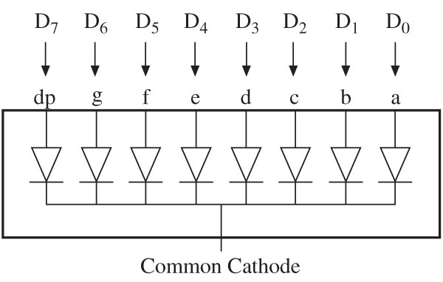
Seven-Segment Display
Common Cathode
  All cathodes are connected together to ground
  Anodes are connected to data lines
Logic 1 turns on a segment
Example: To display digit 1
  All segments except b and c should be off
  00000110 = 06_{H}
330_09

Slide 14
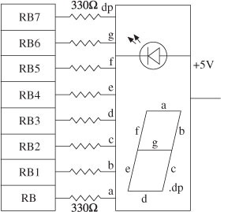
Example 9.4
Interfacing Seven-Segment Display to PORTB
  Common Anode
  Table Look-Up
330_09

Slide 15
Illustrative Program
Problem Statement
  Interface two common-anode seven-segment displays to PORTD and PORTC of the PIC18F
  Write instructions to implement an up-counter, counting from 00 to 59
  Display the count on the two seven-segment displays
330_09
Notes:
ELEC 330

Slide 16
Interfacing Input Peripherals
Commonly used input peripherals
  DIP switches, push-button keys, keyboards, and A/D converters
DIP switch
  One side of the switch is tied high
    To a power supply through a resistor called a pull-up resistor
  The other side is grounded
  The logic level changes when the position is switched
Push-button key
  Same as the DIP switch except that contact is momentary
330_09

Slide 17
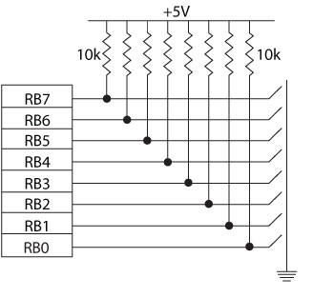
Interfacing Dip Switches
330_09

Slide 18
Reading from an I/O Port
Read input switches on PORTB (RB7-RB4)
  RB0 set HI (1)
  Switches Open = LOW (0)
  Switches Closed = HIGH (1)
Display on PORTC
Opcode | Operands | Comments
MOVLW | 0xF0 | ;Load B’11110000’ into WREG
MOVWF | TRISB | ;Set PORTB TRIS Reg
CLRF | TRISC | ;Set PORTC as Output
BSF | PORTB,0 | ;Set RB0 High
MOVF | PORTB,W | ;Read PORTB
MOVWF | PORTC | ;Display on PORTC
330_09

Slide 19
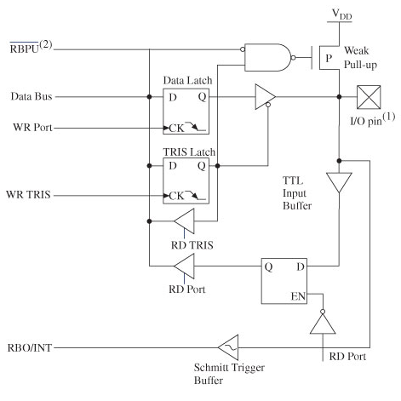
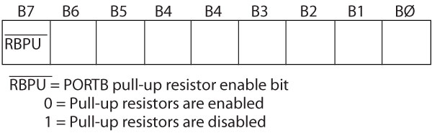
Internal Pull-Up Resistor
Turning off the internal FET provides a pull-up resistor
Bit7 (RBPU) in the INTCON2 register enables or disables the pull-up resistor
  Instruction to Enable Pull Up Resistors:
  BCF INTCON2,7
330_09

Slide 20
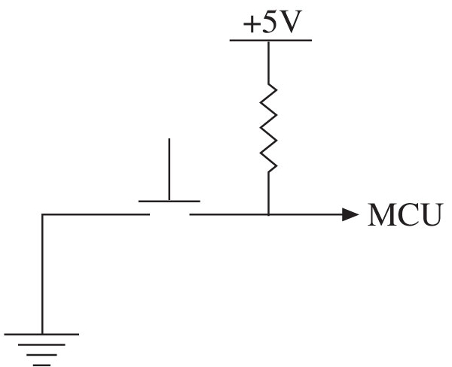
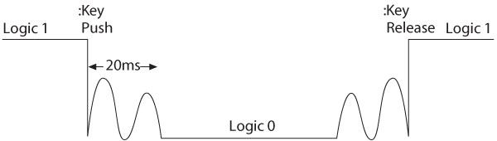
Interfacing Push-Button Keys
When a key is pressed (or released), mechanical metal contact bounces momentarily and can be read as multiple inputs
Key debounce
  Eliminating reading of one contact as multiple inputs
  Hardware or Software
330_09

Slide 21
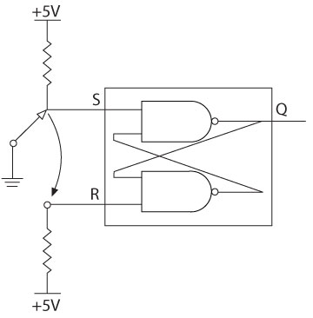
Key Debounce Techniques
Hardware technique
  Two NAND gates
    S-R latch
  The output of the latch is a pulse without a bounce
Software technique
  Wait for 10 to 20 ms after detection of a switch closure
  If the reading is still the same it is accepted
330_09

Slide 22
Interfacing a Matrix Keypad
Problem statement
  Interface a 4 x 4 Hex keypad to PORTB
  Write a program to recognize a key pressed and encode the key in its binary value
  Display binary code on PORTC
330_09

Slide 23
Interfacing a Matrix Keypad
Hardware (PIC18 Simulator)
  4 x 4 matrix keypad organized in the row and column format
  Four columns are connected to the lower half of PORTB (RB0-RB3)
  Four rows are connected to upper half of PORTB (RB4-RB7)
  When a key is pressed, it makes a contact with the corresponding row and column
330_09

Slide 24
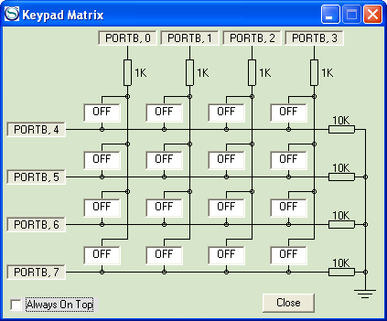
Interfacing a Matrix Keypad
PIC18 Simulator Keypad Matrix
1
2
3
C
4
5
6
D
7
8
9
E
A
0
B
F
330_09

Slide 25
Interfacing a Matrix Keypad
Software
  To recognize and encode the key pressed
    Set all the columns High by sending ones
    Check for any key pressed (non-zero)
    Set one column High at a time
      Check all the rows in that column
    Once a key is identified
      Encode based on its position in the column
330_09

Slide 26
Time Multiplex Scanning Technique
Problem statement
  Interface four common cathode seven-segment displays to PORTB and PORTC using the time multiplex scanning technique.
  Write instructions to display a four-digit number stored in data registers.
330_09

Slide 27
Time Multiplex Scanning
Hardware
  Eight data lines of PORTB are connected to the anodes of each display
  Each cathode is connected to PORTC (RC3-RC0) through a transistor
  Transistors (and LEDs) can be turned on by sending logic 1
  Each display is turned on and off in a sequence to display a digit
330_09

Slide 28
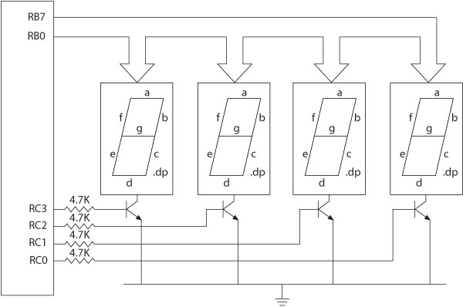
Time Multiplex Scanning
330_09

Slide 29
Time Multiplex Scanning
Software
  Codes of the numbers to be displayed are stored in data registers in sequence
  The program gets the codes from the data registers by using the pointer (FSR0) and sends them out to the LED segments through PORTB
  One display at a time is turned on by sending logic 1 to the corresponding transistor connected to PORTC
  After an appropriate delay, the first display is turned off and the next display is turned on
  Turning displays on/off is repeated in sequence
330_09

Slide 30
Interfacing LCD
Problem statement
  Interface a 2-line x 20 character LCD module with the built-in HD44780 controller to I/O ports of the PIC18 microcontroller.
  Explain the control signals necessary to read from and write to the LCD.
  Write a program to display ASCII characters.
330_09

Slide 31
Interfacing LCD
Hardware
  20 x 2-line LCD display
    Two lines with 20 characters per line
  LCD has a display Data RAM
    Stores data in 8-bit character code
  Each register in Data RAM has its own address
    Corresponds to its position on the line
      Line 1 is 00_{H} to 13_{H}
      Line 2 is 40_{H} to 53_{H}
330_09

Slide 32
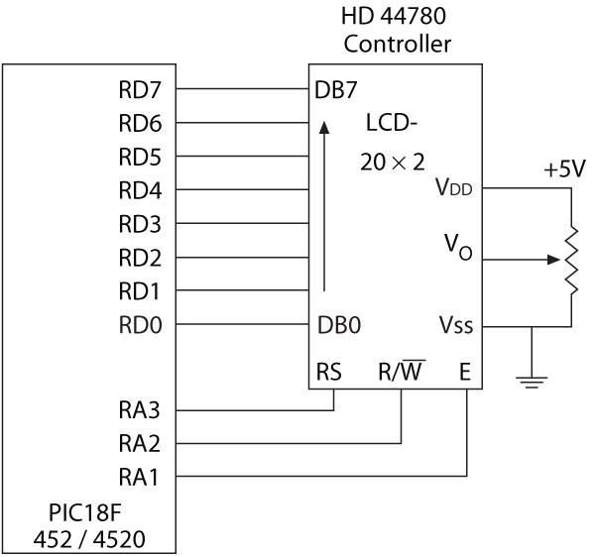
Interfacing LCD
330_09

Slide 33
Interfacing LCD
Driver HD44780
  8-bit data bus (RD7-RD0)
  Three control signals
    RS – Register Select (RA3)
    R/W – Read/Write (RA2)
    E – Enable (RA1)
  Three power connections
    Power, ground, and variable resistor to control brightness
330_09

Slide 34
Interfacing LCD
Can be interfaced either in 8-bit mode or 4-bit mode
  In 8-bit mode, all eight data lines are connected
  In 4-bit mode, only four data lines are connected
    Two transfers per character (or instruction) are needed
Driver has two 8-bit internal registers
  Instruction Register (IR) to write instructions to set up LCD
    Table 9-3
  Data Register (DR) to write data (ASCII characters)
330_09

Slide 35
Interfacing LCD
LCD Operation
  When the MPU writes an instruction to IR or data to DR, the controller:
    Sets DB7 high indicating that the controller is busy
    Sets DB7 low after the completion of the operation
  The MPU should always check whether DB7 is low before sending an instruction or a data byte
330_09

Slide 36
Interfacing LCD
Writing to or Reading from LCD (Table 9-4)
  The MPU:
    Asserts RS low to select IR
    Asserts RS high to select DR
    Reads from LCD by asserting the R/W signal high
    Writes into LCD by asserting the R/W signal low
    Asserts the E signal high and then low (toggles) to latch a data byte or an instruction
330_09

Slide 37
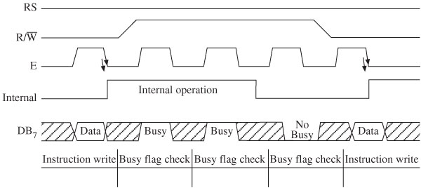
Interfacing LCD
Timing diagram: writing to LCD
330_09

Slide 38
Interfacing LCD
Software
  To write into the LCD
    Send the initial instructions to set up the LCD
      4-bit or 8-bit mode
    Continue to check DB7 until it goes low
    Write instructions to IR to set up LCD parameters
      Number of display lines and cursor status
    Write data to display a message
330_09

