Slide 1
Interrupts
ELEC 330
Digital Systems Engineering
Dr. Ron Hayne
Images Courtesy of Ramesh Gaonkar and Delmar Learning
Notes:
ELEC 330

Slide 2
Basic Concepts of Interrupts
An interrupt is a communication process
  A device
    Requests the MPU to stop processing
    Internal or external
  The MPU
    Acknowledges the request
    Attends to the request
    Goes back to processing where it was interrupted
330_10

Slide 3
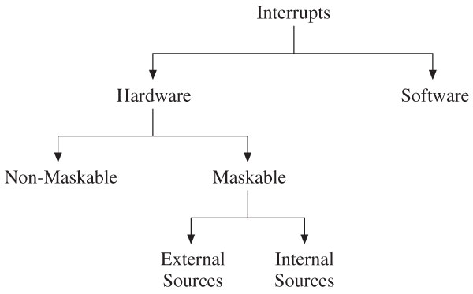
Types of Interrupts
330_10

Slide 4
MPU Response to Interrupts
When interrupts are enabled
  MPU checks interrupt request flag at the end of each instruction
If interrupt request is present, the MPU
  Resets the interrupt flag
  Saves the return address on the stack
MPU redirected to appropriate memory location
  Interrupt vectors
Interrupt service routine (ISR) meets request
MPU returns to where it was interrupted
  Specific return instruction
330_10

Slide 5
PIC18 Interrupts
PIC18 Microcontroller family
  Has multiple sources that can send interrupt requests
  Does not have any non-maskable or software interrupts
    All interrupts are maskable hardware
  Has a priority scheme divided into two groups
    High priority and low priority
  Uses many Special Function Registers (SFRs) to implement the interrupt process
330_10

Slide 6
PIC18 Interrupt Sources
External sources
  Three pins of PORTB
    RB0/INTO, RB1/INT1,and RB2/INT2
    Can be used to connect external interrupting sources
      Keypads or switches
  PORTB Interrupt (RBI)
    Change in logic levels of pins RB4-RB7
Internal peripheral sources
  Examples
    Timers
    A/D Converter
    Serial I/O
330_10

Slide 7
PIC18 Interrupt Sources
Special Function Registers (SFRs)
  RCON
    Priority Enable
  INTCON
    External interrupt sources
  IPR, PIE, and PIR
    Internal peripheral interrupts
Valid interrupt
  Interrupt request bit (flag)
  Interrupt enable bit
  Priority bit
330_10

Slide 8
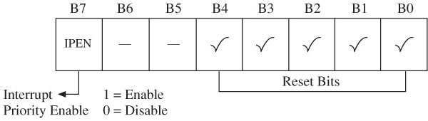
Interrupt Priority
Interrupt priorities
  High-priority interrupt vector 000008_{H}
  Low-priority interrupt vector 000018_{H}
  A high-priority interrupt can interrupt a low-priority interrupt in progress.
  Interrupt priority enable
    Bit7 (IPEN) in RCON register
RCON
330_10

Slide 9
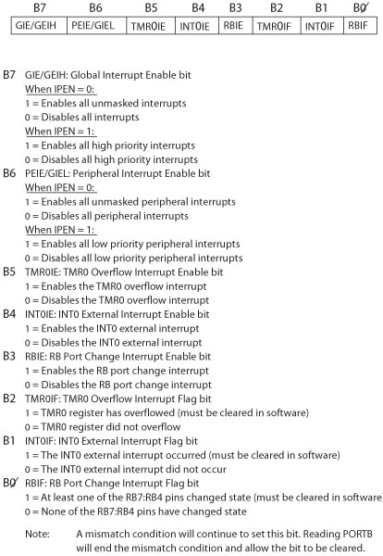
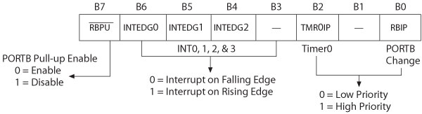
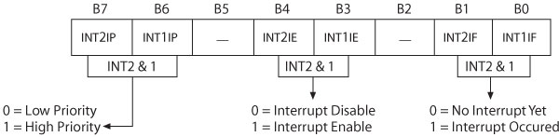
External Interrupts
INTCON Register
INTCON2 Register
INTCON3 Register
330_10

Slide 10
Interrupt Service Routine (ISR)
Similar to a subroutine
Attends to the request of an interrupting source
  Clears the interrupt flag
  Should save register contents that may be affected by the code in the ISR
  Must be terminated with the instruction RETFIE
When an interrupt occurs, the MPU:
  Completes the instruction being executed
  Disables global interrupt enable
  Places the return address on the stack
330_10

Slide 11
Interrupt Service Routine (ISR)
High-priority interrupts
  The contents of W, STATUS, and BSR registers are automatically saved into respective shadow registers.
Low-priority interrupts
  These registers must be saved as a part of the ISR
    If they are affected
RETFIE [s] ;Return from interrupt
RETFIE FAST ;FAST equivalent to s = 1
  If s =1: MPU also retrieves the contents of W, BSR, and
  STATUS registers
330_10

Slide 12
Internal Interrupts
PIC18 MCU internal interrupt sources
  Timers
  A/D converter
  Serial I/O
Each interrupt has three bits
  Interrupt priority bit
  Interrupt enable bit
  Interrupt request bit (flag)
Interrupt registers
  IPR: Interrupt Priority Register
  PIE: Peripheral Interrupt Enable
  PIR: Peripheral Interrupt Request (Flags)
330_10

Slide 13
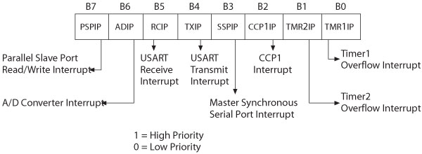
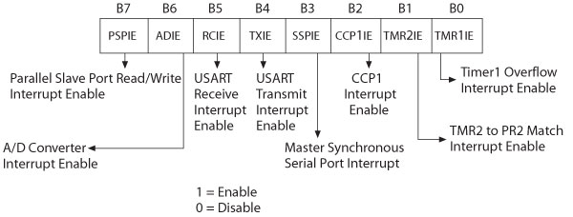
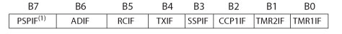
Interrupt Registers
IPR1
PIE1
PIR1
330_10

Slide 14
Multiple Interrupt Sources
All interrupt requests are directed to one of two memory locations (interrupt vectors)
  000008_{H} (high-priority)
  000018_{H} (low-priority)
When there are multiple requests
  The interrupt source must be identified by checking the interrupt flags
330_10

Slide 15
Illustration
Problem Statement
  INT1 set up as a high-priority interrupt
  Timer1 and Timer2 set up as low-priority
  Identify the interrupt sources
    Execute the appropriate interrupt service routines
330_09
Notes:
ELEC 330

Slide 16
Illustration
Label | Opcode | Operand | Comments
S_TMP | EQU | 0x100 | ;Temp Registers
W_TMP | EQU | 0x101
 | ORG | 0x00
 | GOTO | MAIN
 | ORG | 0x08 | ;High-Priority Interrupt Vector
INTCHK: | GOTO | INT1_ISR
 | ORG | 0x18 | ;Low-Priority Interrupt Vector
TIMERCHK: | BTFSC | PIR1,TMR1IF | ;Timer1 Flag, Skip if Clear
 | GOTO | TMR1_ISR
 | BTFSC | PIR1,TMR2IF | ;Timer2 Flag, Skip if Clear
 | GOTO | TMR2_ISR
 | RETFIE
330_04
Notes:
ELEC 330

Slide 17
Illustration
Label | Opcode | Operand | Comments
MAIN: |  |  | ;Main Program goes here
 |  |  | ;Do Something
HERE: | GOTO | HERE | ;Wait for an Interrupt
 | ORG | 0x100
INT1_ISR: | BCF | INTCON3,INT1IF ;Clear Flag
 |  |  | ;Do Something
 | RETFIE | FAST | ;Retrieve registers and Return
330_04
Notes:
ELEC 330

Slide 18
Illustration
Label | Opcode | Operand | Comments
TMR1_ISR: | MOVFF | STATUS, S_TMP
 | MOVWF | W_TMP | ;Save Registers
 | BCF | PIR1,TMR1IF | ;Clear Flag
 |  |  | ;Do Something
 | MOVF | W_TMP,W | ;Retrieve Registers
 | MOVFF | S_TMP,STATUS
 | RETFIE |  | ;Return from interrupt
TMR2_ISR |  |  | ;Similar to Timer1
330_04
Notes:
ELEC 330

