Slide 1
Timers
ELEC 330
Digital Systems Engineering
Dr. Ron Hayne
Images Courtesy of Ramesh Gaonkar and Delmar Learning
Notes:
ELEC 330

Slide 2
Hardware Counters and Timers
Counter (register)
  Can be decremented or incremented per clock cycle
Time calculation
  Find difference between beginning count and last count
  Multiply the count difference by the clock period
330_11

Slide 3
Hardware Counters and Timers
Counter (register)
  Replace the clock with a signal from an event
  Count is incremented (or decremented)
  Total number of events can be counted
330_11

Slide 4
Types of Counters
Up-counter
  Counter is incremented at every clock cycle
  When count reaches the maximum count, a flag is set
  Counter can be reset to zero or to the initial value
Down-counter
  Counter is decremented at every clock cycle
  When count reaches zero, a flag is set
  Counter can be reset to the maximum or the initial value
Free-running counter
  Counter runs continuously and only readable
  When it reaches the maximum count, a flag is set
330_11

Slide 5
Timer Applications
Time delay
Pulse wave generation
Pulse width or frequency measurement
Timer as an event counter
330_11

Slide 6
Capture, Compare, and
PWM (CCP) Modules
CCP modules are common in recent MCUs
  Registers specially designed to perform the following functions (in conjunction with timers)
    Capture: The CCP pin can be set as an input to record the arrival time of a pulse.
    Compare: The CCP pin is set as an output, and at a given count, it can be driven low, high, or toggled.
    Pulse width modulation (PWM): The CCP pin is set as an output and the duty cycle of a pulse can be varied.
330_11

Slide 7
Pulse Width Modulation
Duty cycle
  Percentage ratio of on time of a pulse to its period
Changing of the duty cycle is defined as PWM
  CCP pin is set as an output
  Count for period and duty cycle loaded into CCP registers
  Varying the duty cycle generates PWM
330_11

Slide 8
PIC18 Timers
PIC18 timers
  All up-counters
  8-bit and 16-bit
Timer0
  8-bit or 16-bit timer
Timer1 (and Timer3)
  16-bit timers
Timer2 (and Timer4)
  8-bit timer
SFRs
  T0CON-T2CON
330_11

Slide 9
Timer0
8-bit or 16-bit timer
  Readable and writable
  Parameters in T0CON register
  Eight pre-scale values (Bit2-Bit0)
  Clock source (Bit5)
    Internal (instruction cycle)
    External clock connected to pin RA4/T0CK1
      Rising edge or falling edge (Bit4)
  Generates an interrupt or sets a flag when it overflows
    TMR0IF
    Flag must be cleared to start the timer again
330_11

Slide 10
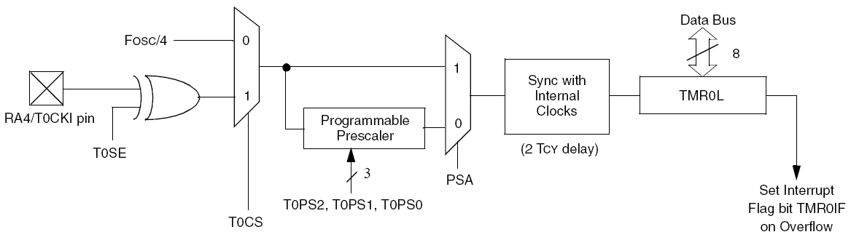
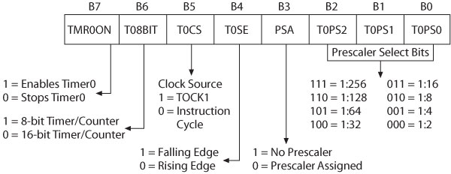
Timer0
T0CON
330_11

Slide 11
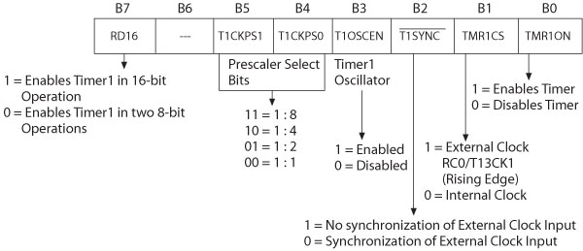
Timer1
16-bit counter/timer
  Two 8-bit registers (TMR1H and TMR1L)
  Four prescale values (Bit5-Bit4)
  Clock source (Bit1)
    Internal (instruction cycle)
    External (pin RC0/T13CK1) on rising edge
330_11

Slide 12
Timer1
Interrupt
  Generates an interrupt or sets a flag when it overflows
    TMR1IF
  Flag must be cleared to start the timer again
Resetting Timer1 using CCP module
  CCP1 in the Compare mode
  Timer1 and CCP1compared at every cycle
  When a match is found, Timer1 is reset
330_11

Slide 13
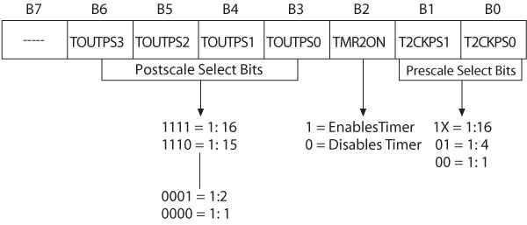
Timer2
8-bit timer (TMR2)
  8-bit period register (PR2)
  TMR2 and PR2 are readable and writable
  Three prescale values (Bit1-Bit0)
  16 postscale values (Bit6-Bit3)
  Flag (TMR2IF) is set when TMR2 matches PR2
    Can generate an interrupt
330_11

Slide 14
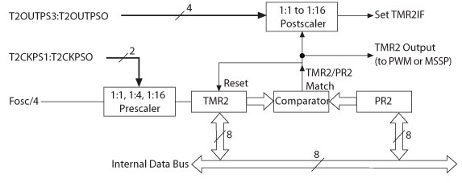
Timer2
Timer2 operation
  8-bit number is loaded in PR2
  When TMR2 and PR2 match
    Output pulse is generated and the timer is reset
  Output pulse goes through postscaler
    Sets the flag TMR2IF
330_11

Slide 15
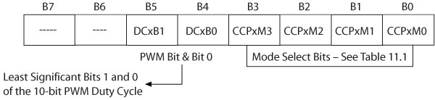
CCP Modules
Capture, Compare, and Pulse Width Modulation (PWM)
CCPR1H (high) and CCPR1L (low)
  16-bit Capture register
  16-bit Compare register
  Duty-cycle PWM register
Timer1 used as clock for Capture and Compare
Timer2 used as clock for PWM
330_11

Slide 16
CCP in the Capture Mode
CCPR1 captures the 16-bit value of Timer1
  When an event occurs on pin RC2/CCP1
Interrupt request flag bit CCP1IF is set
  Must be cleared for the next operation
To capture an event
  Set up pin RC2/CCP1 of PORTC as the input
  Initialize Timer1
    T1CON register
  Initialize CCP1
    CCP1CON register
330_11

Slide 17
CCP in the Compare Mode
CCPR1 constantly compared with TMR1
When a match occurs
  Pin RC2/CCP1 on PORTC
    Driven high, low, or toggled
    Interrupt flag bit CCP1IF is set
To set up CCP1 in Compare mode
  Set up pin RC2/CCP1 of PORTC as output
  Initialize Timer1 and CCP1
  Clear the flag CCP1IF
330_11

Slide 18
PWM Mode
CCP module with Timer2
  Output a pulse wave form for a given frequency/duty cycle
Duty cycle
  CCPR1 register
Period
  PR2 register
When TMR2 is equal to PR2
  TMR2 is cleared
  Pin RC2/CCP1 of PORTC is set high
  PWM duty-cycle byte loaded into CCPR1
330_11

