Slide 1
Data Converters
ELEC 330
Digital Systems Engineering
Dr. Ron Hayne
Images Courtesy of Ramesh Gaonkar and Delmar Learning
Notes:
ELEC 330

Slide 2
Basic Concepts
Analog Signals
  Continuous
  Infinite values in a given range
  Example
    Clock face with hands
Digital Signals
  Discrete values
    On/Off
    1/0
  Example
    Digital clock
330_12

Slide 3
Basic Concepts
Limitations of analog signals
  Pick up noise as they are amplified
  Difficult to store
Advantages of digital signals
  Noise margin
  Easily stored in memory
Limitations of digital signals
  How accurately analog signals are represented
    Quantization
330_12

Slide 4
Embedded System
Typical analog/digital system
  Transducer
    Converts non-electrical signals into electrical signals
  A/D converter
    Converts analog signals into digital signals
  Digital processor
    Processes digital data
  D/A converter
    Converts digital signals into equivalent analog signals
  Transducer
    Converts electrical signals into non-electrical signals
330_12

Slide 5
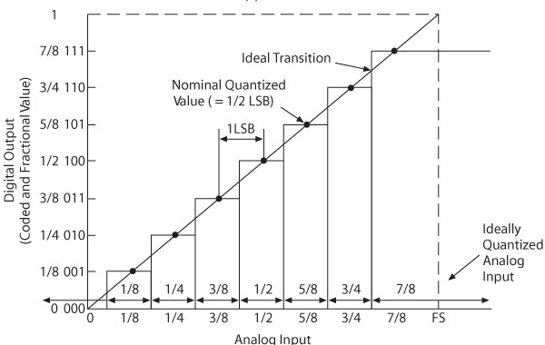
Analog-to-Digital Conversion
A/D, ADC, or A-to-D
  Converting a continuous varying signal, such as voltage or current, into discrete digital quantities that represent the magnitude of the signal compared to standard or reference

Slide 6
A/D Conversion
Flash
  Uses multiple comparators in parallel
  High-speed, high cost
Integrator
  Charges a capacitor for a given amount of time
  Slow, but high accuracy and low noise
Successive Approximation
  Effective compromise among resolution, speed, and cost
Counter
  Similar to successive approximation circuit
  Slower, with variable conversion times
330_12

Slide 7
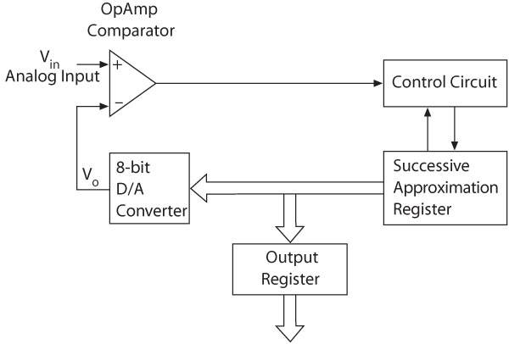
Successive Approximation
330_12

Slide 8
PIC18F A/D Converter Module
The PIC18F4520
  10-bit A/D converter
  13 channels AN0 - AN12
  Three control registers
    ADCON0, ADCON1, and ADCON2
The PIC18F452
  10-bit A/D converter
  8 channels AN0 - AN7
  Two control registers
    ADCON0 and ADCON1
330_12

Slide 9
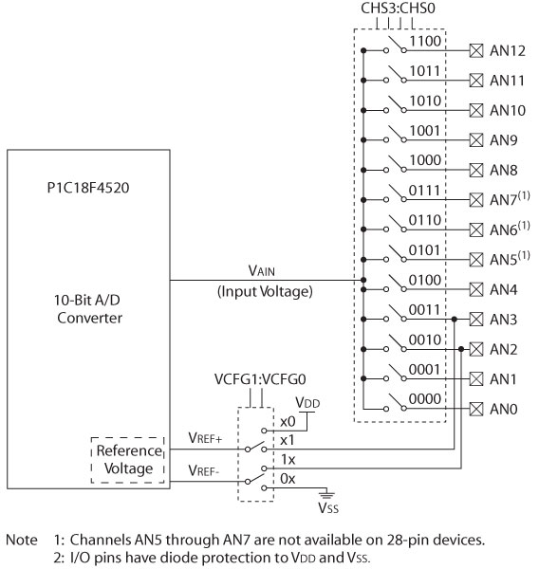
PIC18F4520 A/D Converter
330_12

Slide 10
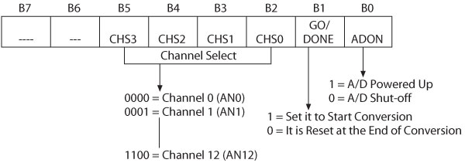
A/D Control Register0
ADCON0 Register
  Select channel for input analog signal
  Start conversion
  Indicate end of conversion
330_12

Slide 11
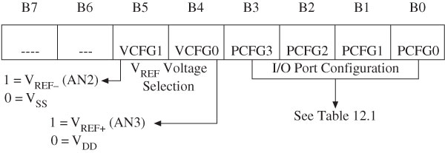
A/D Control Register1
ADCON1 Register
  Set up I/O pins
    Analog signal or digital signals
  Select V_{REF} voltages
330_12

Slide 12
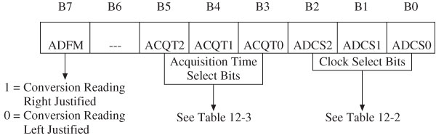
A/D Control Register2
ADCON2 Register
  Select acquisition time and clock frequency
  Right or left justify output reading
330_12

Slide 13
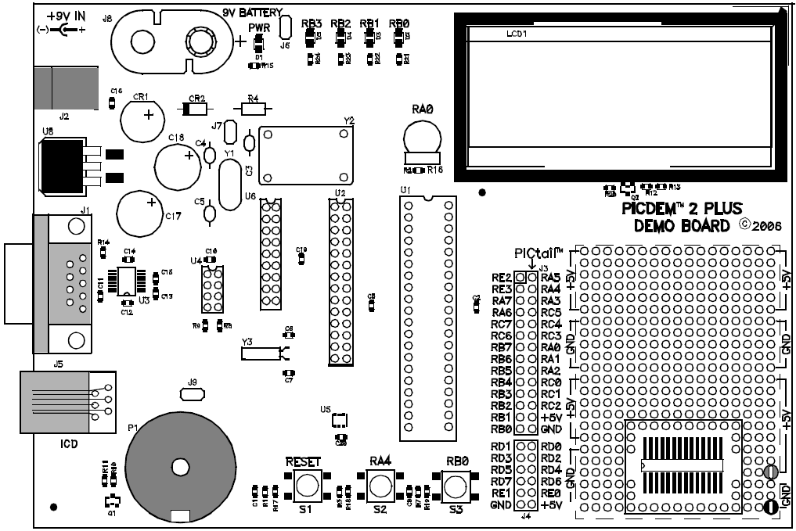
PICDEM 2 Plus
330_12
Notes:
ELEC 330

Slide 14
Digital to Analog Conversion
D/A, DAC, or D-to-A
  Converting discrete signals into analog values that represent the magnitude of the input signal compared to a standard or reference
    Output is discrete analog steps
  Increasing the resolution (number of bits)
    Step size is reduced
    Approximates a continuous analog signal
330_12

Slide 15
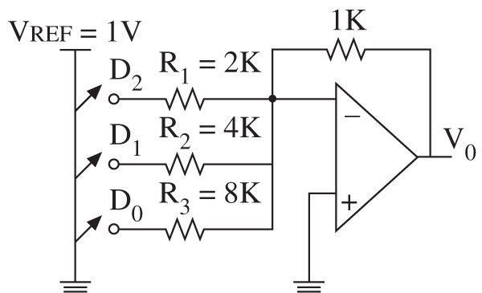
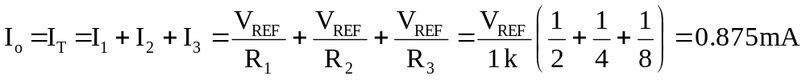
D/A Converter Circuits
330_12

Slide 16
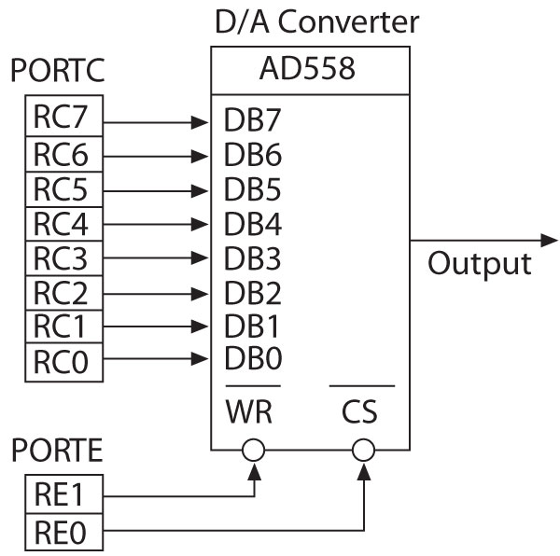
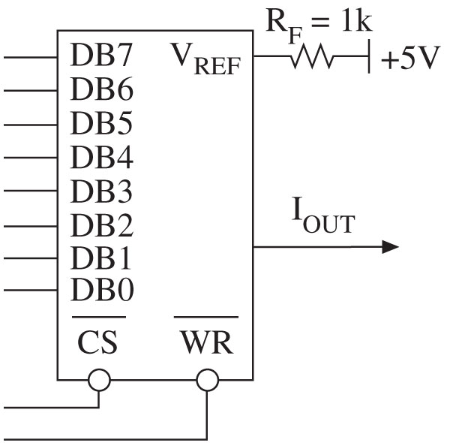

IC D/A Converters
330_12

