Slide 1
Serial I/O
ELEC 330
Digital Systems Engineering
Dr. Ron Hayne
Images Courtesy of Ramesh Gaonkar and Delmar Learning
Notes:
ELEC 330

Slide 2
Serial I/O
Serial I/O (Communication)
  One bit transferred at a time
  Over one line
To transmit data serially
  Microcontroller must convert its parallel word into a stream of serial bits
    Parallel-to-serial conversion
To receive data serially
  Microcontroller must convert a stream of serial bits into a parallel word
    Serial-to-parallel conversion
330_13

Slide 3
Basic Concepts
Transmission issues
  Synchronous vs Asynchronous
  Simplex vs Duplex
  Data Rate
  Errors and Error Checks
  Standards and Protocol
330_13

Slide 4
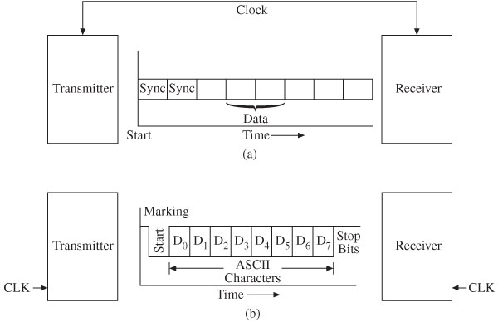
Synchronous vs Asynchronous
330_13

Slide 5
Simplex vs Duplex
Simplex
  Data flow in only one direction
    Such as from a PC to its peripheral
Full duplex
  Data flow in both directions simultaneously
    Such as a telephone conversation or communication via a modem
Half duplex
  Data flow in both directions, only one direction at a time
    Such as a conversation over a CB radio
330_13

Slide 6
Rate of Transmission
Baud and bits per second (BPS)
  Baud is a measure of the “signaling rate”
    Number of changes to the transmission medium per second in a modulated signal
  At slow speeds
    Only one bit of information is encoded in each electrical change
    Baud and bits per second are equal
  At higher speeds
    Multiple bits are encoded in one electrical change
    Generally expressed in bits per second (bps)
330_13

Slide 7
Transmission Errors
Framing error
  Start and Stop bits improperly frame a character
  Recognized when the Stop bit is zero
    Expected to be one
  Flag in control register
Overrun error
  New byte overwrites the earlier byte
    Before the receiver completes reading
  Flag in control register
330_13

Slide 8
Error Checks
Parity
  Last bit is used as a parity bit
  Either an even or odd number of 1s
CheckSum
  Used when blocks of data are transmitted
  All bytes transmitted are XORed
    Sent as the last byte
Receiver recalculates Parity or CheckSum
  Compares to the one transmitted
  No match generates an error
330_13

Slide 9
Standards and Protocols
EIA-232 (formerly known as RS-232)
Serial Peripheral Interface (SPI )
Inter-Integrated Circuit (I²C)
One-wire (1-Wire®) Bus
Controller Area Network Bus (CAN)
Local Interconnect Network (LIN)
330_13

Slide 10
PIC18 Serial Communications
Includes two serial communication modules
  Universal Synchronous Asynchronous Receiver Transmitter (USART)
    Implements EIA-232
    Also known as Serial Communications Interface (SCI)
  Master Synchronous Serial Port (MSSP)
    Also known as Serial Peripheral Interface (SPI)
    Also implements I²C mode
330_13

Slide 11
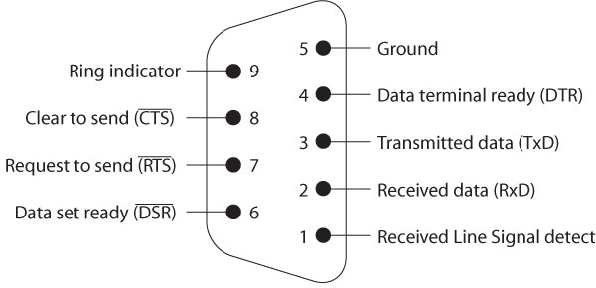
EIA-232 Serial I/O Standard
Negative logic
  Logic 1: –3 V to –25 V or Mark
  Logic 0: +3 V to + 25 V or Space
Connector
  DB25 subminiature
    Twenty-five pins
  DB9 connector
    Nine pins
330_13

Slide 12
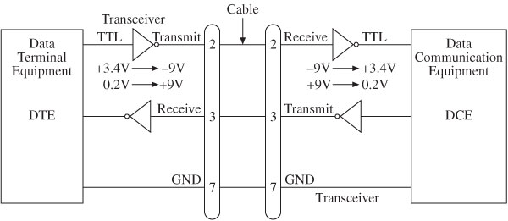
EIA-232 Serial I/O Standard
EIA 232 DTE and DCE Minimum Connection
330_13

Slide 13
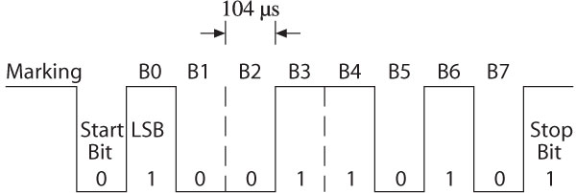
Framing
ASCII Character Y (59H) – 9600 BAUD
330_13

Slide 14
PIC18 USART Module
Configuration Modes
  Asynchronous
    Full duplex
    PC serial communication
      EIA-232 protocol
  Synchronous
    Master or slave half duplex
    Used to communicate with peripherals
      A/D and D/A converters
      Serial EEPROM
330_13

Slide 15
PIC18 USART Module
Control Registers
  SPBRG
    Baud Rate Generator
  TXSTA
    Transmit Status and Control
  RCSTA
    Receive Status and Control
  BAUDCON
    Baud Rate Control
330_13

Slide 16
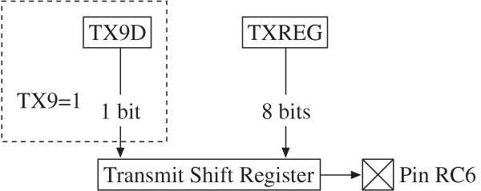
USART Transmission
330_13

Slide 17
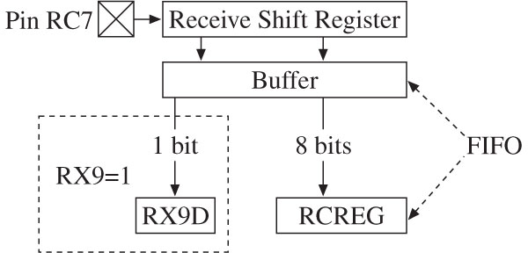
USART Reception
330_13

Slide 18
Interrupts
PIE1
  TXIE (Bit4)
    Transmit Interrupt Enable
  RCIE (Bit5)
    Receive Interrupt Enable
PIR1
  TXIF (Bit4)
    Transmit Interrupt Flag
      Bit is 1 when TXREG (Transmit Register) is empty
  RCIF (Bit5)
    Receive Interrupt Flag
      Bit is 1 when RCREG (Receive Register) is full
330_13

Slide 19
Master Synchronous Serial Port
Master Synchronous Serial Port (MSSP)
  Serial interface used in communicating with other peripheral devices
Can operate in one of two modes
  Serial Peripheral Interface (SPI)
  Inter-Integrated Circuit (I²C)
330_13

Slide 20
Serial Peripheral Interface (SPI)
Serial synchronous data exchange protocol
  High-speed serial communication
    Between a microcontroller and its peripheral devices
    Between a master and a slave device
    EEPROMs, data converters, and display drivers
  Four-wire Interface
    Clock, data in, data out, and slave select
  Synchronous protocol
    Clock signal is provided and controlled by the master device
  Master-Slave protocol
    Can communicate with multiple slave devices
  Data Exchange protocol
    Each device has two data lines
330_13

Slide 21
MSSP: SPI Mode
Transmits and receives data simultaneously
Uses following pins
  Serial Data Out (SDO)
    pin RC5/SDO on PORTC
  Serial Data In (SDI)
    pin RC4/SDI/SDA on PORTC
  Serial Clock (SCK)
    pin RC3/SCK/SCL on PORTC
  Slave Select (/SS)
    Available pin on a PORT
Internal Registers
  SSPSR (Shift Register)
  SSPBUF (Buffer Register)
330_13

Slide 22
SPI Mode
Write and Read operations
  Must be performed for each byte
    Some of data bytes may not have any use in a given application
  Transmission
    Master sends data and receives dummy data from slave device
  Transmission and Reception
    Both exchange data
  Reception
    Master receives data and sends dummy data to slave device
330_13

Slide 23
SPI Applications
SPI-compatible peripherals include
  Converters (ADC and DAC)
  Memories (EEPROM and Flash)
  Sensors (temperature and pressure)
  Real Time Clock (RTC)
  Display (LCD)
  Shift registers
Master-slave configuration
  One master device and multiple slave devices
330_13

Slide 24
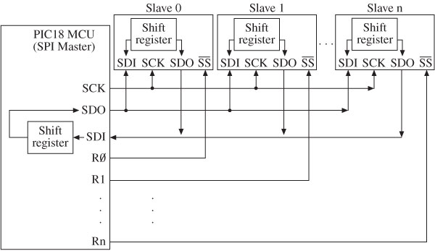
Master and Multiple
Independent Slave Connection
330_13

Slide 25
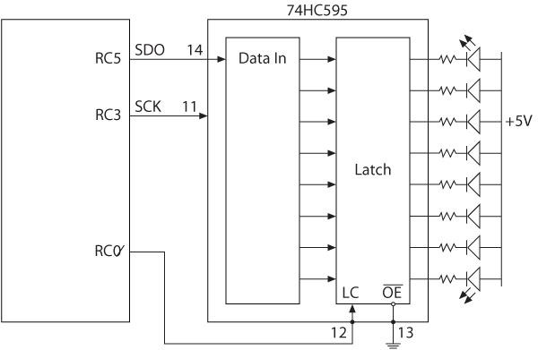
Example
Interfacing 74HC – Shift Register in SPI Mode
330_13

Slide 26
Inter-integrated Circuit Protocol
Inter-integrated Circuit (I²C)
  Two-wire interface
    Two open drain/collector lines
    One for clock and one for data
  Synchronous
    Data are transferred with a synchronous clock initiated by the master device
    Rate of data transfer is 100 kbps in standard mode
      400 kbps in fast mode
  Master/Slave or Many Masters
    Bus may have one master and many slaves or multiple masters
330_13

Slide 27
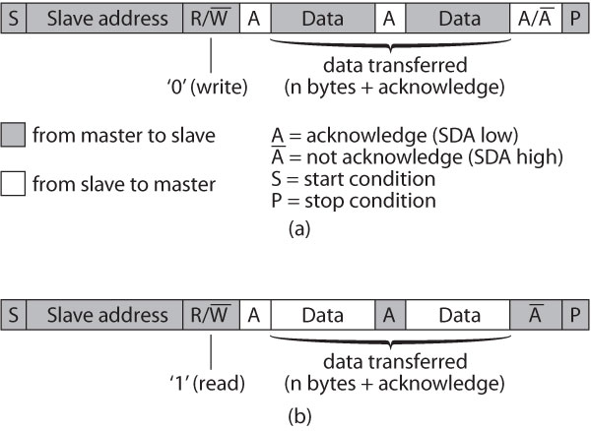
I²C Protocol
330_13

Slide 28
MSSP: I²C Mode
Implements all master and slave functions
  Provides interrupts on Start and Stop bits
Uses the following pins
  SCL (Serial Clock)
    pin RC3/SCK/SCL on PORTC
  SDA (Serial Data)
    pin RC4/SDI/SDA on PORTC
Internal Registers
  SSPSR (Shift Register)
  SSPBUF (Buffer Register)
  SSPADD (Address Register)
330_13

