Slide 1
Microwave Oven Controller
ELEC 330
Digital Systems Engineering
Dr. Ron Hayne
Notes:
ELEC 330

Slide 2
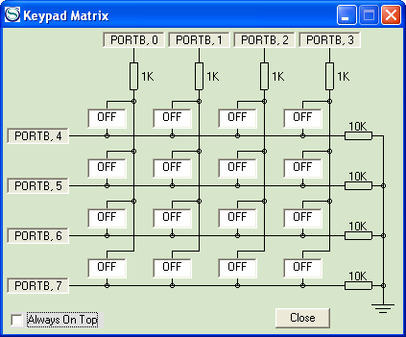
Microwave Oven Controller
Inputs (Keypad Matrix)
  Single digit to set cooking time in 10s of seconds
  Control switches for Start (F), Stop (A), and Door (B)
1
2
3
C
4
5
6
D
7
8
9
E
A
0
B
F
330_Project
Notes:
ELEC 330

Slide 3
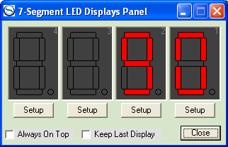
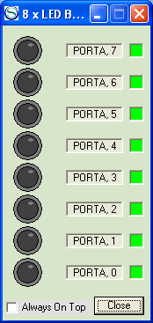
Microwave Oven Controller
Outputs
  Time - two digits (seconds) on 7-segment displays
  Magnetron - LED (RA1) indicates active or inactive
  Buzzer - LED (RA0) indicates cook cycle finished or not
Magnetron
Buzzer
330_Project
Notes:
ELEC 330

Slide 4
Normal Operation
User Input
  Read Cook Time
  Display Cook Time
  Wait for Start
Cooking
  Count down Seconds
  Light Magnetron
Cooking (cont)
  Monitor Door
    Pause if Open
  Monitor Stop
    Terminate cycle
Done
  Activate Buzzer
  Wait for Door Open
330_Project
Notes:
ELEC 330

Slide 5
Demo
1
2
3
4
5
6
7
8
9
Stop
Door
Start
A
0
B
F
Magnetron
Buzzer
330_Project
Notes:
ELEC 330

Slide 6
Hints
Use KEYCHK Subroutine (IP9-7) to interface with the Matrix Keypad
  Input Time
  Control Switches
Use Timer0 to count seconds
  Interrupt Service Routine (Ex11-2)
Count seconds in BCD
  Correctly decrement BCD by testing for LSD = 0
  Use OUTLED Subroutine (IP9-3) to convert BCD digits and output to 7-segment displays
330_Project
Notes:
ELEC 330

Slide 7
Suggestions
Don't Procrastinate
  Due Dates
Use Text and Notes
  Chapter 9 is key
Finish Flow Charts
  Then Start Programming
Resources Provided
  Top-Level Flowchart
  Program Template
Teams of 2 persons
330_Project
Notes:
ELEC 330

