Slide 1
Introduction
ELEC 418
Advanced Digital Systems
Dr. Ron Hayne
Images Courtesy of Thomson Engineering
Notes:
ELEC 418

Slide 2
Admin
Course materials available online
http://ece.citadel.edu/hayne/
  Students are encouraged to print lecture slides in advance and use them to take notes in class
418_01
Notes:
ELEC 418

Slide 3
Homework
Xilinx ISE
  Xilinx ISE WebPACK VHDL Tutorial
    Review from ELEC 311
      Up to UCF File Creation
  Xilinx ISE Simlulator (ISim) Tutorial
    VHDL Simulator for ELEC 418
    Will Need for Project 1
418_01
Notes:
ELEC 418

Slide 4
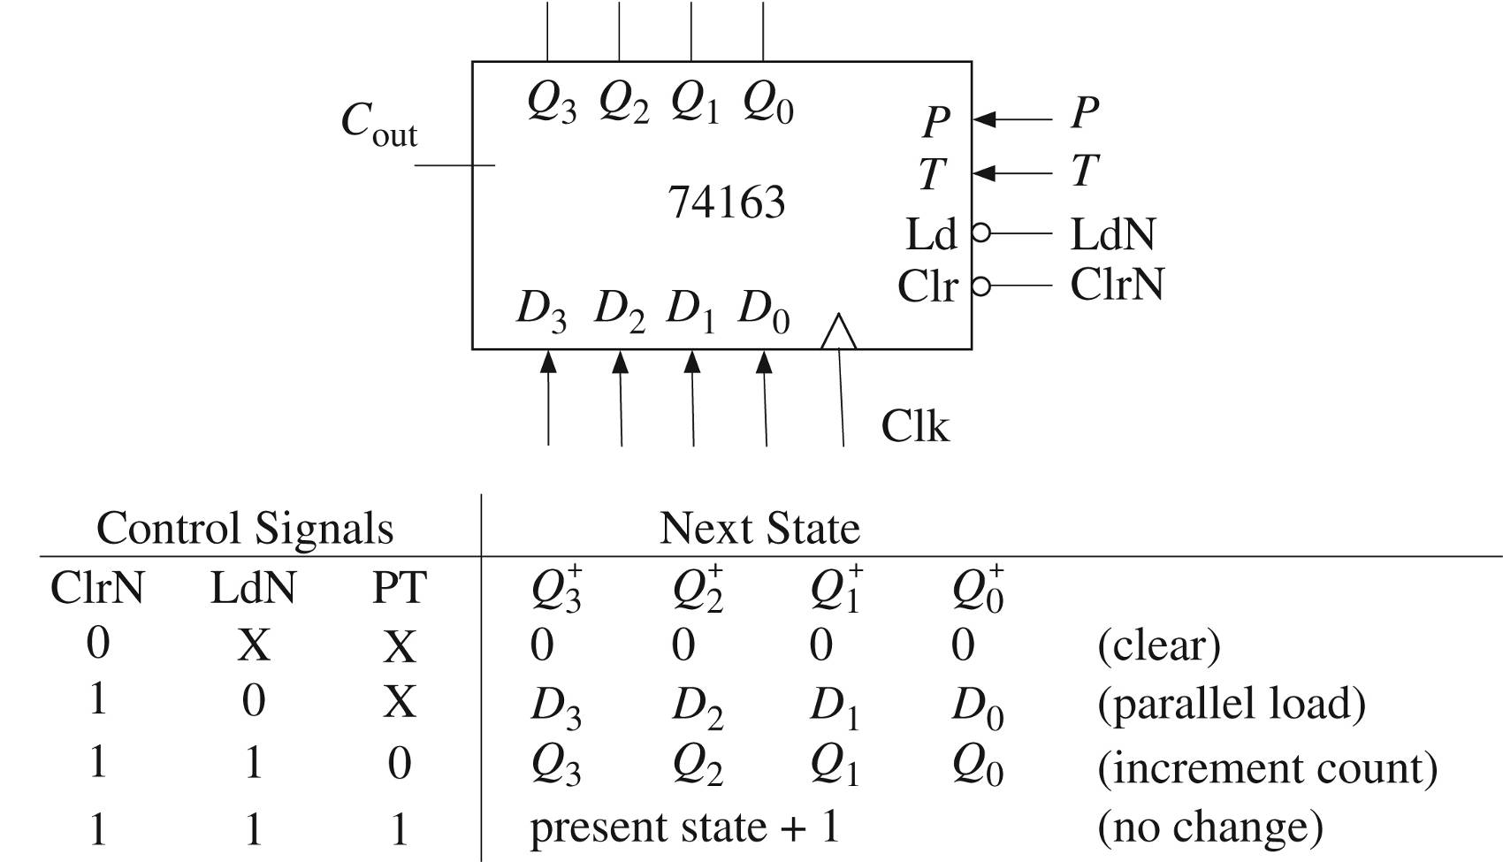
VHDL Counter Example
(clear)
(parallel load)
(no change)
(increment count)
418_01
Notes:
ELEC 418

Slide 5
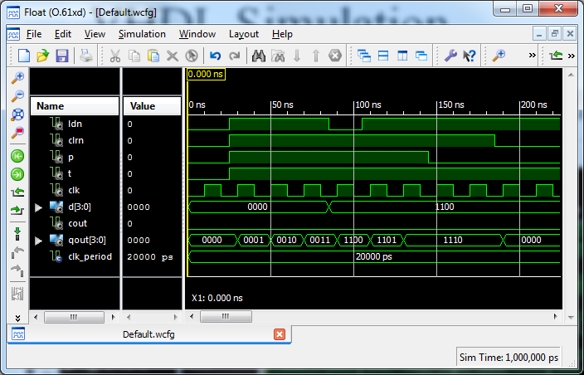
VHDL Simulation (ISim)
418_01
Notes:
ELEC 418

Slide 6
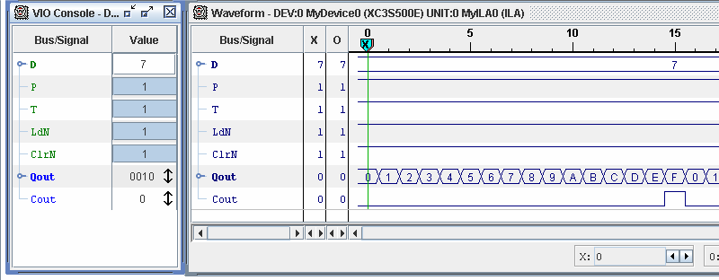
Hardware Demonstration
418_01
Notes:
ELEC 418

Slide 7

Questions?
418_01
Notes:
ELEC 418

Slide 8
Review of Logic Design
Chapter 1
  Combinational Logic
  Boolean Algebra
  Flip-Flops and Latches
  Sequential Circuit Design
  Tristate Logic and Busses
418_01
Notes:
ELEC 418

Slide 9
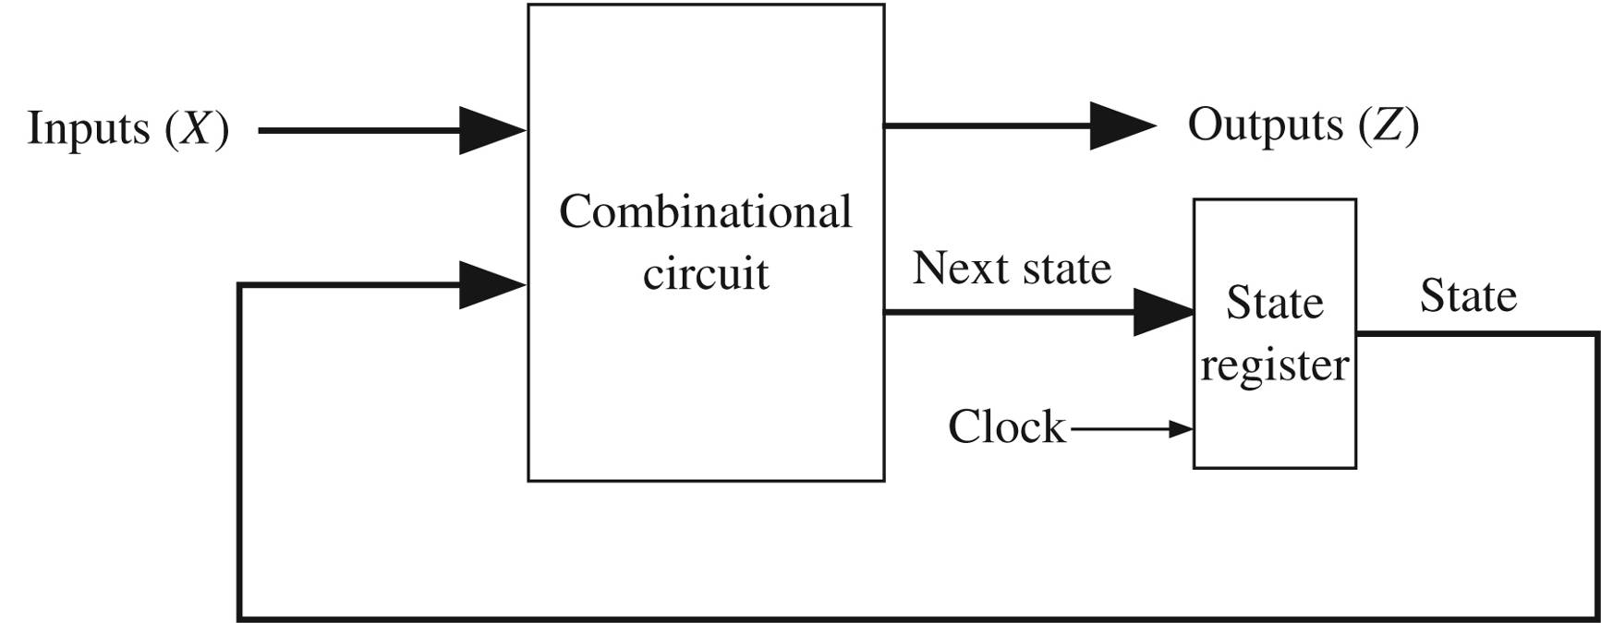
Sequential Circuit Design
Moore
  Z = f (Q)
Mealy
  Z = f (X, Q)
(Q)
418_01
Notes:
ELEC 418

Slide 10
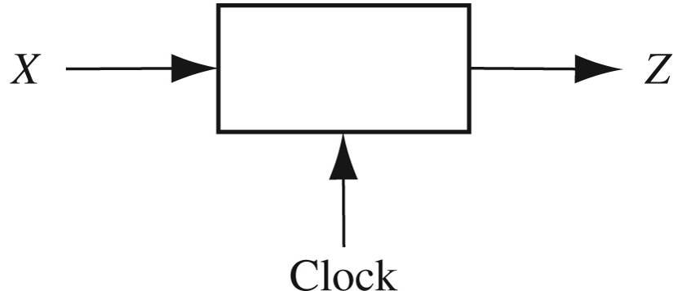
Design Example
Sequence Detector
  The circuit will examine a string of 0's and 1's applied to the X input and generate an output
  Z = 1 only when the input sequence ends in 1 0 1
  Typical Sequence
    X = 0 0 1 1 0 1 1 0 0 1 0 1 0 1 0 0
    Z = 0 0 0 0 0 1 0 0 0 0 0 1 0 1 0 0
418_01
Notes:
ELEC 418

Slide 11
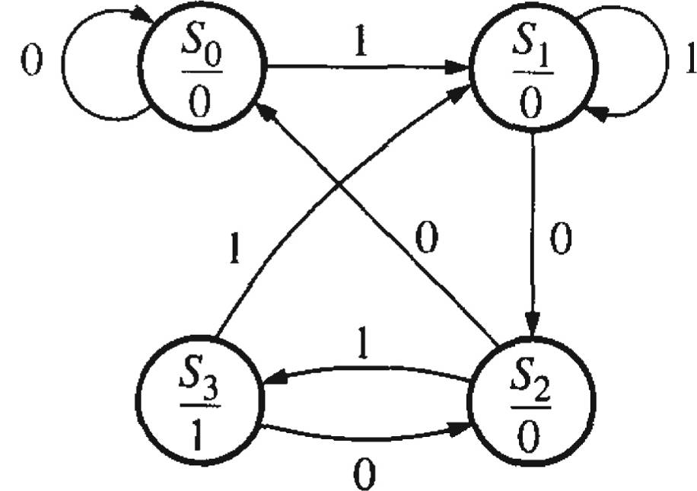
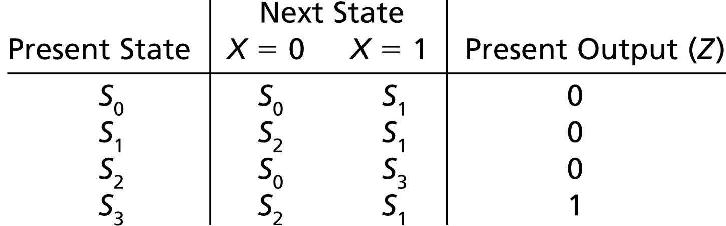
Moore State Graph & Table
418_01
Notes:
ELEC 418

Slide 12
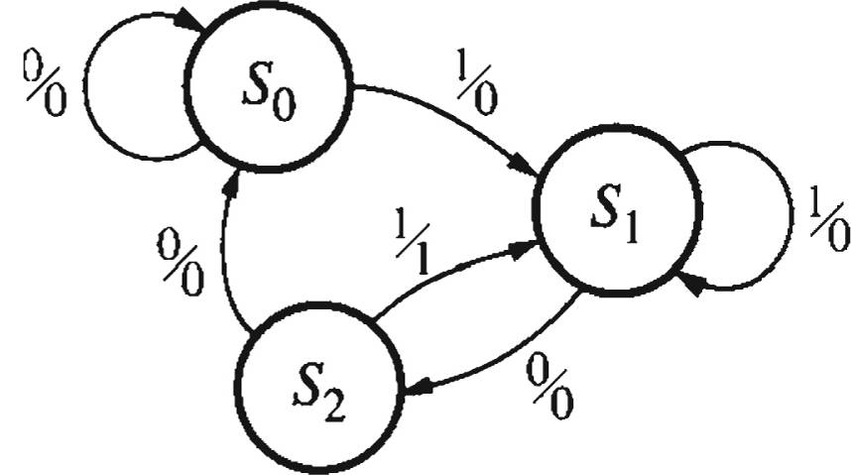
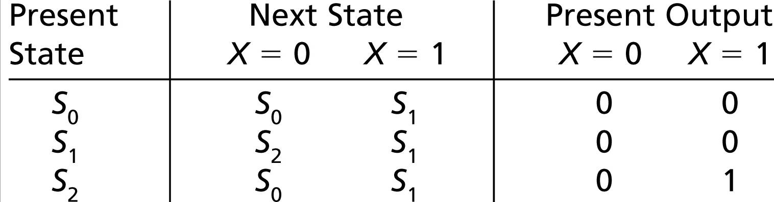
Mealy State Graph & Table
418_01
Notes:
ELEC 418

Slide 13
Summary
Admin
  Course Outline
  Grading
  Homework
Review of Logic Design
  Sequential Circuit Design
418_01
Notes:
ELEC 418

