Slide 1
VHDL
ELEC 418
Advanced Digital Systems
Dr. Ron Hayne
Images Courtesy of Thomson Engineering
Notes:
ELEC 418

Slide 2
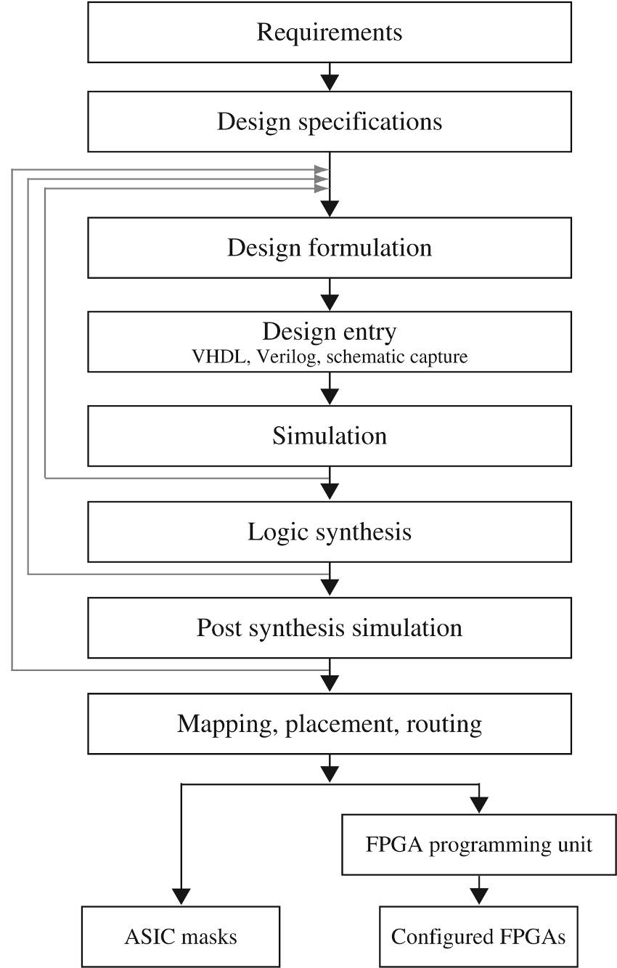
Design Flow
418_02
Notes:
ELEC 418

Slide 3
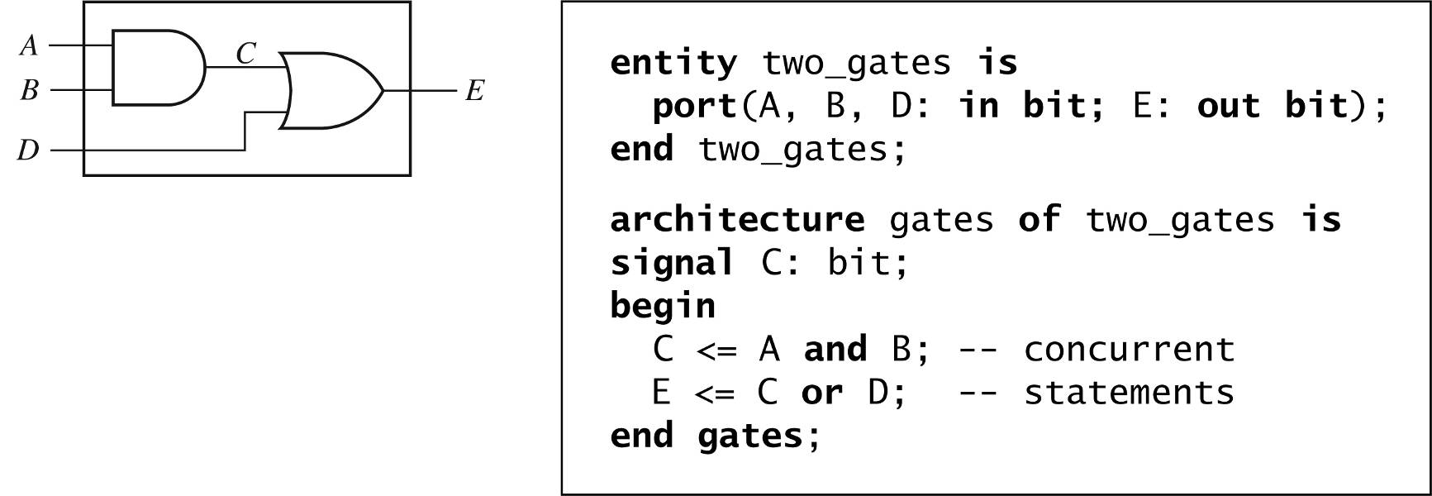
VHDL Modules
418_02
Notes:
ELEC 418

Slide 4
VHDL Libraries
library IEEE;
use IEEE.std_logic_1164.all;
  std_logic
    Single-bit signals
  std_logic_vector
    Multi-bit signals
418_02
Notes:
ELEC 418

Slide 5
Full Adder (Dataflow)
library IEEE;
use IEEE.STD_LOGIC_1164.ALL;
entity FullAdder is
port(X, Y, Cin: in std_logic; --Inputs
Cout, Sum: out std_logic); --Outputs
end FullAdder;
architecture Dataflow of FullAdder is
begin -- concurrent assignment statements
Sum <= X xor Y xor Cin after 2 ns;
Cout <= (X and Y) or (X and Cin) or (Y and Cin)
after 2 ns;
end Dataflow;
418_02
Notes:
ELEC 418

Slide 6
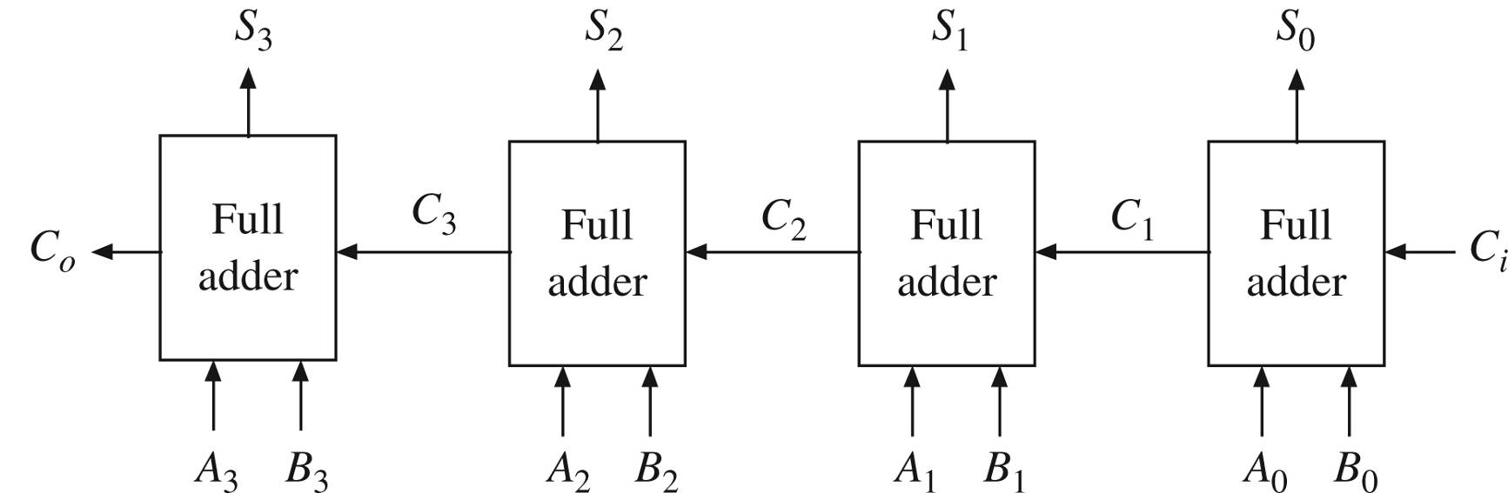
4-bit Ripple-Carry Adder
entity Adder4 is
port(A, B: in std_logic_vector(3 downto 0);
Ci: in std_logic;
S: out std_logic_vector(3 downto 0);
Co: out std_logic);
end Adder4;
418_02
Notes:
ELEC 418

Slide 7
4-bit Adder (Structural)
architecture Structure of Adder4 is
component FullAdder
port(X, Y, Cin: in std_logic; -- Inputs
Cout, Sum: out std_logic); -- Outputs
end component;
signal C: std_logic_vector(3 downto 1); -- internal
begin --instantiate four copies of the FullAdder
FA0: FullAdder port map(A(0),B(0),Ci,C(1),S(0));
FA1: FullAdder port map(A(1),B(1),C(1),C(2),S(1));
FA2: FullAdder port map(A(2),B(2),C(2),C(3),S(2));
FA3: FullAdder port map(A(3),B(3),C(3),Co,S(3));
end Structure;
418_02
Notes:
ELEC 418

Slide 8
VHDL Test Bench
constant PERIOD: time := 10 ns;
BEGIN
stim_proc: process
begin
wait for PERIOD;
A <= "0011";
B <= "0010";
Ci <= '0';
wait for PERIOD;
B <= "1110";
wait;
end process;
END;
418_02
Notes:
ELEC 418

Slide 9
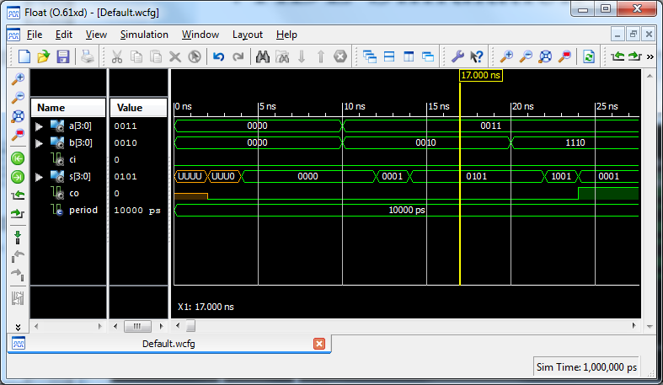
VHDL Simulation
418_02
Notes:
ELEC 418

Slide 10
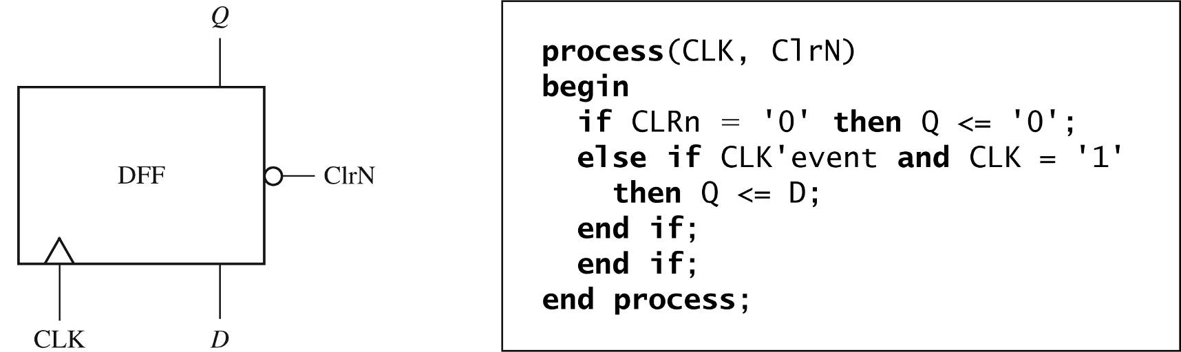
VHDL Processes (Behavioral)
D Flip-Flop with Asyncronous Clear
418_02
Notes:
ELEC 418

Slide 11
VHDL Data Types
Bit
  '0' or '1'
Bit_Vector
  "00", "01", "10", ...
Boolean
  FALSE or TRUE
Time
  integer with units
  fs, ps, ns, us, ms, ...
Integer
Real
Character
  'a', 'b', '1', '2', ...
Enumeration Type
  User defined
418_02
Notes:
ELEC 418

Slide 12
IEEE 1164 Standard Logic
9-Valued Logic System
  'U' Uninitialized
  'X' Forcing Unknown
  '0' Forcing 0
  '1' Forcing 1
  'Z' High Impedance
  'W' Weak Unknown
  'L' Weak 0
  'H' Weak 1
  '-' Don't Care
418_08
Notes:
ELEC 418

Slide 13
VHDL Operators
Logical
  and, or, nand, nor, xor
Relational
  =, /=, <, <=, >, >=
Shift
  sll, srl, sla, sra, rol, ror
Addition
  +, -
Concatenation
  &
Unary Sign
  +, -
Multiplication
  *, /, mod, rem
Miscellaneous
  not, abs, **
418_02
Notes:
ELEC 418

Slide 14
VHDL Synthesis Example
entity Q3 is
port(A, B, F, CLK: in std_logic;
G: out std_logic);
end Q3;
architecture circuit of Q3 is
signal C: std_logic;
begin
process(CLK)
begin
if rising_edge(CLK) then
C <= A and B; -- statement 1
G <= C or F; -- statement 2
end if;
end process;
end circuit;
418_02
Notes:
ELEC 418

Slide 15
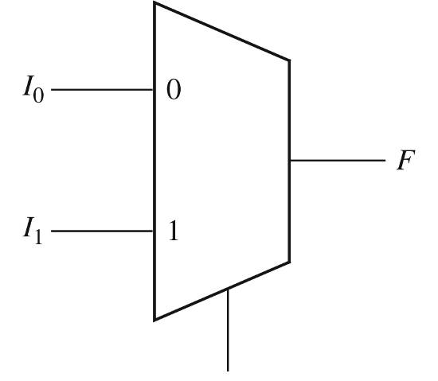
Multiplexers
entity MUX2to1 is
port(I1, I0, S: in std_logic;
F: out std_logic);
end MUX2to1;
architecture Dataflow of MUX2to1 is
begin
F <= I0 when S = '0' else I1;
end Dataflow;
S
418_02
Notes:
ELEC 418

Slide 16
Multiplexers
entity MUX4to1 is
port(I: in std_logic_vector(3 downto 0);
S: in std_logic_vector(1 downto 0);
F: out std_logic);
end MUX4to1;
architecture Dataflow of MUX4to1 is
begin
with S select
F <= I(0) when "00",
I(1) when "01",
I(2) when "10",
I(3) when "11";
end Dataflow;
418_02
Notes:
ELEC 418

Slide 17
VHDL Libraries
library IEEE;
use IEEE.std_logic_1164.all;
  Types std_logic and std_logic_vector
use IEEE.std_logic_unsigned.all;
  Overloaded operators
  Conversion functions
418_02
Notes:
ELEC 418

Slide 18
4-bit Adder (Overload)
library IEEE;
use IEEE.std_logic_1164.all;
use IEEE.std_logic_unsigned.all;
entity Adder4 is
port(A, B: in std_logic_vector(3 downto 0);
Ci: in std_logic;
S: out std_logic_vector(3 downto 0);
Co: out std_logic);
end Adder4;
418_02
Notes:
ELEC 418

Slide 19
4-bit Adder (Overload)
architecture Overload of Adder4 is
signal Sum5: std_logic_vector(4 downto 0);
begin
Sum5 <= ('0' & A) + (‘0’ & B) + (“0000” & Ci);
S <= Sum5(3 downto 0);
Co <= Sum5(4);
end Overload;
418_02
Notes:
ELEC 418

Slide 20
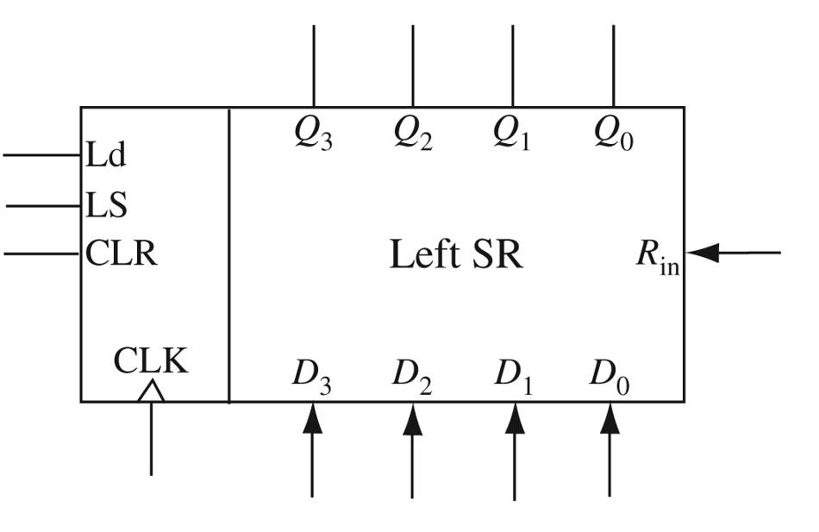
Shift Register
Left Shift Register
  Synchronous Clear and Load
418_02
Notes:
ELEC 418

Slide 21
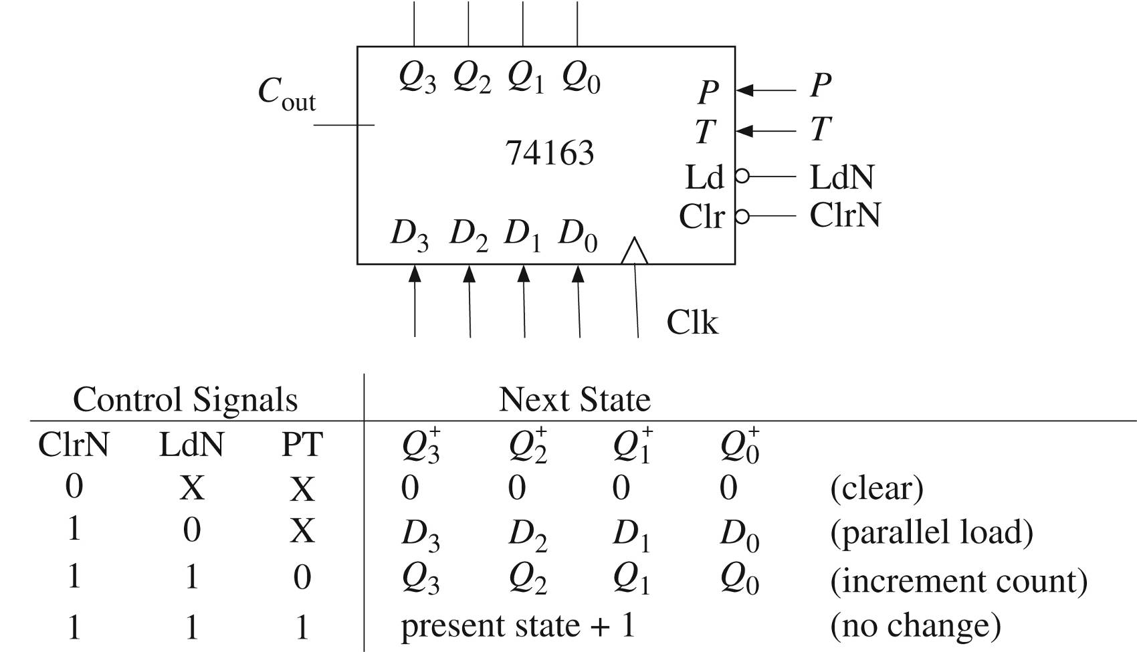
74163 Binary Counter
(clear)
(parallel load)
(no change)
(increment count)
418_02
Notes:
ELEC 418

Slide 22
VHDL Counter (Behavioral)
-- 74163 FULLY SYNCHRONOUS COUNTER
library IEEE;
use IEEE.std_logic_1164.all;
use IEEE.std_logic_unsigned.all;
entity Counter74163 is
port(LdN, ClrN, P, T, Clk: in std_logic;
D: in std_logic_vector(3 downto 0);
Cout: out std_logic;
Qout: out std_logic_vector(3 downto 0));
end Counter74163;
418_02
Notes:
ELEC 418

Slide 23
VHDL Counter (Behavioral)
architecture Behave of Counter74163 is
signal Q: std_logic_vector(3 downto 0) := "0000";
begin
process(Clk)
begin
if rising_edge(Clk) then
if ClrN = '0' then Q <= "0000";
elsif LdN = '0' then Q <= D;
elsif (P and T) = '1' then Q <= Q + 1;
end if;
end if;
end process;
Qout <= Q;
Cout <= '1' when Q = "1111" and T = '1' else '0';
end Behave;
418_02
Notes:
ELEC 418

Slide 24
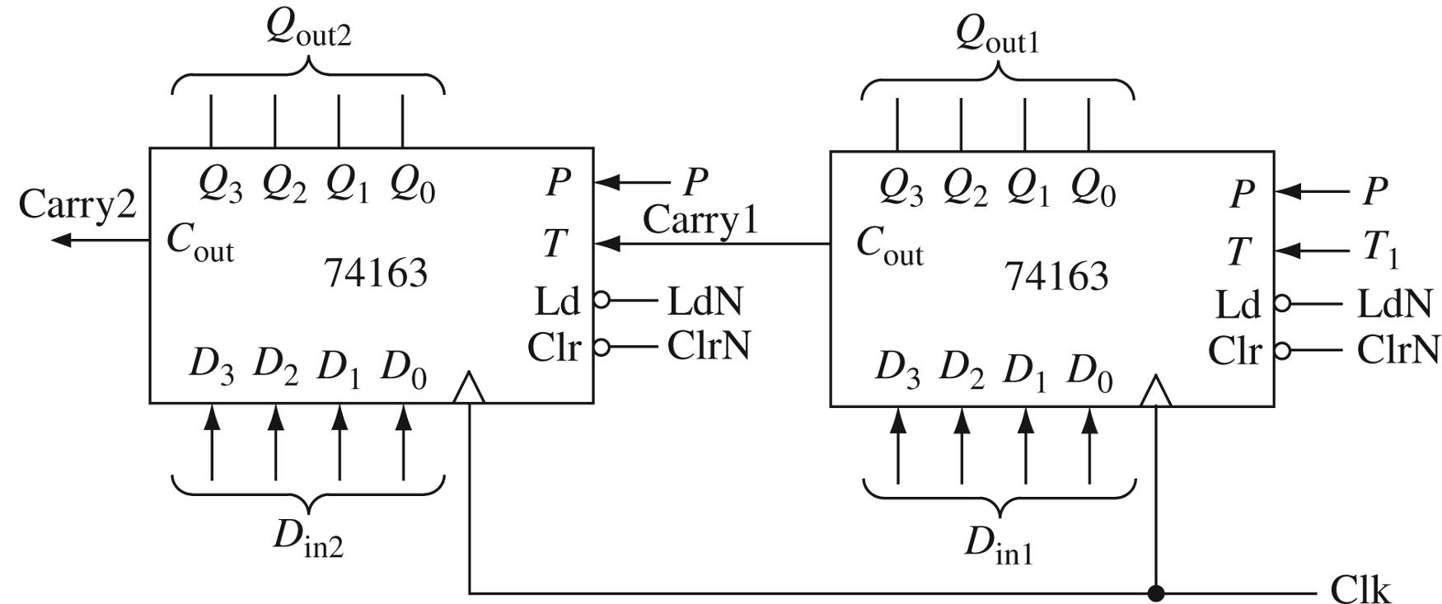
8-bit Counter
418_02
Notes:
ELEC 418

Slide 25
VHDL Counter (Structural)
library IEEE;
use IEEE.std_logic_1164.all;
entity Eight_Bit_Counter is
port(ClrN, LdN, P, T1, Clk: in std_logic;
Din1, Din2: in std_logic_vector(3 downto 0);
Qout: out std_logic_vector(7 downto 0);
Carry2: out std_logic);
end Eight_Bit_Counter;
418_02
Notes:
ELEC 418

Slide 26
VHDL Counter (Structural)
architecture Structure of Eight_Bit_Counter is
component Counter74163 is
port(LdN, ClrN, P, T, Clk: in std_logic;
D: in std_logic_vector(3 downto 0);
Cout: out std_logic;
Qout: out std_logic_vector(3 downto 0));
end component;
signal Carry1: std_logic;
signal Qout1, Qout2: std_logic_vector(3 downto 0);
418_02
Notes:
ELEC 418

Slide 27
VHDL Counter (Structural)
begin
ct1: Counter74163 port map(LdN,ClrN,P,T1,Clk,
Din1,Carry1,Qout1);
ct2: Counter74163 port map(LdN,ClrN,P,Carry1,Clk,
Din2, Carry2, Qout2);
Qout <= Qout2 & Qout1;
end Structure;
418_02
Notes:
ELEC 418

Slide 28
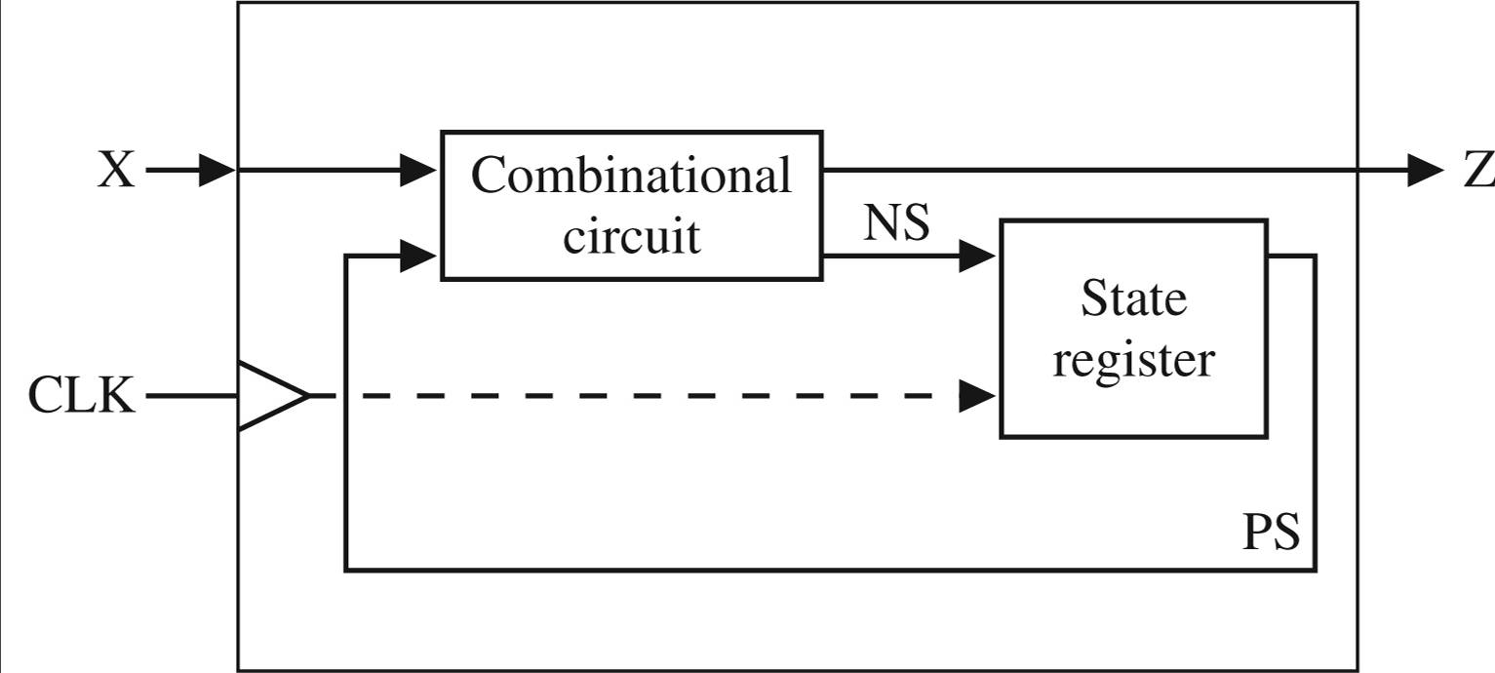
Sequential Machine
418_02
Notes:
ELEC 418

Slide 29
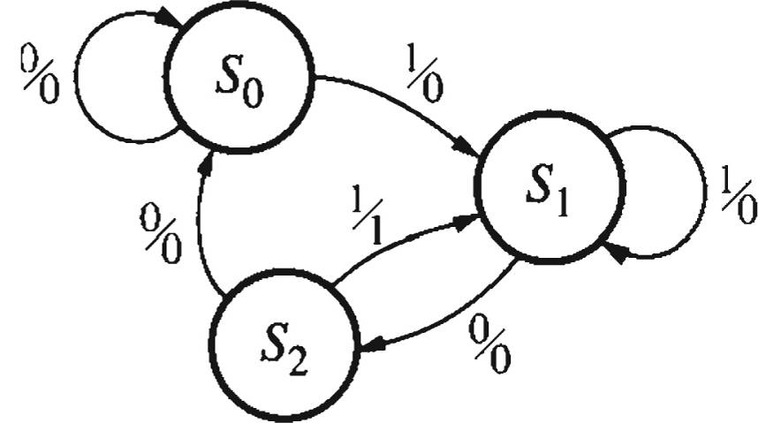
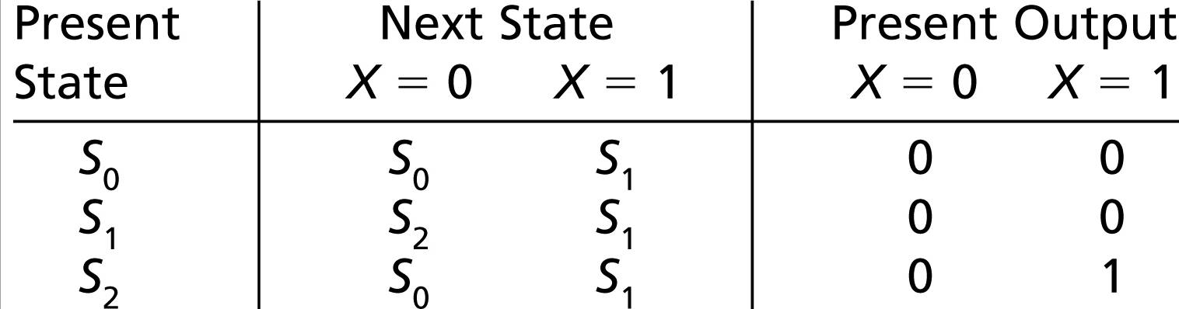
Sequential Machine
418_02
Notes:
ELEC 418

Slide 30
Behavioral Model
entity Sequence_Detector is
port(X, CLK: in std_logic;
Z: out std_logic);
end Sequence_Detector;
architecture Behave of Sequence_Detector is
signal State: integer range 0 to 2 := 0;
begin
process(CLK)
begin
if rising_edge(Clk) then
418_02
Notes:
ELEC 418

Slide 31
Behavioral Model
case State is
when 0 =>
if X = '0' then
State <= 0;
else
State <= 1;
end if;
when 1 =>
if X = '0' then
State <= 2;
else
State <= 1;
end if;
418_02
Notes:
ELEC 418

Slide 32
Behavioral Model
when 2 =>
if X = '0' then
State <= 0;
else
State <= 1;
end if;
end case;
end if;
end process;
Z <= '1' when (State = 2 and X = '1')
else '0';
end Behave;
418_02
Notes:
ELEC 418

Slide 33
Additional VHDL
Variables, Signals and Constants
Arrays
Loops
Assert and Report Statements
418_02
Notes:
ELEC 418

Slide 34
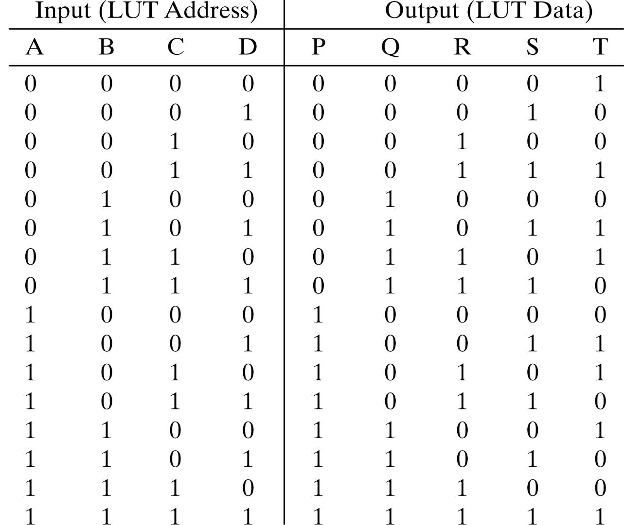
Look-Up Tables
418_02
Notes:
ELEC 418

Slide 35
Look-Up Tables
library IEEE;
use IEEE.std_logic_1164.all;
use IEEE.std_logic_unsigned.all;
entity Parity_Gen is
Port(X: in std_logic_vector(3 downto 0);
Y: out std_logic_vector(4 downto 0));
end Parity_Gen;
418_02
Notes:
ELEC 418

Slide 36
Look-Up Tables
architecture Table of Parity_Gen is
type OutTable is array(0 to 15) of std_logic;
signal ParityBit: std_logic;
constant OT: OutTable :=
('1','0','0','1','0','1','1','0',
'0','1','1','0','1','0','0','1');
begin
ParityBit <= OT(conv_integer(X));
Y <= X & ParityBit;
end Table;
418_02
Notes:
ELEC 418

Slide 37
4-bit Adder Test Bench
constant PERIOD: time := 10 ns;
-- Test vector arrays
constant N: integer := 4;
type arr1 is array(1 to N) of std_logic;
type arr2 is array(1 to N) of std_logic_vector(3 downto 0);
constant A_array: arr2:= ( "0011", "0011", "0011", "1101");
constant B_array: arr2 := ( "0010", "1110", "1101", "0010");
constant Ci_array: arr1 := ( '0', '0', '1', '0');
constant Co_array: arr1:= ('0', '1', '1', '0' );
constant S_array: arr2 := ( "0101", "0001", "0001", "1111");
418_02
Notes:
ELEC 418

Slide 38
4-bit Adder Test Bench
-- Stimulus process
stim_proc: process
begin
for i in 1 to N loop
A <= A_array(i);
B <= B_array(i);
Ci <= Ci_array(i);
wait for PERIOD;
assert (S = S_array(i) and Co = Co_array(i))
report "Wrong Answer"
severity error;
end loop;
report "Test Finished";
end process;
418_02
Notes:
ELEC 418

Slide 39
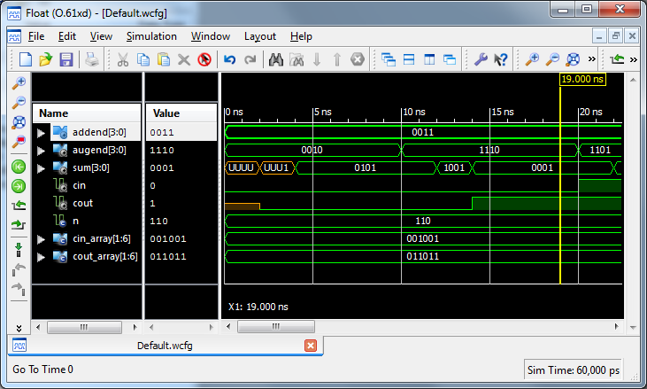
VHDL Simulation
418_02
Notes:
ELEC 418

Slide 40
VHDL Summary
Entity
Architecture
  Dataflow
  Structural
  Behavioral
Data Types and Operators
Synthesis
  Libraries
Simulation
  Test Benches
418_02
Notes:
ELEC 418

