Slide 1
Programmable Logic Devices
ELEC 418
Advanced Digital Systems
Dr. Ron Hayne
Images Courtesy of Thomson Engineering

Slide 2
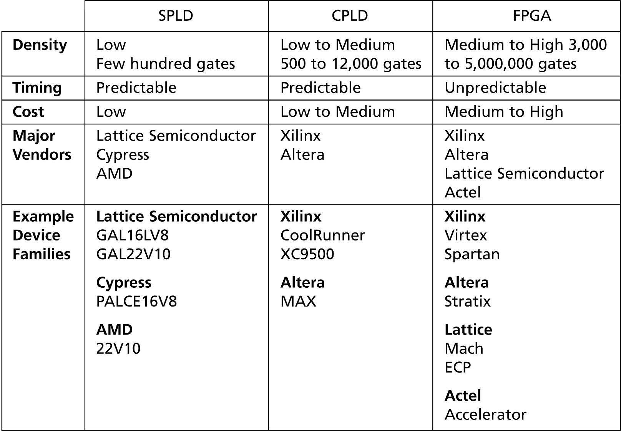
Programmable Logic Devices

Slide 3
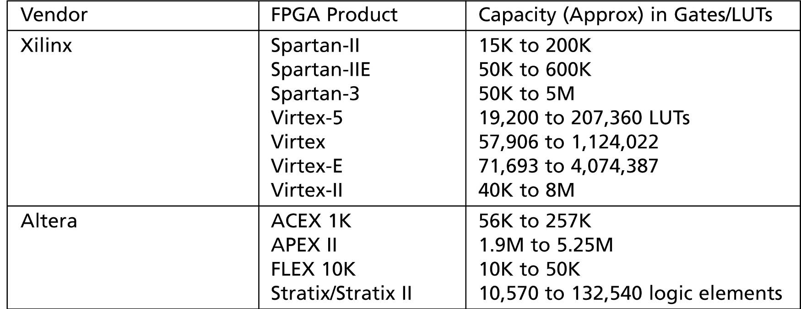
FPGAs
Field Programmable Gate Arrays

Slide 4
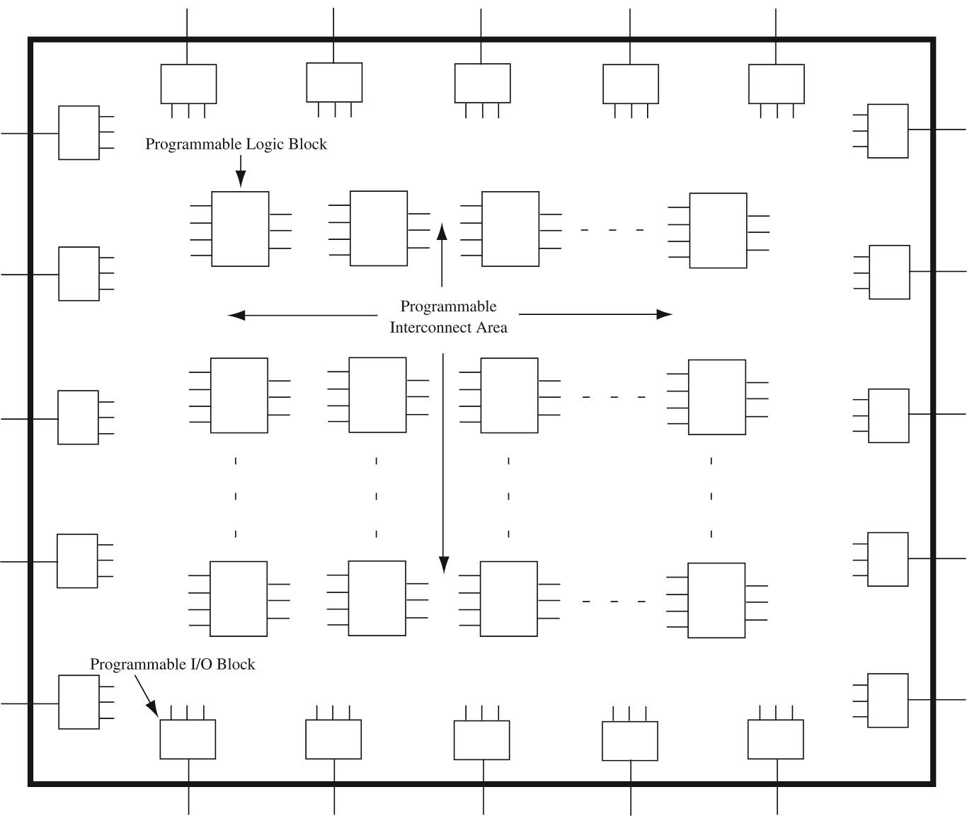
Organization of FPGAs

Slide 5
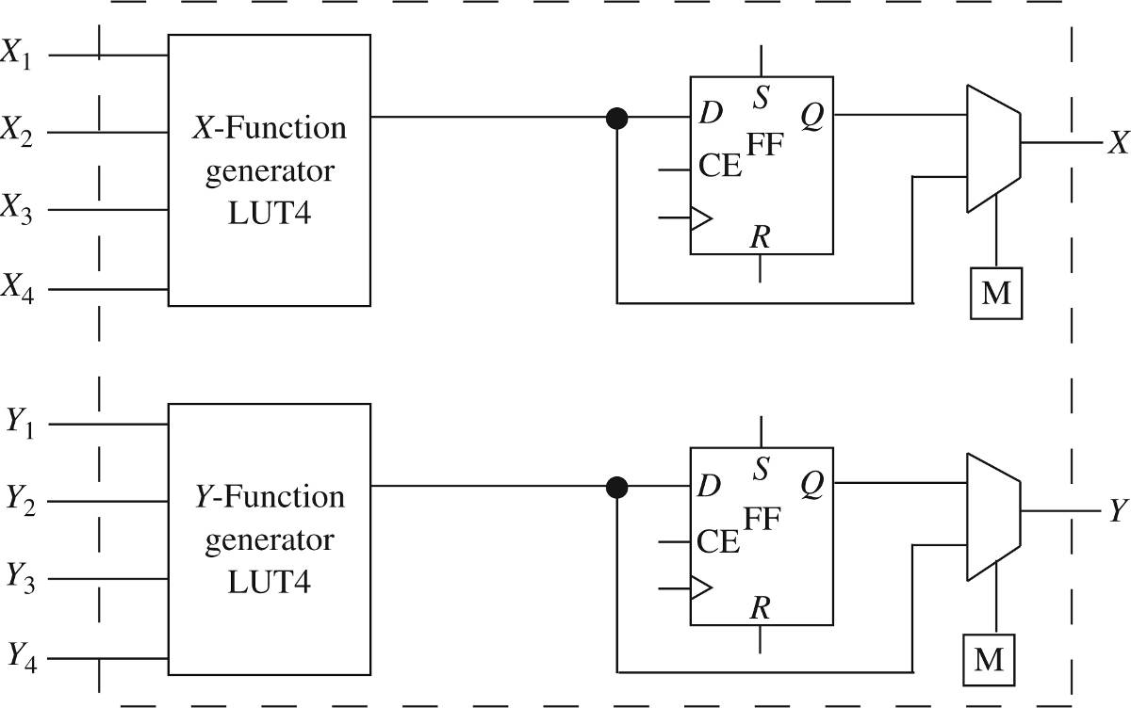
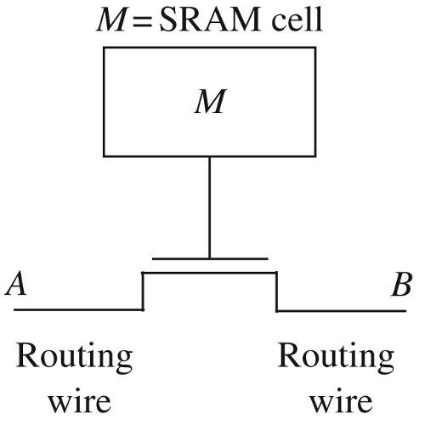
FPGA Programming
Programmable Interconnect
Programmable Logic Block

Slide 6
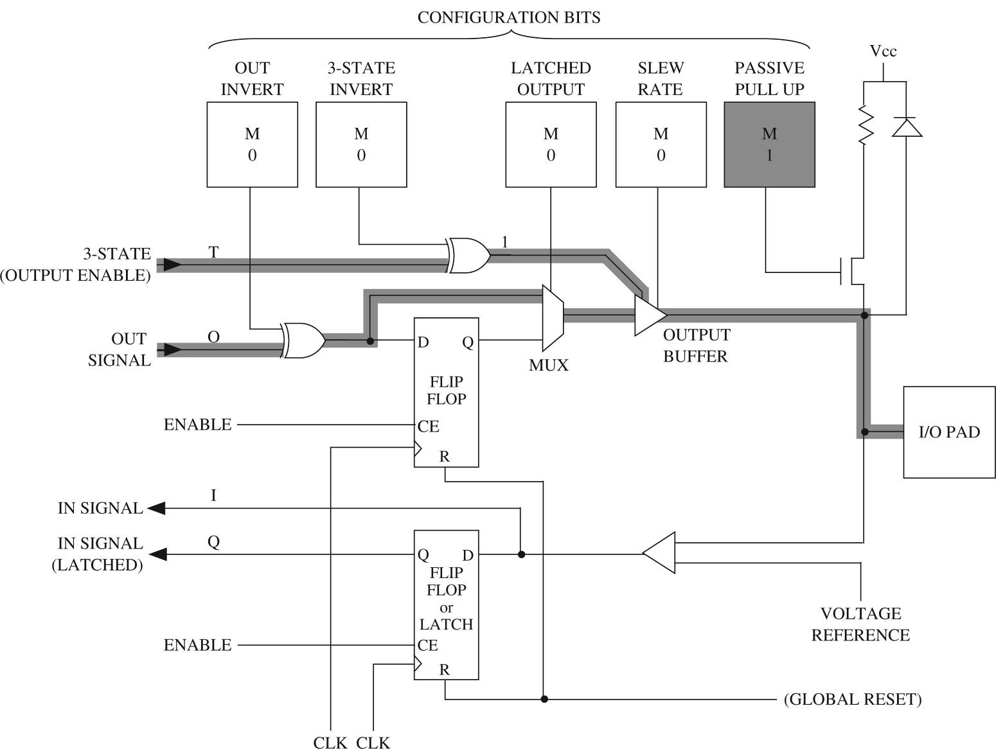
Programmable I/O Block

Slide 7
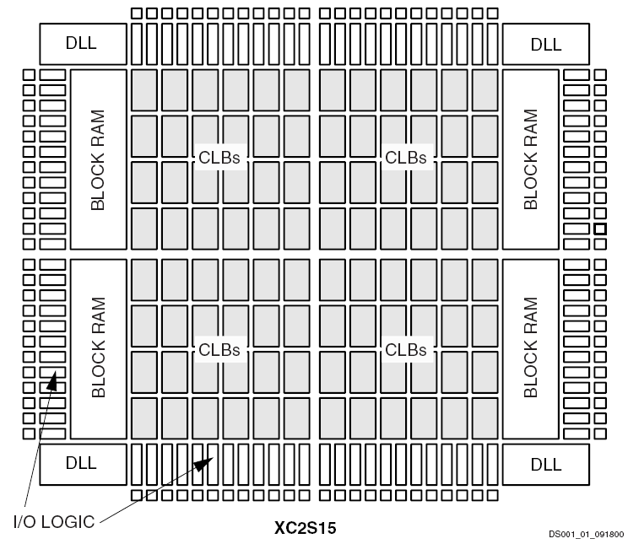
Spartan-II FPGA

Slide 8
Specialized Components
Dedicated Memory
  Block RAM
Dedicated Arithmetic Units
  Fast-Carry Logic
  Dedicated Multipliers
Embedded Processors
Digital Signal Processing Blocks

Slide 9
FPGA Applications
Rapid Prototyping
Medium-Speed Final Product
Reconfigurable Systems
Glue Logic
Hardware Accelerators

Slide 10
FPGA Design Flow
VHDL Model
VHDL Simulation
Synthesis
Mapping
Place and Route
Programming File
Configure and Test

Slide 11
Summary
FPGAs
  Programmable Interconnect
  Programmable Logic Block
  Programmable I/O Block
  Specialized Components
  Applications
  Design Flow

