Slide 1
Design Examples
ELEC 418
Advanced Digital Systems
Dr. Ron Hayne
Images Courtesy of Thomson Engineering
Notes:
ELEC 418

Slide 2
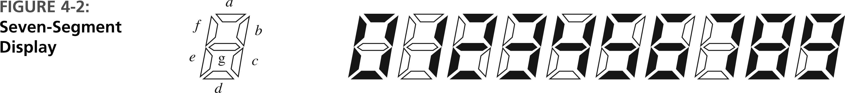
BCD to 7-Segment Display
418_04
Notes:
ELEC 418

Slide 3
BCD to 7-Segment Display
entity BCD_Seven is
port(BCD: in std_logic_vector(3 downto 0);
Seven: out std_logic_vector(7 downto 1));
end BCD_Seven;
architecture Behave of BCD_Seven is
begin
process(BCD)
begin
418_04
Notes:
ELEC 418

Slide 4
BCD to 7-Segment Display
case BCD is
when "0000" => Seven <= "0111111";
when "0001" => Seven <= "0000110";
when "0010" => Seven <= "1011011";
when "0011" => Seven <= "1001111";
when "0100" => Seven <= "1100110";
when "0101" => Seven <= "1101101";
when "0110" => Seven <= "1111101";
when "0111" => Seven <= "0000111";
when "1000" => Seven <= "1111111";
when "1001" => Seven <= "1101111";
when others => null;
end case;
end process;
end Behave;
418_04
Notes:
ELEC 418

Slide 5
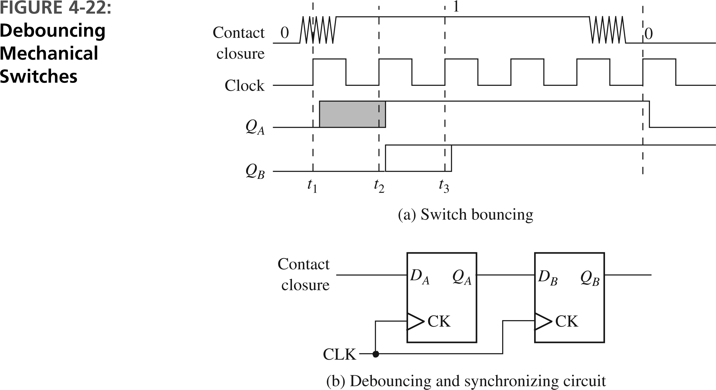
Synchronization & Debouncing
418_04
Notes:
ELEC 418

Slide 6
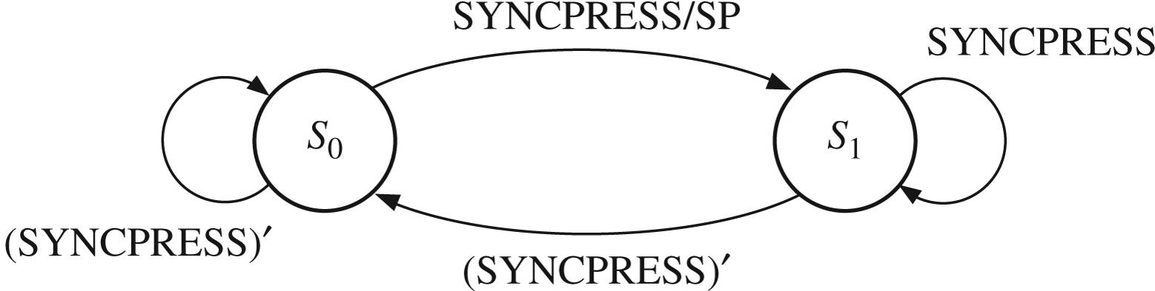
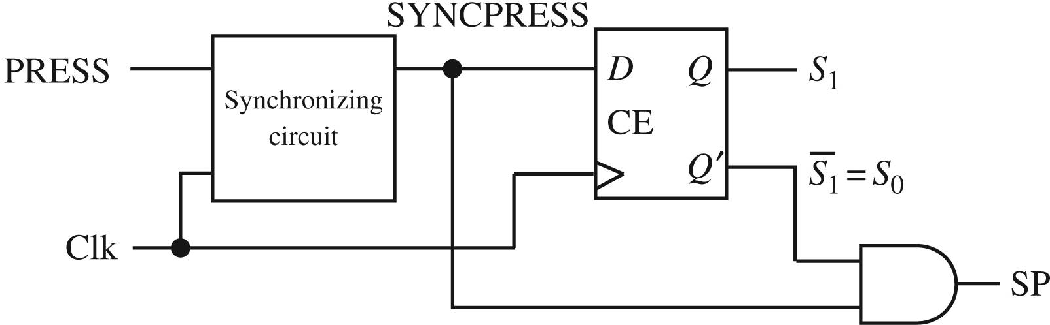
Single Pulser
418_04
Notes:
ELEC 418

Slide 7
Behavioral Model
entity PULSE is
port(SW, CLK: in std_logic;
SP: out std_logic);
end PULSE;
architecture Behave of PULSE is
signal Sync: std_logic_vector(2 downto 0) := "000";
begin
process(CLK)
begin
if rising_edge(CLK) then
Sync <= SW & Sync(2) & Sync(1);
end if;
end process;
SP <= Sync(1) and not Sync(0);
end Behave;
418_04
Notes:
ELEC 418

Slide 8
VHDL Test Bench
entity Pulse_Test is
end Pulse_Test;
architecture Behave of Pulse_Test is
component PULSE
port(SW, CLK: in std_logic;
SP: out std_logic);
end component;
signal SW, CLK: std_logic := '0';
signal SP: std_logic;
constant CLK_period: time := 100 ns;
begin
uut: PULSE port map(SW, CLK, SP);
418_04
Notes:
ELEC 418

Slide 9
VHDL Test Bench
tb : process
begin
wait for 48 ns;
SW <= '1'; wait for 1 ns;
SW <= '0'; wait for 1 ns;
SW <= '1'; wait for 1 ns;
SW <= '0'; wait for 1 ns;
SW <= '1'; wait for 1 ns;
SW <= '0'; wait for 1 ns;
SW <= '1'; wait for 1 ns;
SW <= '0'; wait for 1 ns;
SW <= '1'; wait for 1 ns;
SW <= '0'; wait for 1 ns;
SW <= '1'; wait for 1 ns;
SW <= '0'; wait for 1 ns;
SW <= '1'; wait for 485 ns;
SW <= '0'; wait for 1 ns;
SW <= '1'; wait for 1 ns;
SW <= '0'; wait for 1 ns;
SW <= '1'; wait for 1 ns;
SW <= '0'; wait for 1 ns;
SW <= '1'; wait for 1 ns;
SW <= '0'; wait for 1 ns;
SW <= '1'; wait for 1 ns;
SW <= '0'; wait for 1 ns;
SW <= '1'; wait for 1 ns;
SW <= '0';
wait;
end process;
end;
418_04
Notes:
ELEC 418

Slide 10
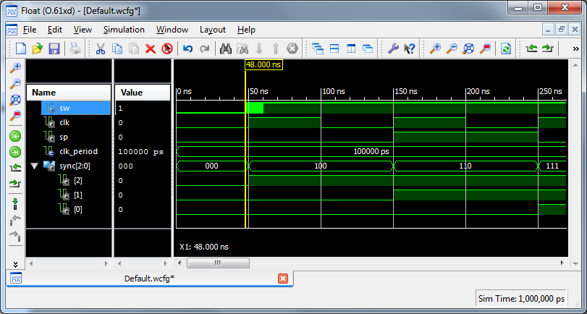
VHDL Simulation
418_04
Notes:
ELEC 418

Slide 11
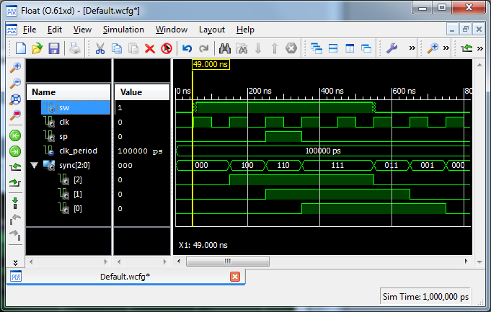
VHDL Simulation
418_04
Notes:
ELEC 418

Slide 12
Adders
Ripple-Carry Adder
  Concatenation of Full Adders
Carry Look-Ahead Adder
  Fast Adder
    Carry signals calculated in advance
Serial Adder
  Single Full Adder
    Shift and add one bit at a time
418_04
Notes:
ELEC 418

Slide 13
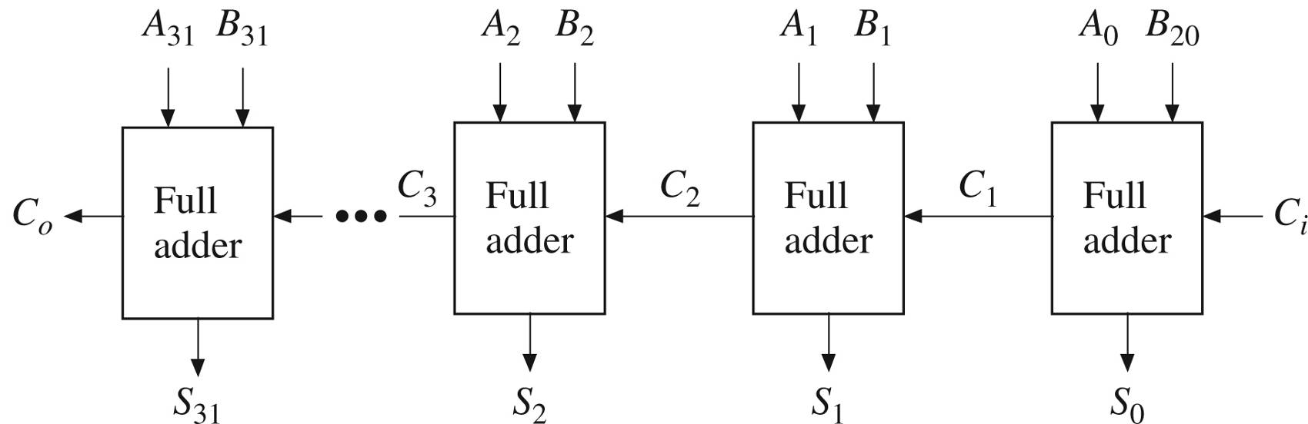
Ripple-Carry Adder
418_04
Notes:
ELEC 418

Slide 14
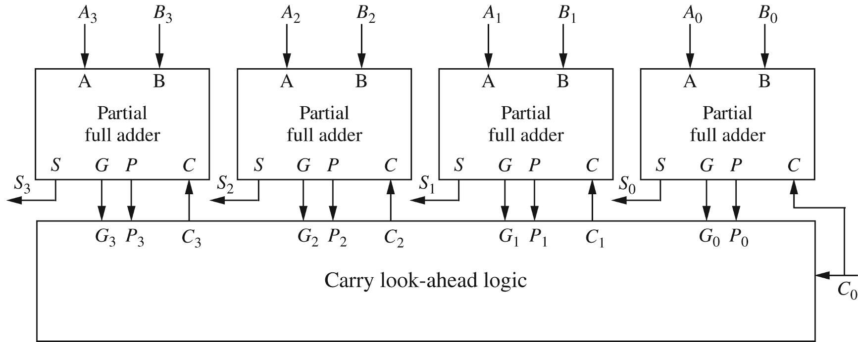
Carry Look-Ahead Adder
418_04
Notes:
ELEC 418

Slide 15
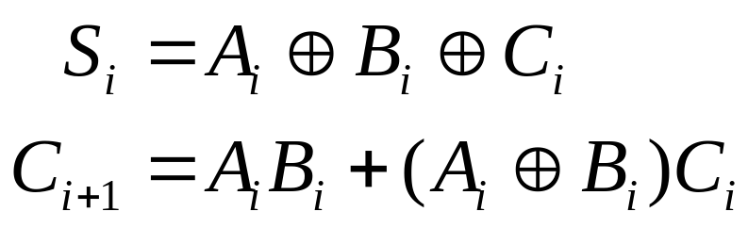
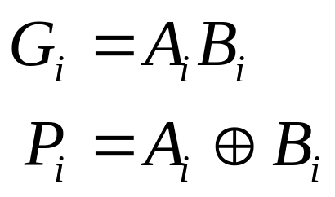
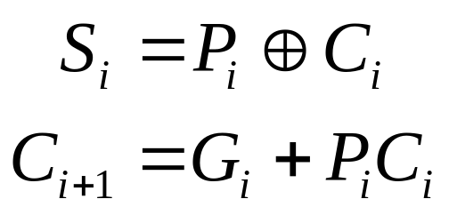
Carry Look-Ahead (CLA)
Generate (both 1)
Propagate (either 1)
418_04
Notes:
ELEC 418

Slide 16
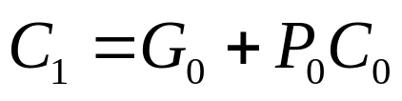
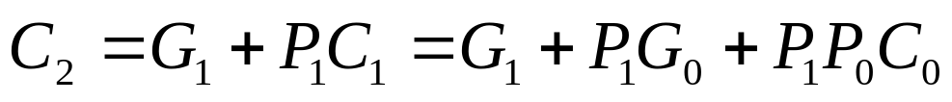
4-bit CLA Adder
Limited by fan-in
418_04
Notes:
ELEC 418

Slide 17
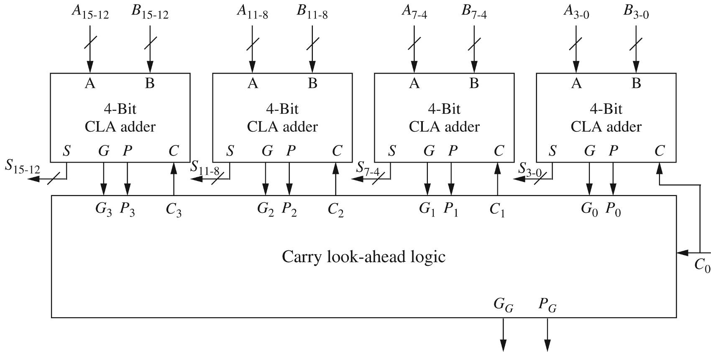
16-bit CLA Adder
418_04
Notes:
ELEC 418

Slide 18
16-bit CLA Adder
entity CLA16 is
port(A, B: in std_logic_vector(15 downto 0);
Ci: in std_logic;
S: out std_logic_vector(15 downto 0);
Co, PG, GG: out std_logic);
end CLA16;
418_04
Notes:
ELEC 418

Slide 19
16-bit CLA Adder
architecture Structure of CLA16 is
component CLA4
port(A, B: in std_logic_vector(3 downto 0);
Ci: in std_logic;
S: out std_logic_vector(3 downto 0);
Co, PG, GG: out std_logic);
end component;
component CLALogic is
port(G, P: in std_logic_vector(3 downto 0);
Ci: in std_logic;
C: out std_logic_vector(3 downto 1);
Co, PG, GG: out std_logic);
end component;
418_04
Notes:
ELEC 418

Slide 20
16-bit CLA Adder
signal G, P: std_logic_vector(3 downto 0);
signal C: std_logic_vector(3 downto 1);
begin
CarryLogic: CLALogic port map(G, P, Ci, C, Co, PG,
GG);
ADD0: CLA4 port map(A(3 downto 0), B(3 downto 0), Ci,
S(3 downto 0), open, P(0), G(0));
ADD1: CLA4 port map(A(7 downto 4), B(7 downto 4),
C(1), S(7 downto 4), open, P(1), G(1));
ADD2: CLA4 port map(A(11 downto 8), B(11 downto 8),
C(2), S(11 downto 8), open, P(2), G(2));
ADD3: CLA4 port map(A(15 downto 12), B(15 downto 12),
C(3), S(15 downto 12), open, P(3), G(3));
end Structure;
418_04
Notes:
ELEC 418

Slide 21
Behavioral Model
library IEEE;
use IEEE.std_logic_1164.all;
use IEEE.std_logic_unsigned.all;
entity Adder_Behave16 is
Port ( A : in std_logic_vector (15 downto 0);
B : in std_logic_vector (15 downto 0);
Ci : in std_logic;
S : out std_logic_vector (15 downto 0);
Co : out std_logic);
end Adder_Behave16;
418_04
Notes:
ELEC 418

Slide 22
Behavioral Model
architecture Behave of Adder_Behave16 is
signal sum17: std_logic_vector(16 downto 0);
begin
sum17 <= ('0' & A) + (‘0’ & B) + (X”0000” & Ci);
S <= sum17(15 downto 0);
Co <= sum17(16);
end Behave;
418_04
Notes:
ELEC 418

Slide 23
FPGA Synthesis Results
Adder Type | Ripple-Carry | CLA | Behavioral
Number of LUTs | 32 | 65 | 16
Combinational Path Delay (ns) | 22.7 | 12.5 | 7.6
Levels of Logic | 18 | 9 | 19
418_04
Notes:
ELEC 418

Slide 24
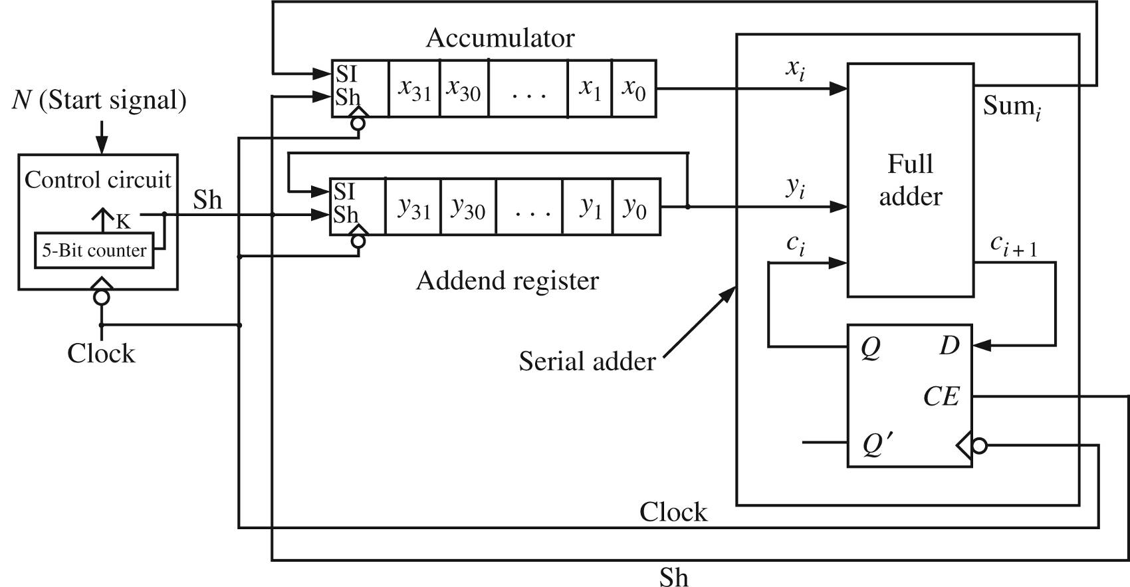
Serial Adder
418_04
Notes:
ELEC 418

Slide 25
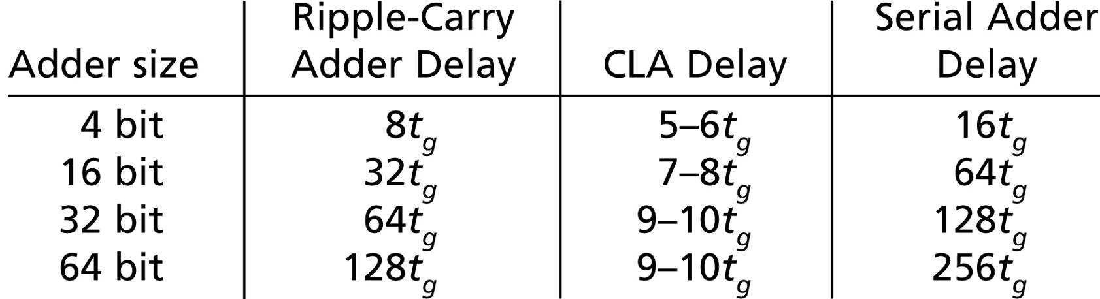
Adder Comparison
418_04
Notes:
ELEC 418

Slide 26
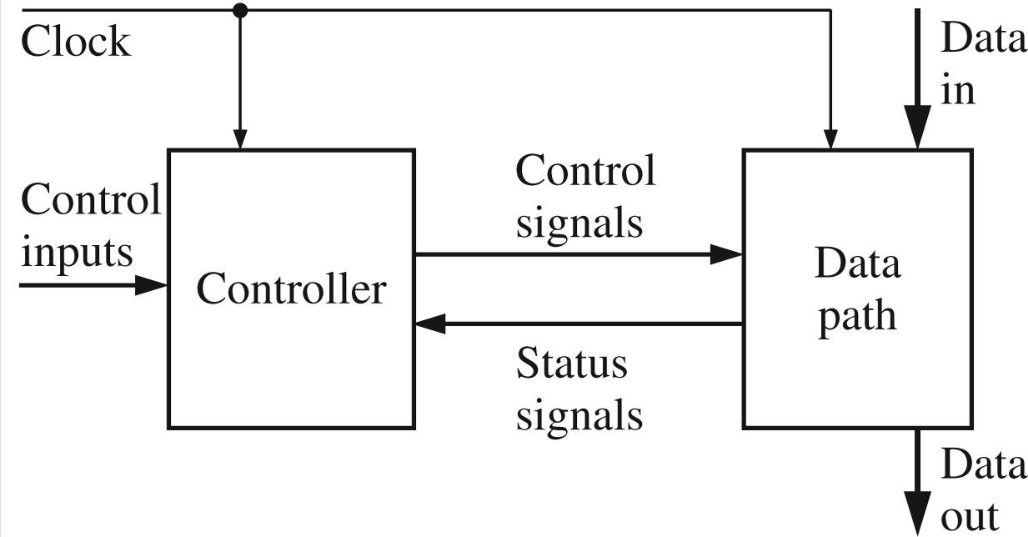
Data Path and Controller
418_04
Notes:
ELEC 418

Slide 27
Add-and-Shift Multiplier
4-bit Multiplicand
4-bit Multiplier
8-bit Product
4-bit Adder
Controller
418_04
Notes:
ELEC 418

Slide 28
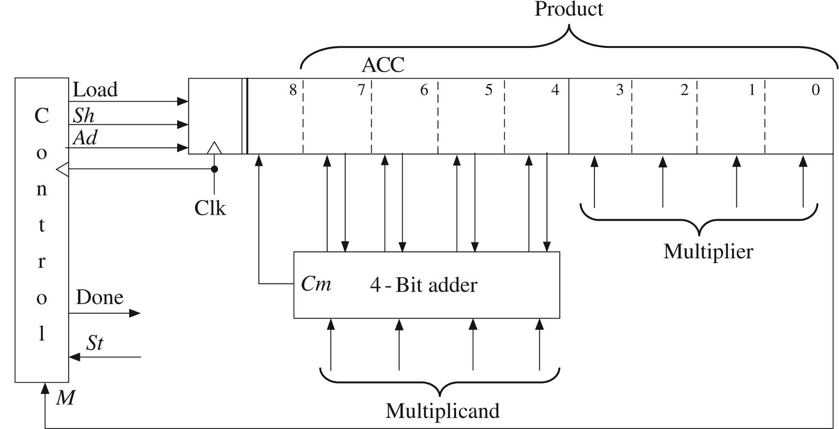
Add-and-Shift Multiplier
418_04
Notes:
ELEC 418

Slide 29
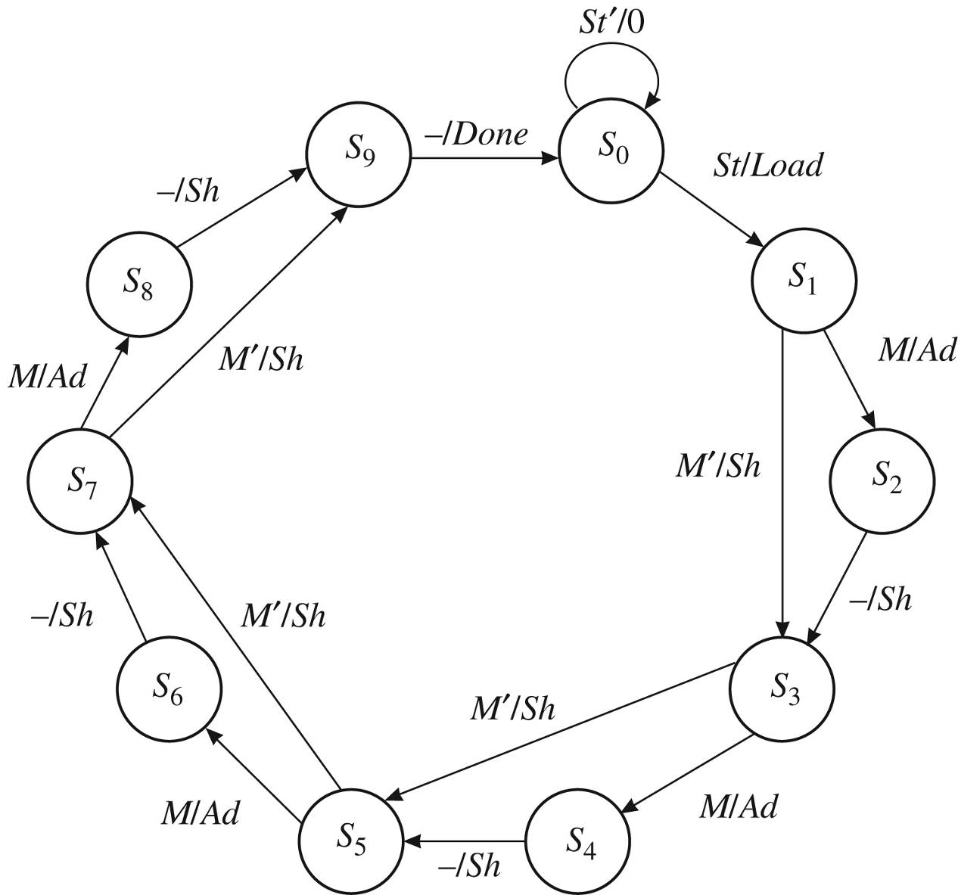
Multiplier Control
418_04
Notes:
ELEC 418

Slide 30
Behavioral Model
library IEEE;
use IEEE.std_logic_1164.all;
use IEEE.std_logic_unsigned.all;
entity Mult4X4 is
port(Clk, St: in std_logic;
Mplier, Mcand: in std_logic_vector(3 downto 0);
Product: out std_logic_vector(7 downto 0);
Done: out std_logic);
end Mult4X4;
418_04
Notes:
ELEC 418

Slide 31
Behavioral Model
architecture Behave of Mult4X4 is
signal State: integer range 0 to 9;
signal ACC: std_logic_vector(8 downto 0);
alias M: std_logic is ACC(0); -- bit 0 of ACC
begin
process(Clk)
begin
if rising_edge(CLK) then
case State is
when 0=>
if St='1' then -- Load
ACC(8 downto 4) <= "00000";
ACC(3 downto 0) <= Mplier;
State <= 1;
end if;
418_04
Notes:
ELEC 418

Slide 32
Behavioral Model
when 1 | 3 | 5 | 7 =>
if M = '1' then -- Add
ACC(8 downto 4) <= '0' & ACC(7 downto 4)
+ Mcand;
State <= State + 1;
else -- Shift
ACC <= '0' & ACC(8 downto 1);
State <= State + 2;
end if;
418_04
Notes:
ELEC 418

Slide 33
Behavioral Model
when 2 | 4 | 6 | 8 => -- Shift
ACC <= '0' & ACC(8 downto 1);
State <= State + 1;
when 9 => -- end of cycle
State <= 0;
end case;
end if;
end process;
Done <= '1' when State = 9 else '0';
Product <= ACC(7 downto 0);
end Behave;
418_04
Notes:
ELEC 418

Slide 34
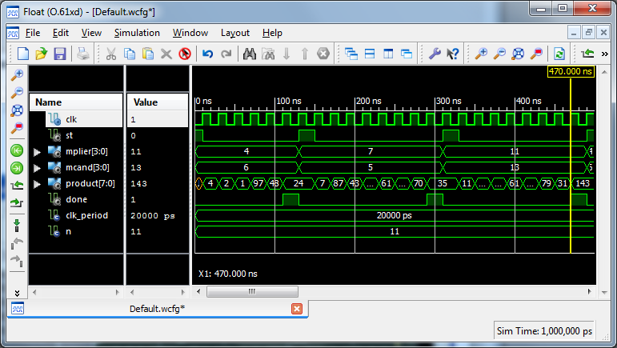
VHDL Simulation
418_04
Notes:
ELEC 418

Slide 35
FPGA Implementation
Xilinx Spartan3e
  250K System Gates
  50 MHz Clock
ChipScope Pro
  Virtual Input/Output Core (VIO)
  Integrated Logic Analyzer (ILA)
Real-Time Verification
  Captures On-chip Signals
  Off-chip Analysis via JTAG Programming Cable
418_04
Notes:
ELEC 418

Slide 36
VHDL Test Bench
entity testmult4x4 is
port(CLK: in std_logic);
end testmult4x4;
architecture test1 of testmult4x4 is
component mult4x4
port(Clk, St: in std_logic;
Mplier, Mcand: in std_logic_vector(3 downto 0);
Product: out std_logic_vector(7 downto 0);
Done: out std_logic);
end component;
418_04
Notes:
ELEC 418

Slide 37
VHDL Test Bench
component ila
port(control: in std_logic_vector(35 downto 0);
clk: in std_logic;
trig0: in std_logic_vector(17 downto 0));
end component;
component vio
port(control: in std_logic_vector(35 downto 0);
clk: in std_logic;
sync_in: in std_logic_vector(8 downto 0);
sync_out: out std_logic_vector(8 downto 0));
end component;
418_04
Notes:
ELEC 418

Slide 38
VHDL Test Bench
signal ...
signal ...
begin
mult1: mult4x4 port map(CLK, St, Mplier, Mcand,
Product, Done);
i_ila: ila port map(control0, clk, trig0);
i_vio: vio port map(control1, clk, sync_in,
sync_out);
418_04
Notes:
ELEC 418

Slide 39
VHDL Test Bench
trig0(17) <= st;
trig0(16 downto 13) <= Mplier;
trig0(12 downto 9) <= Mcand;
trig0(8 downto 1) <= Product;
trig0(0) <= Done;
sync_in(8 downto 1) <= Product;
sync_in(0) <= Done;
St <= sync_out(8);
Mplier <= sync_out(7 downto 4);
Mcand <= sync_out(3 downto 0);
end test1;
418_04
Notes:
ELEC 418

Slide 40
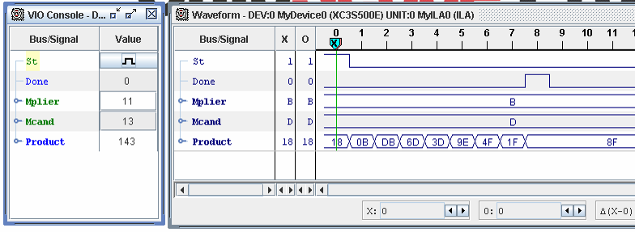
ChipScope Pro Analyzer
418_04
Notes:
ELEC 418

Slide 41
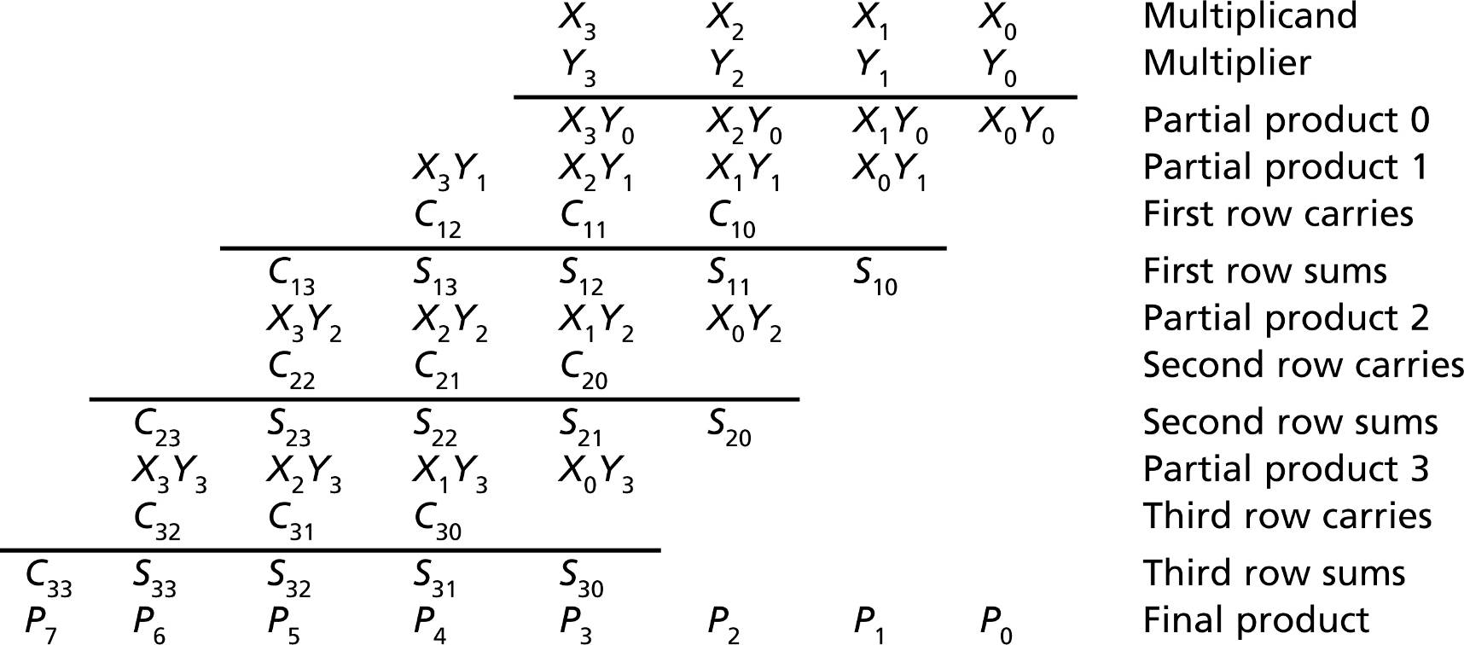
Array Multiplier
418_04
Notes:
ELEC 418

Slide 42
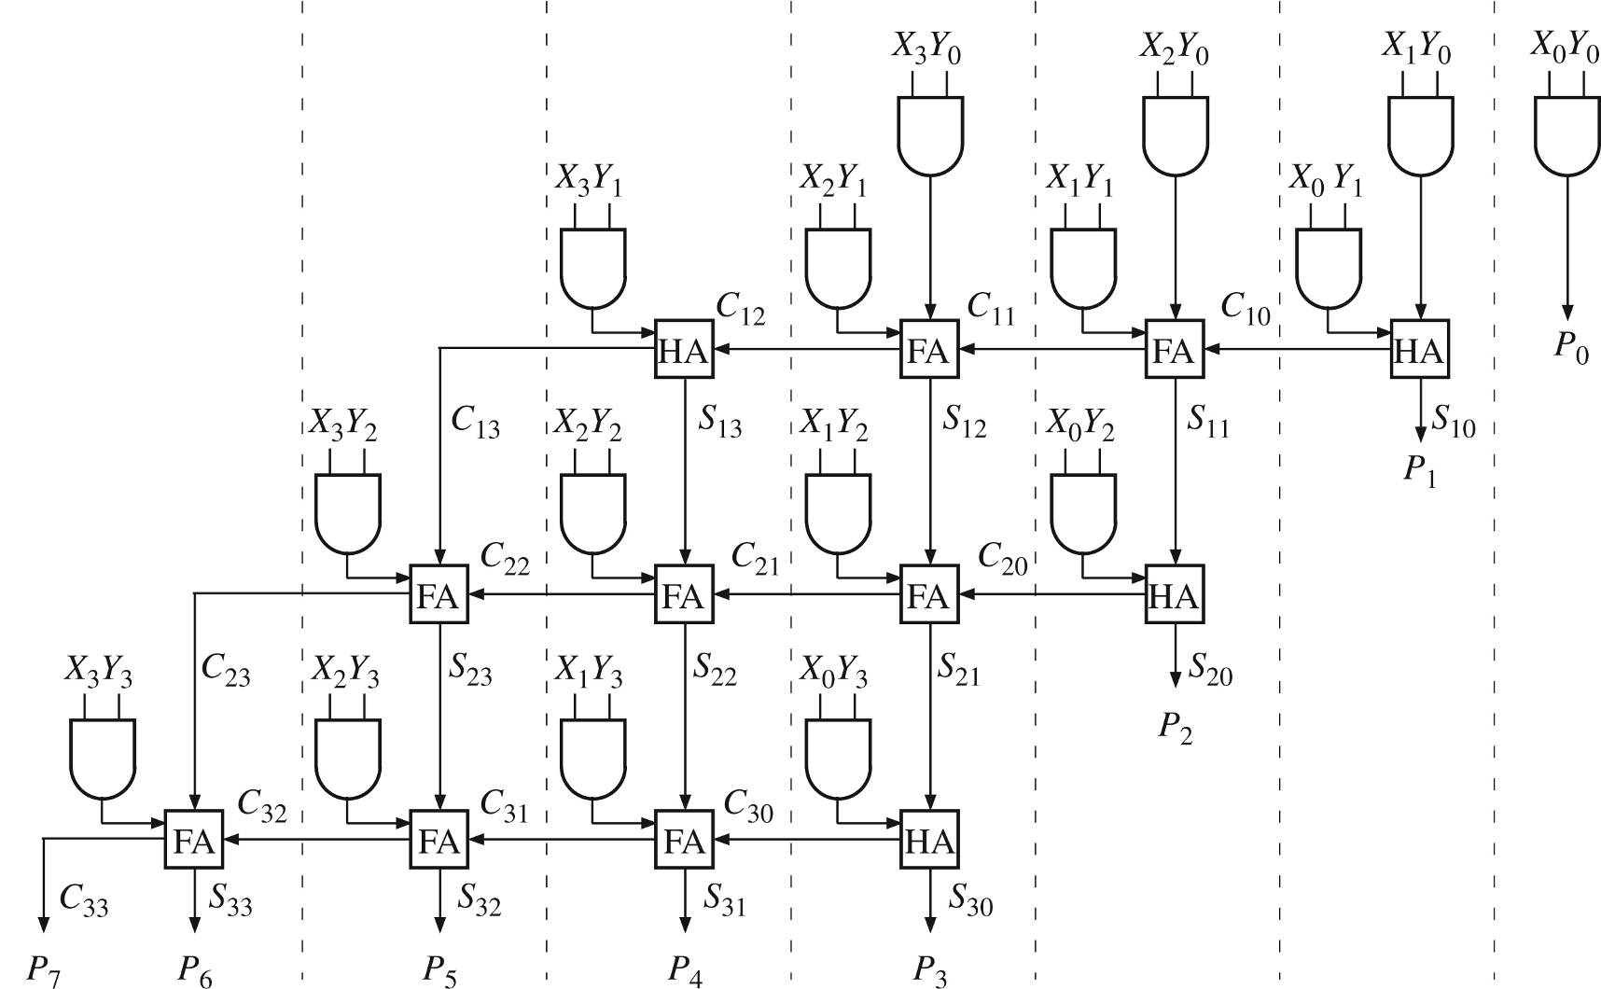
Array Multiplier
418_04
Notes:
ELEC 418

Slide 43
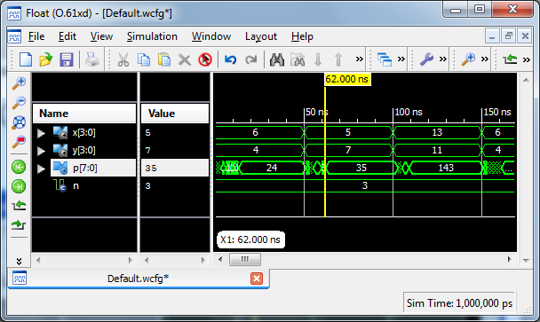
VHDL Simulation
418_04
Notes:
ELEC 418

Slide 44
Hardware Requirements
n-bit Multiplication (2n-bit Product)
  n² And Gates
  (n-1) x n-bit Adders
16-bit Multiplication
  256 And Gates
  15 x 16-bit Adders
32-bit Multiplication
  1024 And Gates
  31 x 32-bit Adders
418_04
Notes:
ELEC 418

Slide 45
Signed Multiplication
Signed Binary Fractions
  2's Complement
  S.XXX
    ± . ¹/₂ ¹/₄ ¹/₈
Four Cases
  + +
  − +
  + −
  − −
418_04
Notes:
ELEC 418

Slide 46
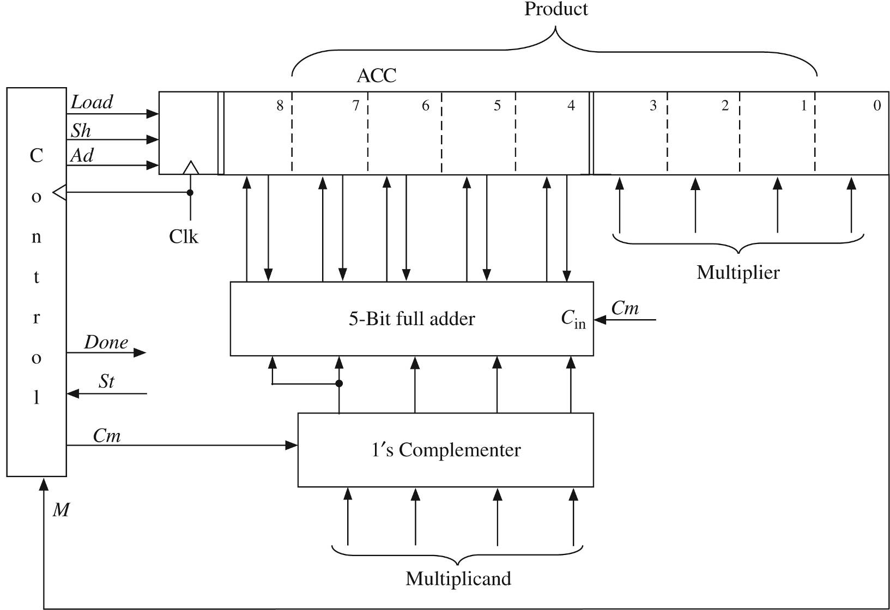
2's Complement Multiplier
418_04
Notes:
ELEC 418

Slide 47
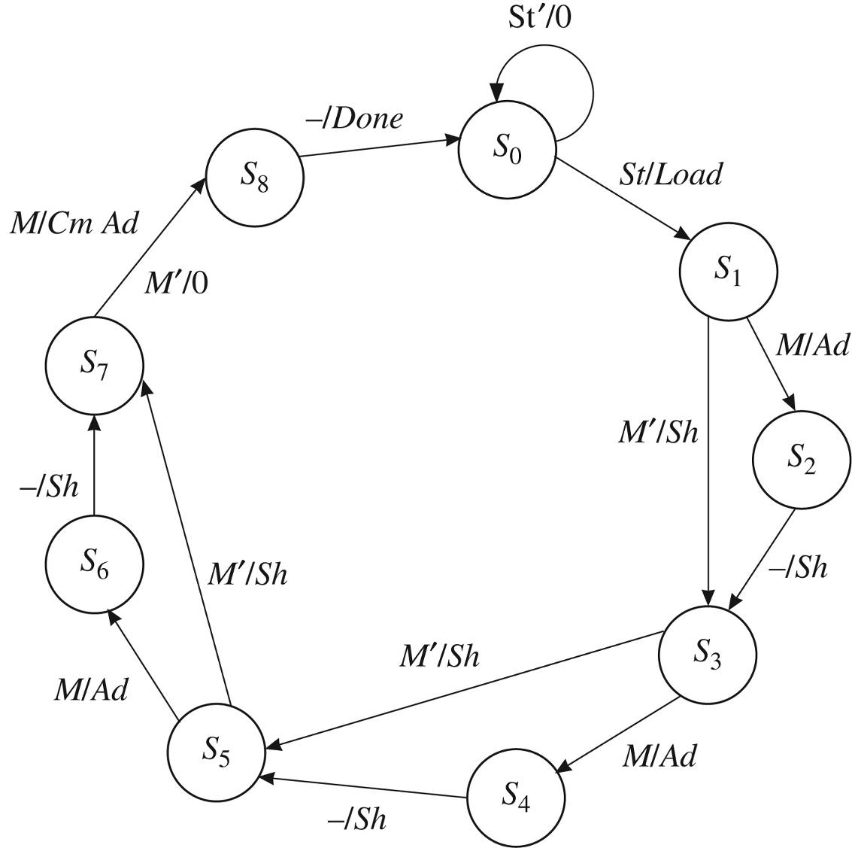
Multiplier Control
418_04
Notes:
ELEC 418

Slide 48
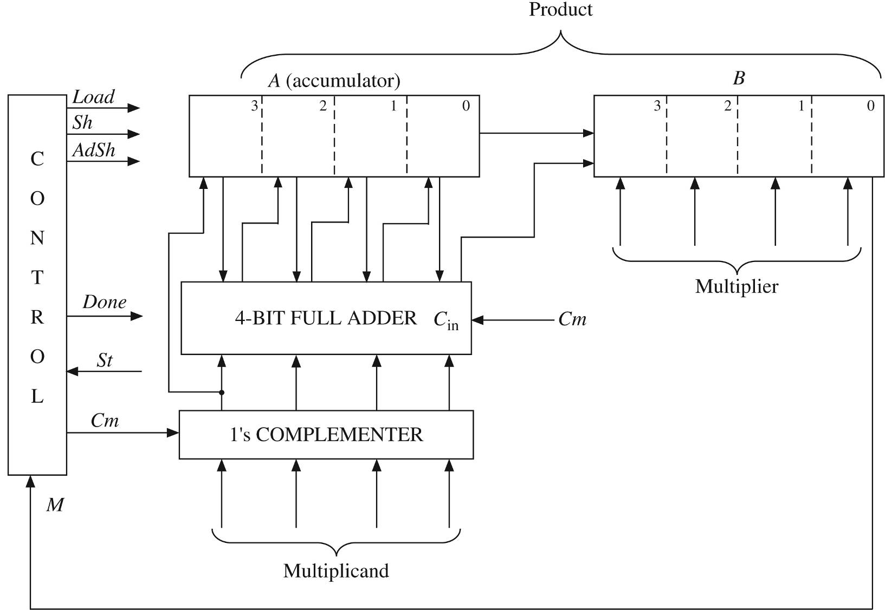
Faster Multiplier
418_04
Notes:
ELEC 418

Slide 49
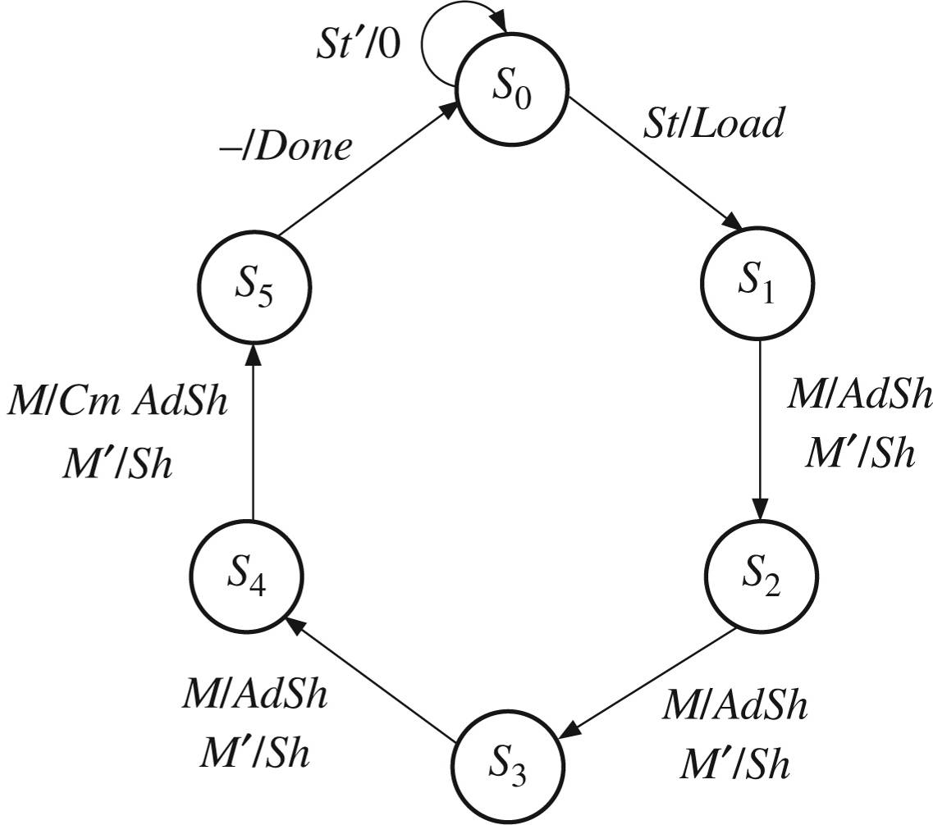
Multiplier Control
418_04
Notes:
ELEC 418

Slide 50
Behavioral Model
-- This VHDL model explicitly defines control signals
library IEEE;
use IEEE.std_logic_1164.all;
use IEEE.std_logic_unsigned.all;
entity Mult2C is
port(CLK, St: in std_logic;
Mplier, Mcand: in std_logic_vector(3 downto 0);
Product: out std_logic_vector (6 downto 0);
Done: out std_logic);
end Mult2C;
418_04
Notes:
ELEC 418

Slide 51
Behavioral Model
architecture Behave2 of Mult2C is
signal State, Nextstate: integer range 0 to 5;
signal A, B, compout, addout:
std_logic_vector(3 downto 0);
signal AdSh, Sh, Load, Cm: std_logic;
alias M: std_logic is B(0);
begin
process(State, St, M)
begin
Load <= '0';
AdSh <= '0';
Sh <= '0';
Cm <= '0';
Done <= '0';
418_04
Notes:
ELEC 418

Slide 52
Behavioral Model
case State is
when 0 =>
if St = '1' then
Load <= '1';
Nextstate <= 1;
else
Nextstate <= 0;
end if;
when 1 | 2 | 3 => -- "add/shift" State
if M = '1' then
AdSh <= '1';
else
Sh <= '1';
end if;
Nextstate <= State + 1;
Notes:
ELEC 418

Slide 53
Behavioral Model
when 4 => -- add complement if sign
if M = '1' then
Cm <= '1';
AdSh <= '1';
else
Sh <= '1';
end if;
Nextstate <= 5;
when 5 =>
Done <= '1';
Nextstate <= 0;
end case;
end process;
418_04
Notes:
ELEC 418

Slide 54
Behavioral Model
compout <= not Mcand when Cm = '1' else Mcand;
addout <= A + compout + Cm;
process(CLK)
begin
if rising_edge(CLK) then
if Load = '1' then
A <= "0000";
B <= Mplier;
end if;
if AdSh = '1' then
A <= compout(3) & addout(3 downto 1);
B <= addout(0) & B(3 downto 1);
end if;
418_04
Notes:
ELEC 418

Slide 55
Behavioral Model
if Sh = '1' then
A <= A(3) & A(3 downto 1);
B <= A(0) & B(3 downto 1);
end if;
State <= Nextstate;
end if;
end process;
Product <= A(2 downto 0) & B;
end ehave2;
418_04
Notes:
ELEC 418

Slide 56
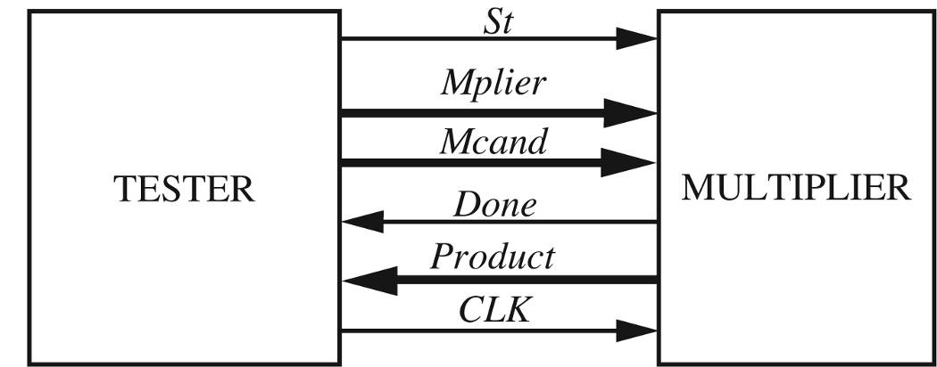
Test Bench
constant Mcandarr: arr :=
( "0100", "1100", "1100", "0010", "0010");
constant Mplierarr: arr :=
( "0110", "0110", "1010", "0101", "1011");
constant Productarr: arr2 :=
("0011000", 1101000","0011000","0001010","1110110");
418_04
Notes:
ELEC 418

Slide 57
Test Bench
stim_proc: process
begin
for i in 1 to N loop
Mcand <= Mcandarr(i);
Mplier <= Mplierarr(i);
St <= '1';
wait until rising_edge(CLK);
St <= '0';
wait until falling_edge(Done);
assert Product = Productarr(i)
report "Incorrect Product"
severity error;
end loop;
report "TEST COMPLETED";
end process;
418_04
Notes:
ELEC 418

Slide 58
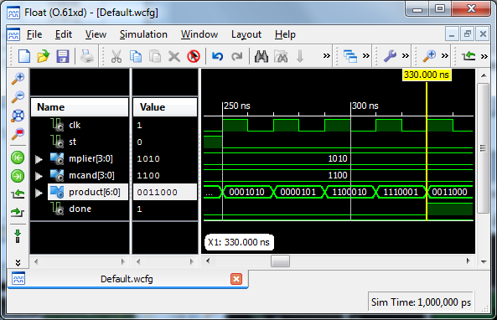
VHDL Simulation
418_04
Notes:
ELEC 418

Slide 59
FPGA Implementation
Xilinx Spartan3e
  250K System Gates
  50 MHz Clock
ChipScope Pro
  Virtual Input/Output Core (VIO)
  Integrated Logic Analyzer (ILA)
Real-Time Verification
  Captures On-chip Signals
  Off-chip Analysis via JTAG Programming Cable
418_04
Notes:
ELEC 418

Slide 60
Summary
Design Examples
  BCD to 7-Segment Display
  Adders
  Multipliers
VHDL Models
VHDL Test Benches
FPGA Implementations
  ChipScope Pro
418_04
Notes:
ELEC 418

