Slide 1
SM Charts and Microprogramming
ELEC 418
Advanced Digital Systems
Dr. Ron Hayne
Images Courtesy of Thomson Engineering
Notes:
ELEC 418

Slide 2
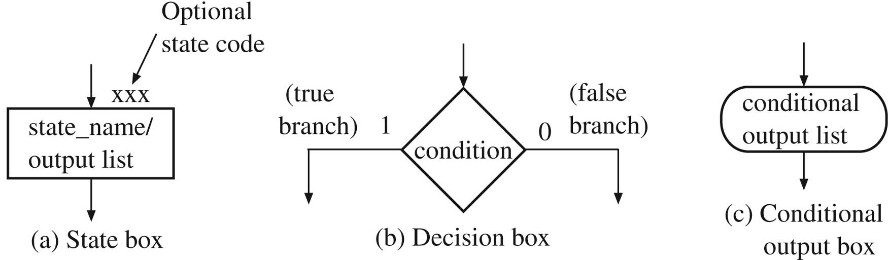
State Machine Charts
Equivalent State Graph
  Exactly One Transition True at Any Time
  Next State Uniquely Defined
SM Block
  One Entrance Path
  One or More Exit Paths
  No Internal Feedback
418_05
Notes:
ELEC 418

Slide 3
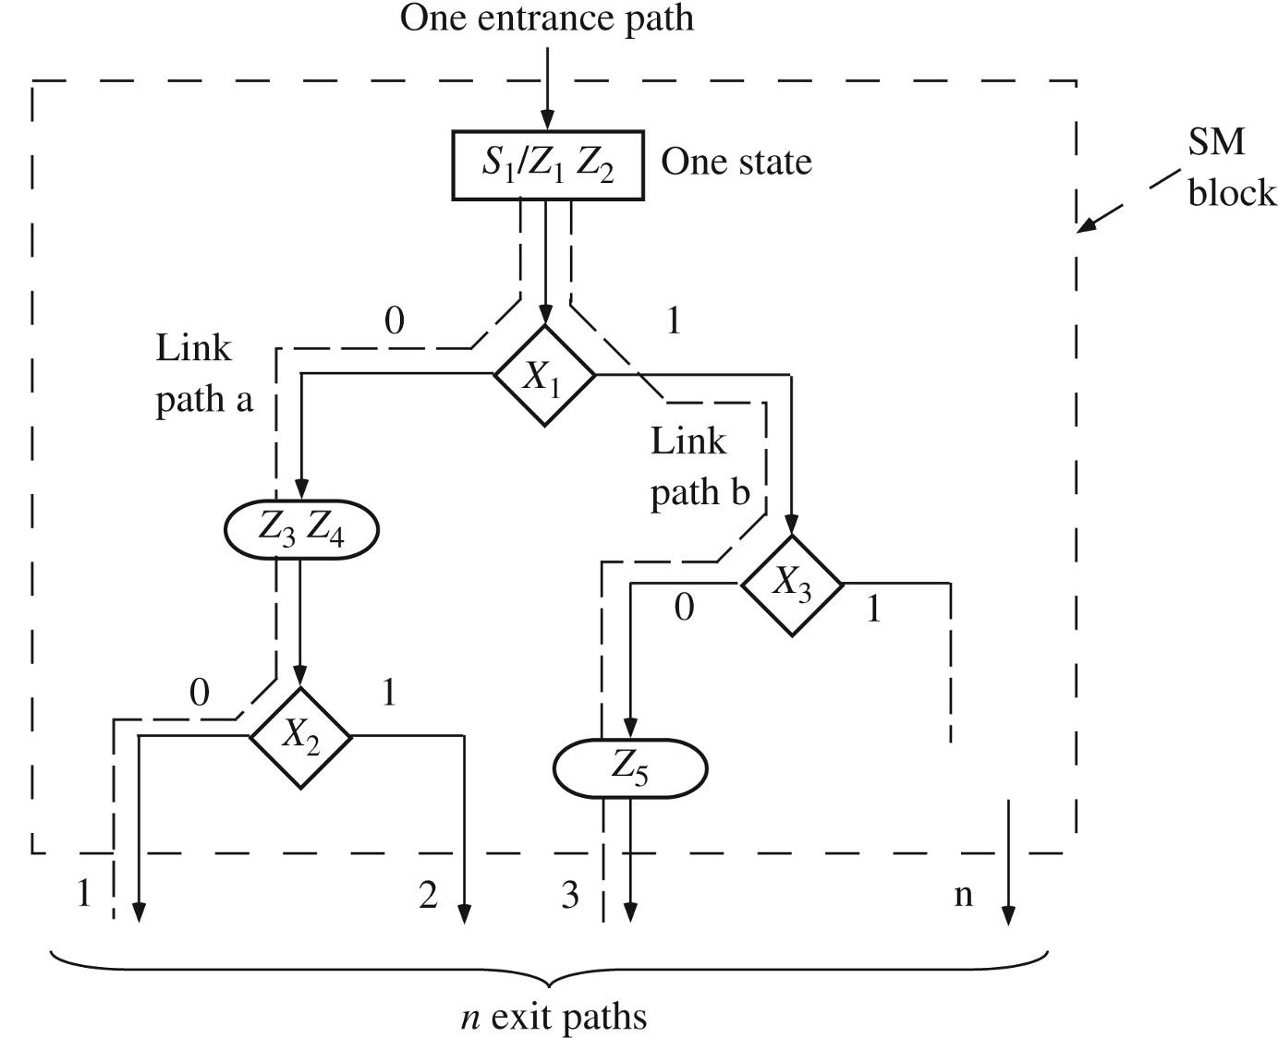
Example SM Block
418_05
Notes:
ELEC 418

Slide 4
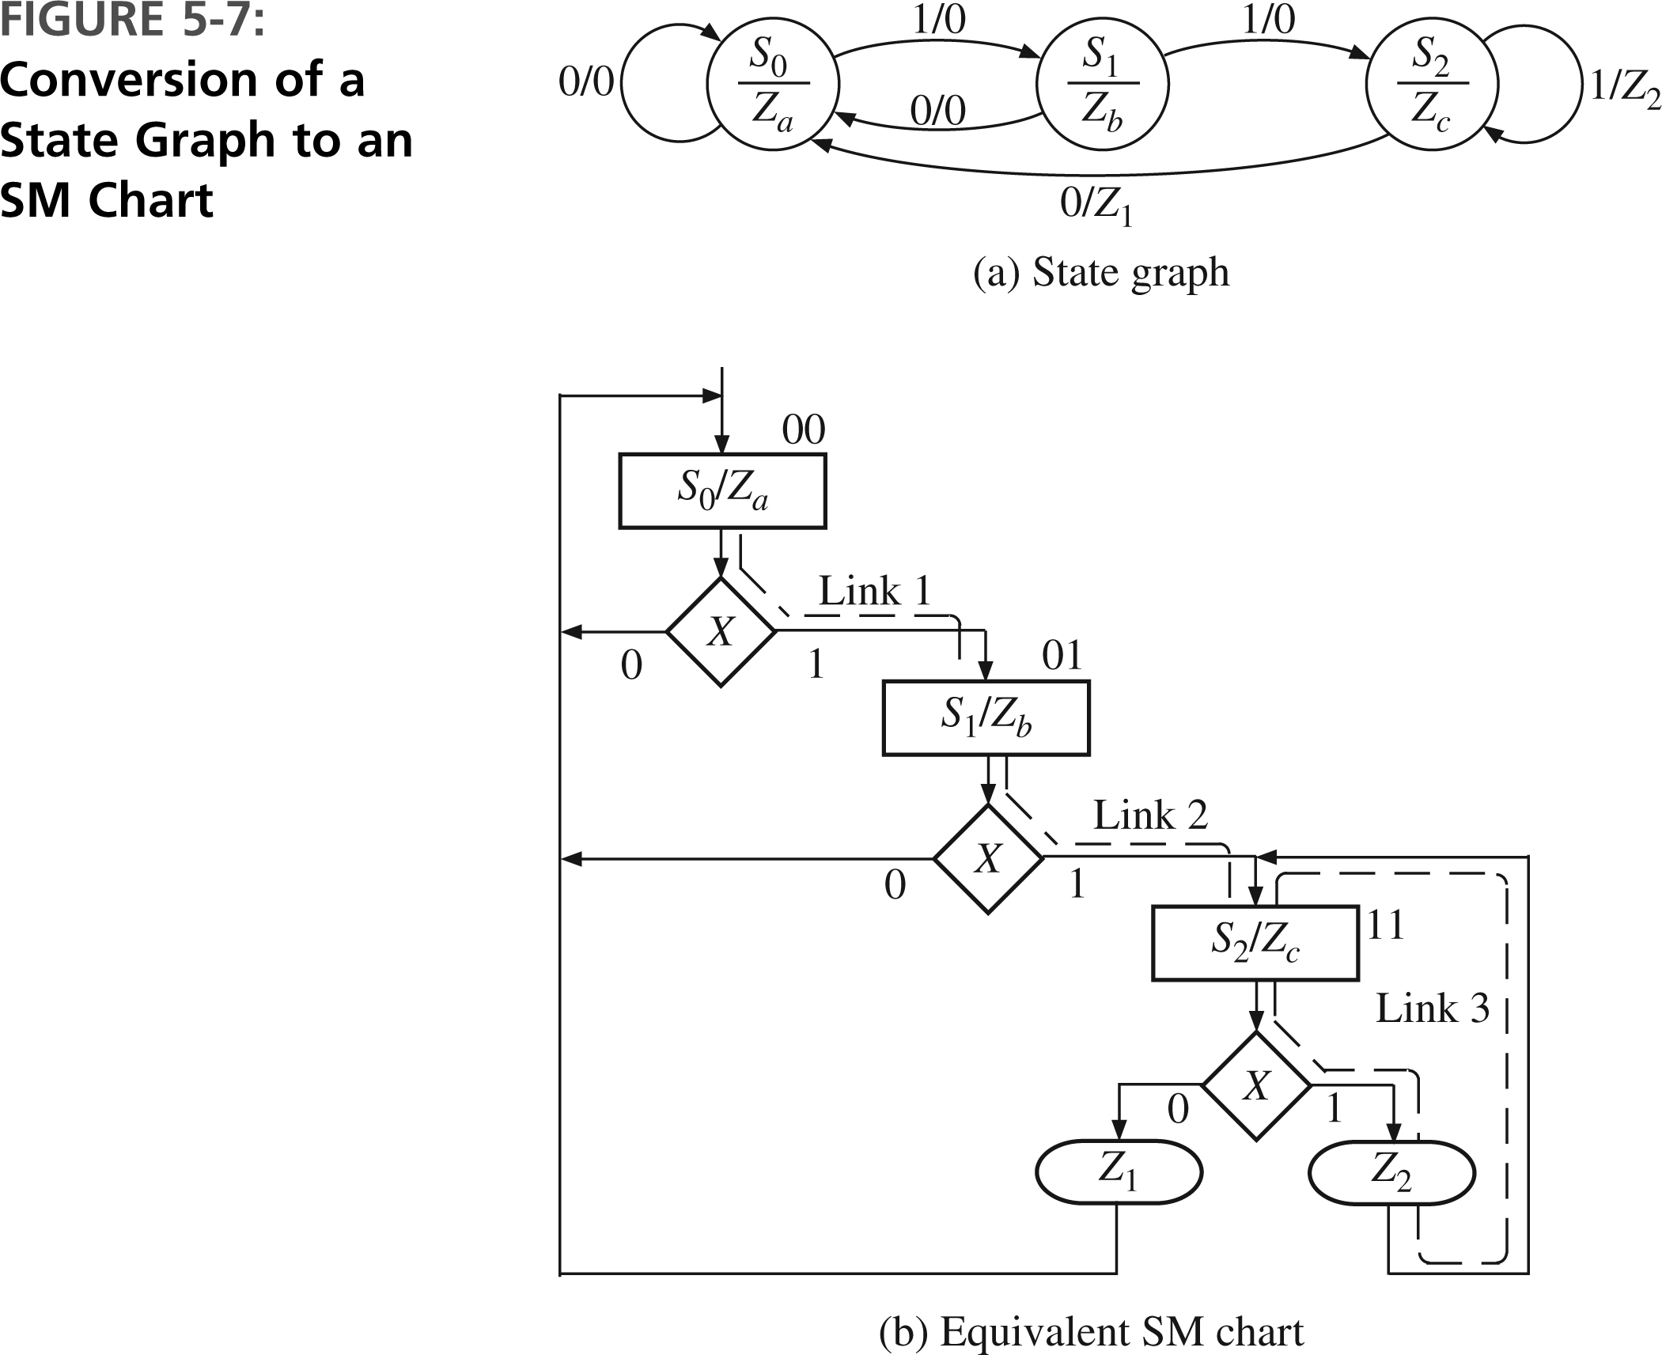
State Graph to SM Chart
418_05
Notes:
ELEC 418

Slide 5
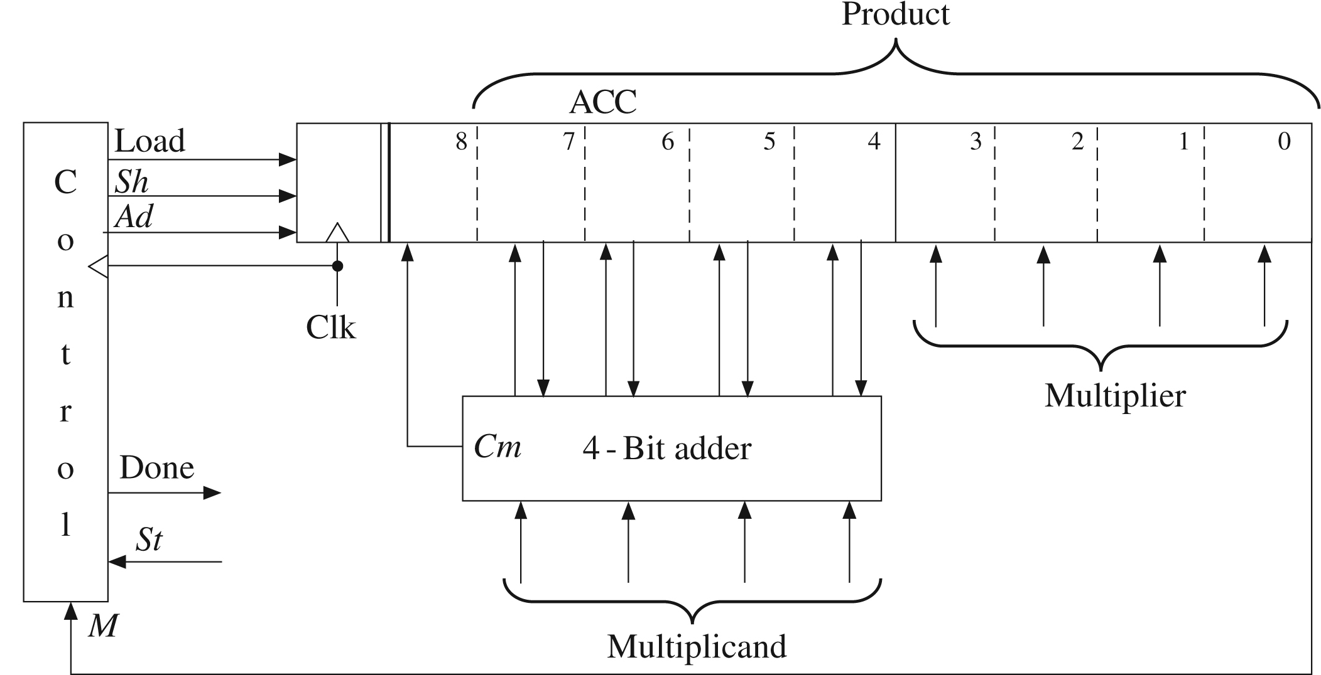
Add-and-Shift Multiplier
418_05
Notes:
ELEC 418

Slide 6
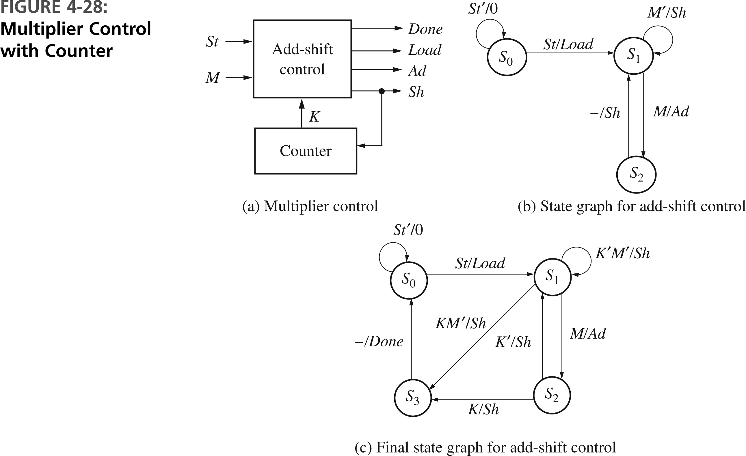
Multiplier Control
418_05
Notes:
ELEC 418

Slide 7
Multiplier Control
entity Mult is
port(CLK, St, K, M: in std_logic;
Load, Sh, Ad, Done: out std_logic);
end Mult;
architecture SMbehave of Mult is
signal State, Nextstate: integer range 0 to 3;
begin
process(St, K, M, State)
begin
Load <= '0'; Sh <= '0'; Ad <= '0'; Done <= '0';
418_05
Notes:
ELEC 418

Slide 8
Multiplier Control
case State is
when 0 =>
if St = '1' then
Load <= '1';
Nextstate <= 1;
else
Nextstate <= 0;
end if;
418_05
Notes:
ELEC 418

Slide 9
Multiplier Control
when 1 =>
if M = '1' then
Ad <= '1';
Nextstate <= 2;
else
Sh <= '1';
if K = '1' then
Nextstate <= 3;
else
Nextstate <= 1;
end if;
end if;
418_05
Notes:
ELEC 418

Slide 10
Multiplier Control
when 2 =>
Sh <= '1';
if K = '1' then
Nextstate <= 3;
else
Nextstate <= 1;
end if;
when 3 =>
Done <= '1';
Nextstate <= 0;
end case;
end process;
418_05
Notes:
ELEC 418

Slide 11
Multiplier Control
process(CLK)
begin
if rising_edge(CLK) then
State <= Nextstate;
end if;
end process;
end SMbehave;
418_05
Notes:
ELEC 418

Slide 12
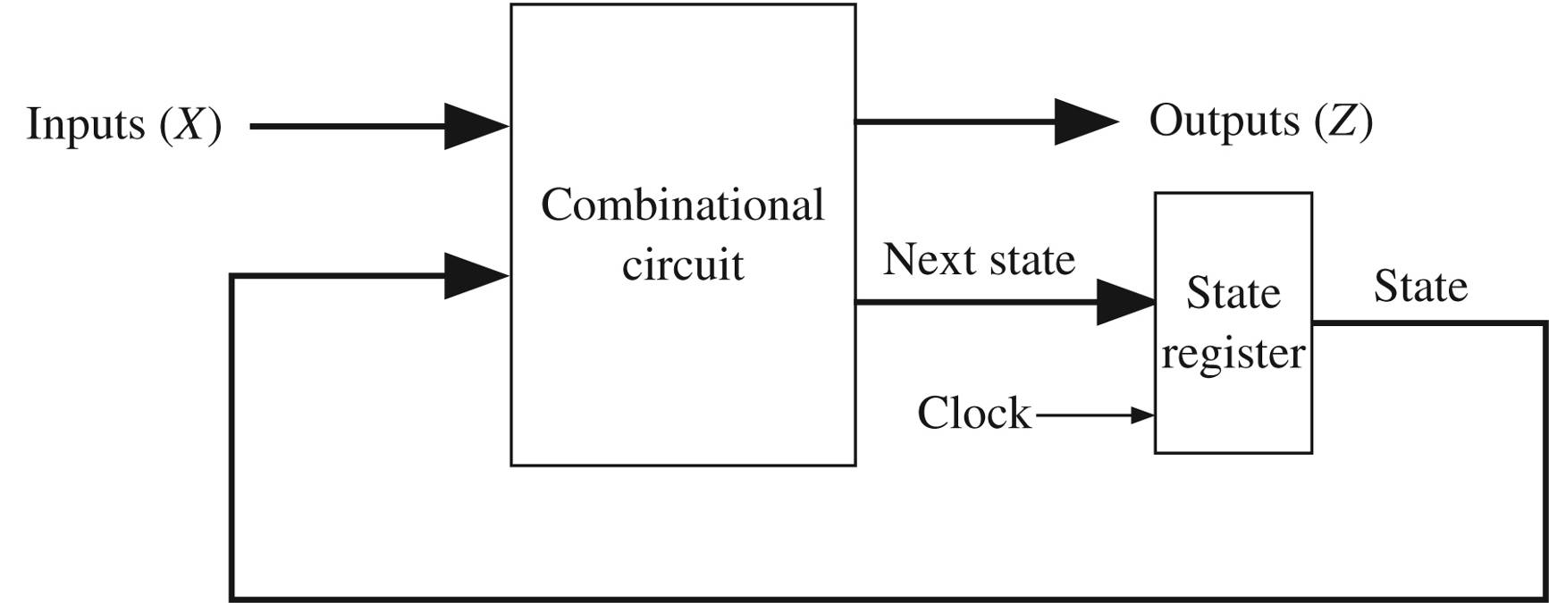
Sequential Machine
Mealy
  Z = f (X, Q)
Moore
  Z = f (Q)
(Q)
418_05
Notes:
ELEC 418

Slide 13
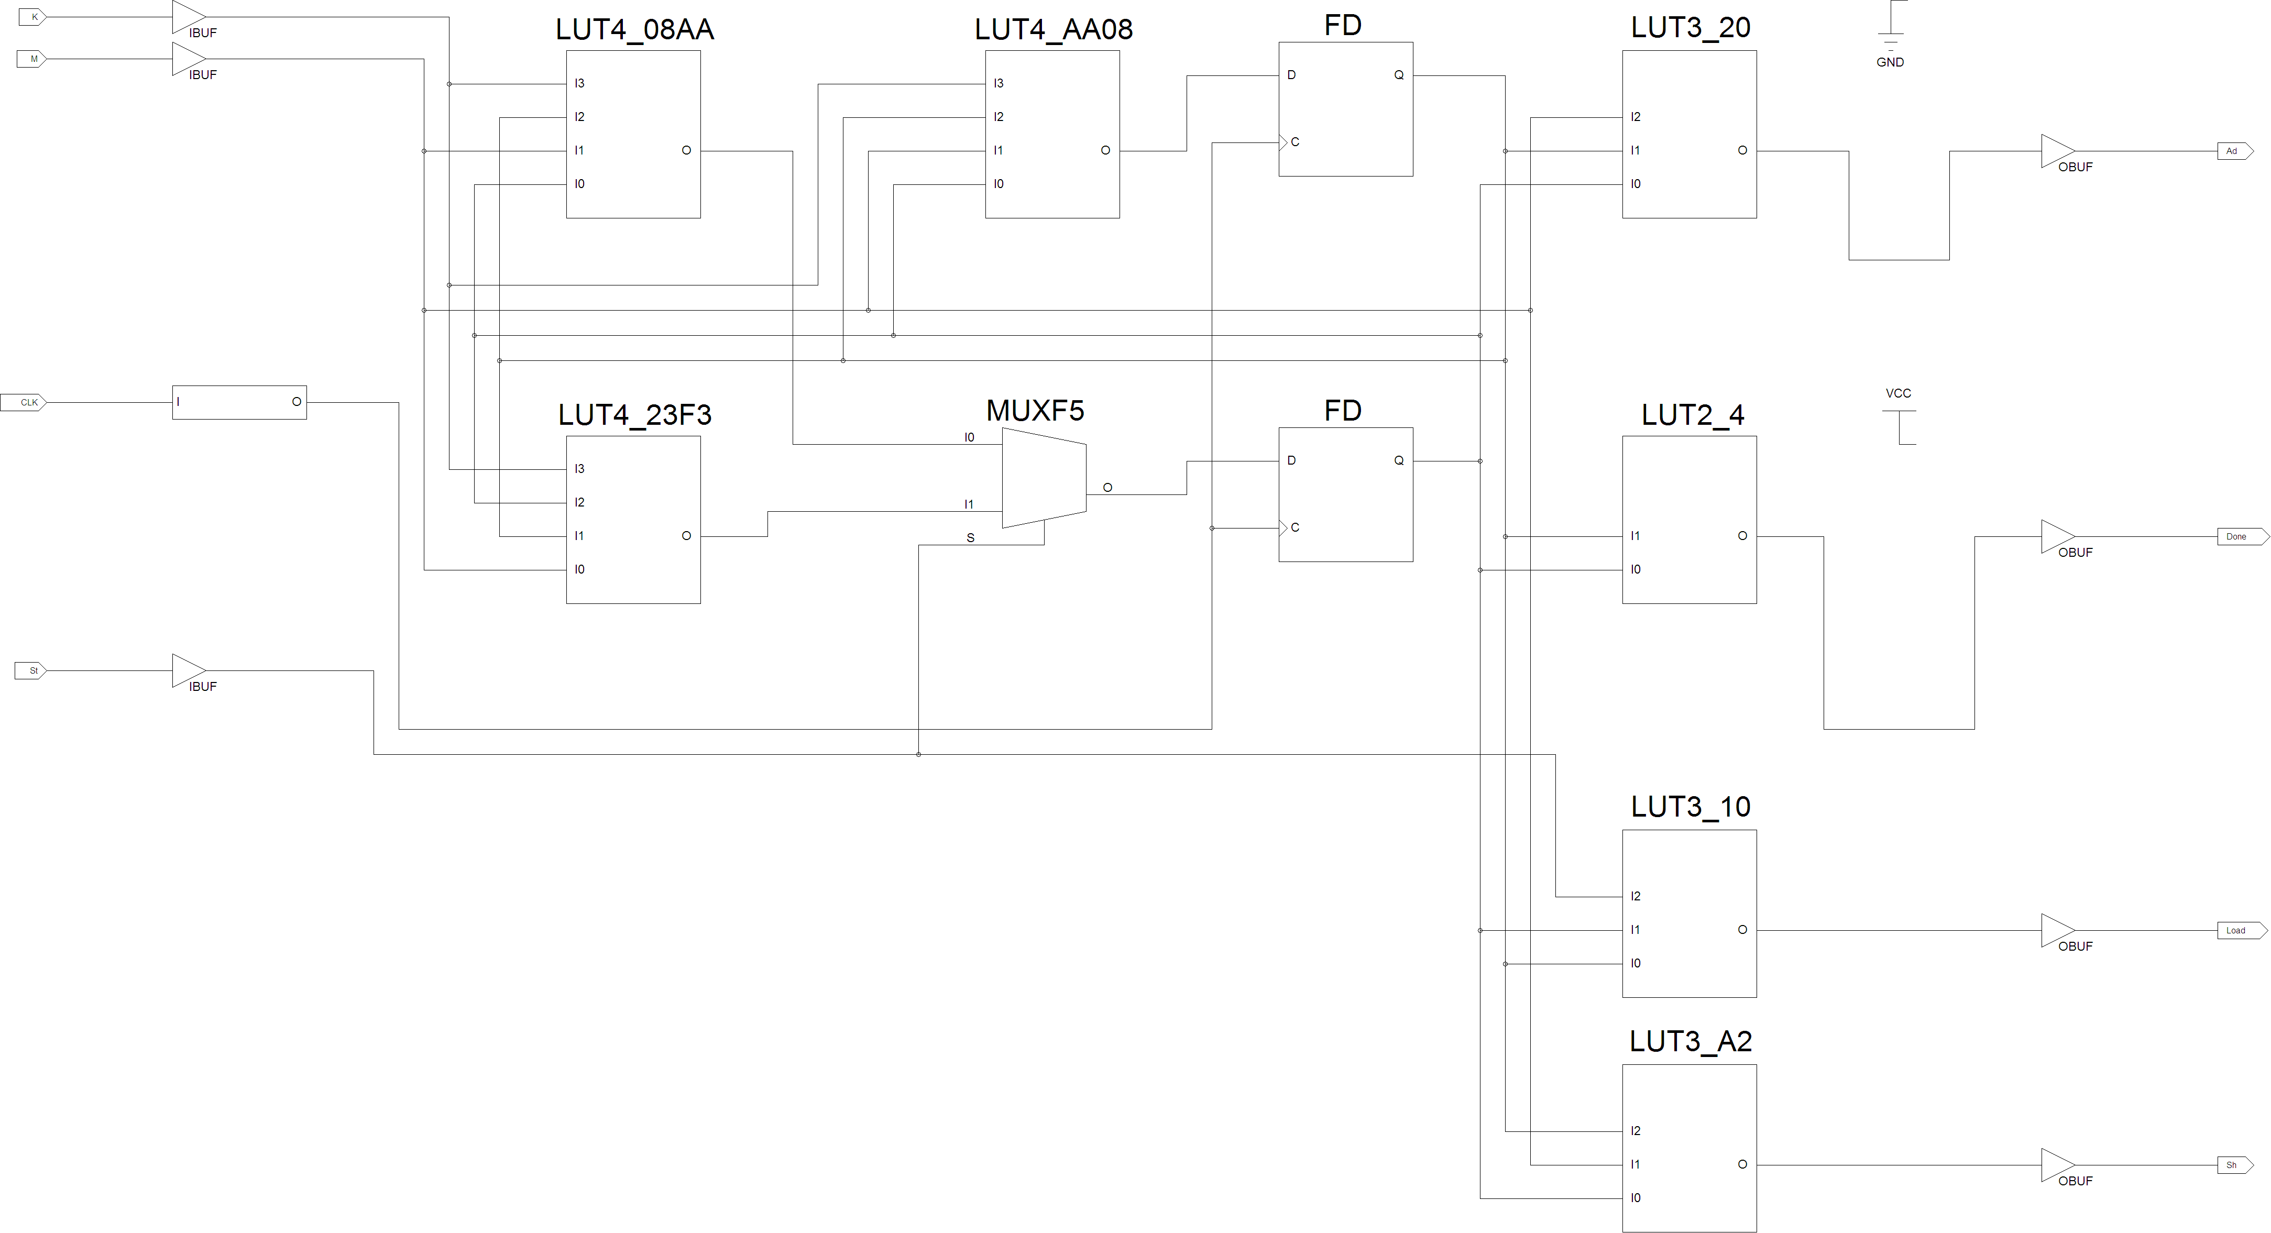
FPGA Synthesis
418_05
Notes:
ELEC 418

Slide 14
Microprogramming
Hardwired Control
  Implemented using gates and flip-flops
  Faster, less flexible, limited complexity
Microprogram Control
  Control Store
    Memory storing control signals and next state info
    Controller sequences through memory
  Slower, more flexible, greater complexity
418_05
Notes:
ELEC 418

Slide 15
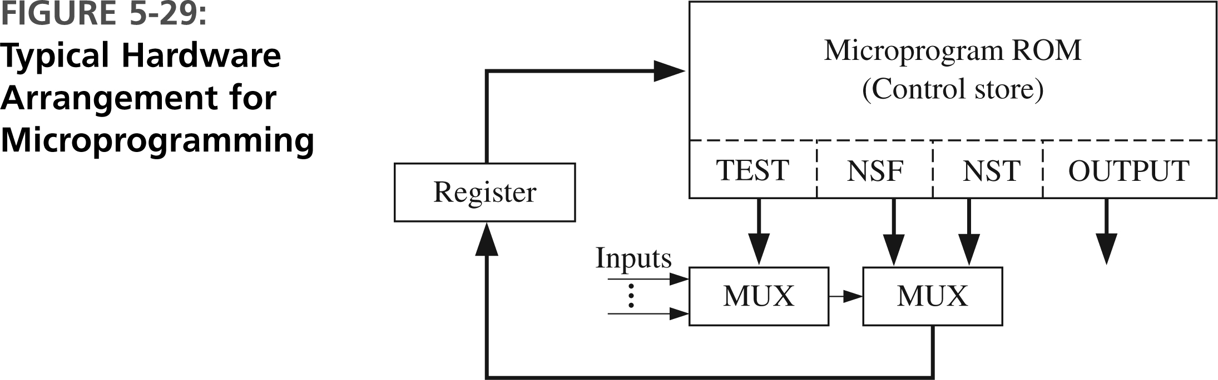
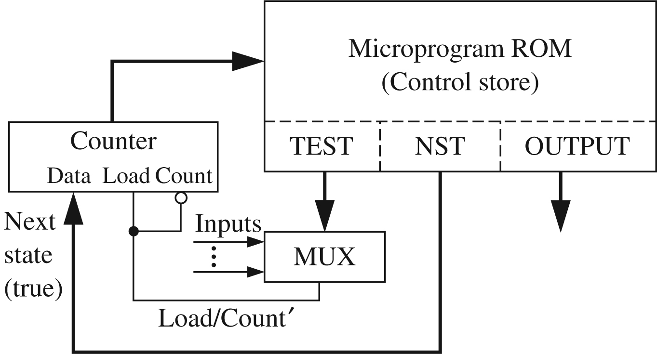
Microprogram Controllers
418_05
Notes:
ELEC 418

Slide 16
Implementing SM Charts
Transformations for Microprogramming
  Eliminate conditional outputs
    Transform to a Moore machine
  Test only one input in each state
  Eliminate redundant states
    Same output and same next states
418_05
Notes:
ELEC 418

Slide 17
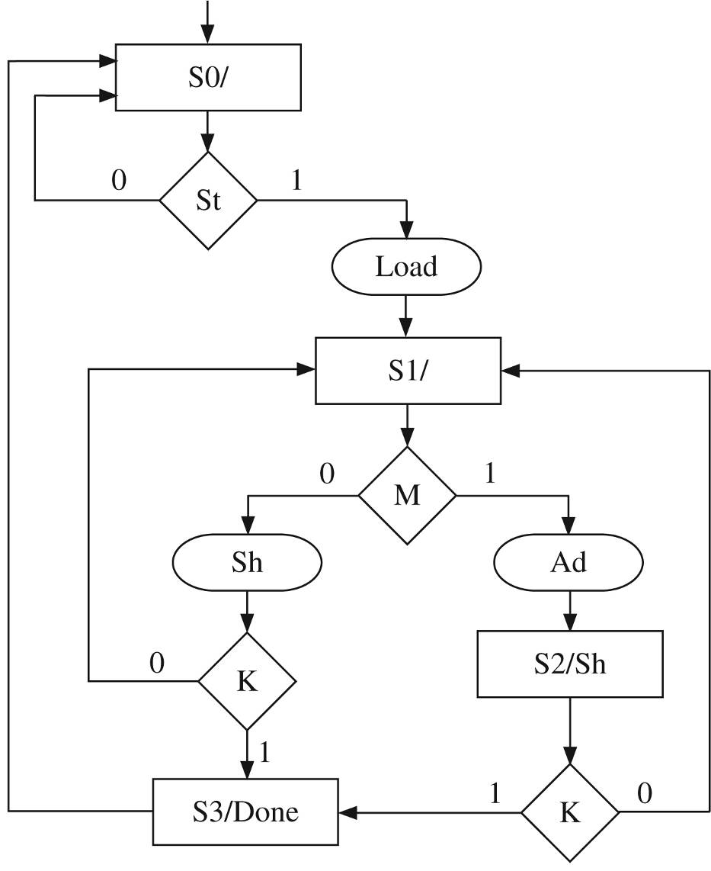
Multiplier Control
418_05
Notes:
ELEC 418

Slide 18
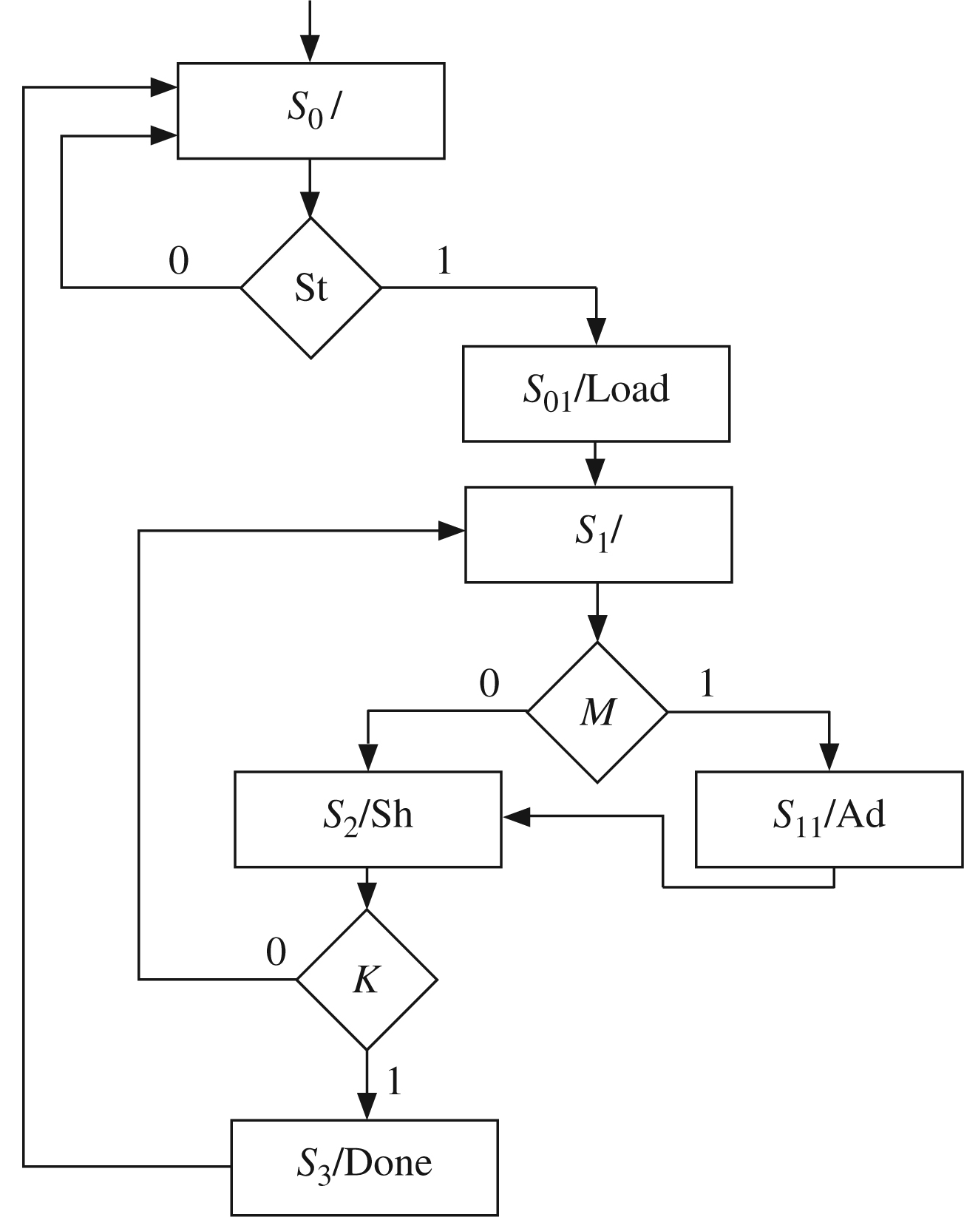
Modified Multiplier Control
418_05
Notes:
ELEC 418

Slide 19
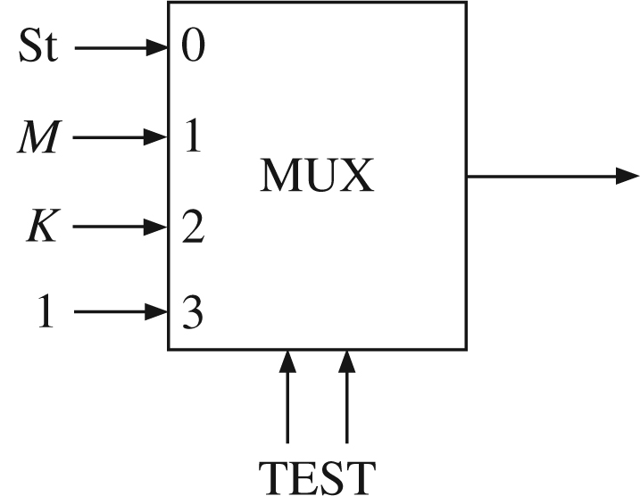
Two-Address Microcode
418_05
Notes:
ELEC 418

Slide 20
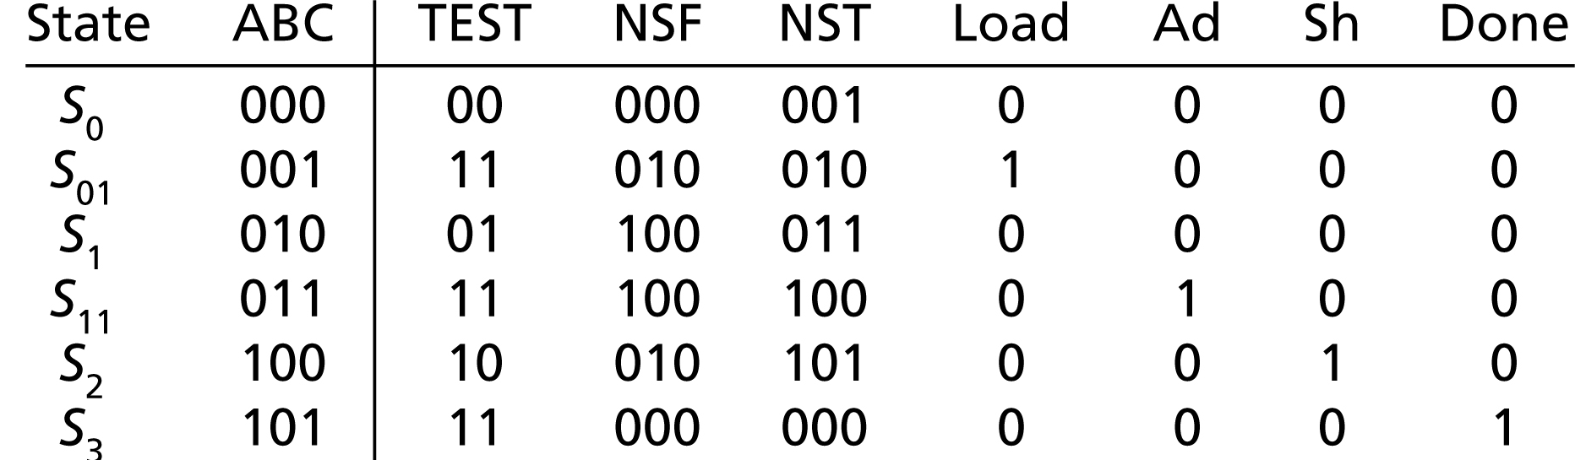
Two-Address Microprogram
418_05
Notes:
ELEC 418

Slide 21
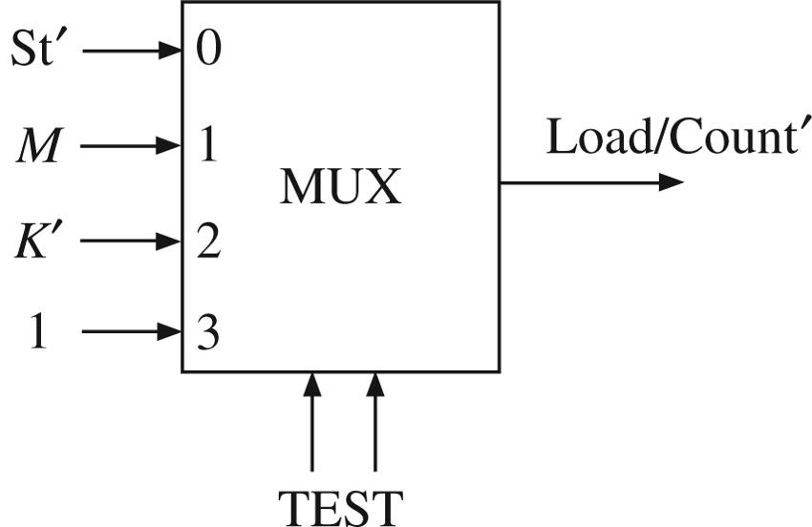
Single-Address Microcode
418_05
Notes:
ELEC 418

Slide 22
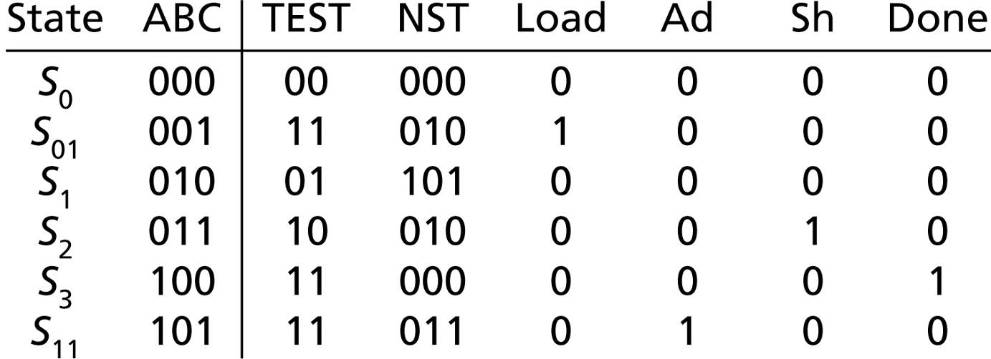
Single-Address Microprogram
418_05
Notes:
ELEC 418

Slide 23
Summary
SM Charts
  Equivalent State Graph
Microprogramming
  Two-Address Microcode
  Single-Address Microcode
418_05
Notes:
ELEC 418

Slide 24
Putting It All Together
Add-and-Shift Multiplier
Multiplier Control
  Counter
  SM Chart
Two-Address Microcode
  Microprogram ROM
ModelSim Simulation
FPGA Implementation
  ChipScope Pro
418_05
Notes:
ELEC 418

Slide 25
Add-and-Shift Multiplier
418_05
Notes:
ELEC 418

Slide 26
Multiplier Control
418_05
Notes:
ELEC 418

Slide 27
Two-Address Microcode
418_05
Notes:
ELEC 418

Slide 28
Two-Address Microprogram
418_05
Notes:
ELEC 418

Slide 29
Look-Up Tables (ROM)
architecture Table of Parity_Gen is
type OutTable is array(0 to 15) of std_logic;
signal ParityBit: std_logic;
constant OT: OutTable :=
('1','0','0','1','0','1','1','0',
'0','1','1','0','1','0','0','1');
begin
ParityBit <= OT(conv_integer(X));
Y <= X & ParityBit;
end Table;
418_02
Notes:
ELEC 418

Slide 30
Multiplexers
entity MUX4to1 is
port(I: in std_logic_vector(3 downto 0);
S: in std_logic_vector(1 downto 0);
F: out std_logic);
end MUX4to1;
architecture Dataflow of MUX4to1 is
begin
with S select
F <= I(0) when "00",
I(1) when "01",
I(2) when "10",
I(3) when "11";
end Dataflow;
418_05
Notes:
ELEC 418

Slide 31
Multiplier VHDL Model
library IEEE;
use ieee.std_logic_1164.all;
use ieee.std_logic_unsigned.all;
entity mult4X4_micro is
port(Clk, St: in std_logic;
Mplier, Mcand: in std_logic_vector(3 downto 0);
Product: out std_logic_vector(7 downto 0);
Done: out std_logic);
end mult4X4_micro;
418_05
Notes:
ELEC 418

Slide 32
VHDL Model
architecture microprogram of mult4X4_micro is
type ROM is array(0 to 5) of
std_logic_vector(11 downto 0);
constant control_store: ROM :=
(X"010", X"D28", X"630", X"E44", X"952", X"C01");
signal ACC: std_logic_vector(8 downto 0);
alias M: std_logic is ACC(0);
signal Load, Ad, Sh, K: std_logic;
signal counter: std_logic_vector(1 downto 0) := "00";
418_05
Notes:
ELEC 418

Slide 33
VHDL Model
signal TMUX: std_logic;
signal uAR: std_logic_vector(2 downto 0) := "000";
signal uIR: std_logic_vector(11 downto 0) := X”000”;
alias TEST: std_logic_vector(1 downto 0) is
uIR(11 downto 10);
alias NSF: std_logic_vector(2 downto 0) is
uIR(9 downto 7);
alias NST: std_logic_vector(2 downto 0) is
uIR(6 downto 4);
418_05
Notes:
ELEC 418

Slide 34
VHDL Model
begin
Load <= uIR(3);
Ad <= uIR(2);
Sh <= uIR(1);
Done <= uIR(0);
Product <= ACC(7 downto 0);
K <= '1' when counter = "11" else '0';
with TEST select
TMUX <= St when "00",
M when "01",
K when "10",
'1' when others;
418_05
Notes:
ELEC 418

Slide 35
VHDL Model
controller: process(Clk)
begin
if falling_edge(Clk) then
uIR <= control_store(to_integer(uAR));
end if;
if rising_edge(Clk) then
if TMUX = '0' then
uAR <= NSF;
else
uAR <= NST;
end if;
if Sh = '1' then
counter <= counter + 1;
end if;
end if; end process;
418_05
Notes:
ELEC 418

Slide 36
VHDL Model
datapath: process(Clk)
begin
if rising_edge(Clk) then
if Load = '1' then
ACC(8 downto 4) <= "00000";
ACC(3 downto 0) <= Mplier;
end if;
if Ad = '1' then
ACC(8 downto 4) <= '0' & ACC(7 downto 4)
+ Mcand;
end if;
if Sh = '1' then
ACC <= '0' & ACC(8 downto 1);
end if;
end if; end process; end microprogram;
418_05
Notes:
ELEC 418

Slide 37
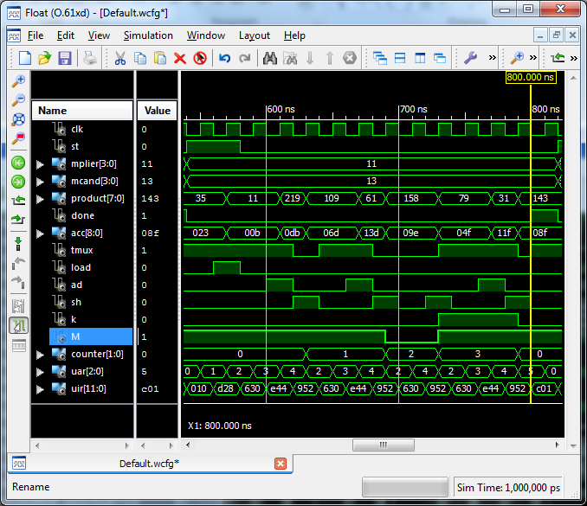
VHDL Simulation
418_05
Notes:
ELEC 418

Slide 38
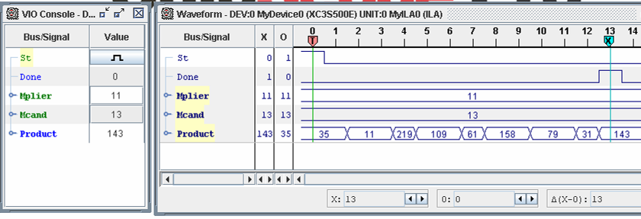
FPGA ChipScope Pro
418_05
Notes:
ELEC 418

Slide 39
Summary
Add-and-Shift Multiplier
Multiplier Control
  Counter
  SM Chart
Two-Address Microcode
  Microprogram ROM
ModelSim Simulation
FPGA Implementation
  ChipScope Pro
418_05
Notes:
ELEC 418

