Slide 1
Designing with FPGAs
ELEC 418
Advanced Digital Systems
Dr. Ron Hayne
Images Courtesy of Thomson Engineering
Notes:
ELEC 418

Slide 2
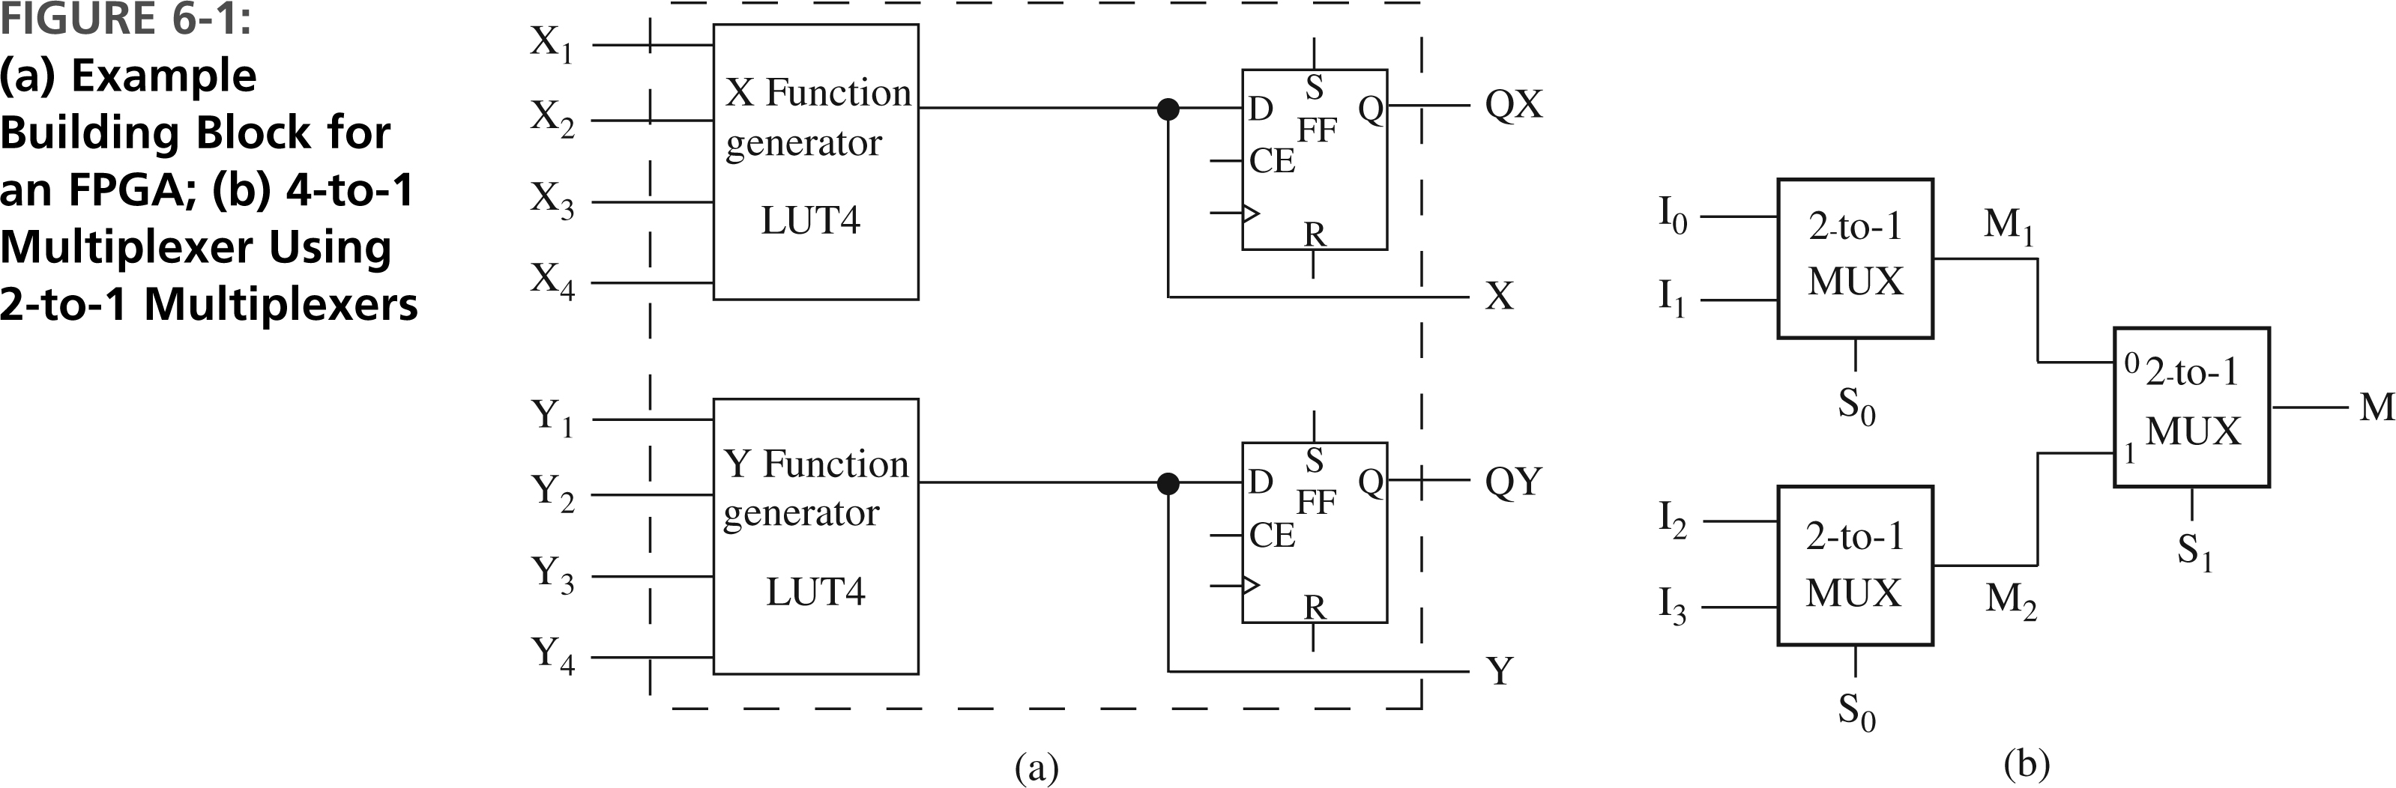
FPGA Logic Blocks
418_06
Notes:
ELEC 418

Slide 3
Implementing Functions
4-to-1 Multiplexer
  M = S₁'S₀'I₀ + S₁'S₀I₁ + S₁S₀'I₂ + S₁S₀I₃
Decomposition into 2-to-1 Multiplexers
  M₁ = S₀'I₀ + S₀I₁
  M₂ = S₀'I₂ + S₀I₃
  M = S₁'M₁ + S₁M₂
418_06
Notes:
ELEC 418

Slide 4
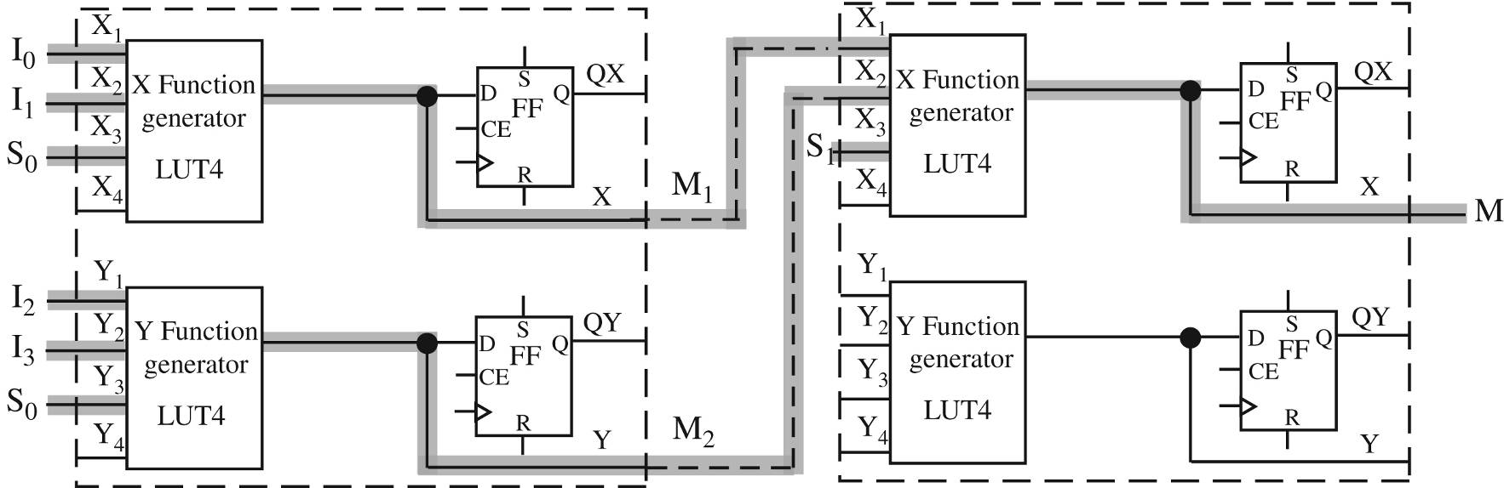
Mapping to Logic Blocks
418_06
Notes:
ELEC 418

Slide 5
LUT Contents
Inputs |  |  |  | Output
X₄ | X₃ (S₀) | X₂ (I₁) | X₁ (I₀) | X (M₁)
X | 0 | 0 | 0 | 0
X | 0 | 0 | 1 | 1
X | 0 | 1 | 0 | 0
X | 0 | 1 | 1 | 1
X | 1 | 0 | 0 | 0
X | 1 | 0 | 1 | 0
X | 1 | 1 | 0 | 1
X | 1 | 1 | 1 | 1
LUT-M1 = 0, 1, 0, 1, 0, 0, 1, 1, 0, 1, 0, 1, 0, 0, 1, 1
418_06
Notes:
ELEC 418

Slide 6
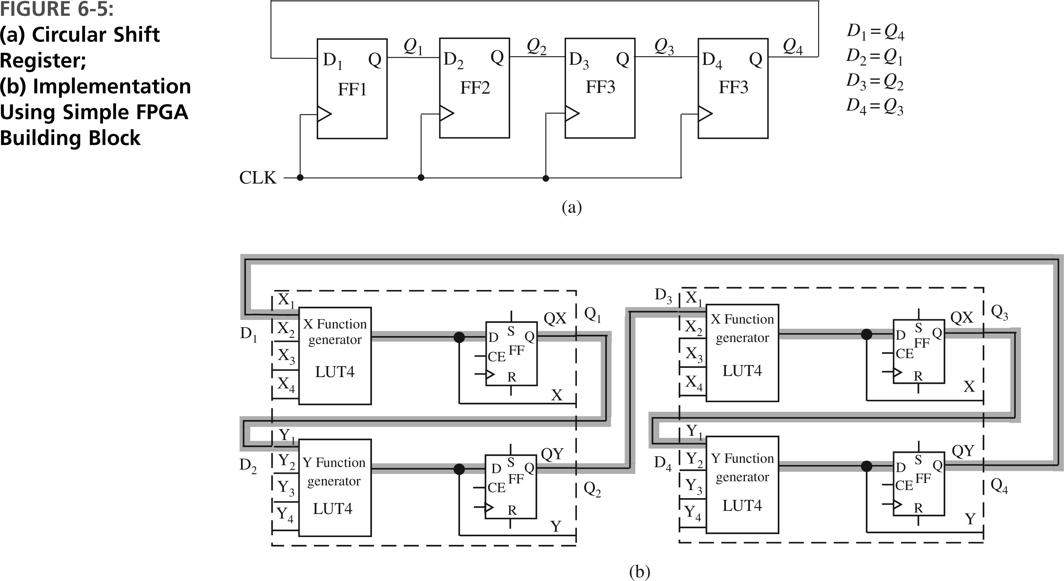
Another Example
Ring Counter
418_06
Notes:
ELEC 418

Slide 7
FPGA Implementation
418_06
Notes:
ELEC 418

Slide 8
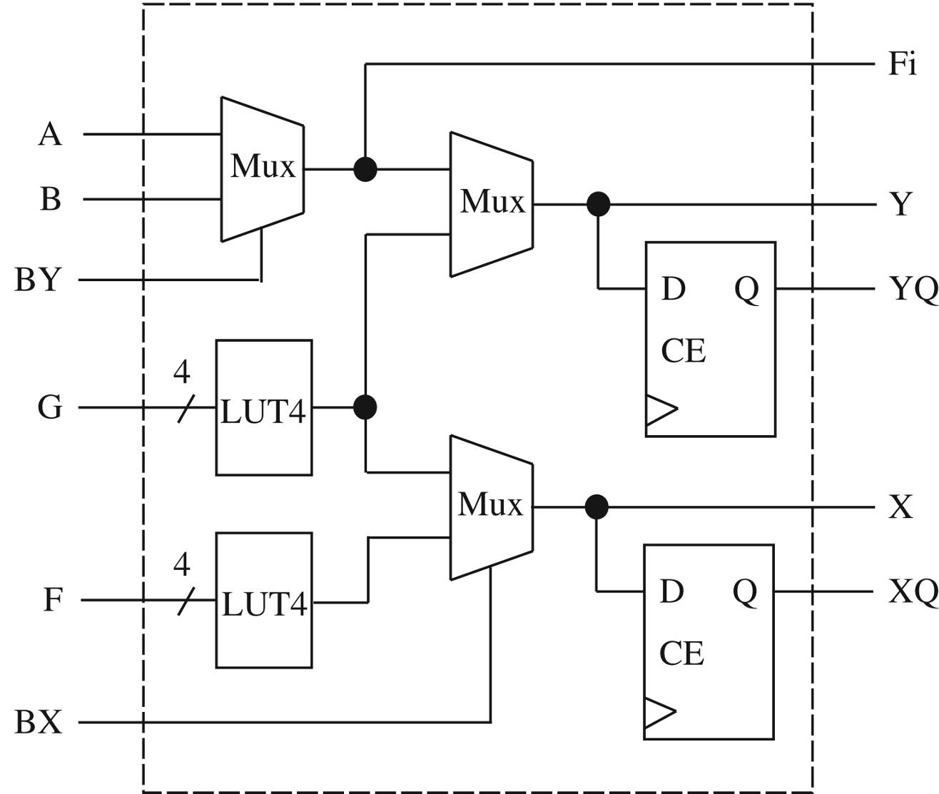
Xilinx Configurable Logic Block
418_06
Notes:
ELEC 418

Slide 9
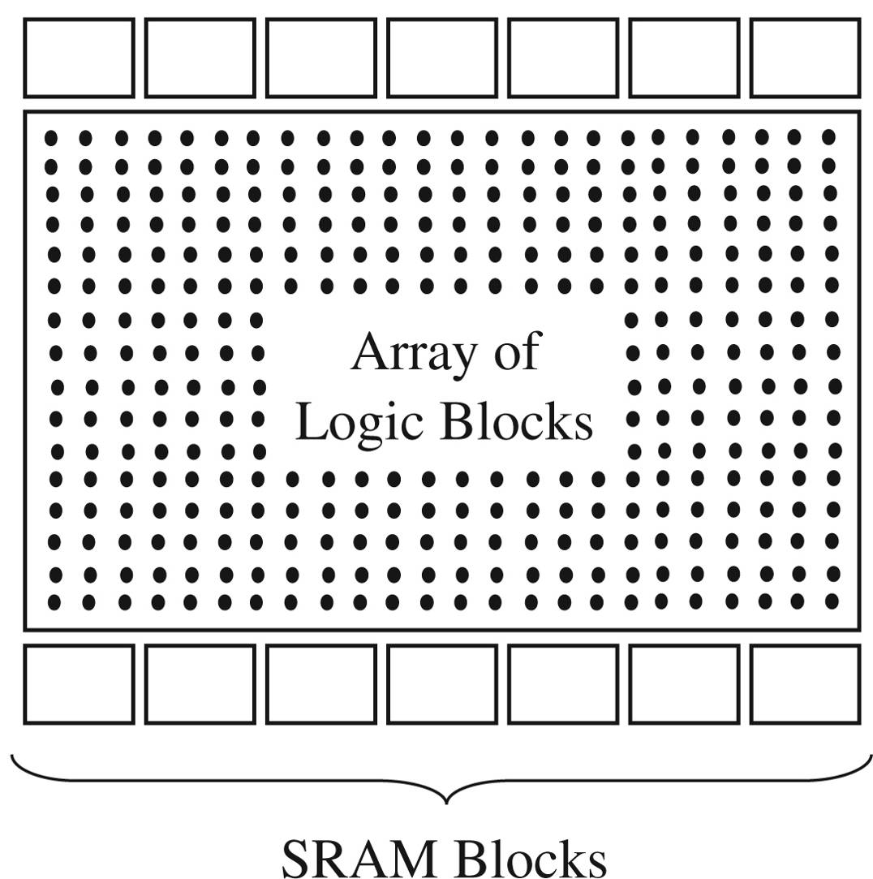
Dedicated Memory in FPGAs
418_06
Notes:
ELEC 418

Slide 10
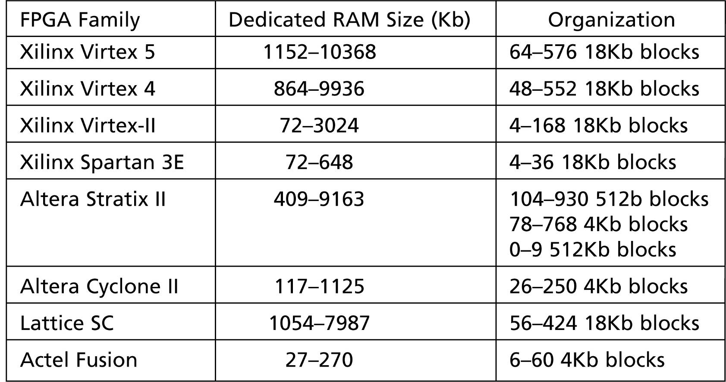
Example RAM Sizes
418_06
Notes:
ELEC 418

Slide 11
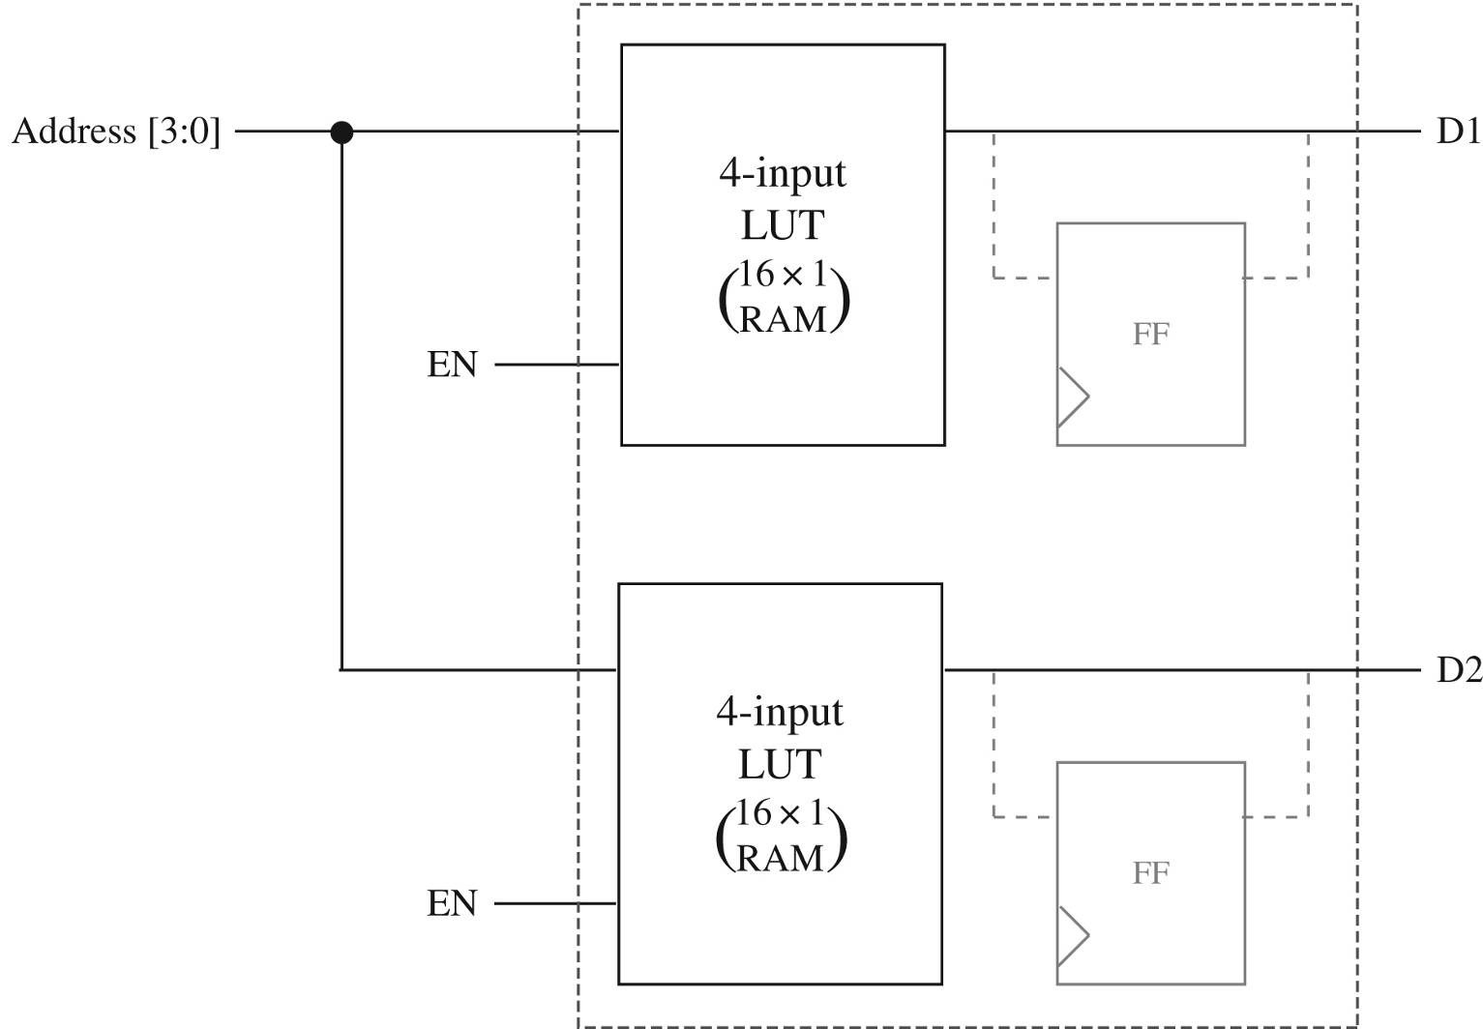
Memory From LUTs
418_06
Notes:
ELEC 418

Slide 12
VHDL Models for Memory
Synchronous or Asynchronous
Synchronous-Write, Asynchronous-Read
  LUT-Based Memory
Synchronous-Write, Synchronous-Read
  Dedicated (Block) Memory
418_06
Notes:
ELEC 418

Slide 13
VHDL Models for Memory
library IEEE;
use IEEE.STD_LOGIC_1164.ALL;
use IEEE.STD_LOGIC_UNSIGNED.ALL;
entity Memory is
port(Address: in STD_LOGIC_VECTOR(6 downto 0);
Clk, MemWrite: in STD_LOGIC;
Data_In: in STD_LOGIC_VECTOR(31 downto 0);
Data_out: out STD_LOGIC_VECTOR(31 downto 0));
end Memory;
418_06
Notes:
ELEC 418

Slide 14
LUT-Based Memory
architecture LUT of Memory is
type RAM is array (0 to 127) of
std_logic_vector(31 downto 0);
signal DataMEM: RAM;
begin
process(CLK)
begin
if rising_edge(CLK) then
if MemWrite = '1' then
DataMEM(conv_integer(Address)) <= Data_In;
end if;
end if;
end process;
Data_Out <= DataMEM(conv_integer(Address));
end LUT;
418_06
Notes:
ELEC 418

Slide 15
Dedicated Memory
architecture Dedicated of Memory is
type RAM is array (0 to 127) of
std_logic_vector(31 downto 0);
signal DataMEM: RAM;
begin
process(CLK)
begin
if rising_edge(CLK) then
if MemWrite = '1' then
DataMEM(conv_integer(Address)) <= Data_In;
end if;
Data_Out <= DataMEM(conv_integer(Address));
end if;
end process;
end Dedicated;
418_06
Notes:
ELEC 418

Slide 16
CAD Design Flow
Synthesis (Translation)
  Logic Optimization
Mapping
Placement
Routing
418_06
Notes:
ELEC 418

Slide 17
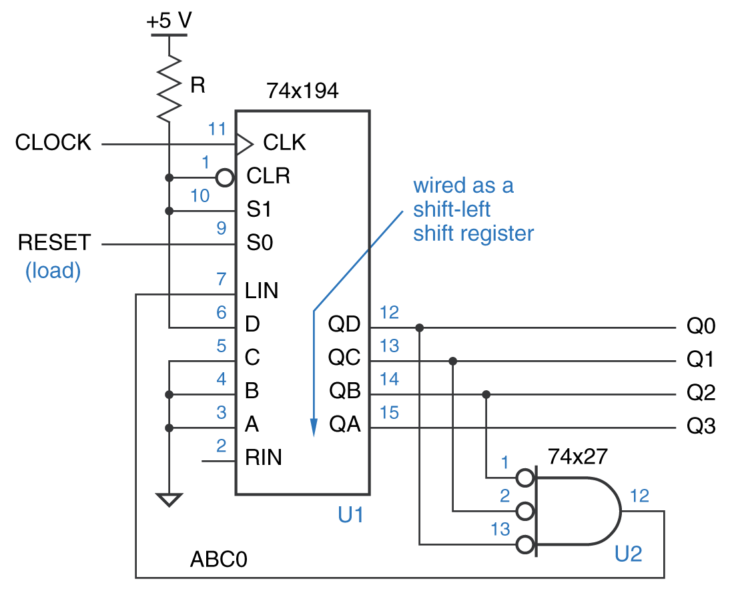
Self-Correcting Ring Counter
418_06
Notes:
ELEC 418

Slide 18
Synthesis Example
-- 4-std_logic Self-Correcting Ring Counter
library IEEE;
use IEEE.STD_LOGIC_1164.ALL;
entity RING_COUNT is
port (CLK, RESET: in std_logic;
Q : out std_logic_vector(3 downto 0));
end RING_COUNT;
architecture BEHAVE of RING_COUNT is
signal IQ : std_logic_vector(3 downto 0);
signal LIN : std_logic;
418_06
Notes:
ELEC 418

Slide 19
Synthesis Example
begin
LIN <= not IQ(2) and not IQ(1) and not IQ(0);
process(CLK)
begin
if rising_edge(CLK) then
if RESET = '1' then
IQ <= "0001";
else
IQ <= IQ(2 downto 0) & LIN;
end if;
end if;
end process;
Q <= IQ;
end BEHAVE;
418_06
Notes:
ELEC 418

Slide 20
Design Flow Continued
Mapping
  Process of binding technology-dependent circuits of target technology to technology-independent circuits in the design
    MUX, ROM, LUT, NAND, NOR
Placement
  Process of taking defined logic and I/O blocks and assigning them to physical locations
Routing
  Process of interconnecting the sub-blocks
418_06
Notes:
ELEC 418

Slide 21
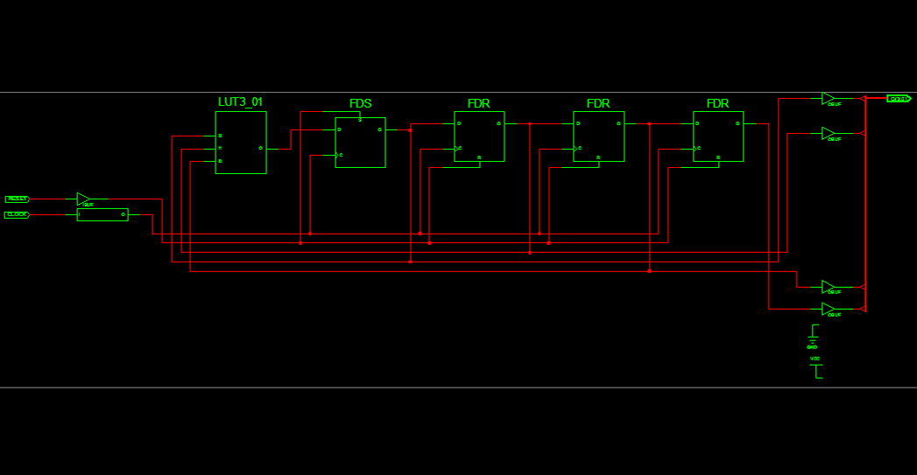
Mapping
418_06
Notes:
ELEC 418

Slide 22
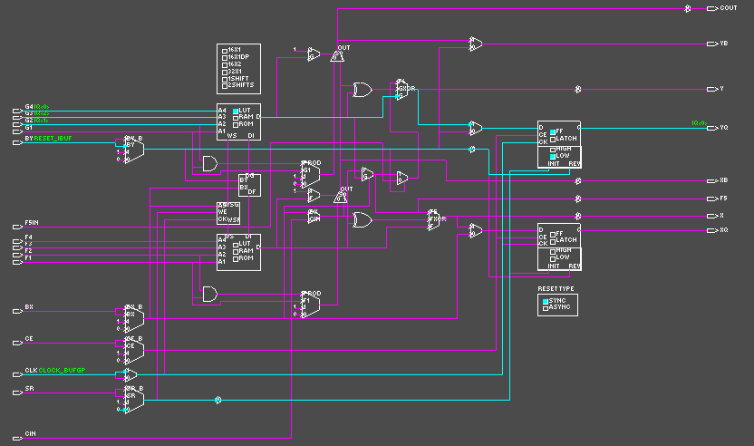
Placement
418_06
Notes:
ELEC 418

Slide 23
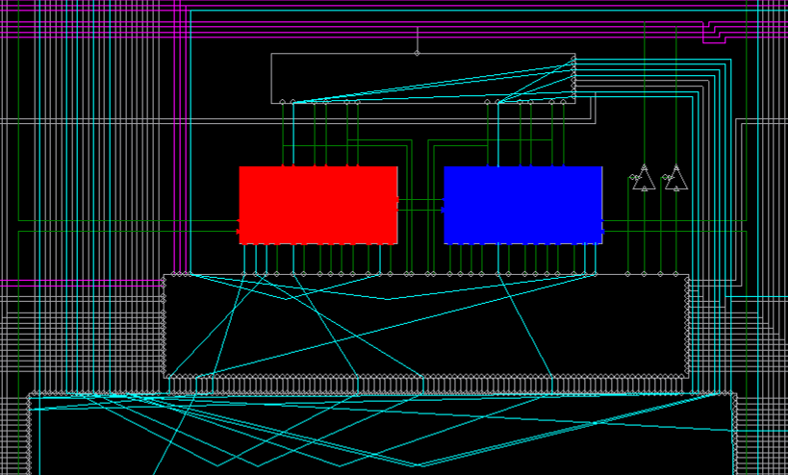
Routing
418_06
Notes:
ELEC 418

Slide 24
Summary
Designing with FPGAs
  Implementing Functions
  Memory
  CAD Design Flow
418_06
Notes:
ELEC 418

