Slide 1
Floating-Point Arithmetic
ELEC 418
Advanced Digital Systems
Dr. Ron Hayne
Images Courtesy of Thomson Engineering
Notes:
ELEC 418

Slide 2
IEEE 754 Floating-Point
Fraction
  Sign-Magnitude
IEEE Single Precision Format (32-bits)
IEEE Double Precision Format (64-bits)
Exponent
  Biased Notation
418_07
Notes:
ELEC 418

Slide 3
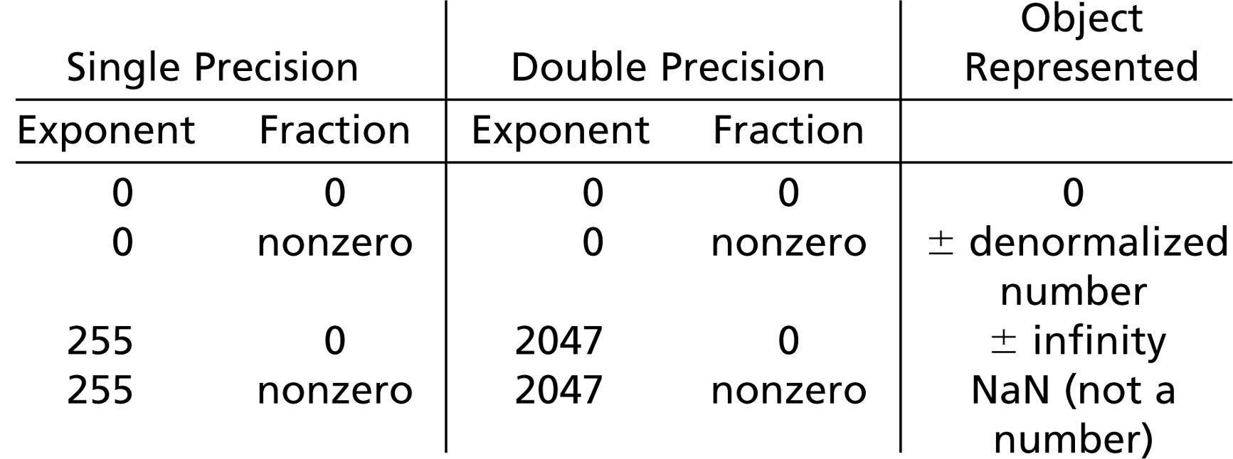
Special Cases
418_07
Notes:
ELEC 418

Slide 4
A Simple Floating-Point Format
N = F x 2E
  Fraction
    4-bit 2's Complement
    s.fff
    Range -1 to +0.875
  Exponent
    4-bit 2's Complement
    eeee
    Range -8 to +7
  Normalization
    Shift left until sign bit and next bit are different
  Zero
    F = 0.000
    E = 1000
    N = 0.000 x 2⁻⁸
418_07
Notes:
ELEC 418

Slide 5
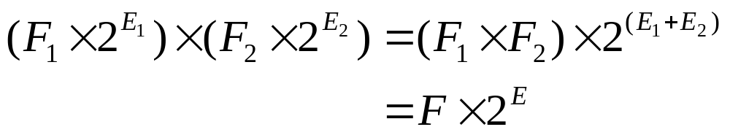
Floating-Point Multiplication
Add exponents
Multiply fractions
If product is 0, adjust for proper 0
Normalize product fraction
Check for exponent overflow or underflow
Round product fraction
418_07
Notes:
ELEC 418

Slide 6
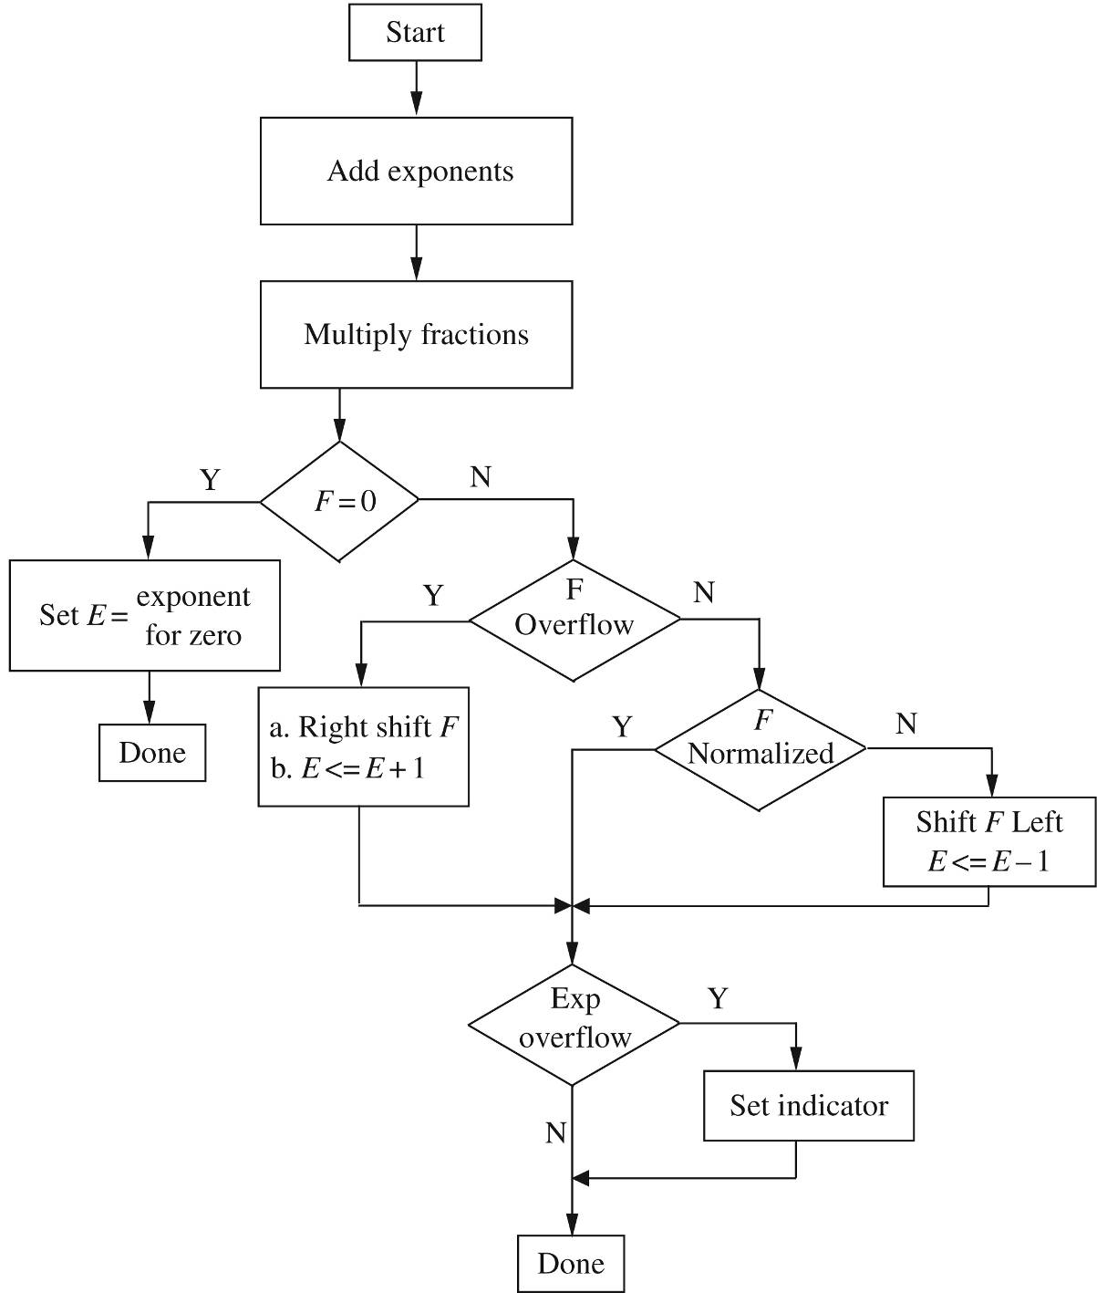
Notes:
ELEC 418

Slide 7
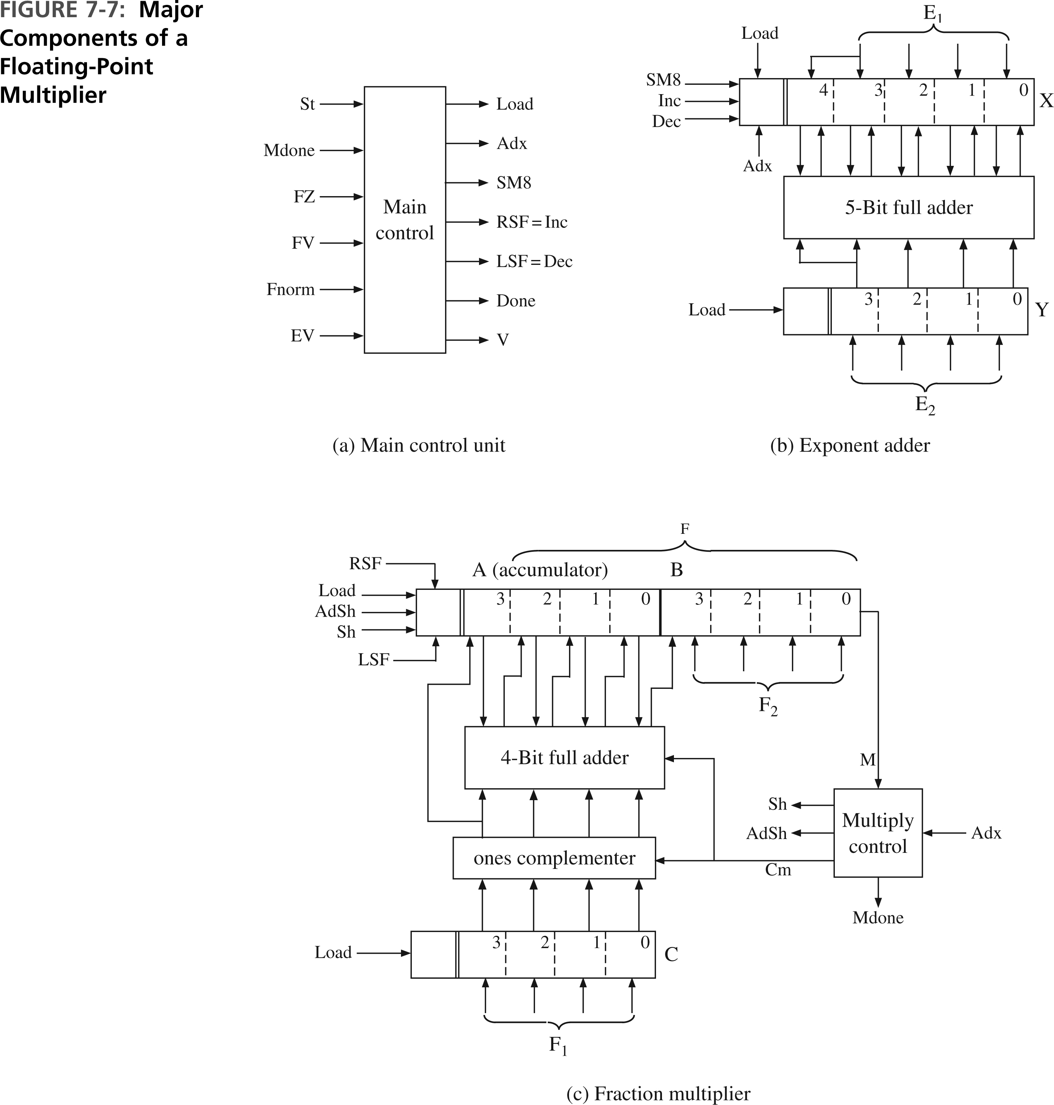
Floating-Point Hardware
418_07
Notes:
ELEC 418

Slide 8
Floating-Point Hardware
418_07
Notes:
ELEC 418

Slide 9
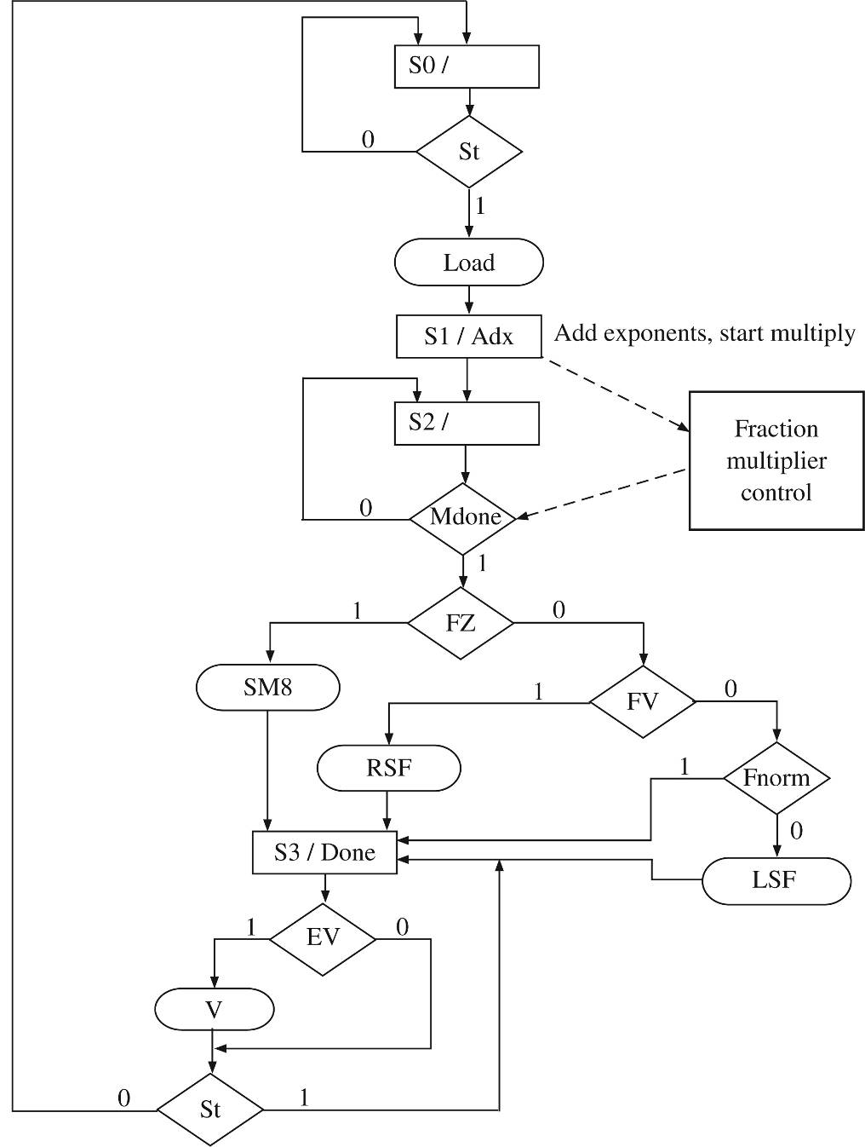
SM Chart
418_07
Notes:
ELEC 418

Slide 10
VHDL Model
library IEEE;
use ieee.std_logic_1164.all;
use ieee.std_logic_unsigned.all;
entity FMUL is
port(CLK, St: in std_logic;
F1, E1, F2, E2: in std_logic_vector(3 downto 0);
F: out std_logic_vector(6 downto 0);
E: out std_logic_vector(4 downto 0);
V, done: out std_logic);
end FMUL2;
418_07
Notes:
ELEC 418

Slide 11
VHDL Model
architecture BEHAVE of FMUL is
signal A, B, C: std_logic_vector(3 downto 0);--F regs
signal compout, addout: std_logic_vector(3 downto 0);
alias M: std_logic is B(0);
signal X, Y: std_logic_vector(4 downto 0); -- E regs
signal Load, Adx, SM8, RSF, LSF: std_logic; -- Main
signal AdSh, Sh, Cm, Mdone: std_logic; -- Mult
signal PS1, NS1: integer range 0 to 3;-- Main state
signal State, Nextstate: integer range 0 to 4;-- Mult
418_07
Notes:
ELEC 418

Slide 12
VHDL Model
begin
main_control: process(PS1, St , Mdone, X, A, B)
begin
Load <= '0'; Adx <= '0'; NS1 <= 0; SM8 <= '0';
RSF <= '0'; LSF <= '0'; V <= '0'; done <= '0';
case PS1 is
when 0 =>
if St = '1' then
Load <= '1';
NS1 <= 1;
end if;
when 1 =>
Adx <= '1';
NS1 <= 2;
418_07
Notes:
ELEC 418

Slide 13
VHDL Model
when 2 =>
if Mdone = '1' then
if A = 0 then -- FZ
SM8 <= '1';
elsif A = 4 and B = 0 then -- FV
RSF <= '1';
elsif A(2) = A(1) then -- not Fnorm
LSF <= '1';
end if;
NS1 <= 3;
else
NS1 <= 2;
end if;
418_07
Notes:
ELEC 418

Slide 14
VHDL Model
when 3 =>
done <= '1';
if X(4) /= X(3) then -- EV
V <= '1';
end if;
if ST = '0' then
NS1 <= 0;
end if;
end case;
end process main_control;
418_07
Notes:
ELEC 418

Slide 15
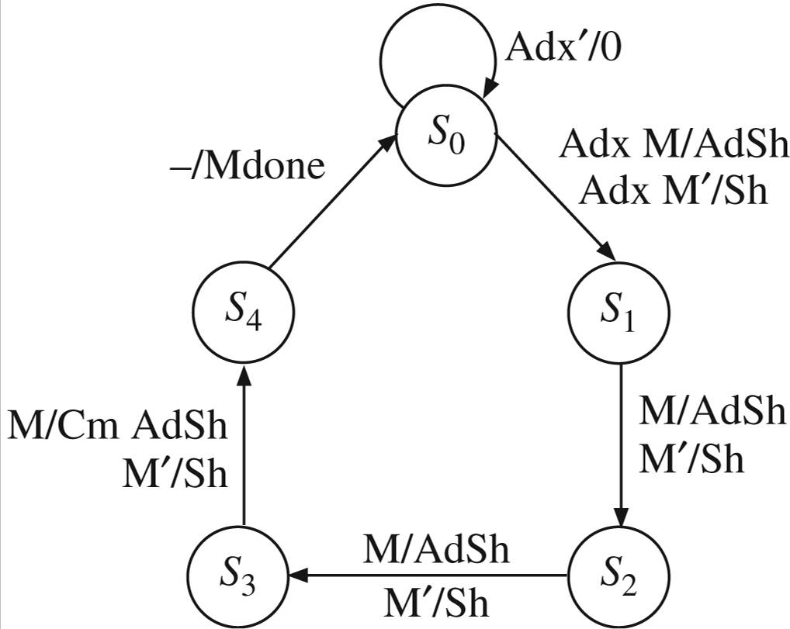
Multiplier Control
418_07
Notes:
ELEC 418

Slide 16
VHDL Model
mul2c: process(State, Adx, M)
begin
AdSh <= '0'; Sh <= '0'; Cm <= '0'; Mdone <= '0';
Nextstate <= 0;
case State is
when 0 =>
if Adx = '1' then
if M = '1' then
AdSh <= '1';
else
Sh <= '1';
end if;
Nextstate <= 1;
end if;
418_07
Notes:
ELEC 418

Slide 17
VHDL Model
when 1 | 2 =>
if M = '1' then
AdSh <= '1';
else
Sh <= '1';
end if;
Nextstate <= State + 1;
418_07
Notes:
ELEC 418

Slide 18
VHDL Model
when 3 =>
if M = '1' then
Cm <= '1';
AdSh <= '1';
else
Sh <='1';
end if;
Nextstate <= 4;
when 4 =>
Mdone <= '1';
Nextstate <= 0;
end case;
end process mul2c;
418_07
Notes:
ELEC 418

Slide 19
Data Path
418_07
Notes:
ELEC 418

Slide 20
VHDL Model
compout <= not C when Cm = '1' else C;
addout <= A + compout + Cm;
datapath: process(CLK)
begin
if rising_edge(CLK) then
PS1 <= NS1;
State <= Nextstate;
if Load = '1' then
X <= E1(3) & E1;
Y <= E2(3) & E2;
A <= "0000";
B <= F2;
C <= F1;
end if;
418_07
Notes:
ELEC 418

Slide 21
VHDL Model
if ADX = '1' then
X <= X + Y;
end if;
if SM8 = '1' then
X <= "11000";
end if;
418_07
Notes:
ELEC 418

Slide 22
VHDL Model
if RSF = '1' then
A <= '0' & A(3 downto 1);
B <= A(0) & B(3 downto 1);
X <= X + 1;
end if;
if LSF = '1' then
A <= A(2 downto 0) & B(3);
B <= B(2 downto 0) & '0';
X <= X - 1;
end if;
418_07
Notes:
ELEC 418

Slide 23
VHDL Model
if AdSh = '1' then
A <= compout(3) & addout(3 downto 1);
B <= addout(0) & B(3 downto 1);
end if;
if Sh = '1' then
A <= A(3) & A(3 downto 1);
B <= A(0) & B(3 downto 1);
end if;
end if;
end process datapath;
F <= A(2 downto 0) & B;
E <= X;
end BEHAVE;
418_07
Notes:
ELEC 418

Slide 24
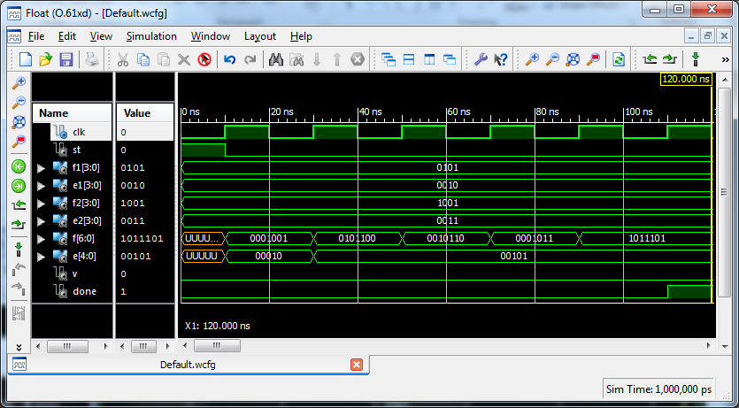
VHDL Simulation
418_07
Notes:
ELEC 418

Slide 25
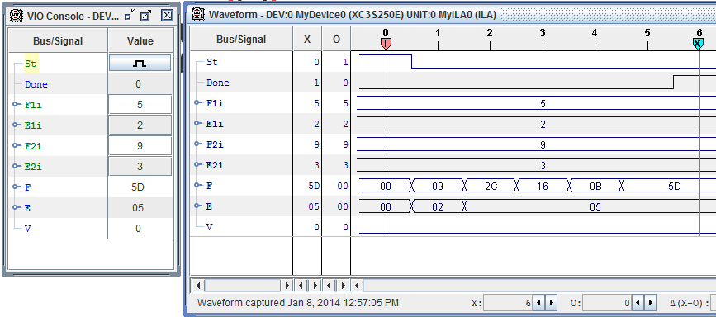
FPGA Implementation
418_07
Notes:
ELEC 418

Slide 26
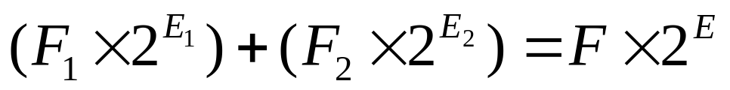
Floating-Point Addition
Compare exponents. If not equal, shift smaller fraction to right and add 1 to exponent (repeat).
Add fractions.
If result is 0, adjust for proper 0.
If fraction overflow, shift right and add 1.
If unnormalized, shift left and subtract 1 (repeat).
Check for exponent overflow.
Round fraction. If not normalized, go to step 4.
418_07
Notes:
ELEC 418

Slide 27
Floating-Point Hardware
Comparator for exponents (step 1a)
Shift register (right), incrementer (step 1b)
ALU (adder) to add fractions (step 2)
Shifter (right/left), incrementer/decrementer (steps 4,5)
Overflow detector (step 6)
Rounding hardware (step 7)
418_07
Notes:
ELEC 418

Slide 28
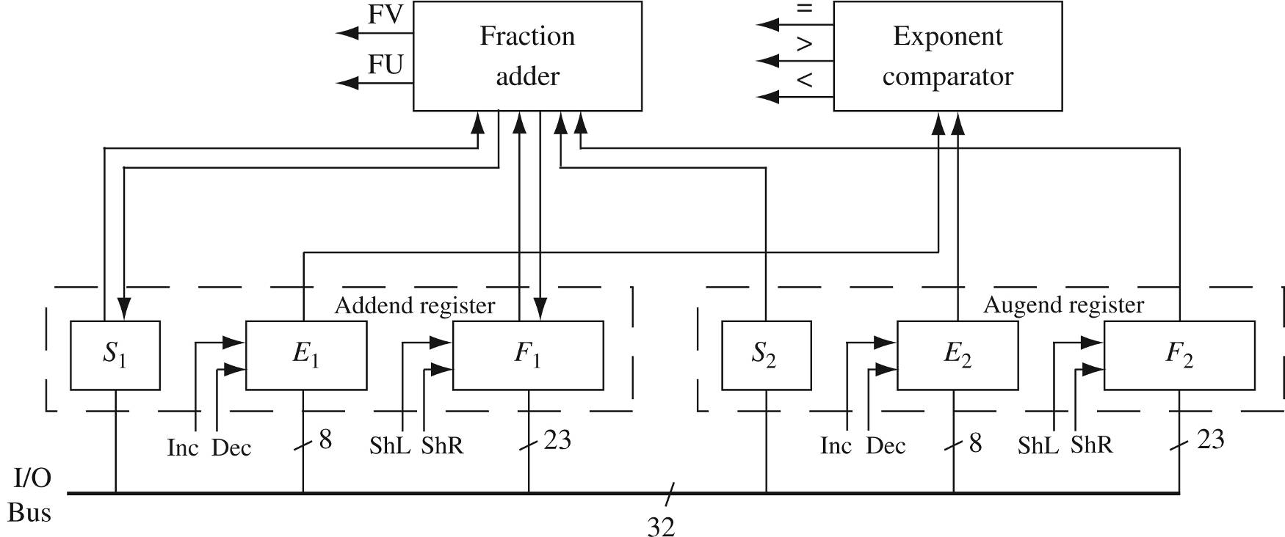
Floating-Point Adder
* IEEE Format
418_07
Notes:
ELEC 418

Slide 29
VHDL Model
entity FPADD is
port(CLK, St: in std_logic;
done, ovf, unf: out std_logic;
FPinput: in std_logic_vector(31 downto 0);
FPsum: out std_logic_vector(31 downto 0));
end FPADD;
architecture FPADDER of FPADD is
signal F1, F2: std_logic_vector(25 downto 0);
signal E1, E2: std_logic_vector(7 downto 0);
signal S1, S2, FV, FU: std_logic;
signal F1comp, F2comp: std_logic_vector(27 downto 0);
signal Addout, Fsum: std_logic_vector(27 downto 0);
signal State: integer range 0 to 6;
418_07
Notes:
ELEC 418

Slide 30
VHDL Model
begin
F1comp <= not("00" & F1) + 1 when S1 = '1' else
"00" & F1;
F2comp <= not("00" & F2) + 1 when S2 = '1' else
"00" & F2;
Addout <= F1comp + F2comp;
Fsum <= Addout when Addout(27) = '0' else
not Addout + 1;
FV <= Fsum(27) xor Fsum(26);
FU <= not F1(25);
FPsum <= S1 & E1 & F1(24 downto 2);
418_07
Notes:
ELEC 418

Slide 31
VHDL Model
process(CLK)
begin
if rising_edge(CLK) then
case State is
when 0 =>
if St = '1' then
E1 <= FPinput(30 downto 23); S1 <= FPinput(31);
F1(24 downto 0) <= FPinput(22 downto 0) & "00";
if FPinput = 0 then
F1(25) <= '0';
else
F1(25) <= '1';
end if;
done <= '0'; ovf <= '0'; unf <= '0'; State <= 1;
end if;
418_07
Notes:
ELEC 418

Slide 32
VHDL Model
when 1 =>
E2 <= FPinput(30 downto 23); S2 <= FPinput(31);
F2(24 downto 0) <= FPinput(22 downto 0) & "00";
if FPinput = 0 then
F2(25) <= '0';
else
F2(25) <= '1';
end if;
State <= 2;
418_07
Notes:
ELEC 418

Slide 33
VHDL Model
when 2 =>
if F1 = 0 or F2 = 0 then
State <= 3;
else
if E1 = E2 then
State <= 3;
elsif E1 < E2 then
F1 <= '0' & F1(25 downto 1); E1 <= E1 + 1;
else
F2 <= '0' & F2(25 downto 1); E2 <= E2 + 1;
end if;
end if;
418_07
Notes:
ELEC 418

Slide 34
VHDL Model
when 3 =>
S1 <= Addout(27);
if FV = '0' then
F1 <= Fsum(25 downto 0);
else
F1 <= Fsum(26 downto 1); E1 <= E1 + 1;
end if;
State <= 4;
when 4 =>
if F1 = 0 then
E1 <= "00000000"; State <= 6;
else
State <= 5;
end if;
418_07
Notes:
ELEC 418

Slide 35
VHDL Model
when 5 =>
if E1 = 0 then
unf <= '1'; State <= 6;
elsif FU = '0' then
State <= 6;
else
F1 <= F1(24 downto 0) & '0'; E1 <= E1 - 1;
end if;
when 6 =>
if E1 = 255 then
ovf <= '1';
end if;
done <= '1'; State <= 0;
end case; end if; end process; end FPADDER;
418_07
Notes:
ELEC 418

Slide 36
Summary
IEEE Floating-Point Formats
Simple Floating-Point Format
Floating-Point Multiplication
Floating-Point Addition
418_07
Notes:
ELEC 418

