Slide 1
Additional VHDL
ELEC 418
Advanced Digital Systems
Dr. Ron Hayne
Images Courtesy of Thomson Engineering
Notes:
ELEC 418

Slide 2
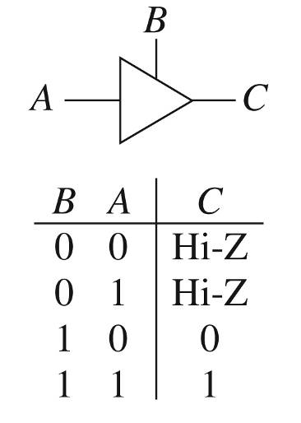
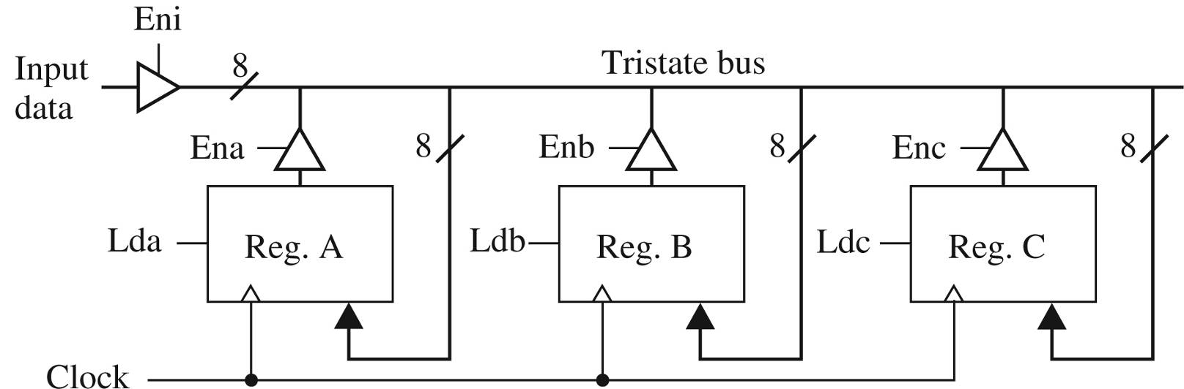
Tristate Logic and Busses
418_08
Notes:
ELEC 418

Slide 3
IEEE 1164 Standard Logic
9-Valued Logic System
  'U' Uninitialized
  'X' Forcing Unknown
  '0' Forcing 0
  '1' Forcing 1
  'Z' High Impedance
  'W' Weak Unknown
  'L' Weak 0
  'H' Weak 1
  '-' Don't Care
418_08
Notes:
ELEC 418

Slide 4
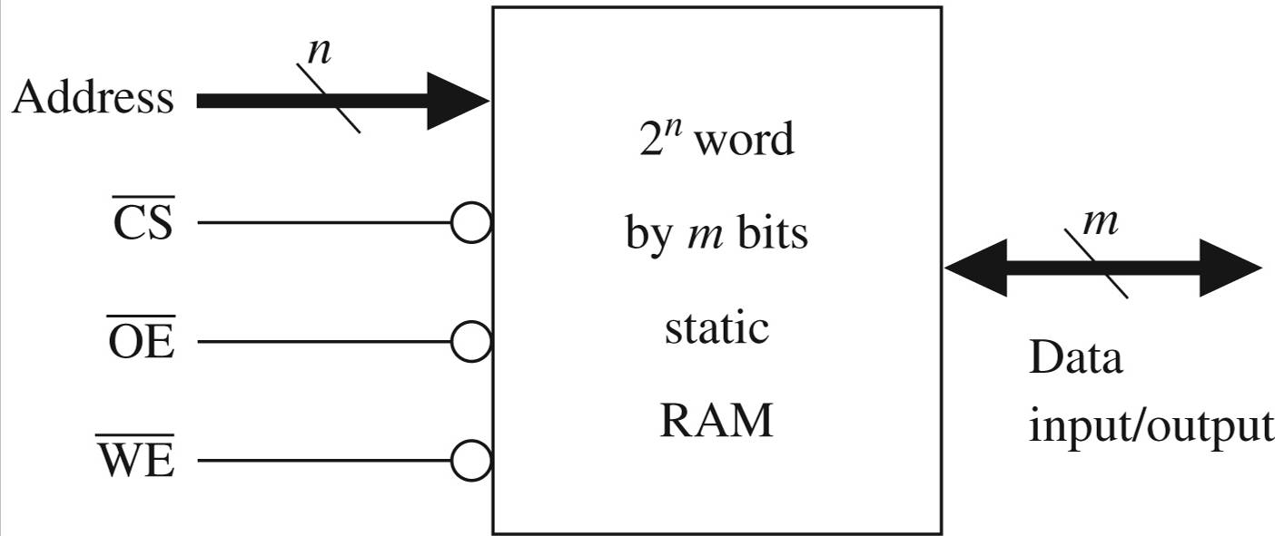
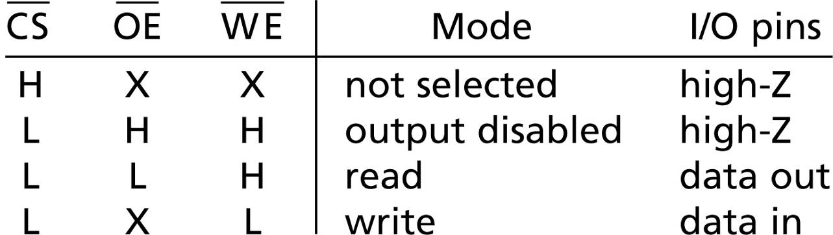
SRAM Model
418_08
Notes:
ELEC 418

Slide 5
VHDL Model
library IEEE;
use IEEE.std_logic_1164.all;
use IEEE.std_logic_unsigned.all;
entity RAM6116 is
port(Cs_b, We_b, Oe_b: in std_logic;
Address: in std_logic_vector(7 downto 0);
IO: inout std_logic_vector(7 downto 0));
end RAM6116;
418_08
Notes:
ELEC 418

Slide 6
VHDL Model
architecture simple_ram of RAM6116 is
type RAMtype is array(0 to 255) of
std_logic_vector(7 downto 0);
signal RAM1: RAMtype;
begin
IO <= RAM1(conv_integer(Address)) when Cs_b = '0'
and Oe_b = '0'
and We_b = '1'
else "ZZZZZZZZ";
418_08
Notes:
ELEC 418

Slide 7
VHDL Model
process(We_b, Cs_b)
begin
if Cs_b = '0' and rising_edge(We_b) then
RAM1(conv_integer(Address)) <= IO;
end if;
end process;
end simple_ram;
418_08
Notes:
ELEC 418

Slide 8
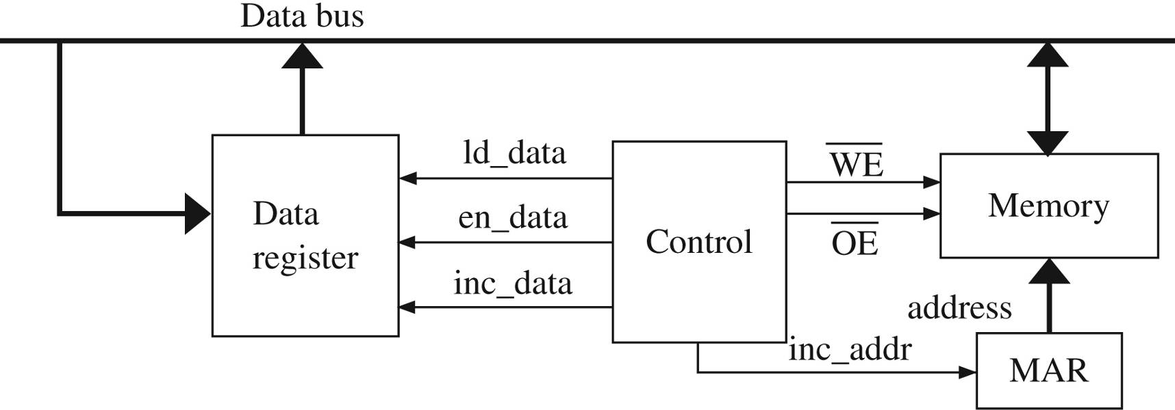
SRAM Read/Write System
Reads contents of 32 memory locations
Increments each data value
Stores data back into RAM
418_08
Notes:
ELEC 418

Slide 9
Generics
library IEEE;
use IEEE.std_logic_1164.all;
entity Businv is
generic(width: positive);
port(x: in std_logic_vector(width-1 downto 0);
y: out std_logic_vector(width-1 downto 0));
end Businv;
architecture Behave of Businv is
begin
y <= not x;
end Behave;
418_08
Notes:
ELEC 418

Slide 10
Generic Instantiation
entity Businv_8 is
port(in8: in std_logic_vector(7 downto 0);
out8: out std_logic_vector(7 downto 0));
end Businv_8;
architecture Structure of Businv_8 is
component Businv
generic(width: positive);
port(x: in std_logic_vector(width-1 downto 0);
y: out std_logic_vector(width-1 downto 0));
end component;
begin
B1: Businv generic map(8) port map(in8, out8);
end Structure;
418_08
Notes:
ELEC 418

Slide 11
Time Modeling
library IEEE;
use IEEE.std_logic_1164.all;
entity xor2 is
generic(gate_delay: time := 2 ns);
port(in1, in2: in std_logic;
z: out std_logic);
end xor2;
architecture behave of xor2 is
begin
z <= in1 xor in2 after gate_delay;
end behave;
418_08
Notes:
ELEC 418

Slide 12
Named Association
component FA is
port(X, Y, Cin: in std_logic;
Cout, Sum: out std_logic);
end component;
FA0: FA port map(A(0), B(0), '0', open, S(0));
FA0: FA port map(Sum => S(0),
X => A(0),
Y => B(0),
Cin => '0');
418_08
Notes:
ELEC 418

Slide 13
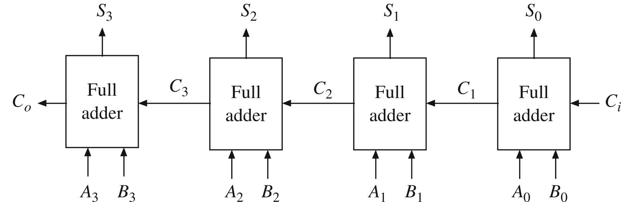
Regular Structures (Generate)
entity Adder4 is
port(A, B: in std_logic_vector(3 downto 0);
Ci: in std_logic;
S: out std_logic_vector(3 downto 0);
Co: out std_logic);
end Adder4;
418_08
Notes:
ELEC 418

Slide 14
Generate Statements
architecture Structure of Adder4 is
component FullAdder
port(X, Y, Cin: in std_logic;
Cout, Sum: out std_logic);
end component;
signal C: std_logic_vector(4 downto 0);
begin
C(0) <= Ci;
Co <= C(4);
FullAdd4: for i in 0 to 3 generate
begin
FAx: FullAdder port map (A(i), B(i), C(i),
C(i+1), S(i));
end generate FullAdd4;
end Structure;
418_08
Notes:
ELEC 418

Slide 15
Summary
IEEE 1164 Standard logic
Generics
Named Association
Generate Statements
418_08
Notes:
ELEC 418

