Slide 1
Processor Design
ELEC 418
Advanced Digital Systems
Dr. Ron Hayne
Images Courtesy of Thomson Engineering
Notes:
ELEC 418

Slide 2
68HC11 Programming Model
Motorola 68HC11 Microcomputer
7 A 0 | 7 B 0 |  |  |  |  |  |  |  | 8-bit Accumulators A & B
15 D 0 |  |  |  |  |  |  |  |  | 16-bit Double Accumulator D
15 X 0 |  |  |  |  |  |  |  |  | Index Register X
15 Y 0 |  |  |  |  |  |  |  |  | Index Register Y
15 SP 0 |  |  |  |  |  |  |  |  | Stack Pointer
15 PC 0 |  |  |  |  |  |  |  |  | Program Counter
 | S | X | H | I | N | Z | V | C | Condition Code Register
418_09
Notes:
ELEC 418

Slide 3
68HC11 Instruction Set Table
Source Form | Operation | Boolean Expression | Addr. Mode | Machine Code |  | Bytes | Cycles
 |  |  |  | Op Code | Op-erand
ABX | Add B to X | X + 00:B → X | INH | 3A |  | 1 | 3
• | • | • | • | • | • | • | •
ADDA (opr) | Add Memory to A | A + M → A | A IMM A DIR A EXT A IND,X A IND,Y | 8B 9B BB AB 18 AB | ii dd hh ll ff ff | 22323 | 23445
• | • | • | • | • | • | • | •
CLC | Clear Carry Bit | 0 → C | INH | 0C |  | 1 | 2
• | • | • | • | • | • | • | •
LDX (opr) | Load Index Register X | M:(M + 1) → X | X IMM X DIR | CE DE | jj kk dd | 32 | 34
418_09
Notes:
ELEC 418

Slide 4
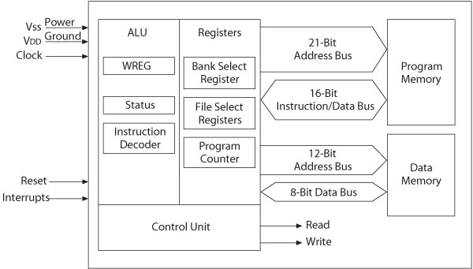
PIC18F – MPU and Memory
418_09

Slide 5
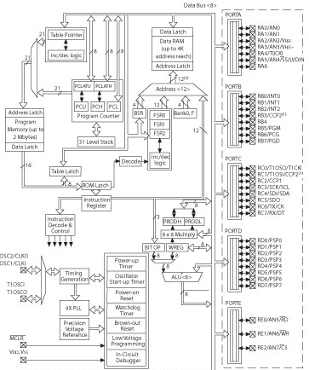
PIC18F4X2 Architecture Block Diagram
418_09

Slide 6
MIPS ISA
Instruction Set Architecture
  32 General-Purpose Registers (32-bits)
  3 Instruction Formats
    R-format (register)
    I-format (immediate)
    J-format (jump)
  1 Addressing Mode
    Base register and signed offset
418_09
Notes:
ELEC 418

Slide 7
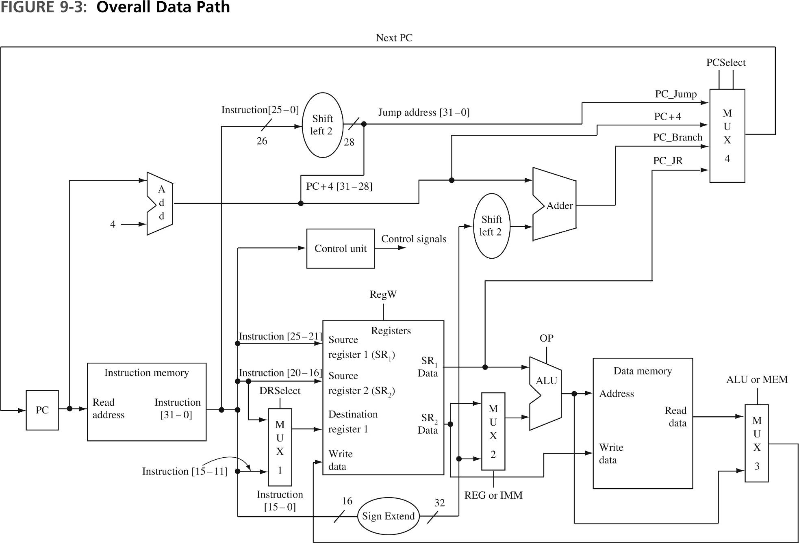
418_09
Notes:
ELEC 418

Slide 8
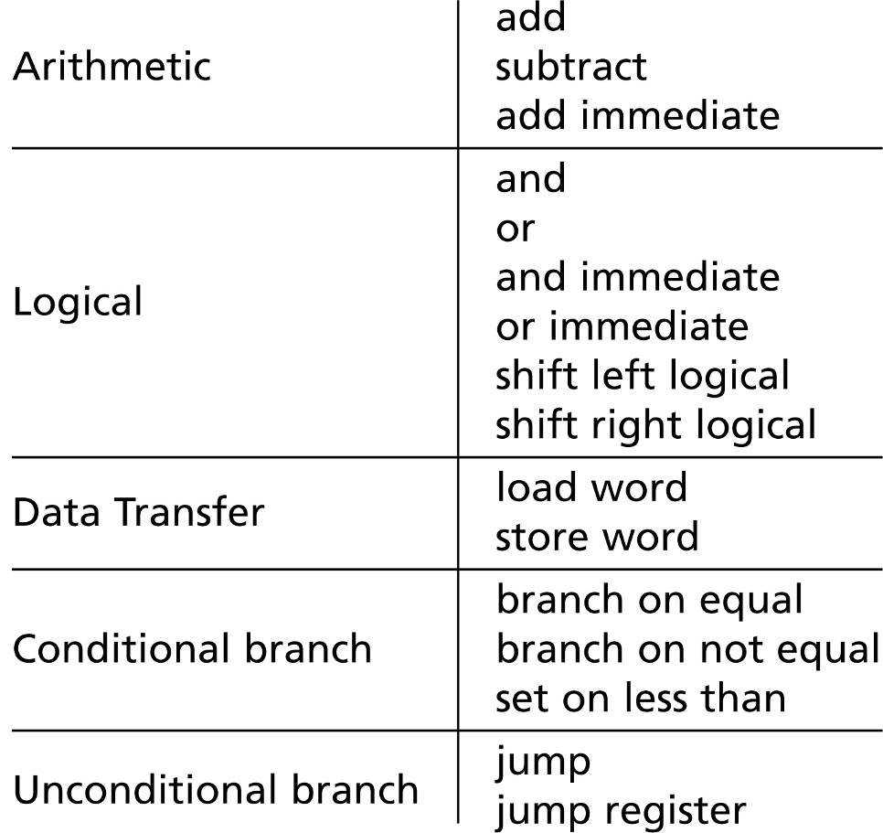
Data Path Design
MIPS Subset
Sequence of Operations
  Fetch an Instruction
  Decode the Instruction
  Execute the Instruction
418_09
Notes:
ELEC 418

Slide 9
Instructional Processor Design
3 Bus Organization
  16 bit Data Path
4 Word Register File
4K Word Memory
8 Function ALU
  2 Condition Code Flags
5 Data Instructions
  4 Addressing Modes
4 Branch Instructions
418_09
Notes:
ELEC 418

Slide 10
Data Path & Memory
STACK
BUS A
BUS B
BUS C
 | Memory
000 | I/O
007
008 | Data
07F
080 | Program
FFF
PC
12
IR
1
A1
A2
REGS
2
2
MUX
A
ALU
R
MUX
B
STATUS
NZ
MDR
MAR
12
MEM
Notes:
ECE 445
RJH

Slide 11
ALU Multiplexers
BUS A₁₅₋₅
0's,A₁₀₋₉
0's,A₁₀₋₅
1's,A₁₀₋₉
1's,A₁₀₋₅
BUS A₄₋₀
0
1
0
1
S
S
Branch
BUS B₁₅₋₅
0's,B₁₀₋₉
0's,B₆₋₅
BUS B₄₋₀
0
1
0
1
S
Sign
(IR₁₀)
S
SRC or
DST
0
1
0
1
S
Extend
S
Address
11
5
11
5
ALU A₁₅₋₅
ALU A₄₋₀
ALU B₁₅₋₅
ALU B₄₋₀
418_09
Notes:
ECE 445
RJH

Slide 12
Data Path Registers & Memory
Program Counter (PC)
  12-bit Program Address
Subroutine Stack (STACK)
  16 x 12-bit Addresses
Instruction Register (IR)
  16-bit Instructions
Register File (REGS)
  4 x 16-bit Registers
Arithmetic Logic Unit (ALU)
  8 Functions (ALU_OP)
Flag Register (STATUS)
  Negative Flag (N)
  Zero Flag (Z)
Memory Data Register (MDR)
  16-bits to/from Memory
Memory Address Reg (MAR)
  12-bit Memory Address
Memory (MEM)
  4K x 16-bit Memory
418_09

Slide 13
Memory Map
4K (4096) RAM
  8 Memory-mapped I/O Ports
    0x000 Switch (Input)
    0x001 LED (Output)
  120 Data Memory Locations
    0x008 - 0x07F
  3968 Program Memory Locations
    0x080 - 0xFFF
418_09
Notes:
ELEC 418

Slide 14
Addressing Modes
Method of specifying of an operand
  Immediate (Literal) addressing
    The operand is a number that follows the opcode
  Direct (Absolute) addressing
    The address of the operand is a part of the instruction
  Indirect addressing
    An address is specified in a register (pointer) and the MPU looks up the address in that register
418_09

Slide 15
Data Instruction Format
15 14 13 12 11 10 9 8 7 6 5 4 3 2 1 0
OP
SRC
DST
VALUE
IR
 | Mode | REG # | Name | Syntax | Effective Address
SRC or DST | 00 | 00-11 | Register Direct | Rn | EA = Rn
 | 01 | 00-11 | Register Indirect | (Rn) | EA = [Rn]
 | 10 | vv | Absolute | Value | EA = Value
 | 11* | vv | Immediate | #Value | Operand = Value
EA = Effective Address
vv = Upper 2 bits of Value
* = SRC only
418_09
Notes:
ECE 445
RJH

Slide 16
Data Instructions
OP | Fn | Assembly Language | Register Transfer Notation (RTN)
000 | MOVE | MOVE SRC,DST | DST ← SRC
001 | ADD | ADD SRC,DST | DST ← SRC + DST
010 | INV | INV SRC,DST | DST ← not SRC
011 | AND | AND SRC,DST | DST ← SRC and DST
100 | ROTL | ROTL SRC,DST | DST ← SRC(14 dt 0) & SRC(15)
...
418_09
Notes:
ECE 445
RJH

Slide 17
Branch Instruction Format
15 14 13 12 11 10 9 8 7 6 5 4 3 2 1 0
OP
MD
OFFSET
IR
OP | MD | Fn | Assy Lang | RTN
111 | 00 | BRA | BRA Offset | PC ← PC + Offset
 | 01 | BGTZ | BGTZ Offset | PC ← PC + Offset (STATUS > 0)
 | 10 | BSR | BSR Offset | STACK ← PC; PC ← PC + Offset
 | 11 | RTN | RTN | PC ← STACK
418_09
Notes:
ECE 445
RJH

Slide 18
Assembly Language Program
MOVE N,R1
MOVE #NUM1,R2
MOVE #0,R0
LOOP ADD (R2),R0
ADD #1,R2
ADD #-1,R1
BGTZ LOOP
MOVE R0,SUM
STOP BRA STOP
 | . . .
SUM
N | n
NUM1
NUM2
 | . . .
NUMn
418_09
Notes:
ECE 445
RJH

Slide 19
Control Unit Organization
CLK
Control Step
Counter
Step DCD
I₀
T₀
. . .
T₇
Instruction
DCD
. . .
I₇
M₀
N
SRC_MODE
DCD
STATUS
IR
M₃
Encoder
. . .
. . .
C
M₀
DST_MODE
DCD
M₃
. . .
Clear
Control
Signals
418_09
Notes:
ECE 445
RJH

Slide 20
Control Signals
BUS_A
BUS_B
REGS_Read1
REGS_Read2
Extend
Address
ALU_Op
MEM_Read
MEM_Write
Inc_PC
Load_PC
Push_PC
Pop_PC
Load_IR
REGS_Write
Load_STATUS
Load_MDR
Load_MAR
Clear
418_09
Notes:
ELEC 418

Slide 21
Control Unit Design
Instruction Fetch
Step | RTN | Control Signals
T0 | MAR ← PC, PC ← PC + 1 | BUS_B <= PC ALU_OP <= Pass_B Load_MAR <= ‘1’ Inc_PC <= ‘1’
T1 | MDR ← MEM(MAR) | MEM_Read <= ‘1’ Load_MDR <= ‘1’
T2 | IR ← MDR | BUS_B <= MDR ALU_OP <= Pass_B Load_IR <= ‘1’
418_09
Notes:
ELEC 418

Slide 22
Control Unit Design
Instruction Execute
  MOVE Rs,Rd
    Register Direct (M0), Register Direct (M0)
Step | RTN | Control Signals
T3 | R(D) ← R(S) | REGS_Read1 <= ‘1’ ALU_OP <= Pass_A Load_STATUS <= ‘1’ REGS_Write <= ‘1’ Clear <= ‘1’
418_09
Notes:
ELEC 418

Slide 23
Control Unit Design
Instruction Execute
  MOVE Value,Rd
    Immediate (M3), Register Direct (M0)
Step | RTN | Control Signals
T3 | R(D) ← Value | BUS_A <= IR Extend <= ‘1’ ALU_OP <= Pass_A Load_STATUS <= ‘1’ REGS_Write <= ‘1’ Clear <= ‘1’
418_09
Notes:
ELEC 418

Slide 24
Control Unit Design
Instruction Execute
  BRA Offset
    Branch Always
    OP (111), Mode (M0)
Step | RTN | Control Signals
T3 | PC ← PC + Offset | BUS_A <= IR BUS_B <= PC Extend <= '1' ALU_OP <= ADD Load_PC <= '1' Clear <= '1'
418_09
Notes:
ELEC 418

Slide 25
VHDL Model (Phase 1)
Data Path
  Components
Control Unit
  Instruction Fetch
  Instruction Execute
First Test Program
  program1.asm
  program1.bin
  MOVE #3,R1
  MOVE R1,R2
  STOP BRA STOP
418_09
Notes:
ELEC 418

Slide 26
VHDL Model (Phase 1)
BUS A
BUS B
BUS C
processor1.vhd
processor1_components.vhd
PC
12
IR
1
A1
A2
REGS
1
A1
A2
2
REGS
2
2
2
MUX
A
ALU
A
R
ALU
MUX
B
STATUS
R
NZ
B
MDR
MAR
12
MEM
MEM
418_09
Notes:
ELEC 418

Slide 27
VHDL Testbench
constant CLK_period : time := 20 ns;
stim_proc : process
begin
RESET <= '1';
wait for CLK_period*1.25;
RESET <= '0';
wait for CLK_period*15;
end process;
418_09
Notes:
ELEC 418

Slide 28
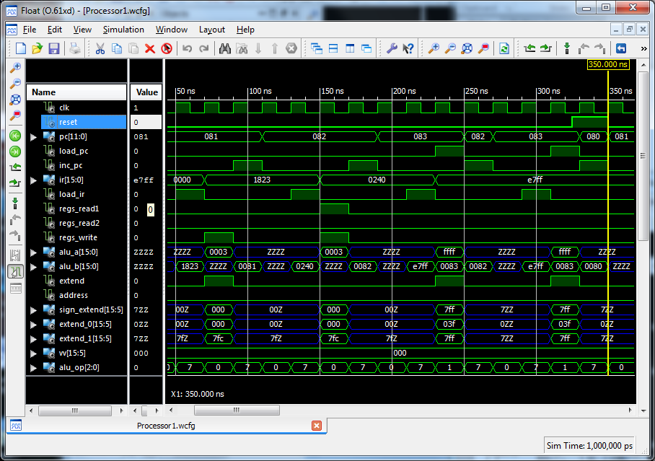
VHDL Simulation (Phase 1)
418_09
Notes:
ELEC 418

Slide 29
Control Unit Design (Phase 2)
  MOVE Rs,Addr
    Register Direct (M0), Absolute (M2)
Step | RTN | Control Signals
T3 | MDR ← R(S) | REGS_Read1 <= ‘1’ ALU_OP <= Pass_A Load_STATUS <= ‘1’ Load_MDR <= ‘1’
T4 | MAR ← Value | BUS_B <= IR; Address <= ‘1’ ALU_OP <= Pass_B Load_MAR <= ‘1’
T5 | MEM(MAR) ← MDR | MEM_Write <= ‘1’ Clear <= ‘1’
418_09
Notes:
ELEC 418

Slide 30
Control Unit Design (Phase 2)
  MOVE Addr,Rd
    Absolute (M2), Register Direct (M0)
Step | RTN | Control Signals
T3 | MAR ← Value | BUS_B <= IR Address <= ‘1’ ALU_OP <= Pass_B Load_MAR <= ‘1’
T4 | MDR ← MEM(MAR) | MEM_Read <= ‘1’ Load_MDR <= ‘1’
T5 | R(D) ← MDR | BUS_B <= MDR ALU_OP <= Pass_B Load_STATUS <= ‘1’ REGS_Write <= ‘1’ Clear <= ‘1’
418_09
Notes:
ELEC 418

Slide 31
Control Unit Design (Phase 2)
  ADD (Rs),Rd
    Register Indirect (M1), Register Direct (M0)
Step | RTN | Control Signals
T3 | MAR ← R(S) | REGS_Read1 <= ‘1’ ALU_OP <= Pass_A Load_MAR <= ‘1’
T4 | MDR ← MEM(MAR) | MEM_Read <= ‘1’ Load_MDR <= ‘1’
T5 | R(D) ← MDR + R(D) | BUS_A <= MDR REGS_Read2 <= ‘1’ ALU_OP <= OP Load_STATUS <= ‘1’ REGS_Write <= ‘1’ Clear <= ‘1’
418_09
Notes:
ELEC 418

Slide 32
Control Unit Design (Phase 2)
  ADD #Value,Rd
    Immediate (M3), Register Direct (M0)
Step | RTN | Control Signals
T3 | R(D) ← Value + R(D) | BUS_A <= IR Extend <= ‘1’ REGS_Read2 <= ‘1’ ALU_OP <= OP Load_STATUS <= ‘1’ REGS_Write <= ‘1’ Clear <= ‘1’
418_09
Notes:
ELEC 418

Slide 33
Control Unit Design (Phase 2)
  BGTZ Offset
    Branch if greater than zero
    OP (111), Mode (M1)
Step | RTN | Control Signals
T3 | if N = 0 and Z = 0 then PC ← PC + Offset | BUS_A <= IR BUS_B <= PC Extend <= ‘1’ ALU_OP <= ADD Load_PC <= ‘1’ Clear <= ‘1’
418_09
Notes:
ELEC 418

Slide 34
Assembly Language Program
program.asm
program.bin
 | . . .
SUM
N | n
NUM1
NUM2
 | . . .
NUMn
MOVE N,R1
MOVE #NUM1,R2
MOVE #0,R0
LOOP ADD (R2),R0
ADD #1,R2
ADD #-1,R1
BGTZ LOOP
MOVE R0,SUM
STOP BRA STOP
418_09
Notes:
ECE 445
RJH

Slide 35
VHDL Control Unit (Phase 2)
processor2.vhd
CLK
Control Step
Counter
Step DCD
I₀
T₀
. . .
T₇
Instruction
DCD
. . .
I₇
M₀
N
SRC_MODE
DCD
STATUS
IR
M₃
Encoder
. . .
. . .
C
M₀
DST_MODE
DCD
M₃
. . .
Clear
Control
Signals
418_09
Notes:
ECE 445
RJH

Slide 36
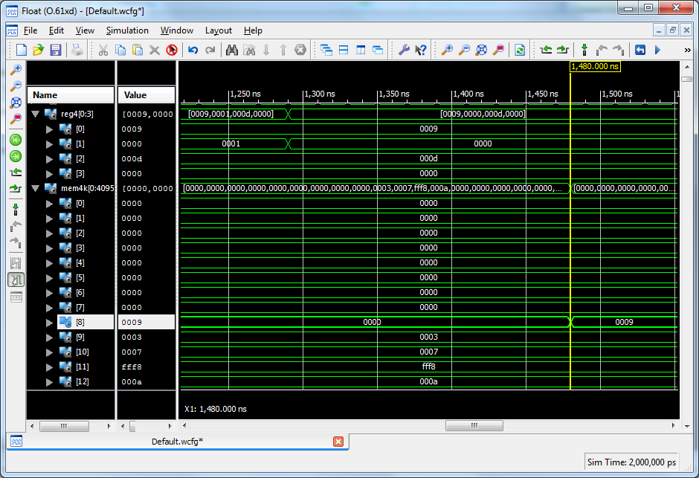
VHDL Simulation (Phase 2)
418_09
Notes:
ELEC 418

Slide 37
Microcontroller (Phase 3)
4K (4096) RAM
  8 Memory-mapped I/O Ports
    0x000 SWITCH (Input) 8-bit
    0x001 LED (Output) 8-bit
    0x002 ANODE (Output) 4-bit
    0x003 CATHODE (Output) 8-bit
  120 Data Memory Locations
    0x008 - 0x07F
418_09
Notes:
ELEC 418

Slide 38
MEM4K
entity MEM4K is
port(CLK: in std_logic;
MEM_Read: in std_logic;
MEM_Write: in std_logic;
Addr: in std_logic_vector(11 downto 0);
Data_In: in std_logic_vector(15 downto 0);
Data_Out: out std_logic_vector(15 downto 0);
SWITCH: in std_logic_vector(7 downto 0);
LED: out std_logic_vector(7 downto 0);
ANODE: out std_logic_vector(3 downto 0);
CATHODE: out std_logic_vector(7 downto 0));
end MEM4K;
418_09
Notes:
ELEC 418

Slide 39
Data Instruction Format
15 14 13 12 11 10 9 8 7 6 5 4 3 2 1 0
OP
SRC
DST
VALUE
IR
 | Mode | REG # | Name | Syntax | Effective Address
SRC or DST | 00 | 00-11 | Register Direct | Rn | EA = Rn
 | 01 | 00-11 | Register Indirect | (Rn) | EA = [Rn]
 | 10 | vv | Absolute | Value | EA = Value
 | 11* | vv | Immediate | #Value | Operand = Value
EA = Effective Address
vv = Upper 2 bits of Value
* = SRC only
418_09
Notes:
ECE 445
RJH

Slide 40
Data Instructions
OP | Fn | Assembly Language | Register Transfer Notation (RTN)
000 | MOVE | MOVE SRC,DST | DST ← SRC
001 | ADD | ADD SRC,DST | DST ← SRC + DST
010 | INV | INV SRC,DST | DST ← not SRC
011 | AND | AND SRC,DST | DST ← SRC and DST
100 | ROTL | ROTL SRC,DST | DST ← SRC(14 dt 0) & SRC(15)
...
418_09
Notes:
ECE 445
RJH

Slide 41
Branch Instruction Format
15 14 13 12 11 10 9 8 7 6 5 4 3 2 1 0
OP
MD
OFFSET
IR
OP | MD | Fn | Assy Lang | RTN
111 | 00 | BRA | BRA Offset | PC ← PC + Offset
 | 01 | BGTZ | BGTZ Offset | PC ← PC + Offset (STATUS > 0)
 | 10 | BSR | BSR Offset | STACK ← PC; PC ← PC + Offset
 | 11 | RTN | RTN | PC ← STACK
418_09
Notes:
ECE 445
RJH

Slide 42
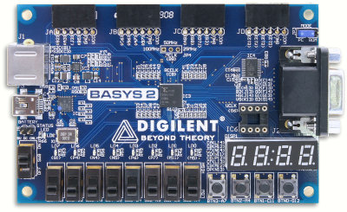
FPGA Implementation
Clock
Processor
LED
Reset
SWITCH
ANODE/CATHODE
Notes:
ELEC 418

Slide 43
Summary
Example Microprocessors
  Instruction Set Architecture
Instructional Processor Design
  Data Path
  Memory
  Instruction Processing
VHDL Model
  ISim Simulation
  FPGA Implementation
418_09
Notes:
ELEC 418

