Slide 1
Processor Design
ELEC 418
Advanced Digital Systems
Dr. Ron Hayne
Images Courtesy of Thomson Engineering
Notes:
ELEC 418

Slide 2
68HC11 Programming Model
Motorola 68HC11 Microcomputer
7 A 0 | 7 B 0 |  |  |  |  |  |  |  | 8-bit Accumulators A & B
15 D 0 |  |  |  |  |  |  |  |  | 16-bit Double Accumulator D
15 X 0 |  |  |  |  |  |  |  |  | Index Register X
15 Y 0 |  |  |  |  |  |  |  |  | Index Register Y
15 SP 0 |  |  |  |  |  |  |  |  | Stack Pointer
15 PC 0 |  |  |  |  |  |  |  |  | Program Counter
 | S | X | H | I | N | Z | V | C | Condition Code Register
418_09
Notes:
ELEC 418

Slide 3
68HC11 Instruction Set Table
Source Form | Operation | Boolean Expression | Addr. Mode | Machine Code |  | Bytes | Cycles
 |  |  |  | Op Code | Op-erand
ABX | Add B to X | X + 00:B → X | INH | 3A |  | 1 | 3
• | • | • | • | • | • | • | •
ADDA (opr) | Add Memory to A | A + M → A | A IMM A DIR A EXT A IND,X A IND,Y | 8B 9B BB AB 18 AB | ii dd hh ll ff ff | 22323 | 23445
• | • | • | • | • | • | • | •
CLC | Clear Carry Bit | 0 → C | INH | 0C |  | 1 | 2
• | • | • | • | • | • | • | •
LDX (opr) | Load Index Register X | M:(M + 1) → X | X IMM X DIR | CE DE | jj kk dd | 32 | 34
418_09
Notes:
ELEC 418

Slide 4
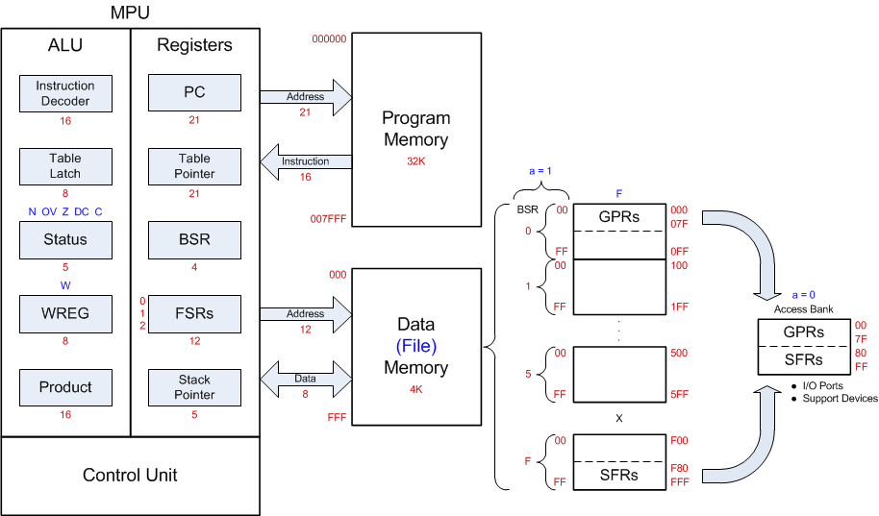
PIC18F452 Programming Model
418_09

Slide 5
MIPS ISA
Instruction Set Architecture
  32 General-Purpose Registers (32-bits)
  3 Instruction Formats
    R-format (register)
    I-format (immediate)
    J-format (jump)
  3 Addressing Modes
    Immediate
    Register
    Base and signed offset
418_09
Notes:
ELEC 418

Slide 6
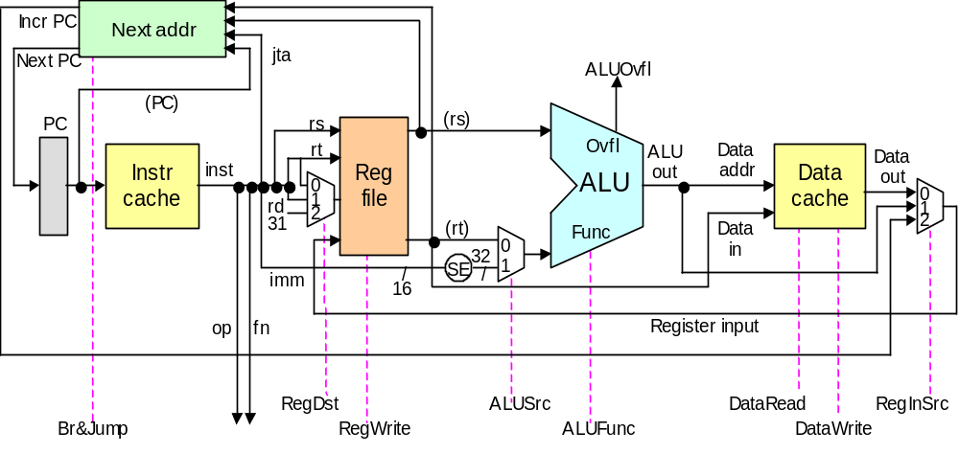
MicroMIPS
Register
writeback
Instruction fetch
Reg access / decode
ALU operation
Data access
Fig. 13.3 Key elements of the single-cycle MicroMIPS data path.

Slide 7
Instructional Processor Design
3 Bus Organization
  16 bit Data Path
4 Word Register File
4K Word Memory
8 Function ALU
  2 Condition Code Flags
6 Data Instructions
  4 Addressing Modes
7 Branch Instructions
418_09
Notes:
ELEC 418

Slide 8
Data Path & Memory
STACK
BUS A
BUS B
BUS C
 | Memory
000 | I/O
007
008 | Data
07F
080 | Program
FFF
PC
12
IR
1
A1
A2
REGS
2
2
MUX
A
ALU
R
MUX
B
STATUS
NZ
MDR
MAR
12
MEM
Notes:
ECE 445
RJH

Slide 9
Data Path Registers & Memory
Program Counter (PC)
  12-bit Program Address
Subroutine Stack (STACK)
  16 x 12-bit Addresses
Instruction Register (IR)
  16-bit Instructions
Register File (REGS)
  4 x 16-bit Registers
Arithmetic Logic Unit (ALU)
  8 Functions (ALU_OP)
Flag Register (STATUS)
  Negative Flag (N)
  Zero Flag (Z)
Memory Data Register (MDR)
  16-bits to/from Memory
Memory Address Reg (MAR)
  12-bit Memory Address
Memory (MEM)
  4K x 16-bit Memory
418_09

Slide 10
Addressing Modes
Method of specifying of an operand
  Immediate (Literal) addressing
    The operand is a number that follows the opcode
  Direct (Absolute) addressing
    The address of the operand is a part of the instruction
  Indirect addressing
    An address is specified in a register (pointer) and the MPU looks up the address in that register
418_09

Slide 11
Data Instruction Format
15 14 13 12 11 10 9 8 7 6 5 4 3 2 1 0
OP
SRC
DST
VALUE
IR
 | Mode | REG # | Name | Syntax | Effective Address
SRC or DST | 00 | 00-11 | Register Direct | Rn | EA = Rn
 | 01 | 00-11 | Register Indirect | [Rn] | EA = (Rn)
 | 10 | vv | Absolute | [Value] | EA = Value
 | 11* | vv | Immediate | Value | Operand = Value
EA = Effective Address
vv = Upper 2 bits of Value
* = SRC only
418_09
Notes:
ECE 445
RJH

Slide 12
Data Instructions
OP | Fn | Assembly Language | Register Transfer Notation
000 | MOVE | MOVE SRC,DST | DST ← SRC
001 | ADD | ADD SRC,DST | DST ← SRC + DST
010 | INV | INV SRC,DST | DST ← not SRC
011 | AND | AND SRC,DST | DST ← SRC and DST
100 | SHL | SHL SRC,DST | DST ← SRC(14 dt 0) & 0
101 | ASHR | ASHR SRC,DST | DST ← SRC(15) & SRC(15 dt 1)
110 | ...
418_09
Notes:
ECE 445
RJH

Slide 13
Branch Instruction Format
15 14 13 12 11 10 9 8 7 6 5 4 3 2 1 0
OP
MD
OFFSET
IR
OP | MD | Fn | Assembly Language | Register Transfer Notation
111 | 000 | BRA | BRA Offset | PC ← PC + Offset
 | 001 | BZ | BZ Offset | PC ← PC + Offset (Z = 1)
 | 010 | BNZ | BNZ Offset | PC ← PC + Offset (Z = 0)
 | 011 | BN | BN Offset | PC ← PC + Offset (N = 1)
 | 100 | BNN | BNN Offset | PC ← PC + Offset (N = 0)
 | 101 | ...
 | 110 | BSR | BSR Offset | STACK ← PC; PC ← PC + Offset
 | 111 | RTN | RTN | PC ← STACK
418_09
Notes:
ECE 445
RJH

Slide 14
Control Unit Organization
CLK
Control Step
Counter
Step DCD
I₀
T₀
. . .
T₇
Instruction
DCD
. . .
I₇
M₀
N
SRC_MODE
DCD
STATUS
IR
M₃
Encoder
. . .
Z
M₀
DST_MODE
DCD
M₃
. . .
. . .
Clear
Control
Signals
418_09
Notes:
ECE 445
RJH

Slide 15
Control Unit Design
Instruction Fetch
Step | RTN | Control Signals
T0 | MAR ← PC, PC ← PC + 1 | BUS_B <= PC ALU_OP <= Pass_B Load_MAR <= ‘1’ Inc_PC <= ‘1’
T1 | MDR ← MEM(MAR) | MEM_Read <= ‘1’ Load_MDR <= ‘1’
T2 | IR ← MDR | BUS_B <= MDR ALU_OP <= Pass_B Load_IR <= ‘1’
418_09
Notes:
ELEC 418

Slide 16
Control Unit Design
Instruction Execute
  MOVE Rs,Rd
    Register Direct (M0), Register Direct (M0)
Step | RTN | Control Signals
T3 | R(D) ← R(S) | REGS_Read1 <= ‘1’ ALU_OP <= OP Load_STATUS <= ‘1’ REGS_Write <= ‘1’ Clear <= ‘1’
418_09
Notes:
ELEC 418

Slide 17
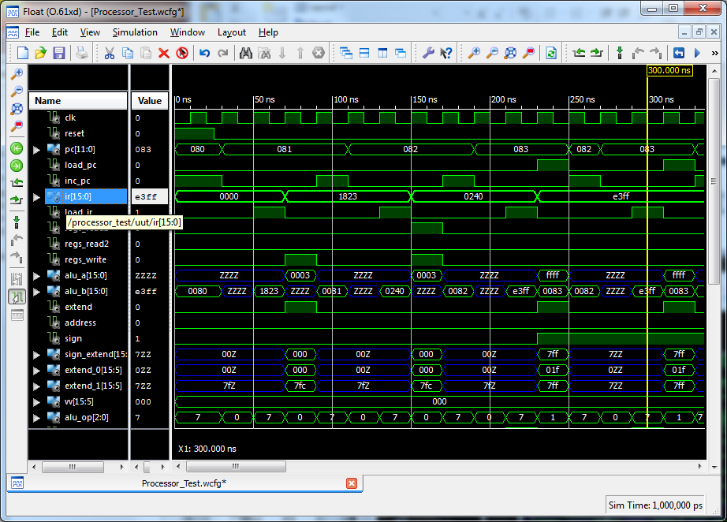
VHDL Simulation (Phase 1)
418_09
Notes:
ELEC 418

Slide 18
Microcontroller (Phase 3)
4K (4096) RAM
  8 Memory-mapped I/O Ports
    0x000 SWITCH (Input) 8-bit
    0x001 LED (Output) 8-bit
    0x002 ANODE (Output) 4-bit
    0x003 CATHODE (Output) 8-bit
    0x004 JA (Output) 4-bit
    0x005 JB (Input) 4-bit
  120 Data Memory Locations
    0x008 - 0x07F
418_09
Notes:
ELEC 418

Slide 19
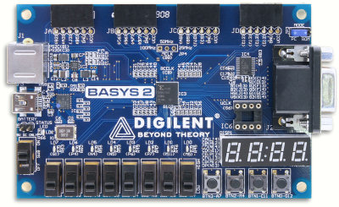
FPGA Implementation
JA
JB
Clock
Processor
LED
Reset
SWITCH
ANODE/CATHODE
Notes:
ELEC 418

Slide 20
Summary
Example Microprocessors
  Instruction Set Architecture
Instructional Processor Design
  Data Path
  Memory
  Instruction Processing
VHDL Model
  ISim Simulation
  FPGA Implementation
418_09
Notes:
ELEC 418

