Slide 1
Boolean Algebra
ELEC 311
Digital Logic and Circuits
Dr. Ron Hayne
Images Courtesy of Cengage Learning

Slide 2
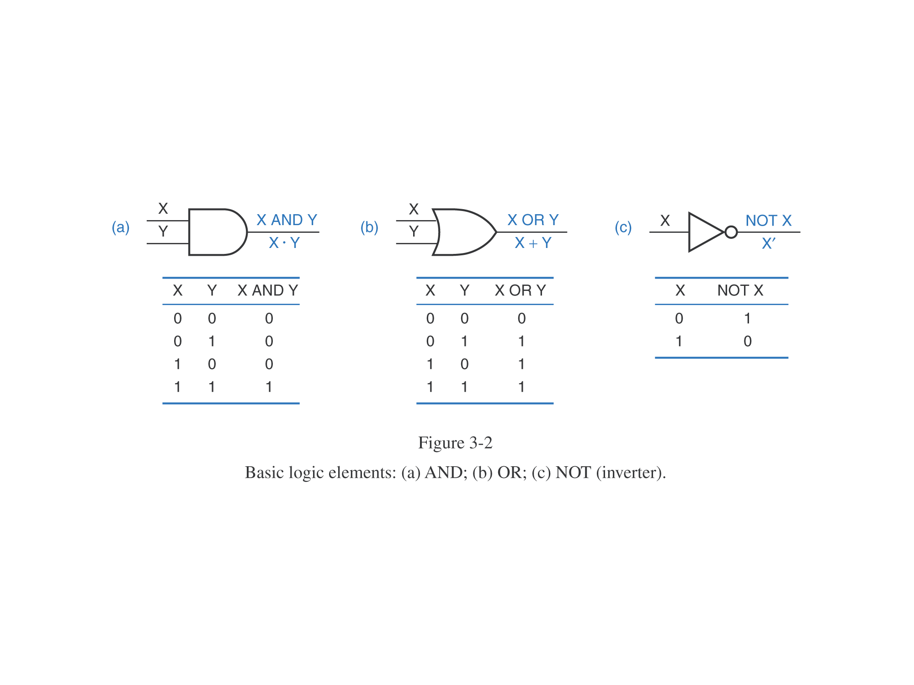
Logic Gates

Slide 3
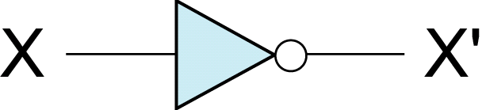
Inverter (Not Gate)
If X = 0 then X' = 1
If X = 1 then X' = 0

Slide 4
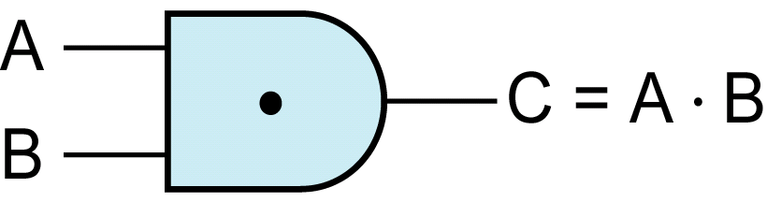

AND Gate
If A = 1 and B = 1 then C = 1 (else C = 0)

Slide 5
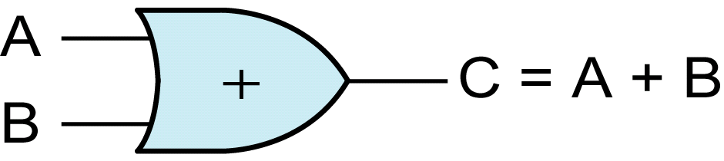

OR Gate
If A = 1 or B = 1 then C = 1 (else C = 0)

Slide 6
Boolean Algebra
AND Operation
0 ∙ 0 = 0
0 ∙ 1 = 0
1 ∙ 0 = 0
1 ∙ 1 = 1
OR Operation
0 + 0 = 0
0 + 1 = 1
1 + 0 = 1
1 + 1 = 1
NOT Operation (Complement)
0' = 1
1' = 0

Slide 7
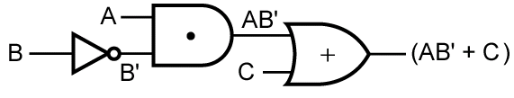
Boolean Expressions
F = AB' + C

Slide 8
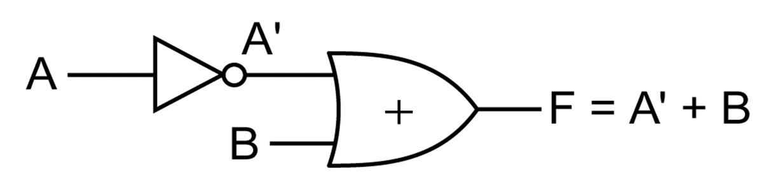
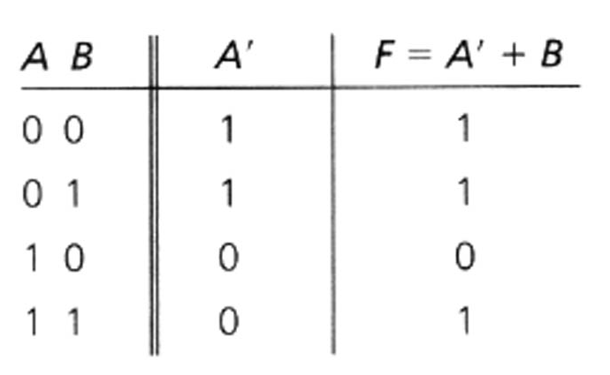
Truth Table

Slide 9
Laws and Theorems (p.46)
Operations with 0 and 1:
1. X + 0 = X 1D. X • 1 = X
2. X + 1 = 1 2D. X • 0 = 0
Idempotent laws:
3. X + X = X 3D. X • X = X
Involution law:
4. (X')' = X
Laws of complements:
5. X + X' = 1 5D. X • X' = 0

Slide 10
Laws and Theorems (p.46)
Commutative laws:
6. X + Y = Y + X 6D. XY = YX
Associative laws:
7. (X + Y) + Z = X + (Y + Z) 7D. (XY)Z = X(YZ) = XYZ
Distributive laws:
8. X(Y + Z) = XY + XZ 8D. X + YZ = (X + Y)(X + Z)
DeMorgan's laws:
9. (X + Y )' = X'Y' 12D. (XY)' = X' + Y'
Simplification theorems:
10. XY + XY' = X (Adjacency Theorem)
11. X + XY = X

Slide 11
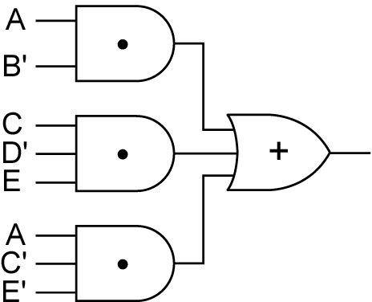
Sum of Products (SOP)
AB' + CD'E + AC'E'

Slide 12
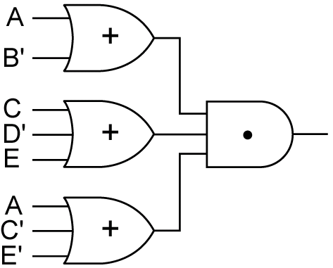
Product of Sums (POS)
(A + B')(C + D' + E)(A + C' + E')

Slide 13
Summary
Logic Gates
Boolean Algebra
Truth Tables
Laws and Theorems

