Slide 1
Combinational Design
ELEC 311
Digital Logic and Circuits
Dr. Ron Hayne
Images Courtesy of Cengage Learning

Slide 2
Combinational Circuit Design
The three main steps in designing a single-output combinational switching circuit are:
Find a switching function that specifies the desired behavior of the circuit.
Find a simplified algebraic expression for the function.
Realize the simplified function using available logic elements.

Slide 3
Example 1
F
A
B
Define a two-valued variable to indicate whether each phrase is true or false:
F = 1 if “Mary watches TV” is true; otherwise F = 0.
A = 1 if “it is Monday night” is true; otherwise A = 0.
B = 1 if “she has finished her homework” is true; otherwise B = 0.
Because F is “true” if A and B are both “true”, we can represent the sentence by F = A • B

Slide 4
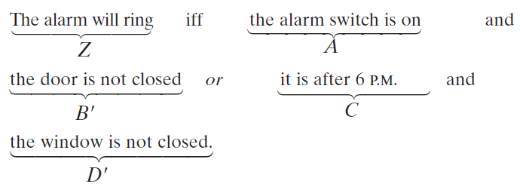
Example 2
The alarm will ring iff the alarm switch is turned on and the door is not closed, or it is after 6 P.M. and the window is not closed.

Slide 5
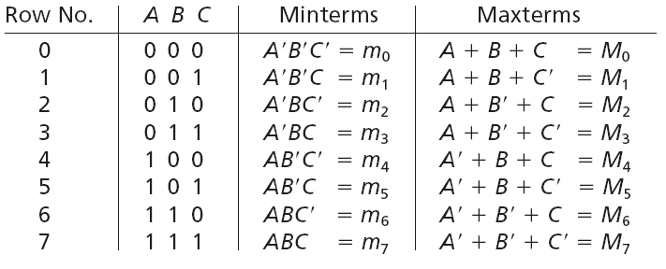
Minterms and Maxterms

Slide 6
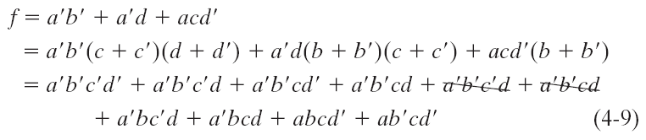
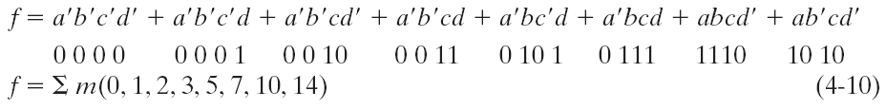
Minterm Expansion
Find the minterm expansion of f(a,b,c,d) = a'(b' + d) + acd'

Slide 7
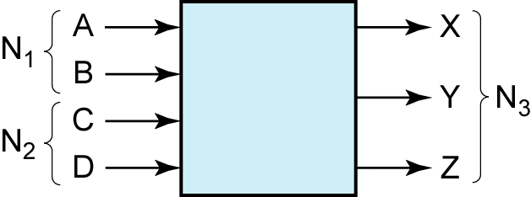
Design Example
Design an adder which adds two 2-bit binary numbers to give a 3-bit binary sum.

Slide 8
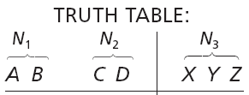


Truth Table

Slide 9
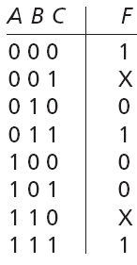


Incompletely Specified Functions
don't-cares

Slide 10
Design Example
Design a circuit so that the output (Z) is 1 iff the decimal number represented in BCD is exactly divisible by 3.

Slide 11
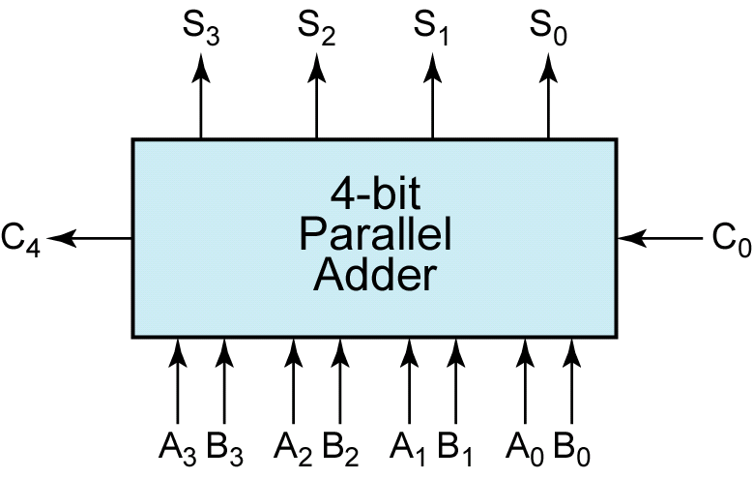
Binary Adder Design

Slide 12
Binary Addition (Full Adder)

Slide 13
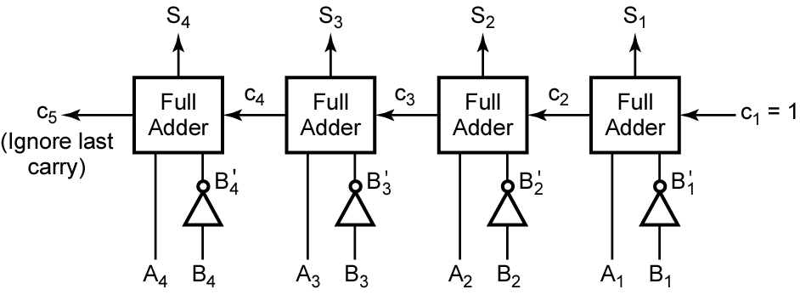
Binary Subtracter

Slide 14
Summary
Word Problems
Truth Tables
Minterms and Maxterms
Don't Cares

