Slide 1
Karnaugh Maps
ELEC 311
Digital Logic and Circuits
Dr. Ron Hayne
Images Courtesy of Cengage Learning

Slide 2
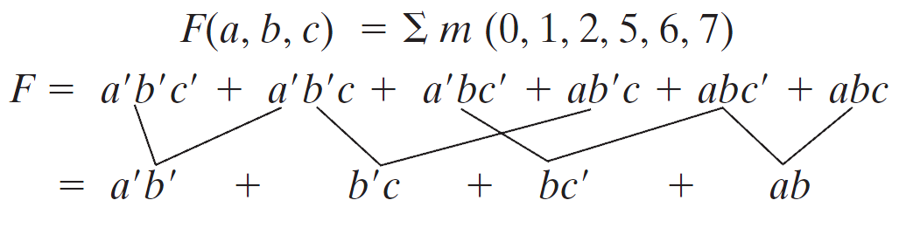
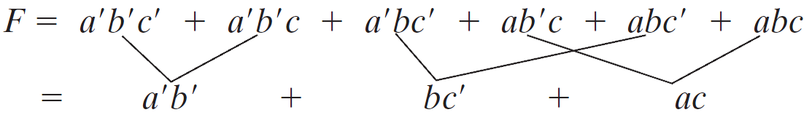
Minimum Switching Functions
Find a minimum sum-of-products expression for
None of the terms in the above expression can be eliminated by consensus. However, combining terms in a different way leads directly to a minimum sum of products:

Slide 3
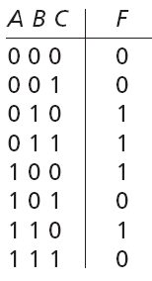
Karnaugh Map
A BC | 0 | 1
00 | 0 | 4
01 | 1 | 5
11 | 3 | 7
10 | 2 | 6
1
1
1
1
F(A,B,C) = Σm(2,3,4,6)
F

Slide 4
Four-Variable Karnaugh Map
AB CD | 00 | 01 | 11 | 10
00 | 0 | 4 | 12 | 8
01 | 1 | 5 | 13 | 9
11 | 3 | 7 | 15 | 11
10 | 2 | 6 | 14 | 10

Slide 5
Terminology
Minterm
Implicant
Cover
Prime Implicant
Essential Prime Implicant
Secondary Prime Implicant
Minimal Sum

Slide 6
Methodology
Minimal Sum
Essential Prime Implicants
Secondary Prime Implicants
Minimal Cover

Slide 7
Example
WX YZ | 00 | 01 | 11 | 10
00 | 0 | 4 | 12 | 8
01 | 1 | 5 | 13 | 9
11 | 3 | 7 | 15 | 11
10 | 2 | 6 | 14 | 10
1
F = (YZ) + (XY) + (WX′Z) +
(WXZ′)
1
1
1
1
1
1
1
F(W,X,Y,Z) = Σm(3,6,7,9,11,12,14,15)

Slide 8
Don't Cares
x₁x₂ x₃x₄ | 00 | 01 | 11 | 10
00 | 0 | 4 | 12 | 8
01 | 1 | 5 | 13 | 9
11 | 3 | 7 | 15 | 11
10 | 2 | 6 | 14 | 10
1
1
X
1
B = x₂′ + (x₃′x₄′) + (x₃x₄)
1
X
1
1
1
X
X
1
X
X
B(x₁,x₂,x₃,x₄) = Σm (0,1,2,3,4,7,8,9) + Σd(10-15)

Slide 9
Summary
Minimizing Switching Functions
Karnaugh Maps
Three-Variable
Four-Variable
Don't Cares

