Slide 1
NAND and NOR Gates
ELEC 311
Digital Logic and Circuits
Dr. Ron Hayne
Images Courtesy of Cengage Learning

Slide 2
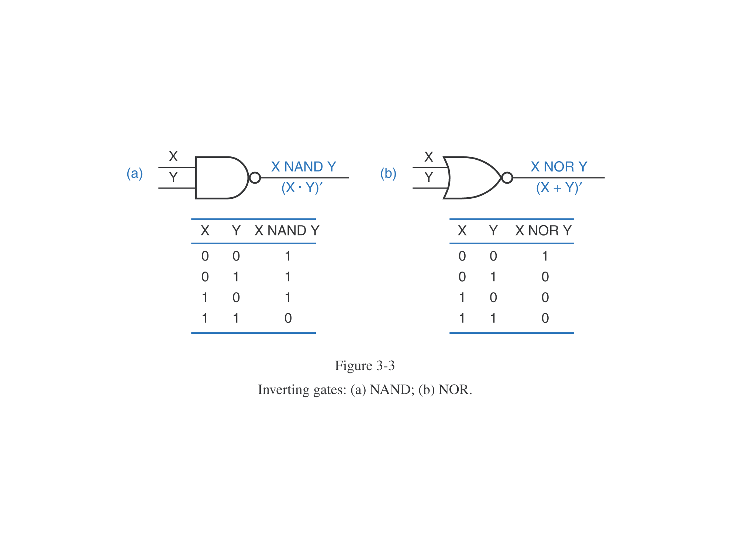
NAND and NOR Gates

Slide 3
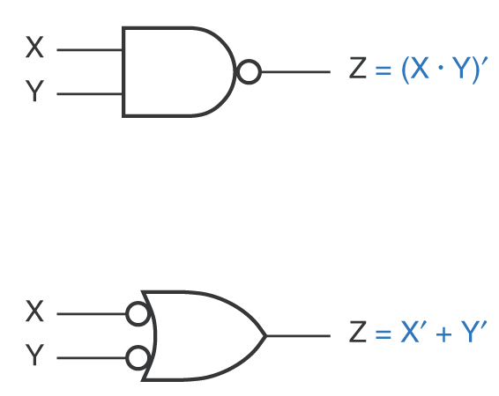
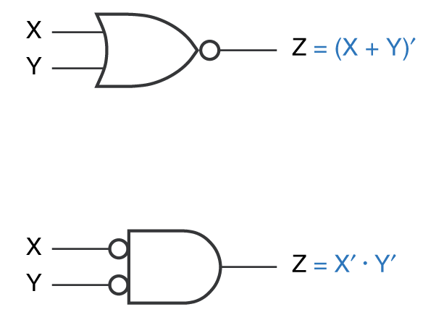
DeMorgan's Laws
(X ∙ Y)' = X' + Y'
(X + Y)' = X' ∙ Y'

Slide 4
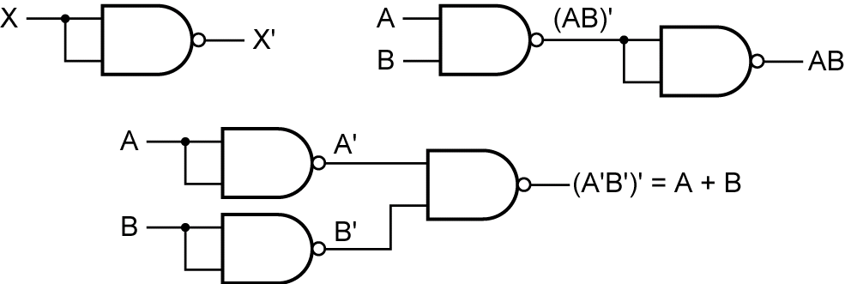
Functionally Complete Set
Any function can be realized using only NAND gates

Slide 5
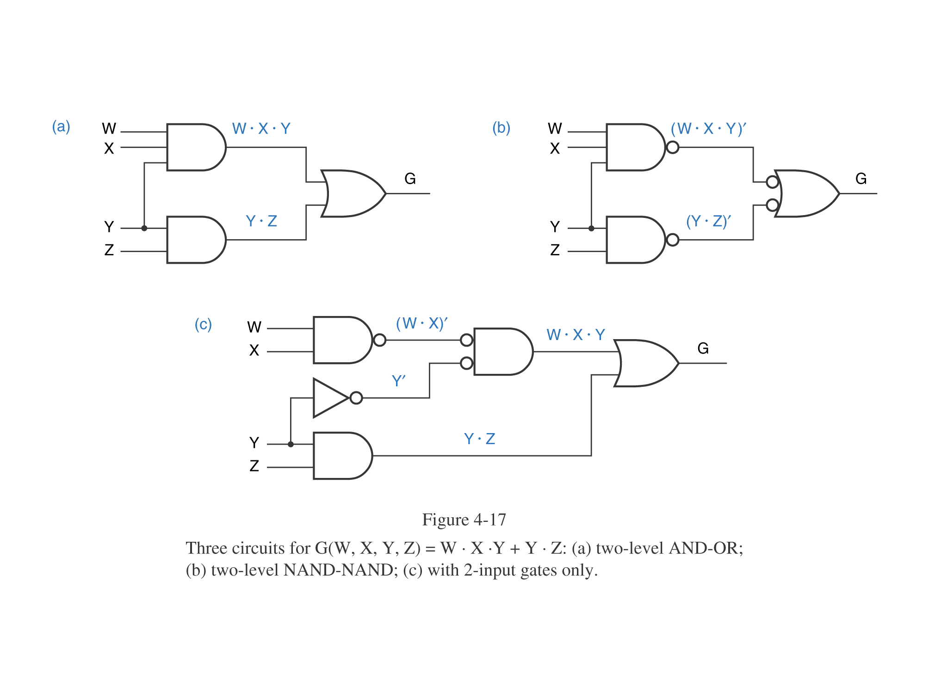
SOP to NAND-NAND
G = WXY + YZ

Slide 6
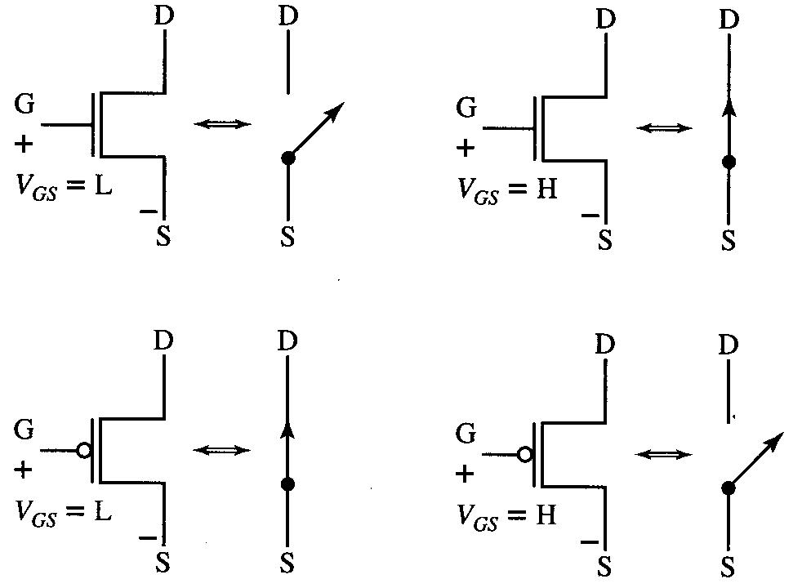
MOSFETs
NMOS
(n-channel)
OFF
ON
PMOS
(p-channel)
ON
OFF

Slide 7
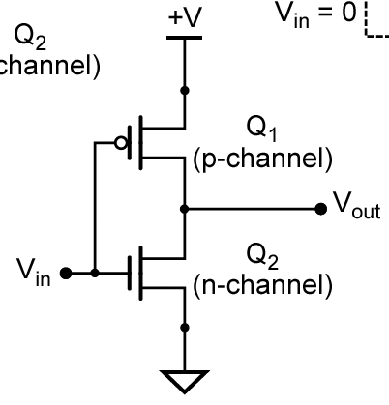
CMOS Inverter

Slide 8
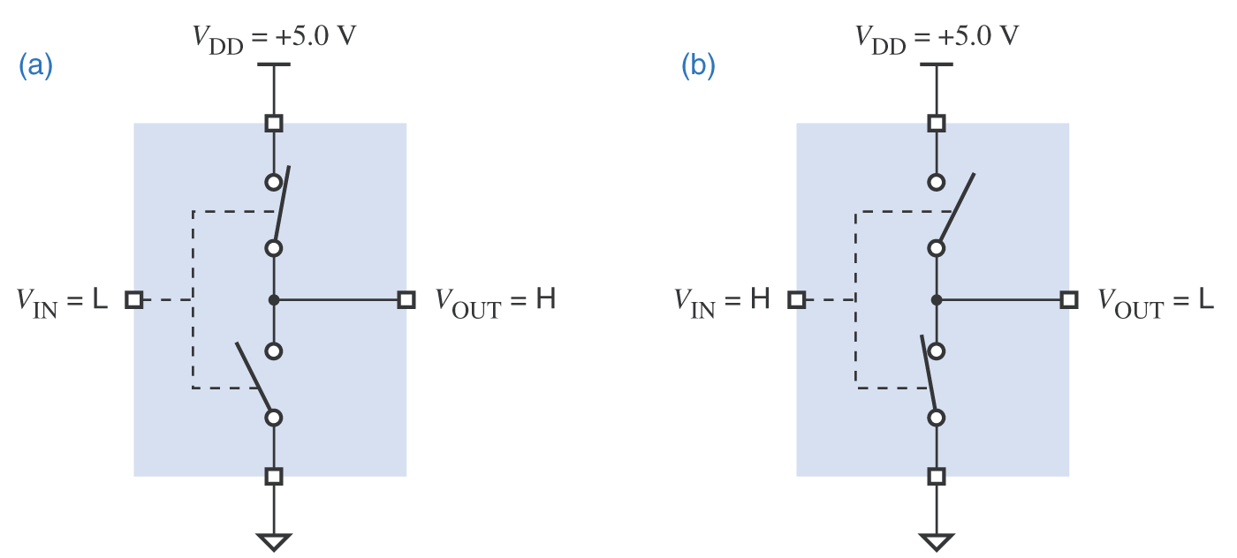
CMOS Inverter
+V (H = 1)
+V (H = 1)
ON
OFF
OFF
ON
(L = 0)
(L = 0)
V_{in} | Q₁ | Q₂ | V_{out}
0 (L) | ON | OFF | 1 (H)
1 (H) | OFF | ON | 0 (L)

Slide 9
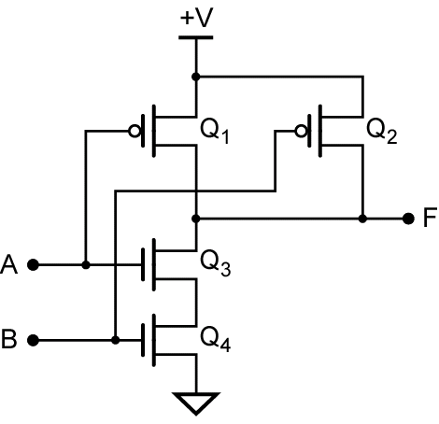
CMOS NAND Gate
(H = 1)
A | B | Q₁ | Q₂ | Q₃ | Q₄ | F
L | L
L | H
H | L
H | H
(L = 0)

Slide 10
CMOS NAND Gate
(H = 1)
A | B | Q₁ | Q₂ | Q₃ | Q₄ | F
L | L | ON | ON | OFF | OFF | H
L | H
H | L
H | H
(L = 0)

Slide 11
CMOS NAND Gate
(H = 1)
A | B | Q₁ | Q₂ | Q₃ | Q₄ | F
L | L | ON | ON | OFF | OFF | H
L | H | ON | OFF | OFF | ON | H
H | L
H | H
(L = 0)

Slide 12
CMOS NAND Gate
(H = 1)
A | B | Q₁ | Q₂ | Q₃ | Q₄ | F
L | L | ON | ON | OFF | OFF | H
L | H | ON | OFF | OFF | ON | H
H | L | OFF | ON | ON | OFF | H
H | H
(L = 0)

Slide 13
CMOS NAND Gate
(H = 1)
A | B | Q₁ | Q₂ | Q₃ | Q₄ | F
L | L | ON | ON | OFF | OFF | H
L | H | ON | OFF | OFF | ON | H
H | L | OFF | ON | ON | OFF | H
H | H | OFF | OFF | ON | ON | L
(L = 0)

Slide 14
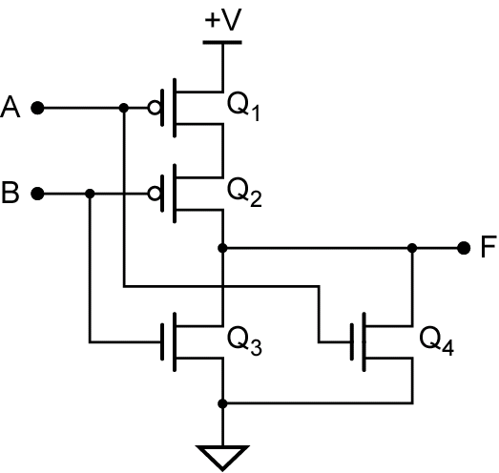
CMOS NOR Gate

Slide 15
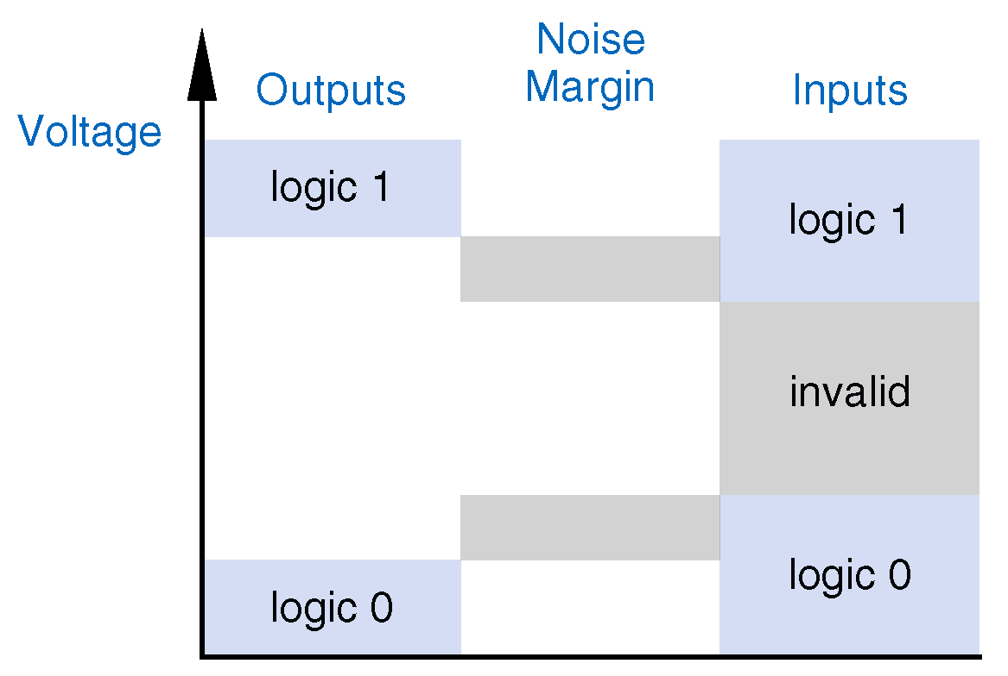
Noise Margin
V_{OHmin}
V_{IHmin}
V_{ILmax}
V_{OLmax}

Slide 16
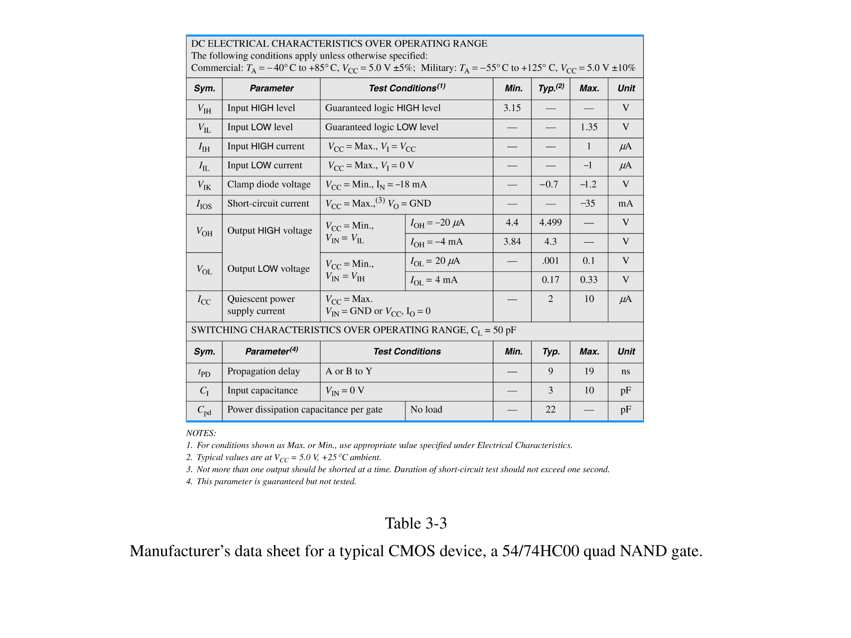
Electrical Characteristics
NM_{H} = V_{OHmin} - V_{IHmin} = 4.4 V - 3.15 V = 1.25 V
NM_{L} = V_{ILmax} - V_{OLmax} = 1.35 V - 0.1 V = 1.25 V

Slide 17
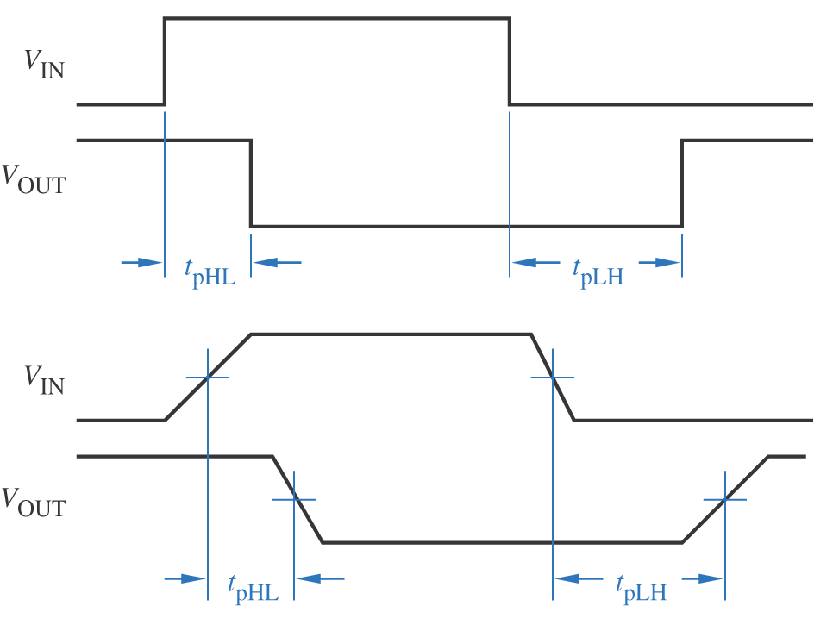
Propagation Delay

Slide 18
Propagation Delay

Slide 19
Summary
NAND and NOR Gates
DeMorgan's Laws
SOP to NAND-NAND
MOSFETs
CMOS Logic Gates
Inverter, NAND, NOR
Electrical Characteristics
Noise Margin
Propagation Delay

