Slide 1
Combinational Circuit Design
ELEC 311
Digital Logic and Circuits
Dr. Ron Hayne
Images Courtesy of Cengage Learning

Slide 2
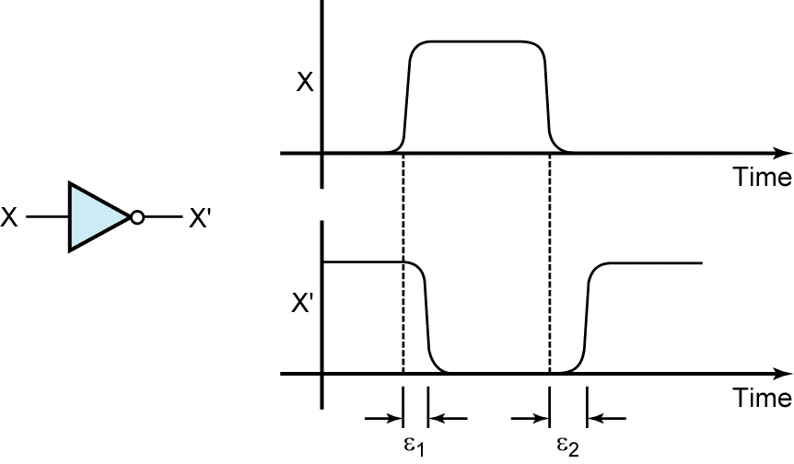
Propagation Delay

Slide 3
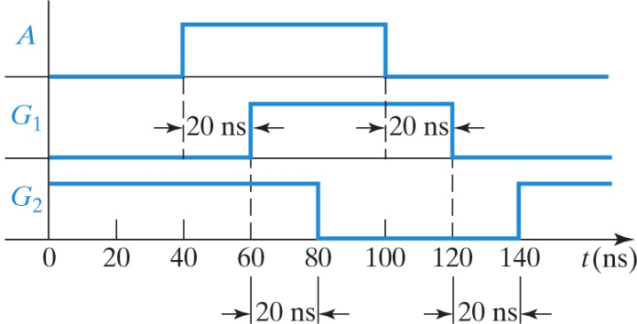
Timing Diagrams

Slide 4
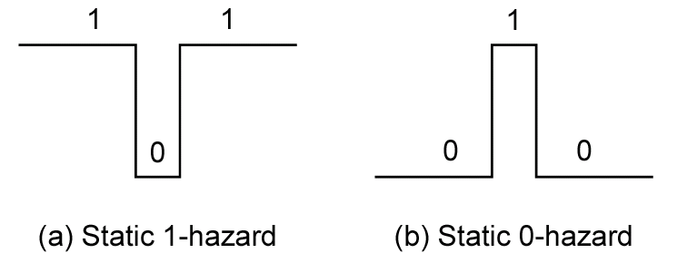
Static Hazards

Slide 5
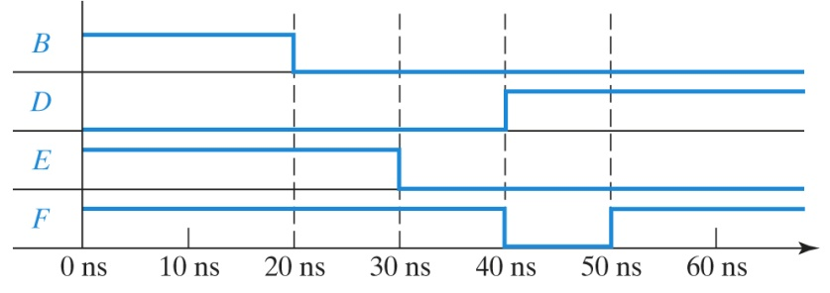
Detection of a Static Hazard

Slide 6
Testing of Logic Circuits
Truth Table
Input Combinations
Verify Outputs
Incorrect Outputs
Error Design
Error in Wiring
Error in Gate

Slide 7
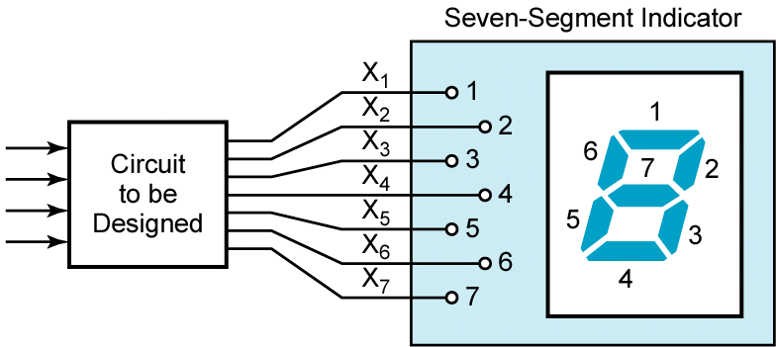
Design Example

Slide 8
