Slide 1
Multiplexers, Decoders, and PLDs
ELEC 311
Digital Logic and Circuits
Dr. Ron Hayne
Images Courtesy of Cengage Learning

Slide 2
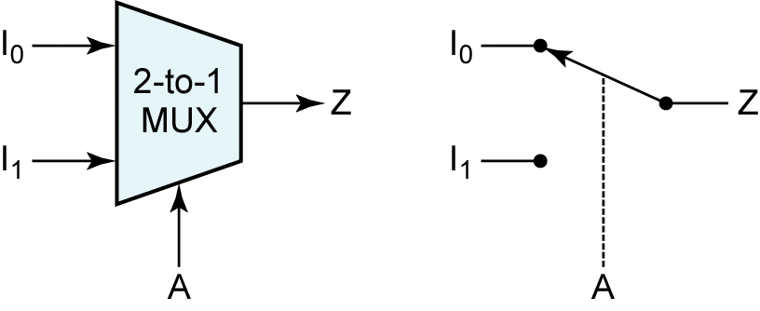
Multiplexers

Slide 3
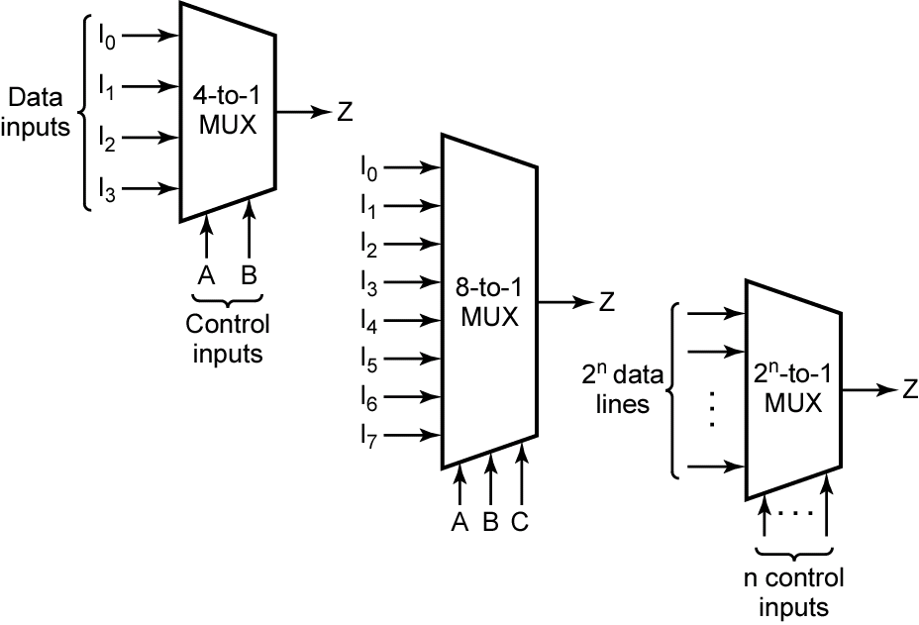
Larger Multiplexers

Slide 4
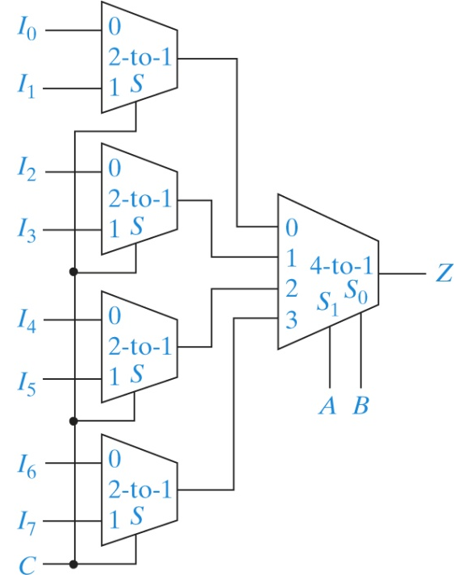
Cascading Multiplexers

Slide 5
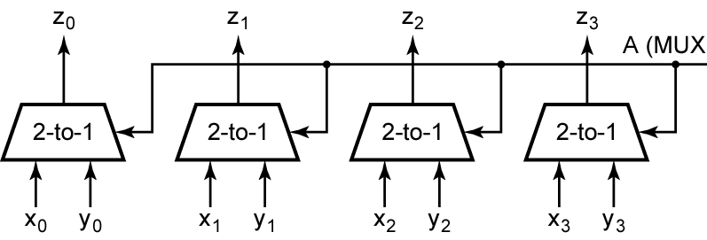
Multiple-Bit Data
S

Slide 6
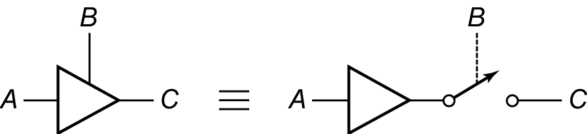
Tri-State Buffer

Slide 7
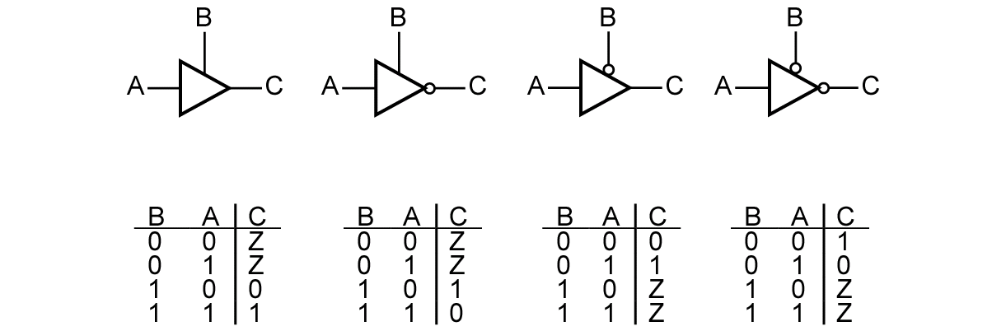
Tri-State Buffers

Slide 8
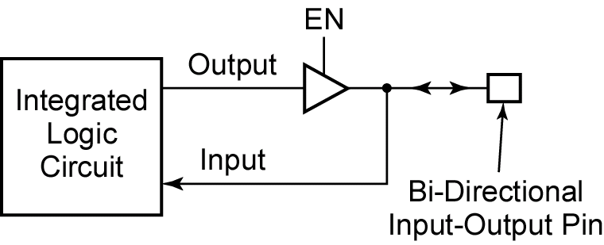
Bi-Directional I/O Pins

Slide 9
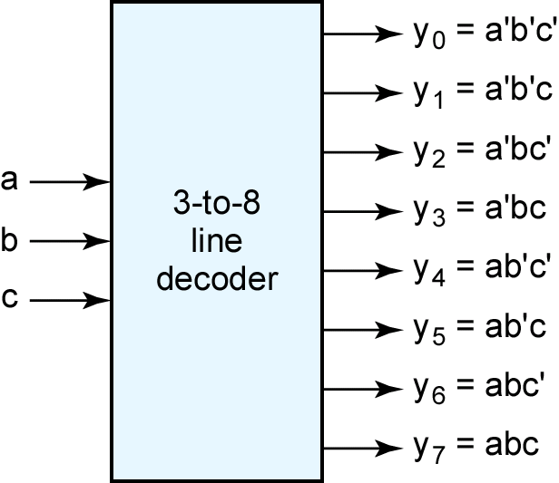
Decoders

Slide 10
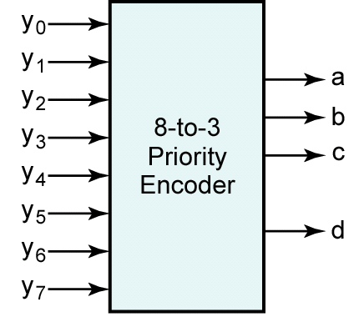
Priority Encoders

Slide 11
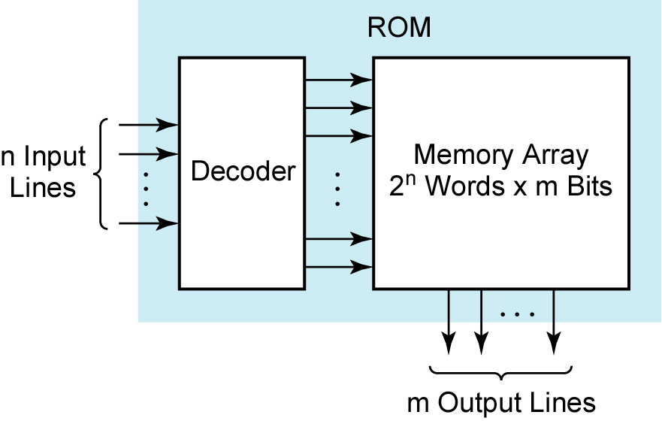
Read-Only Memory

Slide 12
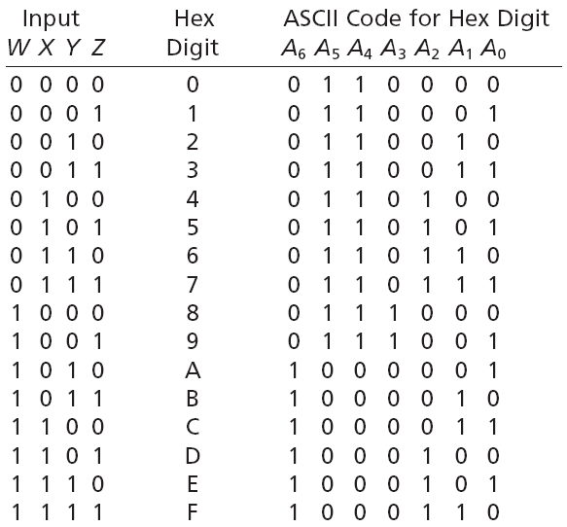
Hex to ASCII Converter

Slide 13
Programmable Logic Devices
Programmable Logic Array (PLA)
Programmable Array Logic (PAL)
Complex Programmable Logic Device (CPLD)
Field Programmable Gate Array (FPGA)

Slide 14
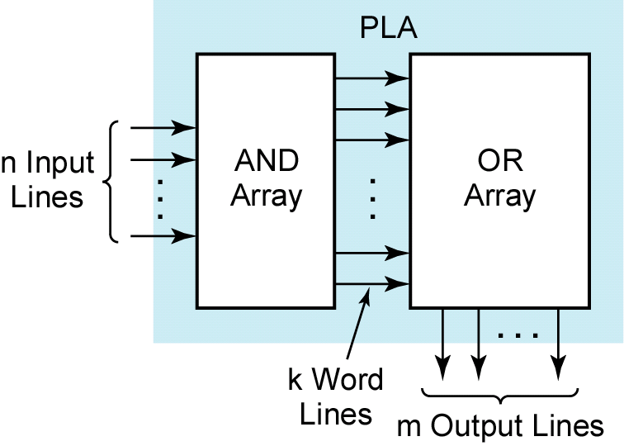
Programmable Logic Arrays

Slide 15
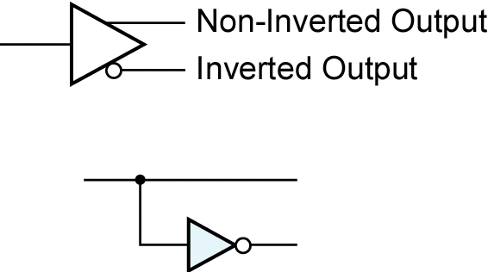
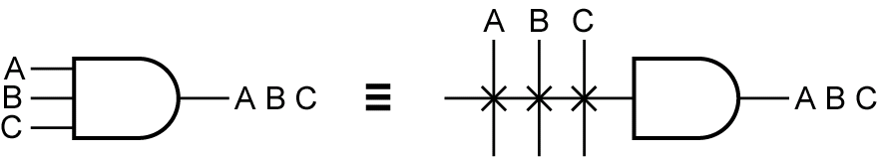
Programmable Array Logic
Logic Symbol
PAL Symbol

Slide 16
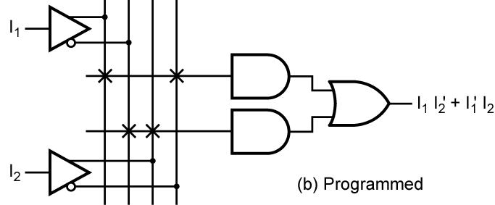
Programmed PAL

Slide 17
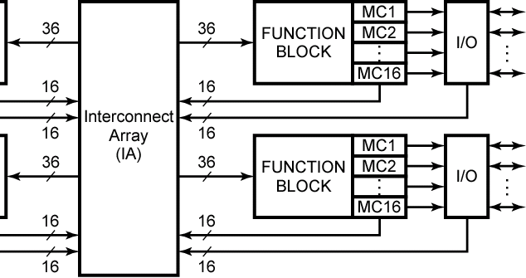
Complex PLD
Architecture of Xilinx XCR3064XL CPLD (© Xilinx, Inc.)

Slide 18
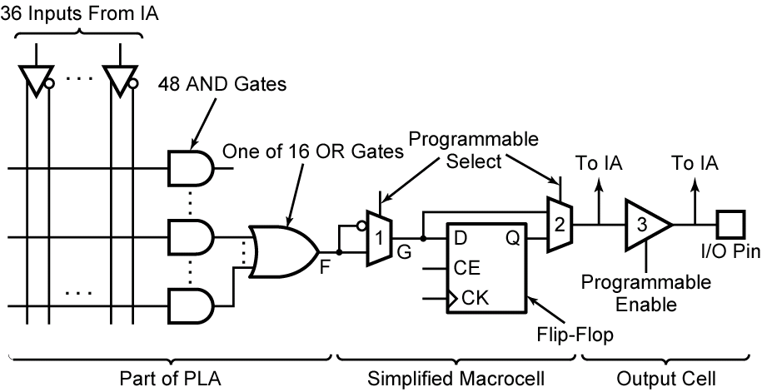
Xilinx CPLD

Slide 19
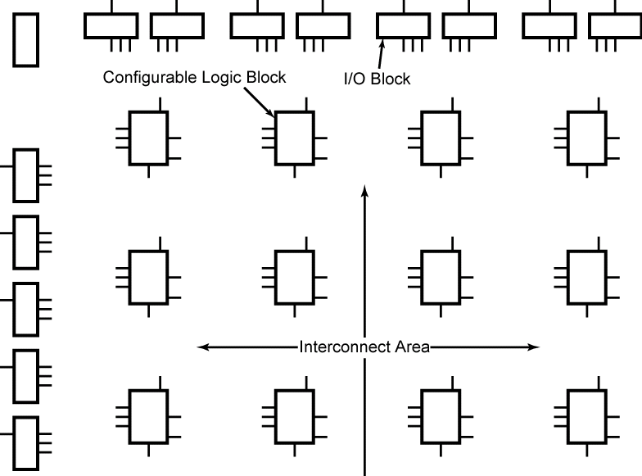
Field Programmable Gate Array

Slide 20
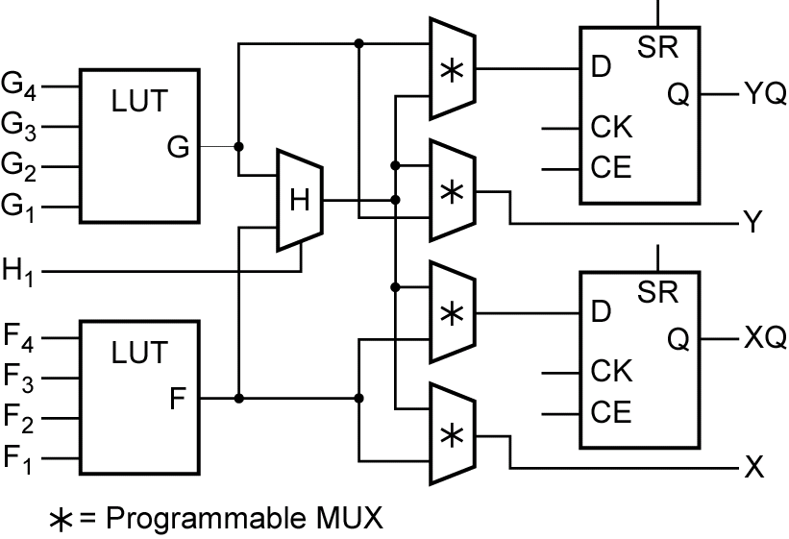
Configurable Logic Block

Slide 21
Summary
Multiplexers
Three-State Buffers
Decoders
Priority Encoders
Read-Only Memory
Complex Programmable Logic Devices
Field Programmable Gate Arrays

