Slide 1
VHDL
ELEC 311
Digital Logic and Circuits
Dr. Ron Hayne
Images Courtesy of Cengage Learning

Slide 2
VHDL Tools
Hardware Description Language Tools
Text Editor
Design Entry
Compiler
Syntax
Simulator
Test Bench
Functional Verification
Synthesis tool
Libraries
Target Technology

Slide 3
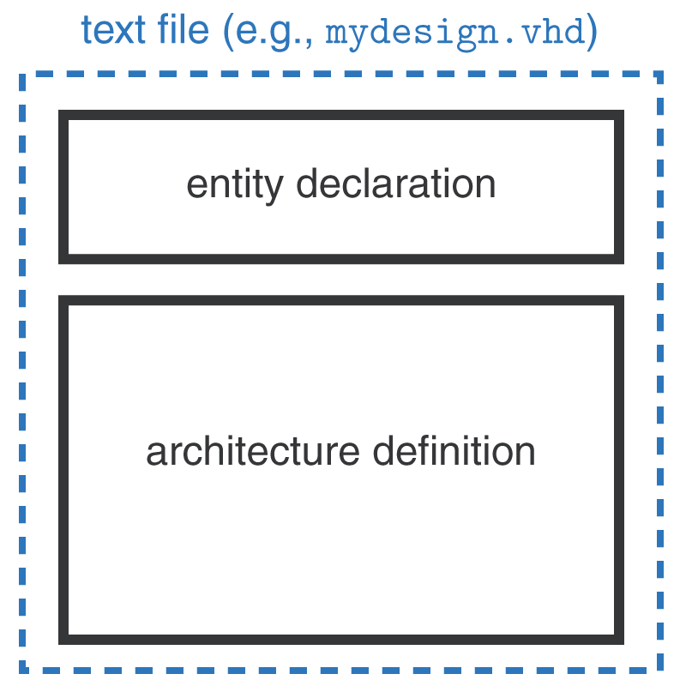
VHDL Model
Entity
Component interface
Inputs
Outputs
Architecture
Structural
Dataflow
Behavioral

Slide 4
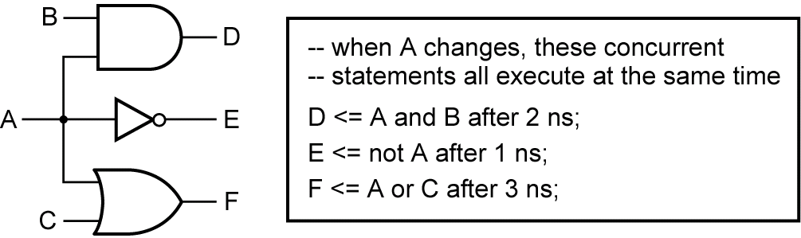
Propagation Delays

Slide 5
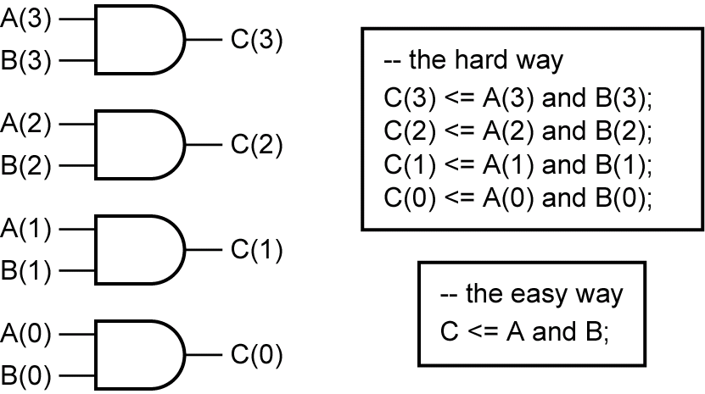
Bit_Vectors

Slide 6
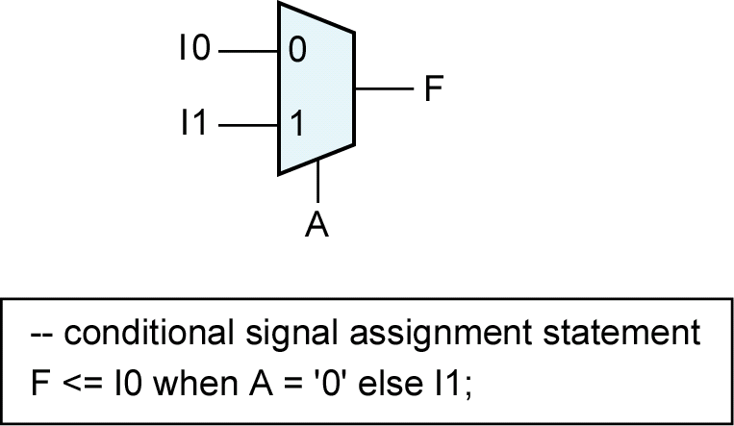
Multiplexers

Slide 7
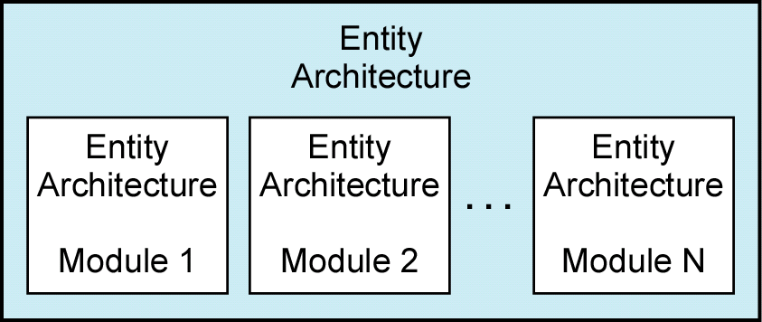
Design Hierarchy

Slide 8
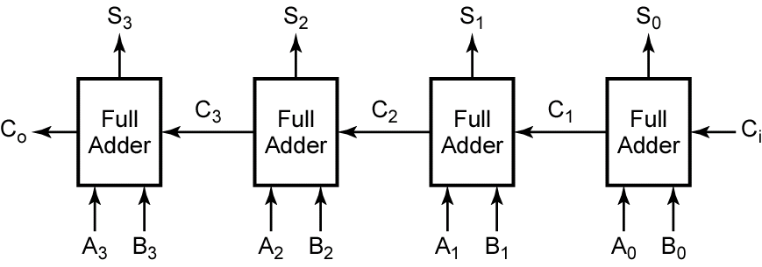
4-bit Adder Example

Slide 9
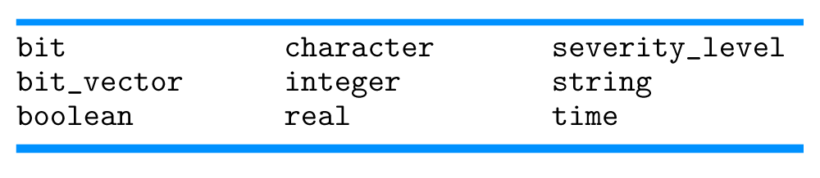
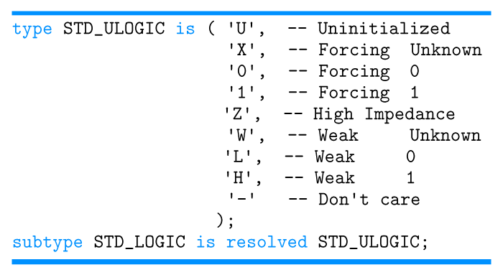
VHDL Types
Predefined Types
IEEE Standard Logic

Slide 10
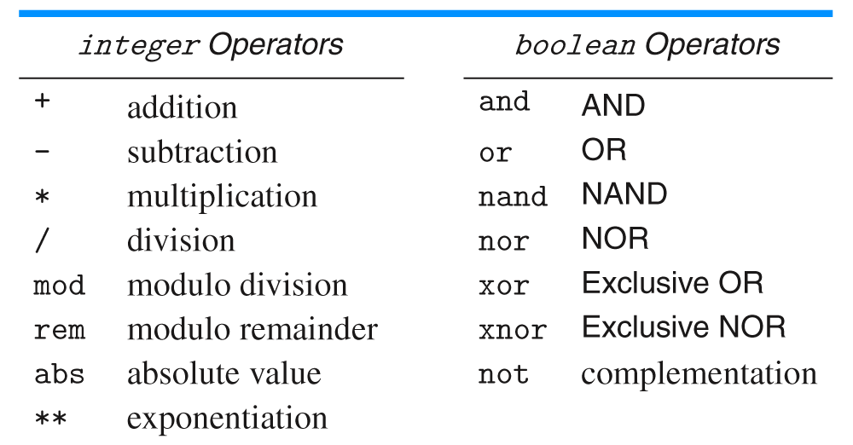
VHDL Operators
& concatenation

Slide 11
VHDL Libraries and Packages
library IEEE;
use IEEE.numeric_bit.all;
library IEEE;
use IEEE.std_logic_1164.all;
use IEEE.numeric_std.all;
use work.project3_gates.all;

Slide 12
Project 3 VHDL
Structural Description
Entity
Structural Architecture
Package
Component declarations
Dataflow descriptions

Slide 13
Project 3 Xilinx
New Project
Top-Level Source Type → HDL
Project → New Source
VHDL Module
Project → Add Copy of Source
project3_gates.vhd

Slide 14
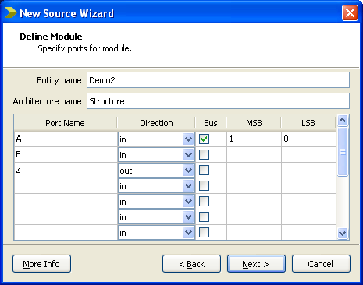
New Source

Slide 15
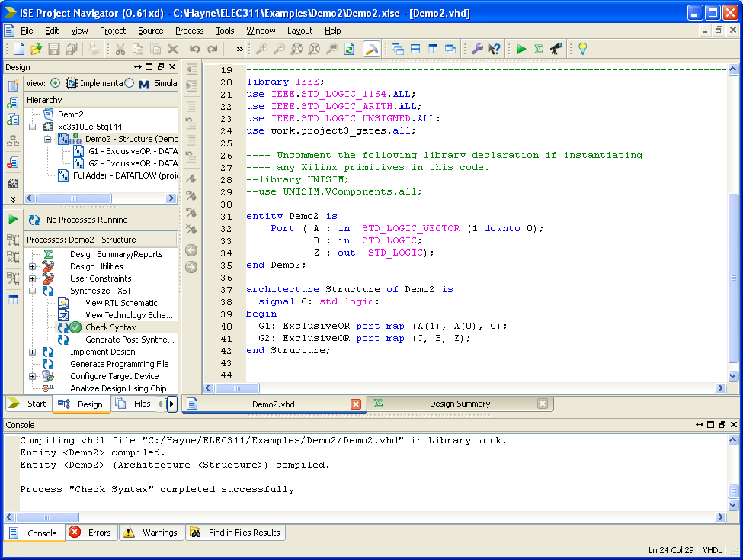

Slide 16
Summary
Entity
Architecture
Structural
Dataflow
Behavioral
Types
Operators
Libraries and Packages

