Slide 1
Latches and Flip-Flops
ELEC 311
Digital Logic and Circuits
Dr. Ron Hayne
Images Courtesy of Cengage Learning

Slide 2
Set-Reset Latch
S
Q'
Q
R

Slide 3
Set-Reset Latch
S
0
Q'
1
0
1
0
0
Q
R

Slide 4
Set-Reset Latch
S
0
/ 1
/ 0
/ 1
Q'
1
/ 0
0
/ 1
1
/ 0
0
/ 1
0
Q
R

Slide 5
Set-Reset Latch
S
0
Q'
0
/ 1
1
/ 0
0
/ 1
1
/ 0
0
Q
/ 1
/ 0
/ 1
R

Slide 6
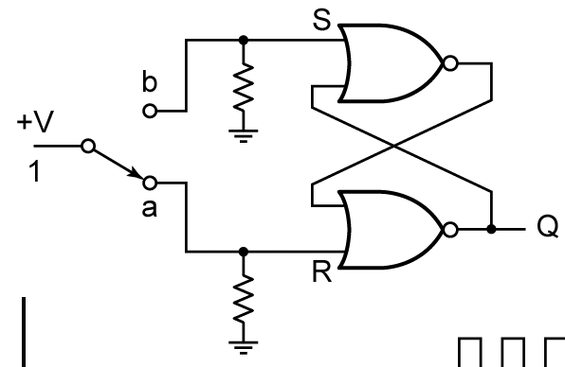
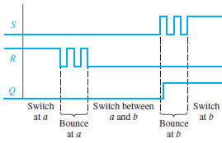
Switch Debouncing

Slide 7
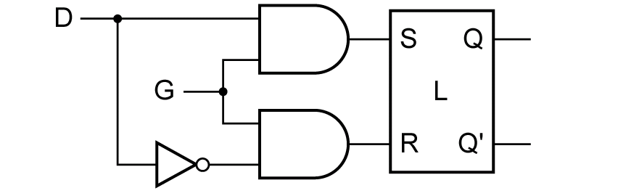
D Latch

Slide 8
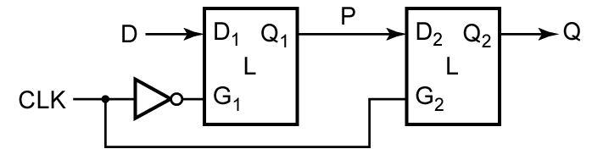
Edge-Triggered D Flip-Flop

Slide 9
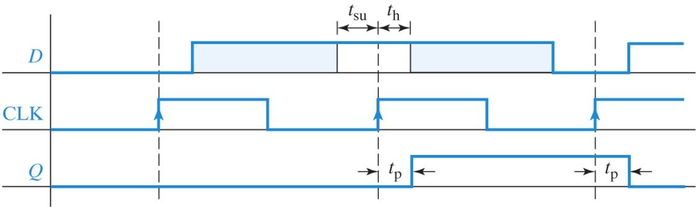
Timing Parameters

Slide 10
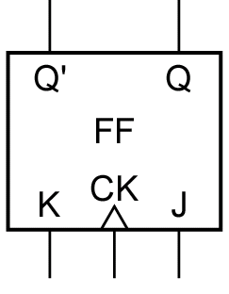
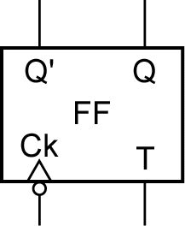
J-K and T Flip-Flops

Slide 11
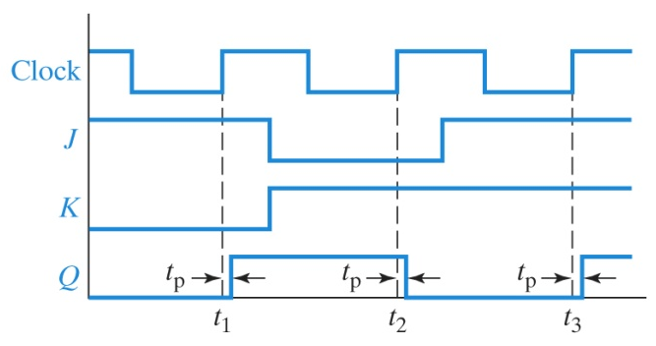
J-K FF Timing Diagram

Slide 12
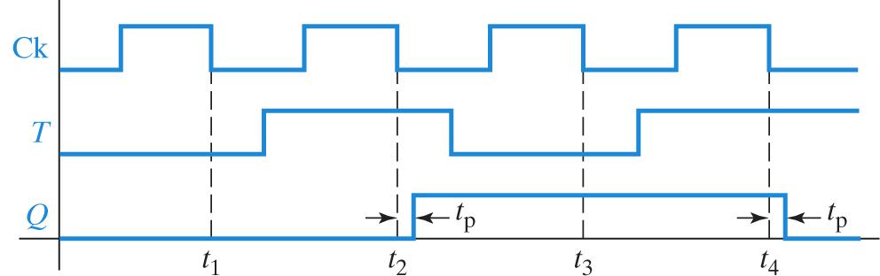
T FF Timing Diagram
(Falling-Edge Triggered)

Slide 13
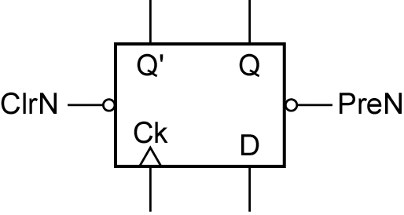
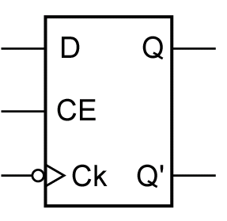
Additional Inputs

Slide 14
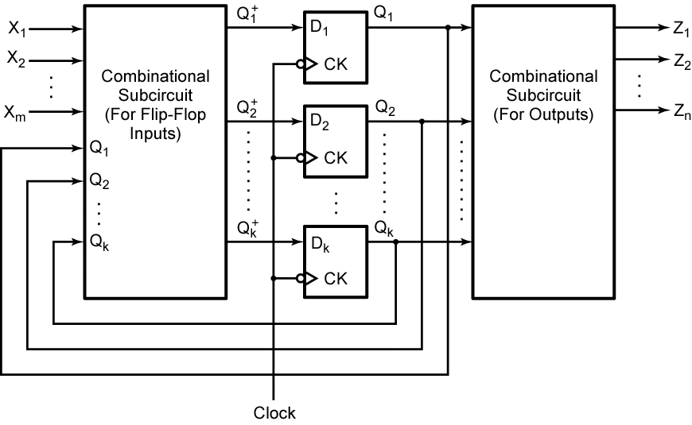
Sequential Circuits

Slide 15
Summary
Latches
S-R (Set-Reset)
D (Data)
Flip-Flops (Edge-Triggered)
D (Data)
J-K (Set-Reset-Toggle)
T (Toggle)

