Slide 1
Sequential Analysis
ELEC 311
Digital Logic and Circuits
Dr. Ron Hayne
Images Courtesy of Cengage Learning

Slide 2
State Tables and Graphs
Present State | Next State |  | Output
 | X = 0 | X = 1 | Z
S₀ | S₁ | S₀ | 0
S₁ | S₃ | S₂ | 0
S₂ | S₃ | S₀ | 0
S₃ | S₃ | S₀ | 1

Slide 3
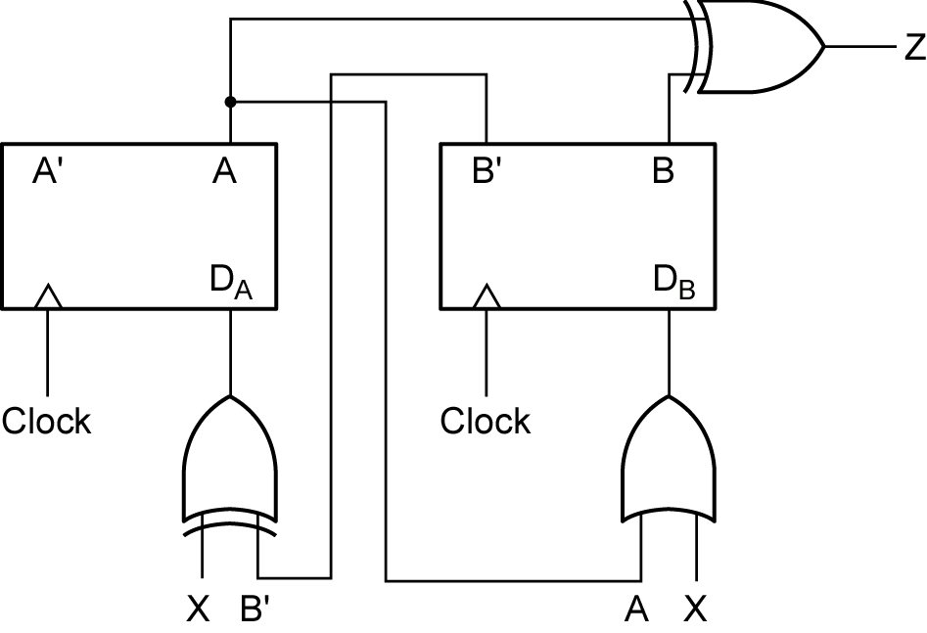
Analysis Example

Slide 4
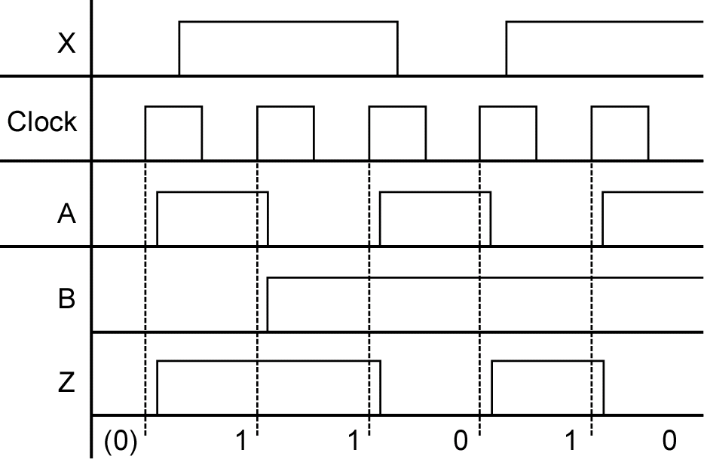
Timing Diagram

Slide 5
Timing Diagram

Slide 6
Timing Diagram

Slide 7
Timing Diagram

Slide 8
Timing Diagram

Slide 9
Analysis Example (cont)

Slide 10
Timing Diagram

Slide 11
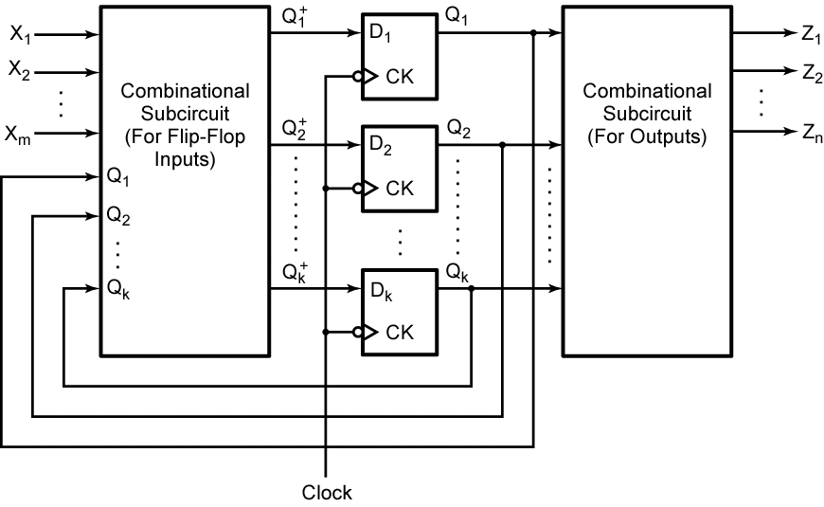
Sequential Circuits

Slide 12
Summary
Sequential Analysis
State Tables
State Graphs
Timing Diagrams

