Slide 1
Sequential Design
ELEC 311
Digital Logic and Circuits
Dr. Ron Hayne
Images Courtesy of Cengage Learning

Slide 2
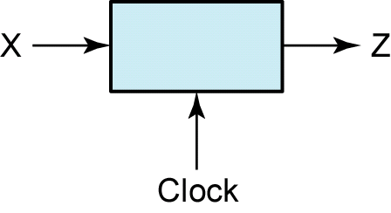
Sequence Detector
Design a circuit that will produce an output Z=1 for any sequence (X) ending in 101
The circuit does not reset when a 1 output occurs

Slide 3
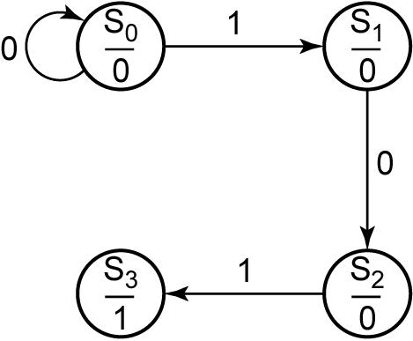
State Graph

Slide 4
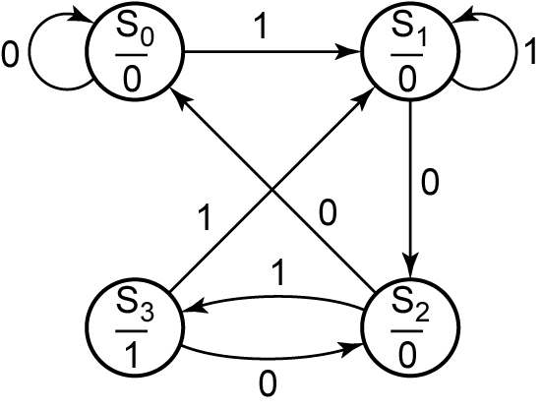
State Graph

Slide 5
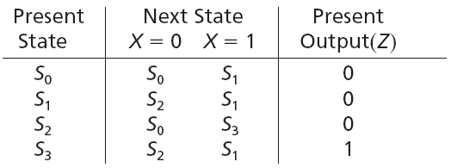
State Table

Slide 6
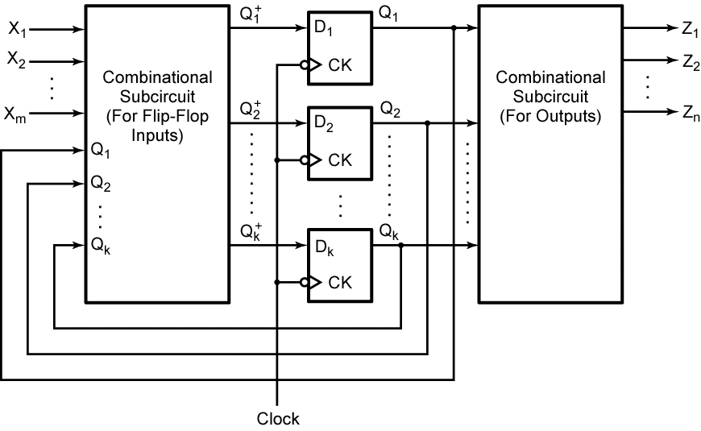
Sequential Circuits

Slide 7
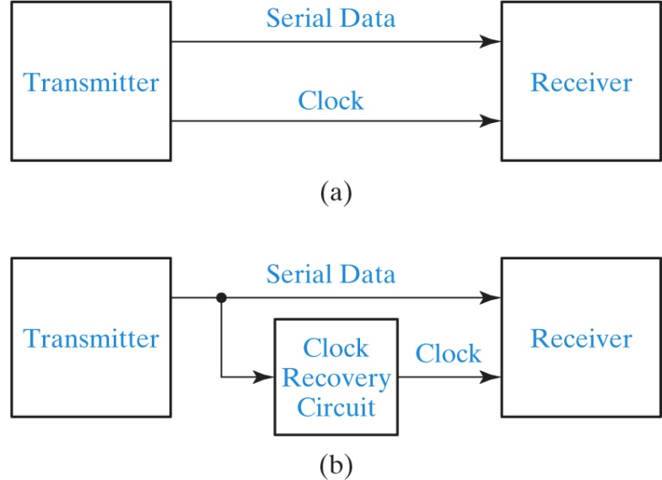
Serial Data Transmission

Slide 8
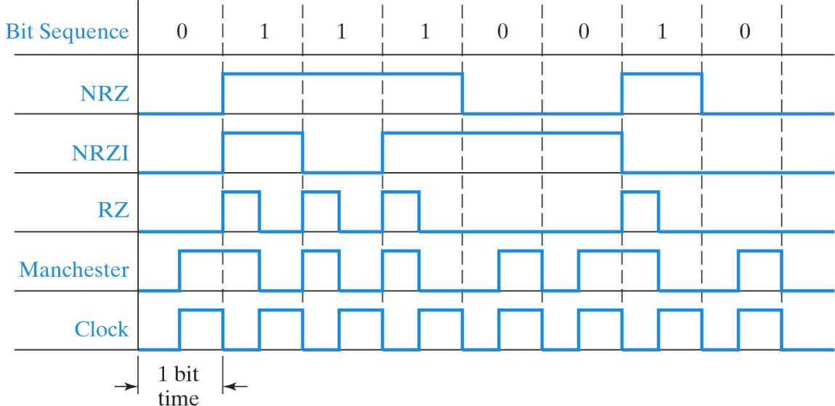
Serial Data Coding Schemes

Slide 9
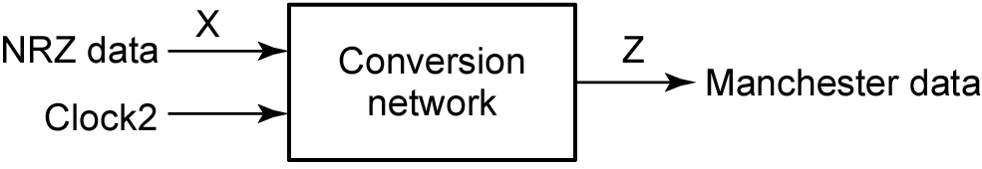
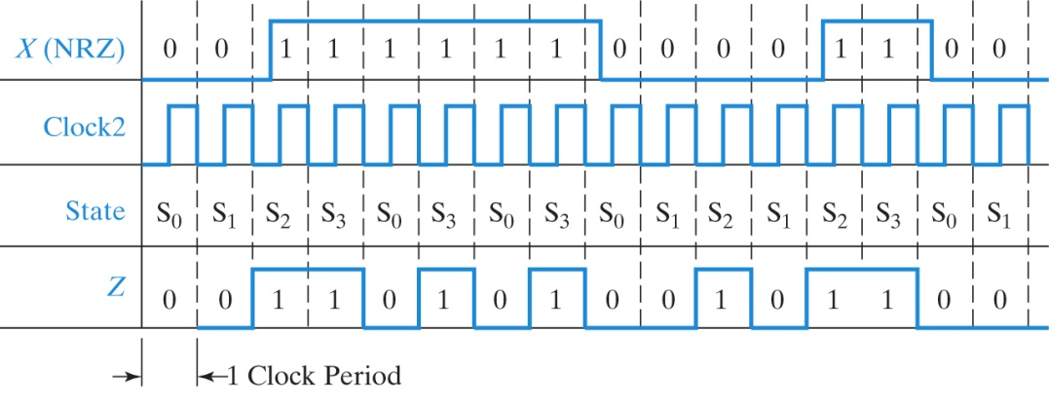
NRZ to Manchester Conversion

Slide 10
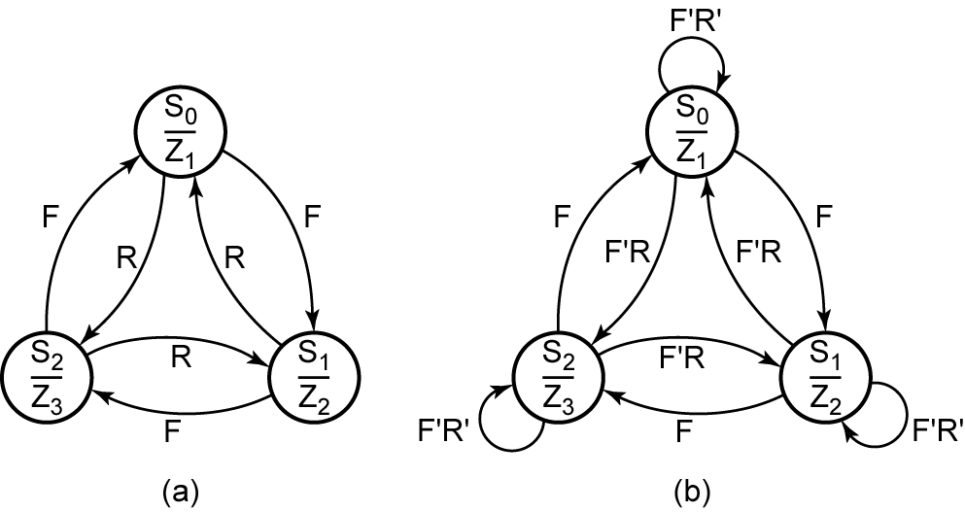
State Graphs

Slide 11
State Graphs

Slide 12
Summary
Sequential Design
State Graph
State Table
Transition Table
Next State Maps
Sequential Circuit

