Slide 1
VHDL for Sequential Logic
ELEC 311
Digital Logic and Circuits
Dr. Ron Hayne
Images Courtesy of Cengage Learning

Slide 2
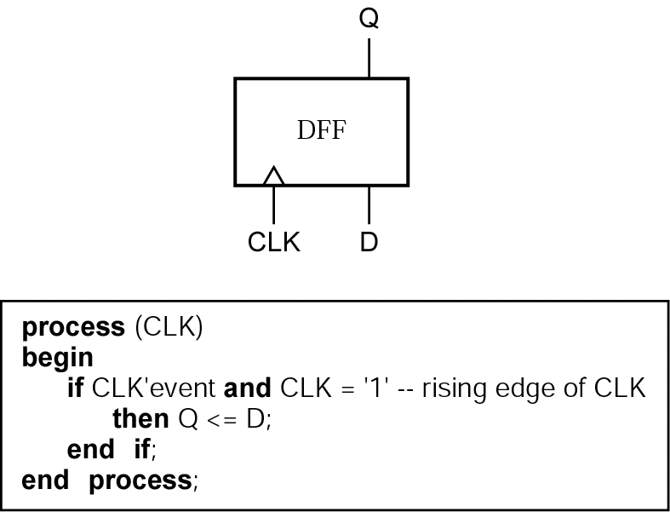
D Flip-Flop

Slide 3
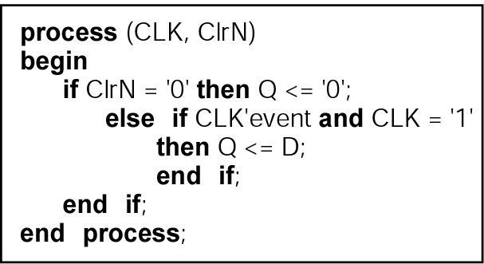
Asynchronous Clear

Slide 4
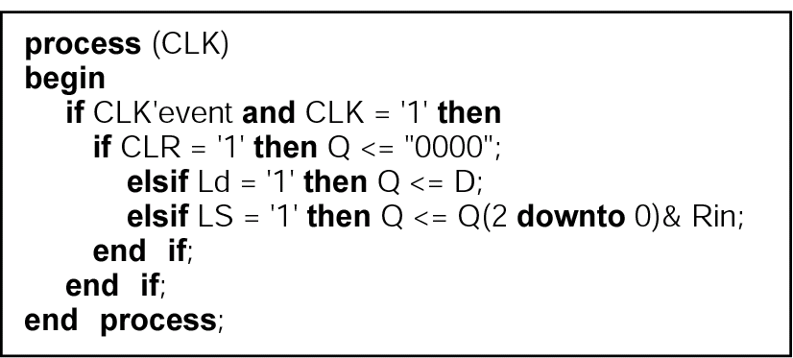
Shift Register

Slide 5
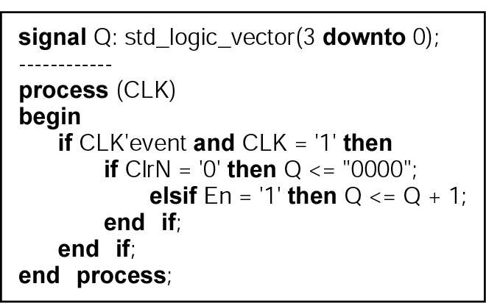
Counter

Slide 6
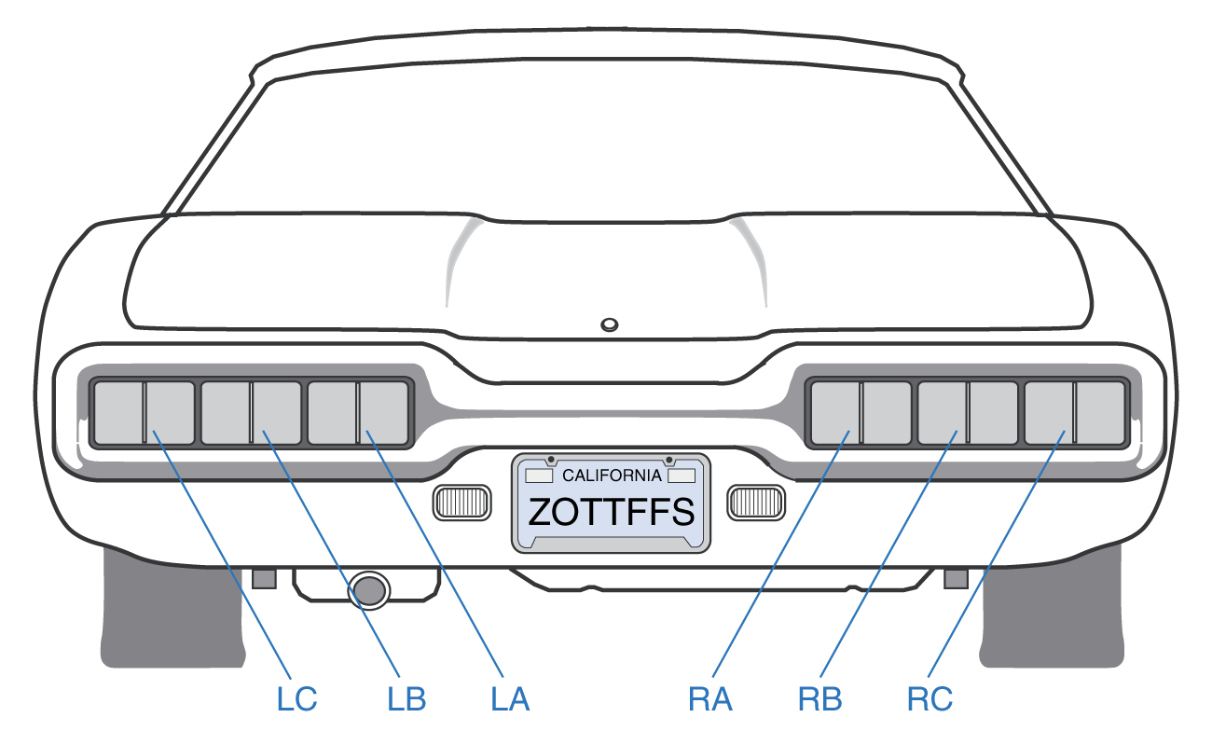
Design Example
T-bird Tail Lights
Left Turn
Right Turn
Hazard

Slide 7
Flashing Sequence

Slide 8
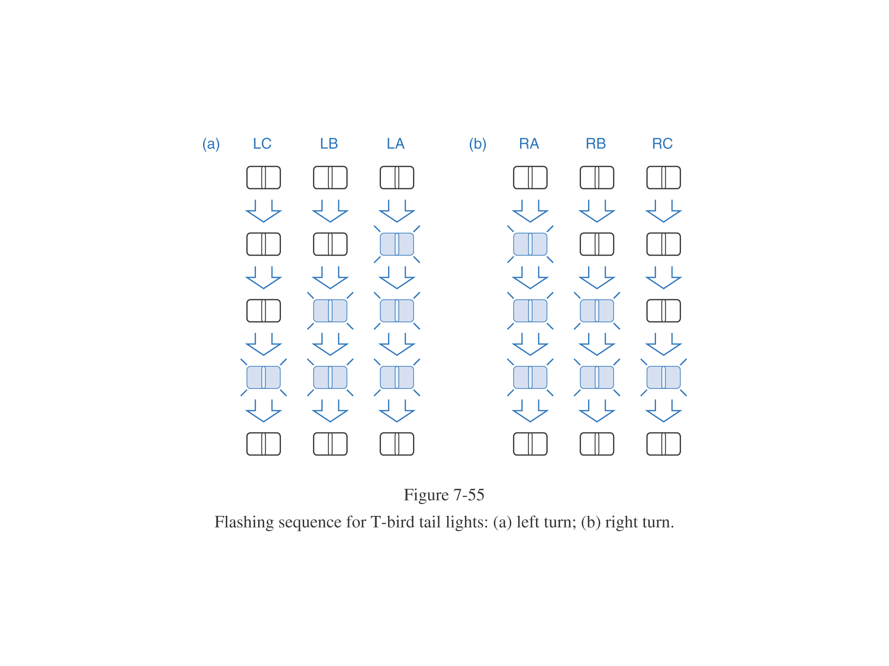
Flashing Sequence
Left Turn
Right Turn

Slide 9
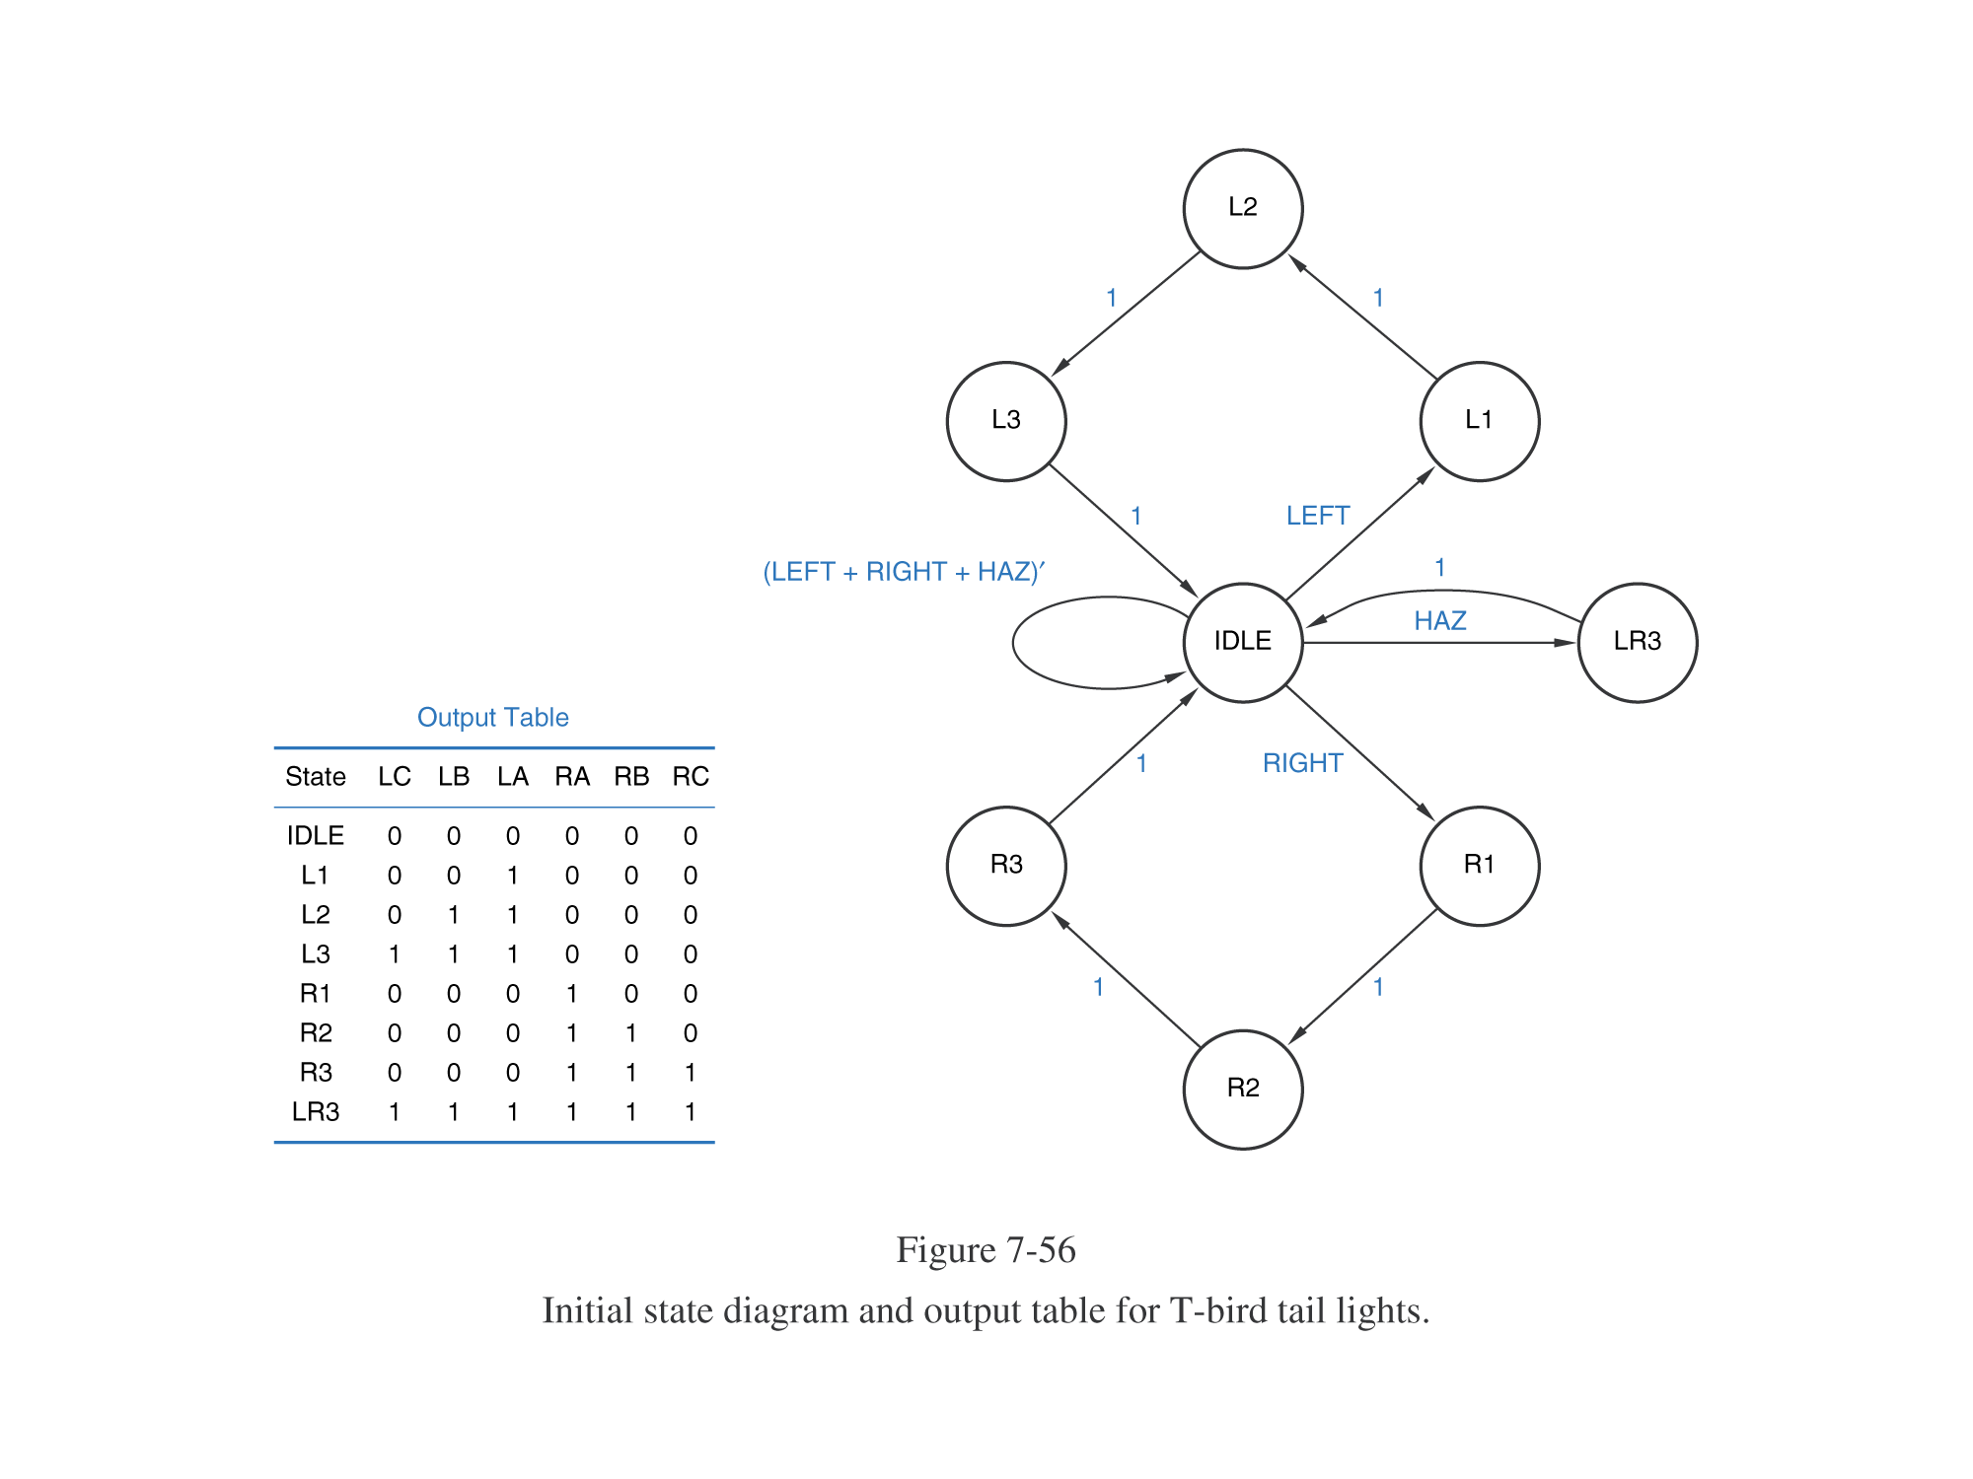
Initial State Graph
Mutual Exclusion?
All Inclusion?

Slide 10
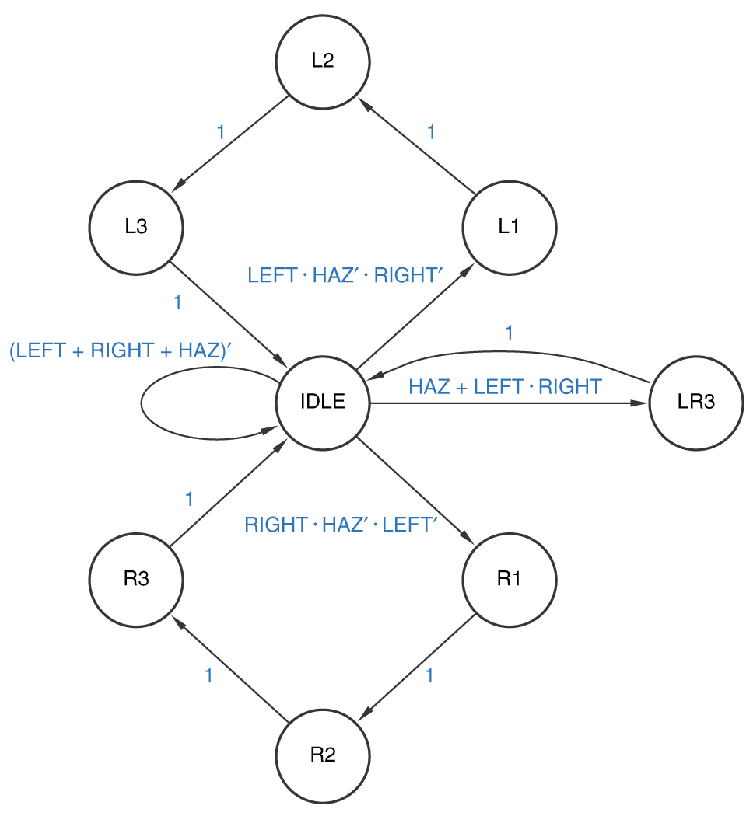
Corrected State Graph
Handles multiple inputs asserted simultaneously

Slide 11
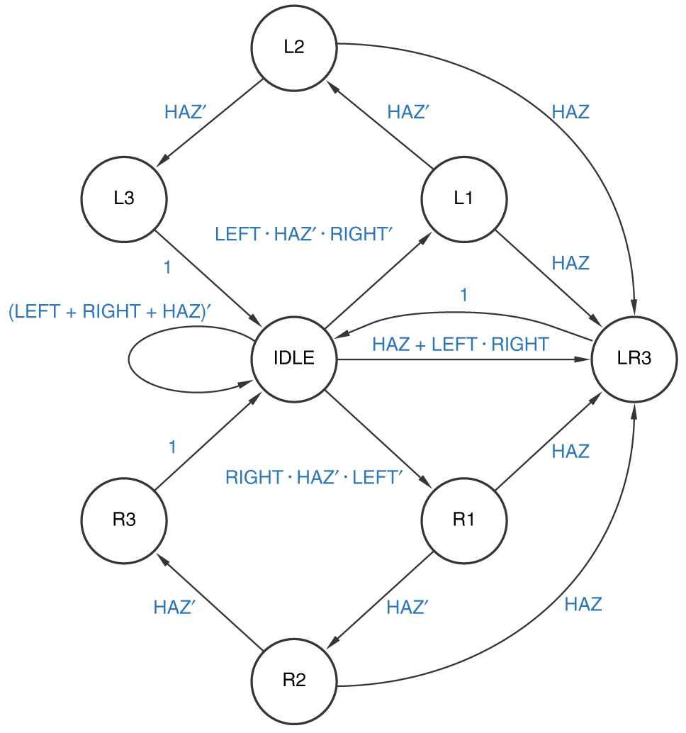
Enhanced State Graph
Goes into hazard mode as soon as possible

Slide 12
VHDL Model
entity TBIRD is
port (clock, left, right, haz : in std_logic;
tail : out std_logic_vector (1 to 6));
end TBIRD;
architecture BEHAVE of TBIRD is
type State_type is (IDLE,L1,L2,L3,R1,R2,R3,LR3); signal State, Next_State: State_type; signal input: std_logic_vector(1 to 3);
begin
input <= left & right & haz;

Slide 13
VHDL Outputs
with State select
tail <= "000000" when IDLE,
"001000" when L1,
"011000" when L2,
"111000" when L3,
"000100" when R1,
"000110" when R2,
"000111" when R3,
"111111" when LR3;

Slide 14
VHDL Sequential Machine
process (input, State)
begin
case State is
when IDLE =>
case input is
when "010" => Next_State <= R1;
when "100" => Next_State <= L1;
when "--1" => Next_State <= LR3;
when others => Next_State <= IDLE;
end case;
when L1 =>
case input is
when "--1" => Next_State <= LR3;
when others => Next_State <= L2;

Slide 15
VHDL Sequential Machine
process (SLOW_CLK)
begin
if SLOW_CLK'event and SLOW_CLK = '1' then
State <= Next_State;
end if;
end process;

Slide 16
Summary
Sequential VHDL
process
if-then-else
case
Design Example

