Slide 1
Sequential Arithmetic
ELEC 311
Digital Logic and Circuits
Dr. Ron Hayne
Images Courtesy of Cengage Learning

Slide 2
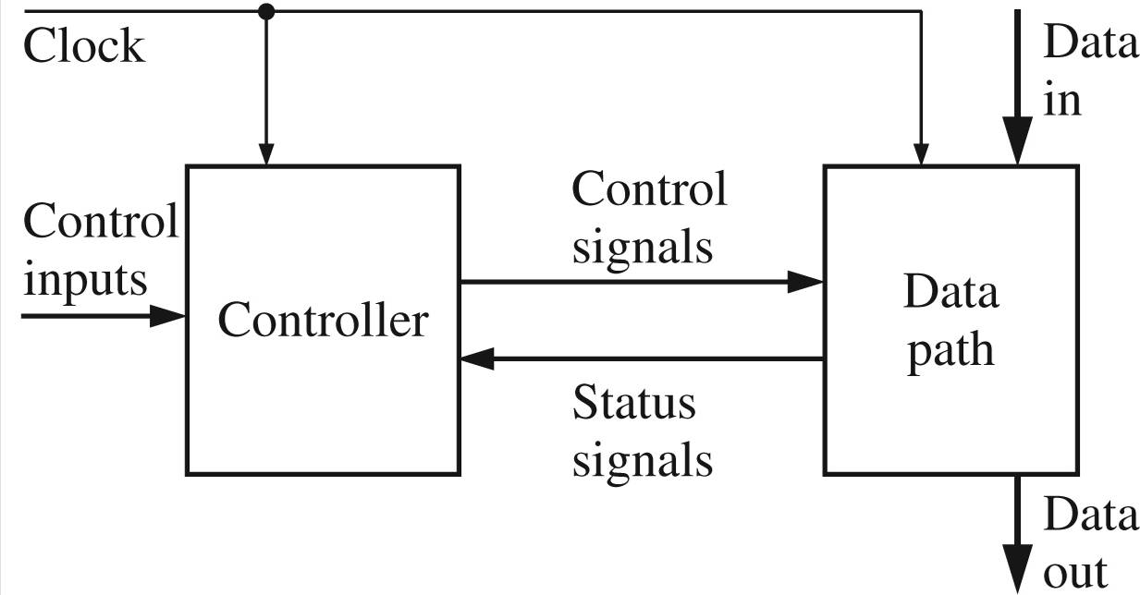
Data Path and Controller

Slide 3
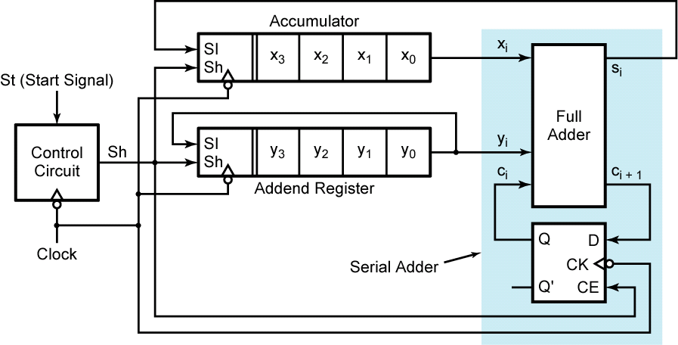
Serial Adder with Accumulator

Slide 4
Combinational Multiplier
X
x Y
P
X₃ X₂ X₁ X₀
x Y₃ Y₂ Y₁ Y₀
X₃Y₀ X₂Y₀ X₁Y₀ X₀Y₀
X₃Y₁ X₂Y₁ X₁Y₁ X₀Y₁
4-bit
Adders
X₃Y₂ X₂Y₂ X₁Y₂ X₀Y₂
X₃Y₃ X₂Y₃ X₁Y₃ X₀Y₃
+
P₇ P₆ P₅ P₄ P₃ P₂ P₁ P₀

Slide 5
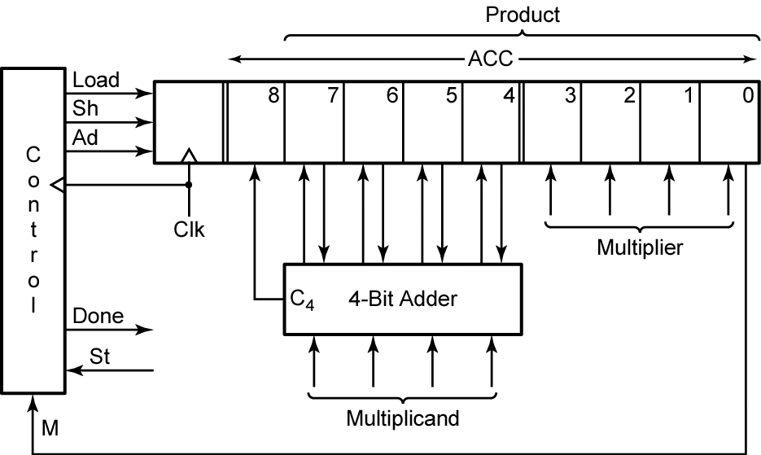
Parallel Binary Multiplier

Slide 6
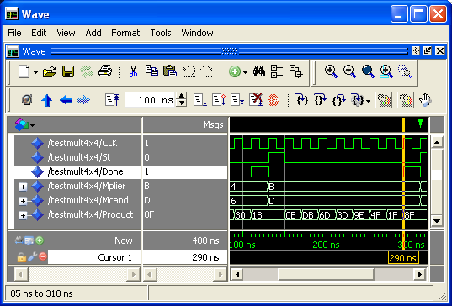
ModelSim Simulation

Slide 7
FPGA Implementation
Xilinx Spartan3e
500K System Gates
50 MHz Clock
ChipScope Pro
Virtual Input/Output Core (VIO)
Integrated Logic Analyzer (ILA)
Real-Time Verification
Captures On-chip Signals
Off-chip Analysis via JTAG Programming Cable

Slide 8
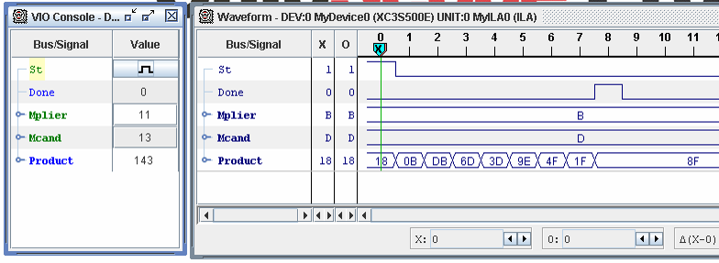
ChipScope Pro Analyzer

Slide 9
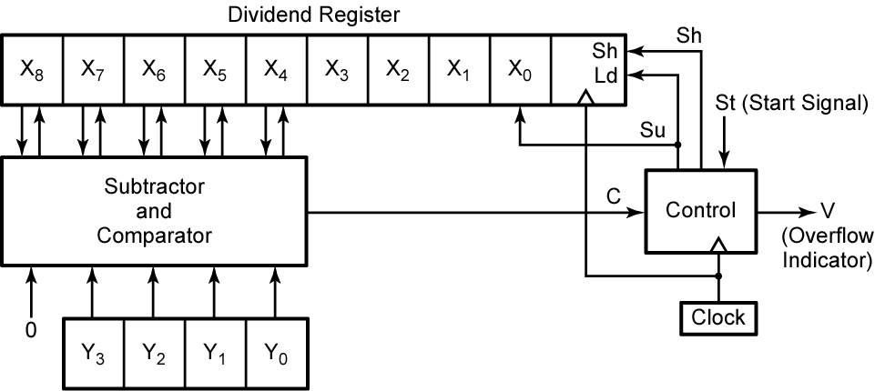
Binary Divider

Slide 10
Summary
Serial Adder
Combinational Multiplier
Parallel Multiplier
ModelSim Simulation
FPGA Implementation
Binary Divider

